Slide 1

Delaware River Basin SPARROW Model
US Geological Survey
Delaware NAWQA
Mary Chepiga, 609-771-3955, mchepiga@usgs.gov
Susan Colarullo, 609-771-3922, colarull@usgs.gov
Jeff Fischer, 609-771-3953, fischer@usgs.gov
Oct. 29, 2002

Slide 2
Delaware River Basin
Collaborative Environmental Monitoring & Research Initiative
CEMRI
The US Geological Survey, US Forest Service, National Park Service and other agencies are implementing a prototype environmental monitoring strategy to link hydrologic, forest, and water quality information across the landscapes of the Delaware River Basin.
Notes:
The initiative follows the "Framework for Environmental Monitoring and Related Research" proposed by the Office of Science and Technology (OSTP) and the Committee on Environmental and Natural Resources (CENR).

Slide 3
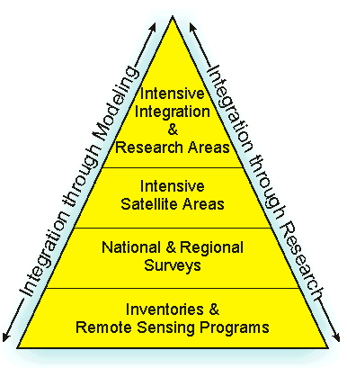
CEMRI Framework
CEMRI promotes environmental monitoring across agencies, scales, and environmental resources to track complex environmental issues at a range of spatial and temporal scales.
Delaware Issues:
Ecosystem Health & Change
  Calcium Depletion
  Carbon Cycling
  Nutrient Cycling
SPARROW

Slide 4
Delaware River Basin SPARROW
SPARROW will integrate monitoring research at various scales in the Delaware River Basin to assess effects of nitrogen deposition and land use on water quality, forest productivity, forest health, and to assess the causes of water quality and environmental impacts.
Notes:
link process data from small-scale watershed studies with monitoring data from large-scale rivers.

Slide 5
Delaware SPARROW
Project Objective
To evaluate the distribution of Total Nitrogen (TN) and Total Phosphorous (TP) loads within the Delaware River Basin for time period 1990 - 2001
To evaluate the statistical significance of factors affecting the predicted TN and TP distributions
Notes:
Sparrow can do other constituents as well. Needs intensive long-term monitoring data.

Slide 6
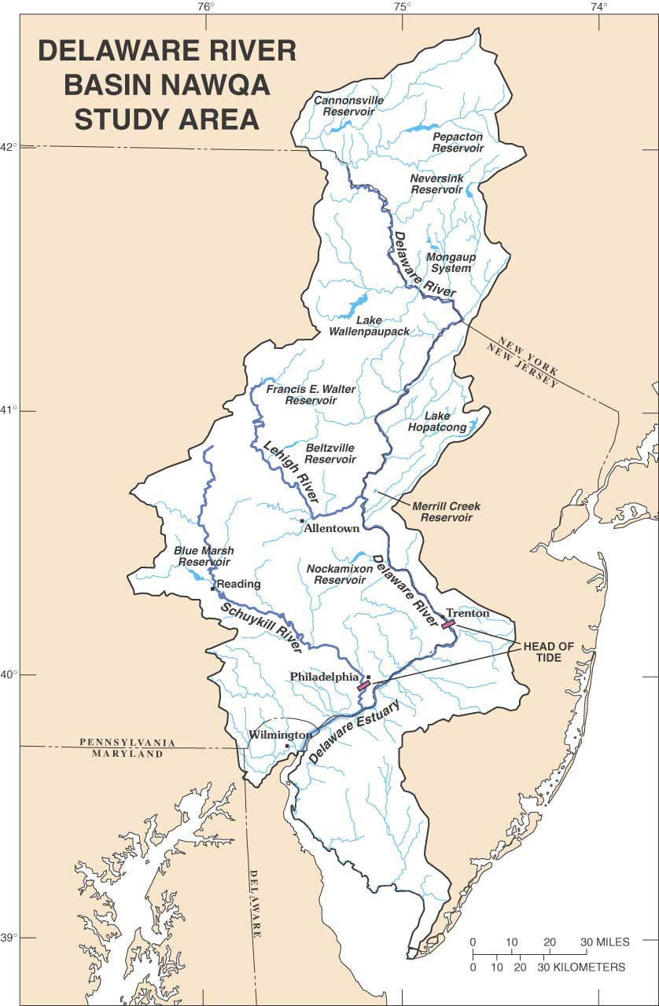
Delaware River Basin
Area > 12,000 square miles
Population over 7 million.
An additional 7 million people outside the basin rely on the Delaware for drinking water.
Delaware River is tidal up to Trenton
Notes:
Modeled area goes into northern half of the State of Delaware (more than show above).
Lehigh and Schuylkill are main tributaries.
How handle tidal river from Trenton to Wilmington in model?

Slide 7
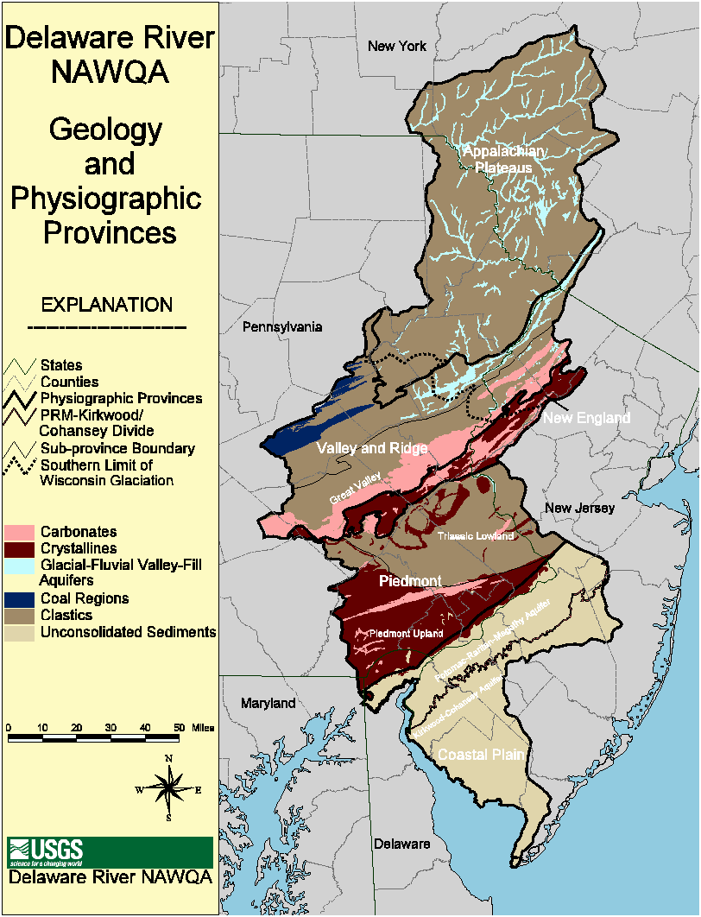
GEOLOGY
5 Physiographic Provinces.
Most of Basin is consolidated sedimentary and metamorphic rocks.
Northern third of basin was glaciated and has unconsolidated valley fill.
Coastal plain is unconsolidated sediments.
Notes:
Mix of metamorphic, clastic, and Carbonate rocks in Piedmont & V&R. Unconsolidated glacial fill in northern vallies

Slide 8
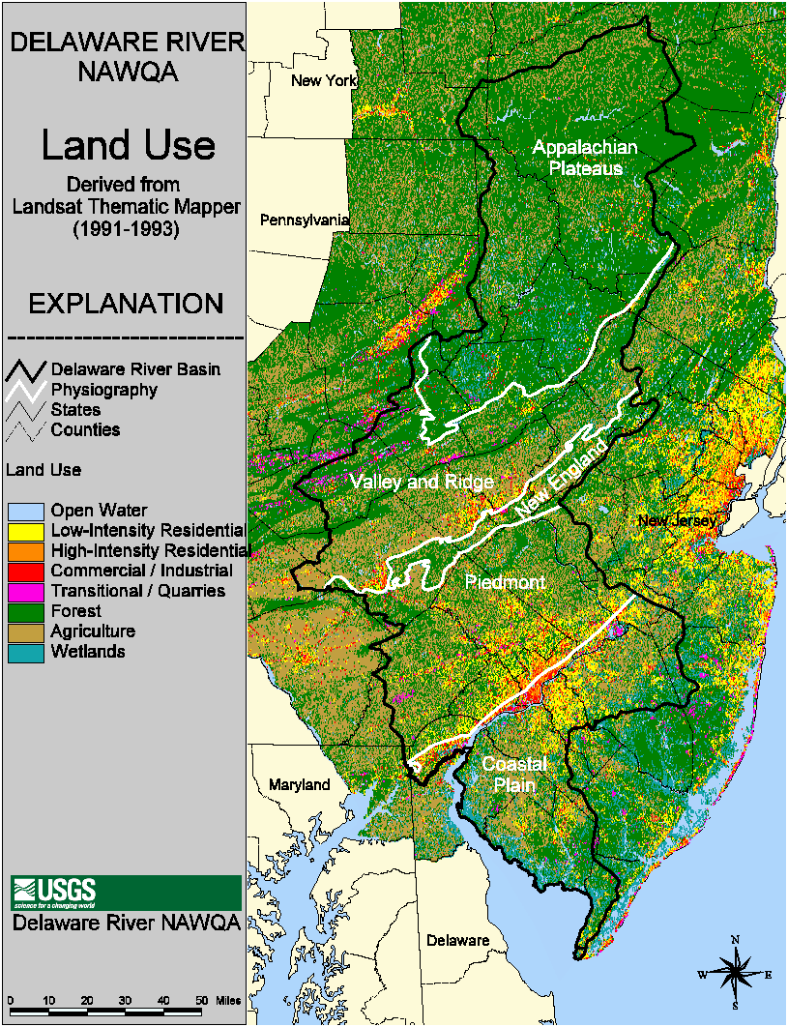
Basin-wide Land use
60% forest,
24% Agriculture,
9% urban.
80% of population lives in Piedmont and Coastal Plain which are >20% Urban land and >30% agriculture.
Appalachians are primarily Forest.
Notes:
1992 MRLC above, 1999 data may be available soon??

Slide 9
SPARROW Model Components
Stream Network and Associated Basins
Stream Loadings from monitoring data (dependent variable)
Nutrient Sources - Point Source, Nonpoint Source, Atmospheric Deposition, Others
Delivery Factors - Soils, Slope, Geology, Meteorology, Stream size, Others

Slide 10
Model Framework
SPARROW uses a digital network of streams and associated contributing basin areas for flow routing and as a spatial reference for all model parameters
For Delaware Model
1:24,000 NHD digital stream network
Use GIS to generate basin areas, flow,
and travel times for stream reaches
Notes:
55,000 stream reaches in the Delaware Basin

Slide 11
Developing Areas, Streamflow, and Travel Times, for 1:24K NHD Stream Reaches
Generate contributing areas for each river segment similar to NECB
Apply runoff to those areas
Use gage data to correct flow at sites that export water and have reservoirs
Estimate travel time using Jobson method
Excluding Estuary and tidal rivers
Notes:
HUC fourteens not available in Delaware

Slide 12
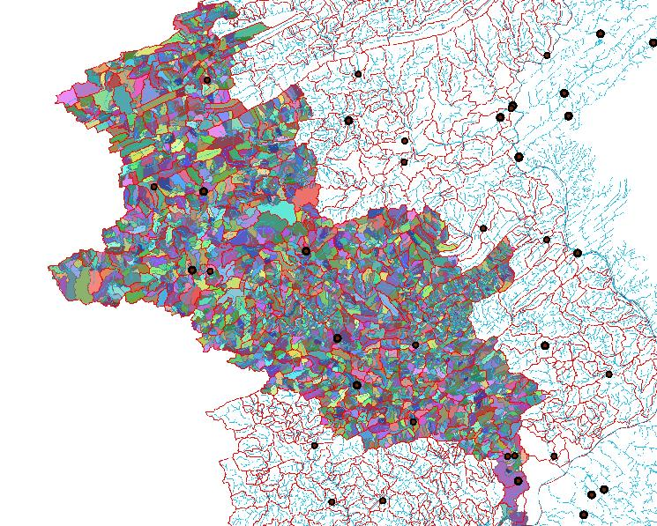
NHD Stream Network and Basins
Schuylkill River GIS Generated Basins

Slide 13
Data Checks
Catchment Areas
  GIS areas vs gaged site areas
  Rivers crossing HUC divides
Flow
  Estimated flow vs measured flow at gage sites
Travel times
  Calculated vs published travel times
Notes:
HUC 14 data not available in Delaware at this time.

Slide 14
FLOW CORRECTIONS
Reservoirs control mainstem flow and are used to export water from the basin.
Drinking water withdrawls at major metropolitan areas.
Many large STPs discharge to Estuary.
Power Releases 0 – 1800 cfs
800 mgd export to NYC
Mandated flow of 1750 cfs
100 mgd export to north NJ
50 mgd transfer to Schuylkill
Major drinking water intakes
Flood control & flow augmentation
Water Supply Reservoirs
3000 cfs minimum flow target
Notes:
800mgd ~1240cfs, 100mgd~155cfs
NYC reservoirs came on line in 1950s and 60s. Most others in 1970s. Merril Creek most recent addition 1990s.

Slide 15
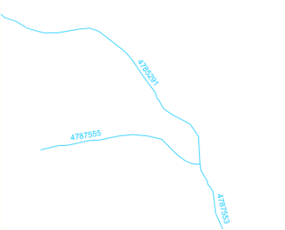
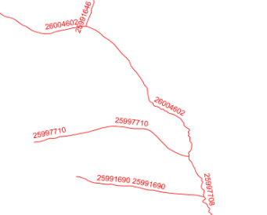
A word on 1:24K NHD Streams
1:100K
1:24K
25991646
26004602
4785291
26004602
4787555
25997110
4787553
25991690
25997708
= start of new reach
New reaches are added at 1:24K scale, but reach numbering is maintained from 1:100K scale. Difficult to distinguish between a reach above and below a new confluence.

Slide 16
Calculated Nutrient Loads at monitoring stations
Data from Federal and State Agencies
1975 to 2000 time period for predictors
Usually 10 or more years of data at each site
Loads calculated using ESTIMATOR for 1990 to 2001 time period

Slide 17
Total Phosphorous Load Sites
State Area Number of Sites .
NJ 2969 sq mi 16 15 31
NY 2363 sq mi 11 40 51
PA 6465 sq mi 24 27 51
DE 968 sq mi 6 23 29
TOTALS 57 105 162
Sites with measured flows and concentrations
Sites with some or all estimated flows
Total Sites
Notes:
33 sites in PA do not have organic N data. Thinking of estimating this data from other QW parameters.

Slide 18
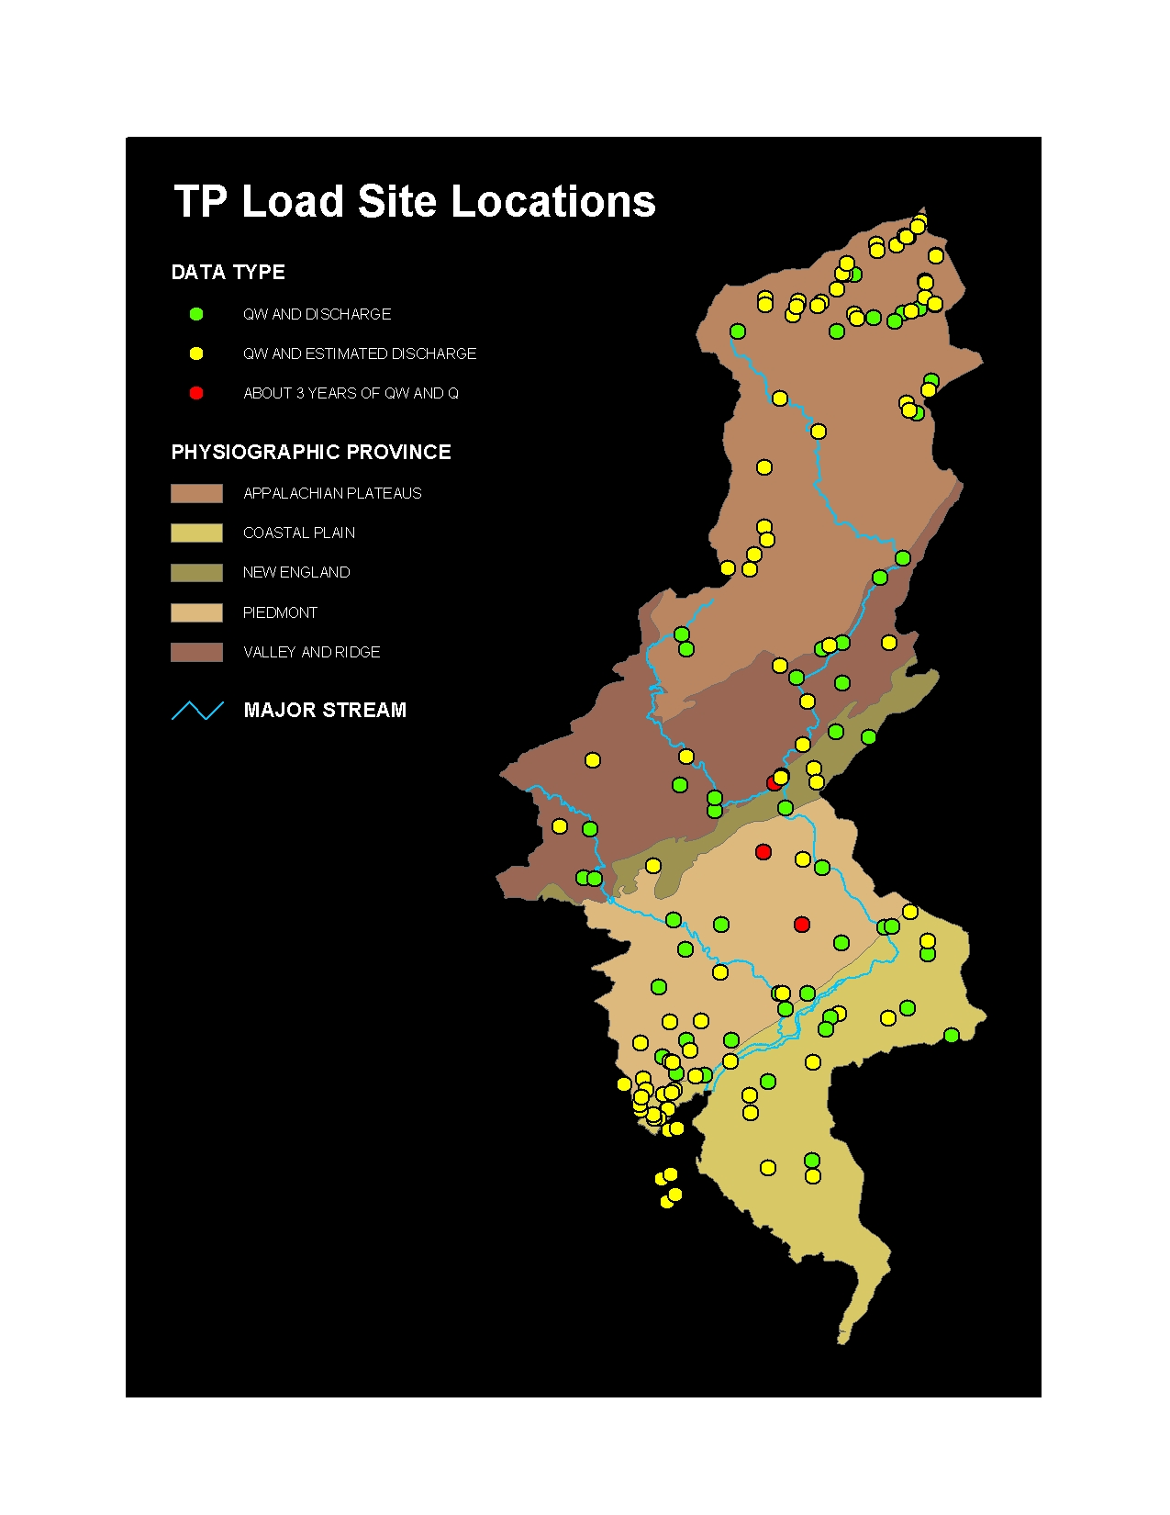
Total Phosphorus Monitoring Station Locations
DATA TYPE
QW and Discharge (Q)
QW with Q estimated
~ 3 years of QW & Q
PHYSIOGRAPHIC PROVINCE
Appalachian
Coastal Plain
New England
Piedmont
Valley and Ridge

Slide 19
Total Nitrate Load Sites
State Area Number of Sites .
NJ 2969 sq mi 14 16 0 30
NY 2363 sq mi 11 45 0 56
PA 6465 sq mi 5 16 33? 54
DE 968 sq mi 6 23 0 29
TOTALS 36 100 33? >169
Sites with measured flows and concentrations
Sites with some or all estimated flows
Sites with some estimated concentrations
Total Sites
Notes:
33 sites in PA do not have organic N data. Thinking of estimating this data from other QW parameters.

Slide 20
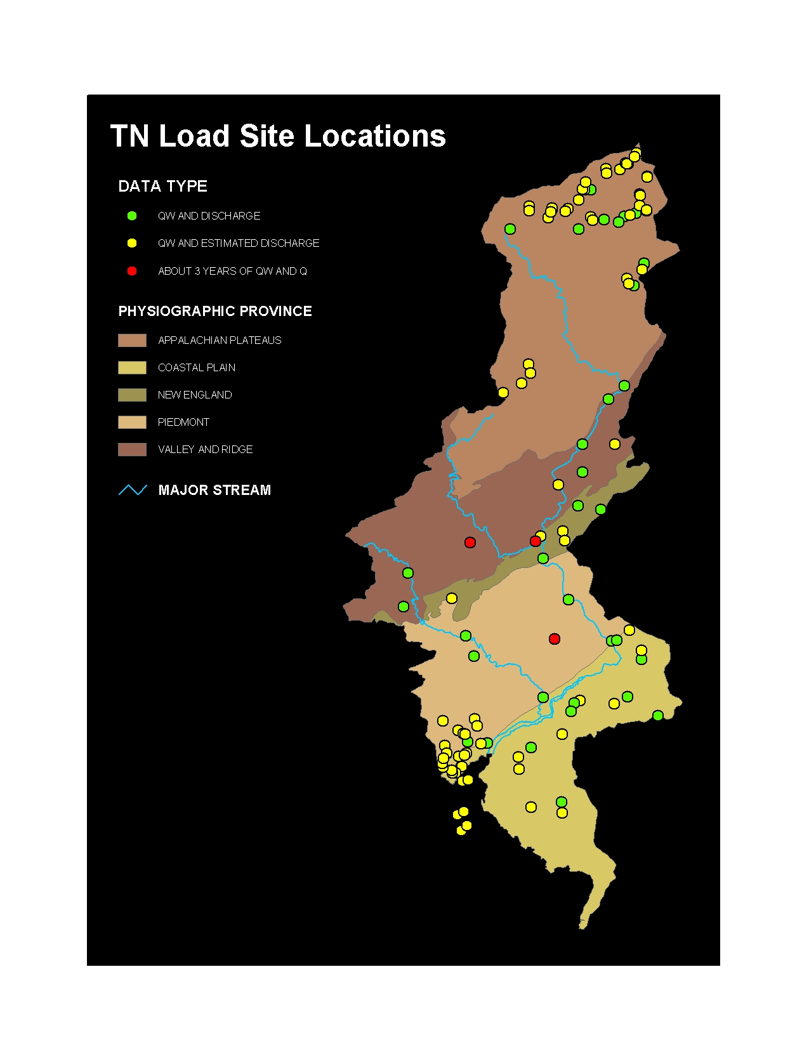
Total Nitrate Monitoring Station Locations
DATA TYPE
QW and Discharge (Q)
QW with Q estimated
~ 3 years of QW & Q
PHYSIOGRAPHIC PROVINCE
Appalachian
Coastal Plain
New England
Piedmont
Valley and Ridge

Slide 21
Estimator Load Calculations
Plans:
  Use post 1974 data to generate predictors.
  Calculate average load for each year 1990-2001.
  Use 12 year average for SPARROW loads
Comments:
  Several versions of ESTIMATOR
  Use of long-term quarterly monitoring data vs
  short-term intensive sites
  Small research basins (<5 mi² )
  Sites with abrupt change in QW

Slide 22
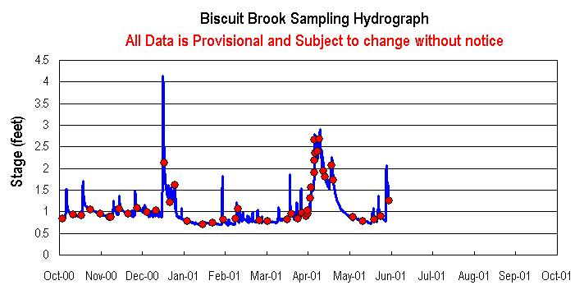
Sites with short period of record and small basins
(including NAWQA sites)
QW sample
Notes:
Discuss effects on model using a mix of long and short-term data sets. This is a small (<4 square mile) basin with over 40 sample points in 1 year. Most state sites have 4 samples per year, but have > 10 years of record. NAWQA sites are larger, but only have 3 years of record with about 36 sample points including some storms.

Slide 23
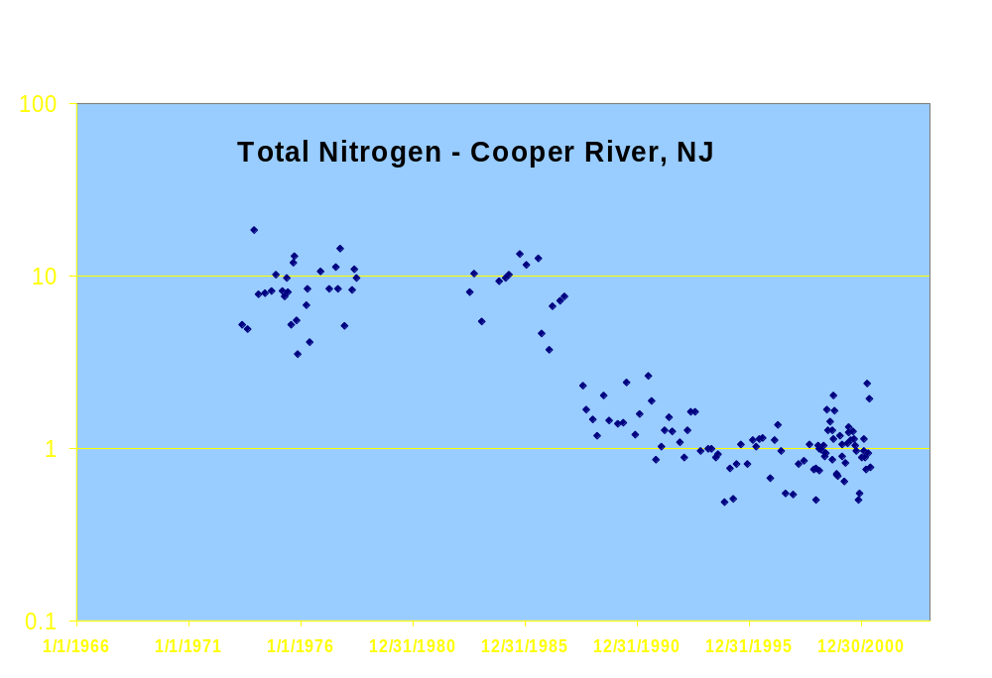
Sites with abrupt changes in QW parameters
Concentration (mg/l)
Regional Sewer System Installed
Notes:
How does estimator deal with abrupt changes in QW?

Slide 24
Nutrient Data Sources
DATA SOURCE
Fertilizer usage, NAWQA/USDA 1992 & 1997
Livestock waste production, NAWQA/USDA 1992 & 1997
Non- agricultural land use, MRLC data from EROS 1992 or 2000
Atmospheric deposition, National Atmospheric 1987-2002 Deposition Program
Point sources, EPA, NOAA 1997-2002 DRBC, state DEP’s
Notes:
Point source data only available at total N & P. Will try to correct locations with state data.

Slide 25
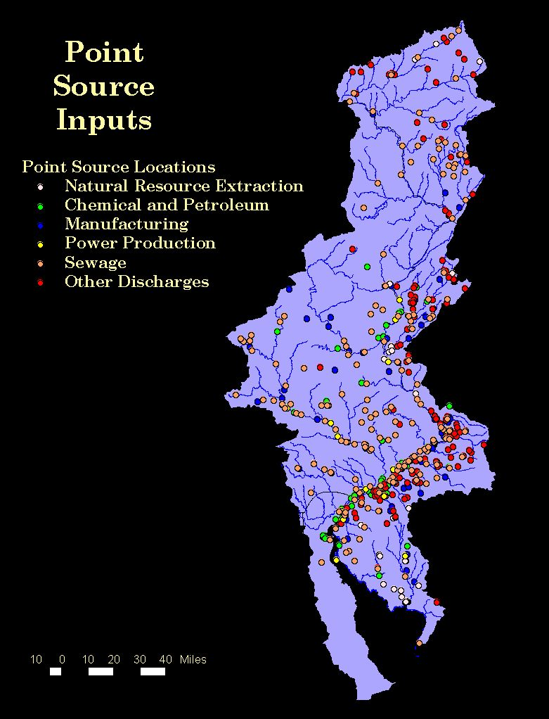
Point Sources
Model will use EPA data from 1992 to 2002, updated with state flow and location data.
Regional sewer systems collect waste from non-tidal basins and discharge into tidal estuary.
Notes:
Discuss fact that numerous 10 to 20 mgd regional sewer systems collect waste from non-tidal basins and discharge into tidal estuary. This is a huge transport of nutrients out of the modeled area. How will this affect model if we don’t include the estuary?

Slide 26
SPARROW Model Input Data
Watershed Characteristics
Land-to-water delivery factors
    Temperature
    Soil permeability
    Land Use
In-stream removal
    Stream-size
    Reservoirs
    Slope
    Others …..
Notes:
Stream size is a surrogate for travel time and cross sectional area of channel.

Slide 27
Delaware SPARROW Model
Unique Aspects
Land-to-water delivery factors
  Forest type and fragmentation.
In-stream removal
  Stream-size (first 1:24K model).
Model Comparisons
  Comparison with PnET Forest productivity model.
Notes:
Gray text is potential work.

Slide 28
Delaware SPARROW Model
Project Plans
ESTIMATOR load calculations - 6 mo.
NHD area, flow, and travel time generation - 12 mo.
Apply Overland and In-stream factors - 6 mo.
Model Simulations - 12 mo.
Reports
  Estimated Nutrient Loads - 2003
  Data
  Delaware SPARROW - 2004
Goal: Completed model by end of 2003.

Slide 29
Modeling Support
NAWQA
  National NAWQA Program
  Delaware NAWQA Project
  NAWQA/State Coop for 1:24K NHD streams
US Forest Service
  Forest Type and Fragmentation Indexes
  Climate and Atmospheric loading data
US EPA
  Point Source Loading data

