Slide 1
Managing Demand
Jeff Bumgarner - PacifiCorp
  Conservation or Crisis - A Northwest Choice
  September 24, 2001

Slide 2
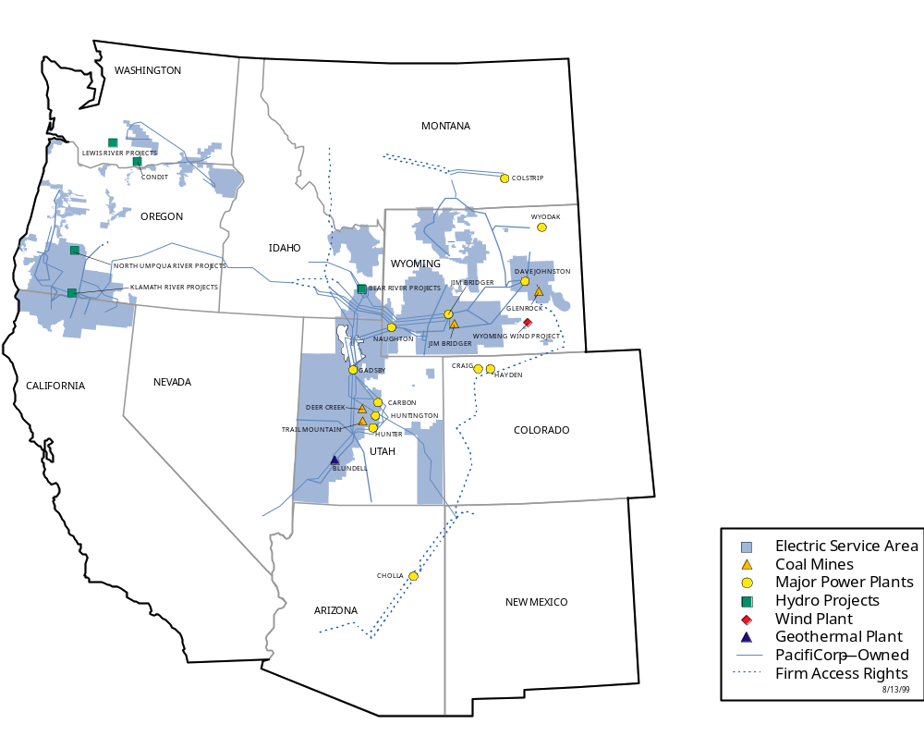
PacifiCorp

Slide 3
Managing Demand
Goal
  Build an increasingly sustainable energy supply business
    Focus on energy resource management, both long-term and immediate
    Achievements and targets
Planning process
  Integrated Resource Planning or Least Cost Plan
    Balancing resources in the long term
  Peak demand controls
    Maximizing resources and addressing market conditions
  Remain environmentally focused and responsible

Slide 4
Where We Start
Education: Our most important tool
Tactics
  Advertising
  “Do the bright thing” campaign
  Public involvement
Goals
  Educate customers about efficient energy use
  Raise awareness of peak energy use and impacts
  Raise awareness of programs and tools available
  Affect real changes in behavior, habits

Slide 5

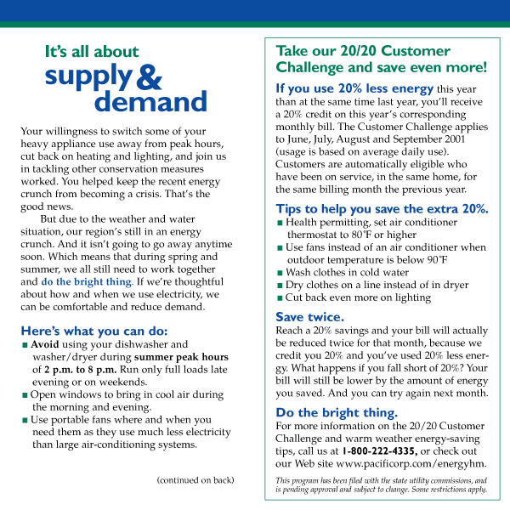

Slide 6



Slide 7

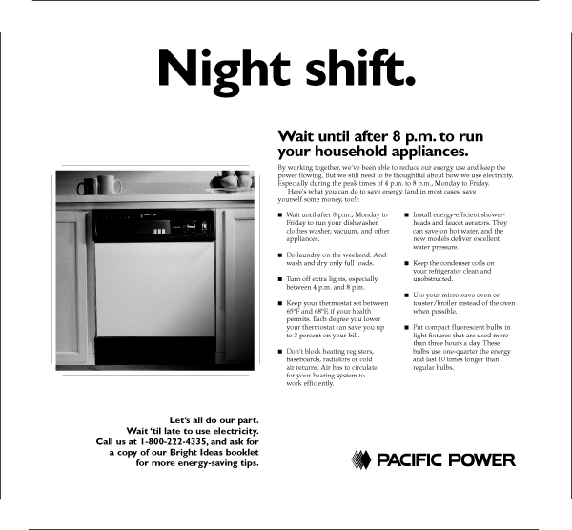
Notes:
Conservation and load shifting ads

Slide 8
Long-term DSM Initiatives
Customer education and awareness
  Advertising; awareness campaign “Do the bright thing”
  Seminars, trade shows, customer presentations, bill inserts, newsletters
  Bright Ideas booklet
Residential energy audits
  In home audits, instant savings measures and weatherization assistance
  Do-it-yourself “information only” audit
Compact Fluorescent Light Bulb (CFL) Giveaway
  Put energy-saving bulbs in customers’ hands
  Re-introduction of improved technology
  Encourage market transformation to better bulbs
Business services
  Facility and operational energy audits, recommendations
  Cash incentives or loans (state dependent)
  Services for new construction and retrofit projects

Slide 9
Short-term Peak Load Programs
Online Energy Exchange (ENX)
  Elective curtailment, incentive for reducing during peak times
Irrigation Initiatives
  Company pays customers not sow
  Curtailment
Customer Energy Challenge
  Challenges customers to voluntarily reduce usage by 10 to 20 percent for a modest incentive
Work with large industrial customers
  Curtailment contracts: Largest customers to reduce load requirements through peak months
  Supplemental generation: Deliver additional generation capacity hosted at a customer’s site
Partnerships - “PowerForward”

Slide 10
Summary
Going forward
  Focus on what we do best
    Educating customers
    Raising awareness
    Managing demand, energy resources
    Developing creative, useful programs to meet needs
  Maintain momentum from programs
  Continue to build a sustainable energy supply

