Slide 1
Summary initial simulation

Slide 2
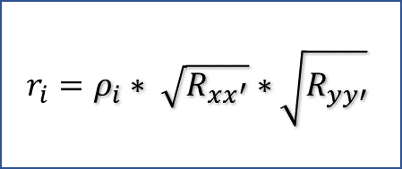
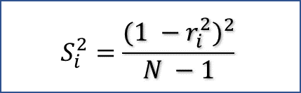
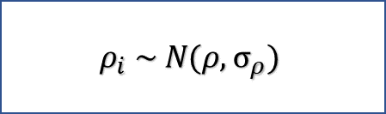
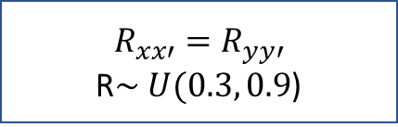
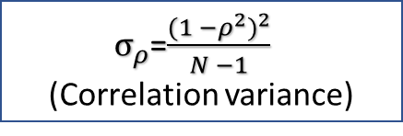
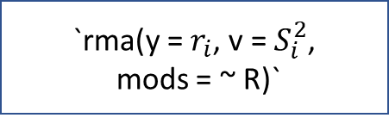
Fixed effect
Pick a true correlation,
e.g., ρ = 0.5
ρ = 0.5
Sample K effect sizes with sampling error
$$ρ_{i} \sim N(ρ,σ_{ρ})$$
$σ_{ρ}$=$\frac{{(1 −ρ^{2})}^{2}}{N −1}$ (
(Correlation variance)
Add measurement error to the K effect sizes
$$r_{i}=ρ_{i}∗ \sqrt{R_{xx^{′}}}∗\sqrt{R_{yy′}}$$
$$R_{xx′}=R_{yy′}$$
R$\sim U(0.3, 0.9$)
Meta-analyze
`rma(y = $r_{i}$, v = $S_{i}^{2}$,
mods = ~ R)`
$$S_{i}^{2}=\frac{{(1 −r_{i}^{2})}^{2}}{N −1}$$

Slide 3
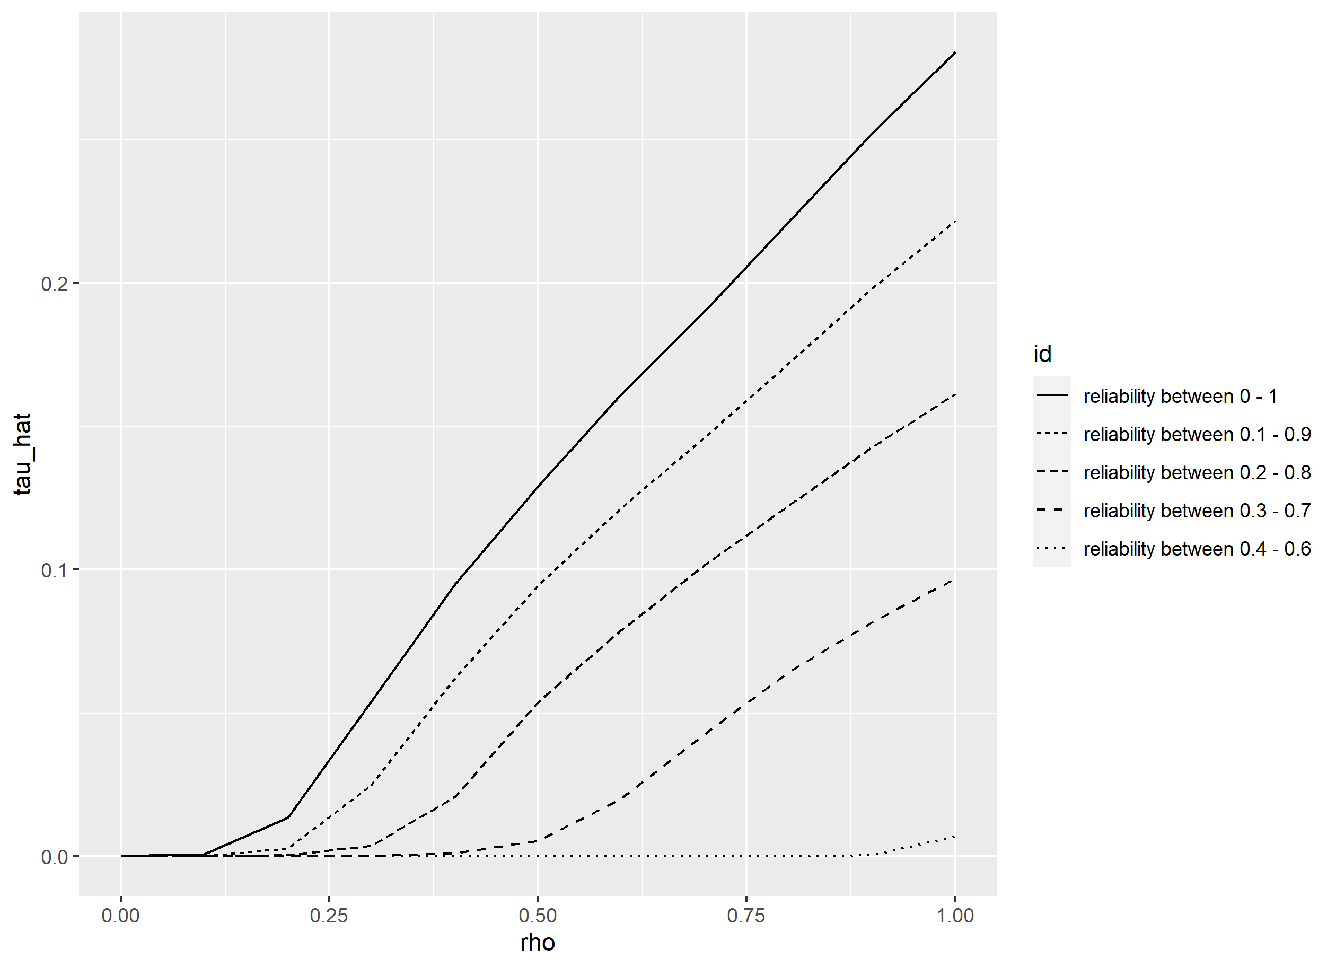

Slide 4


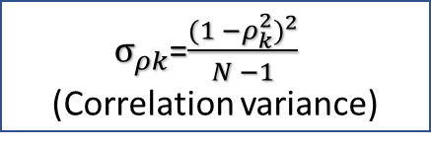


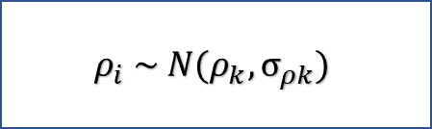
Random effect
Pick an average true correlation (μ) and heterogeneity (τ)
μ = 0.5, τ = 0.1
Sample K true effect sizes ($ρ_{k})$
$ρ_{k}$ $\sim N(\text{μ},\text{τ})$
Sampling K effect sizes with sampling error
$$ρ_{i} \sim N(ρ_{k},σ_{ρk})$$
$σ_{ρk}$=$\frac{{(1 −ρ_{k}^{2})}^{2}}{N −1}$ (
(Correlation variance)
Add measurement error to the K effect sizes
$$r_{i}=ρ_{i}∗ \sqrt{R_{xx^{′}}}∗\sqrt{R_{yy′}}$$
$$R_{xx′}=R_{yy′}$$
R$\sim U(0.3, 0.9$)
Meta-analyze
`rma(y = $r_{i}$, v = $S_{i}^{2}$,
mods = ~ R)`
$$S_{i}^{2}=\frac{{(1 −r_{i}^{2})}^{2}}{N −1}$$

