Slide 1
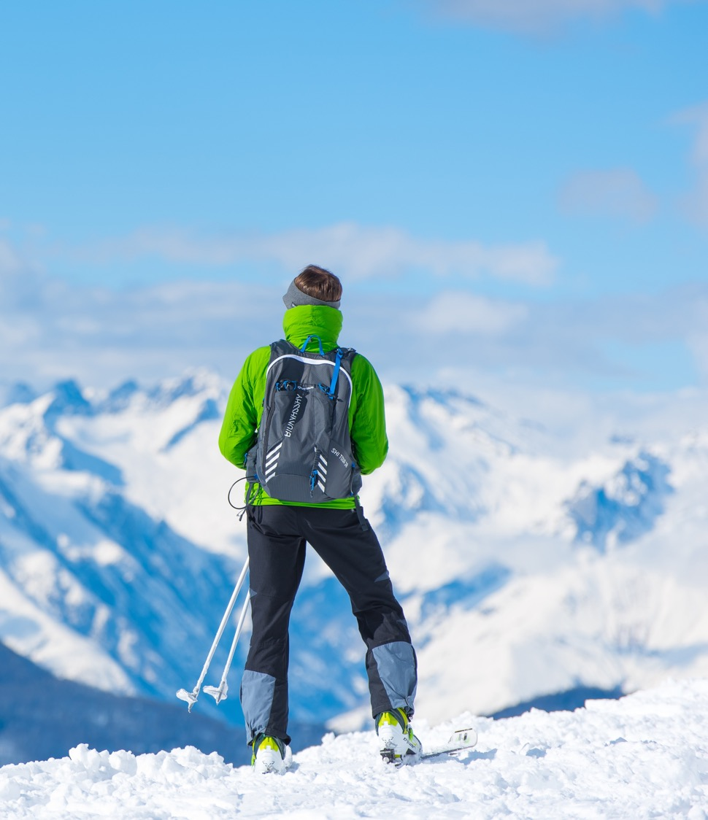
Big Mountain Resort Pricing Strategy
Executive Summary
Jae Chung, PhD | August 8th, 2021

Slide 2
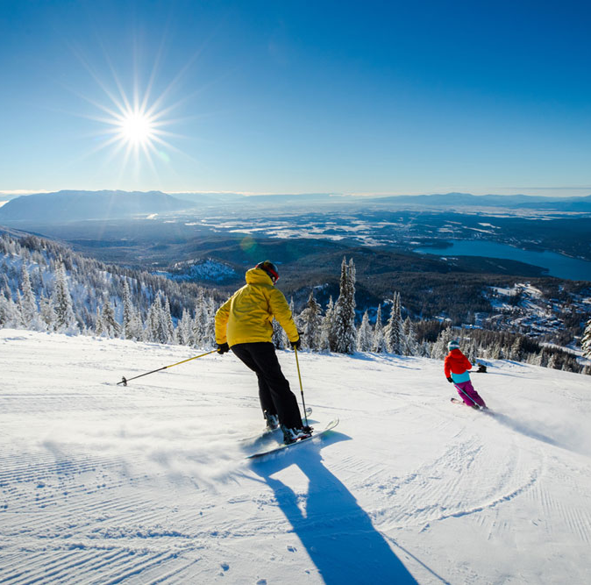

Big Mountain Resort
Montana, with views of Glacier National Park and Flathead National Forest
Biggest ski resort in Montana
# Trails: 105
# Visitors: appx. 350,000/yr
Elevations: Base 4464 ft, Summit 6817 ft, Vertical drop 2353 ft
# Chairs: 14 (11 lifts, 2 T-bars, 1 magic carpet)
Recently installed chair costs $1.5MM/yr
Ticket Price: $81/adult
Notes:
© Copyright Showeet.com – Free PowerPoint Templates

Slide 3
Problem Statement & Success Criteria
Problem Statement
Scope & Success Criteria
How can Big Mountain Resort set its pricing strategy to best generate revenue and capitalize on its existing infrastructure by:
finding a data-driven revenue-maximizing ticket price benchmarked to its competitors, and/or
optimizing redundancies in existing facilities or identifying investment opportunities in new ones?
Identify a data-driven path forward for better revenue generation (within the market segment provided in the data), either through increased ticket prices or lowered operations costs or both.
Run through the four operational scenarios to present recommendations on their profitability based on data

Slide 4
Recommendations
Ticket Pricing
Scenario Analysis
Model supports a ticket price of $96/adult benchmarked against ski resorts across the US
$15/adult (~19%) increase from current price
> $26MM/yr revenue increase if no drop in sales volume
$2.25MM/yr revenue increase even with loss of 50,000 customers per year
Best investment opportunities (cf. ticket prices):
More fast Quad chairs
Additional runs/trails
More snow making area
Greater vertical drop
Scenario 1: Closing runs
Closing first run is free – recommended
Model also supports closing five or eight runs
Closing any other number of runs up to 10 not recommended
Scenario 2: Adding a run, a chair, and vertical drop
Model support a $2/adult increase in ticket price
Additional $3.5MM/yr revenue – recommended
Scenario 3: Scenario 2 + 2 acres of snow making area
Indistinguishable to Scenario 2 from model – not recommended
Scenario 4: 4 acres of snow making area
Model doesn’t support any change in price – not recommended

Slide 5
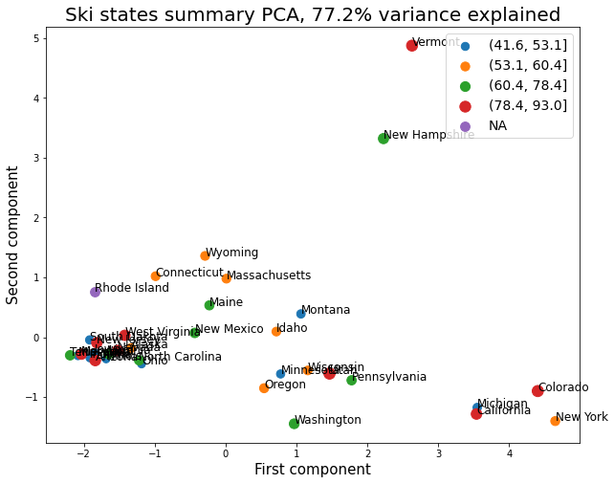
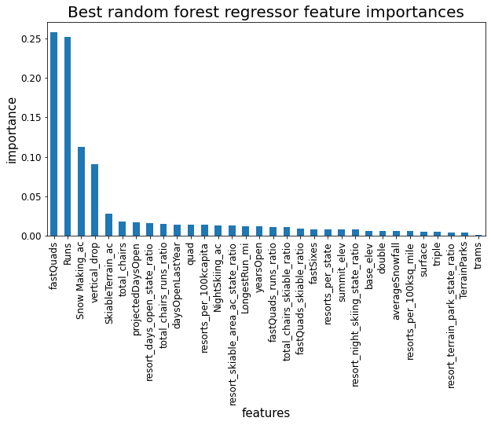
What are the most Important Features in Pricing?
Is State Important?
What features are Important then?
No clustering effect suggests state identity is not important
* Principle components are artificial variables designed to explain the data in the least number of variables. In this case the two components explain ~80% of the variance.
# of Fast Quads (26%)
# of Runs (25%)
Snow Making area (12%)
Vertical drop (9%)
# total chairs (3%)

Slide 6
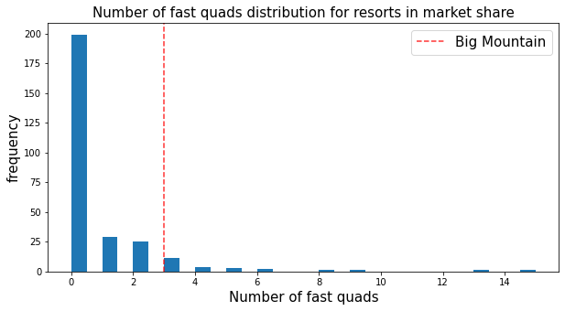
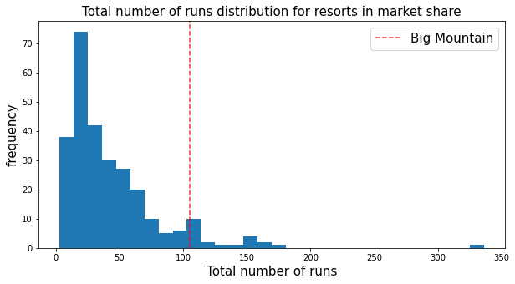
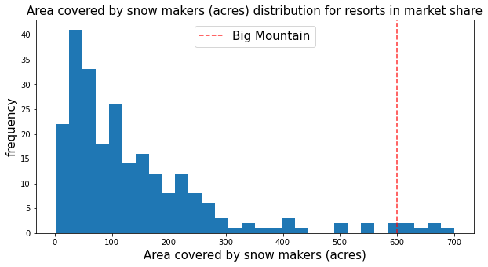
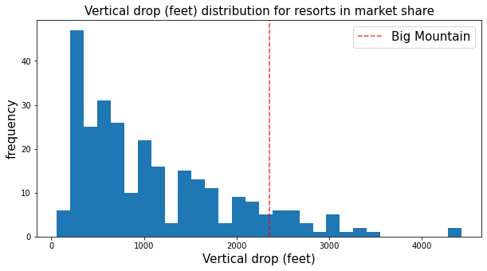
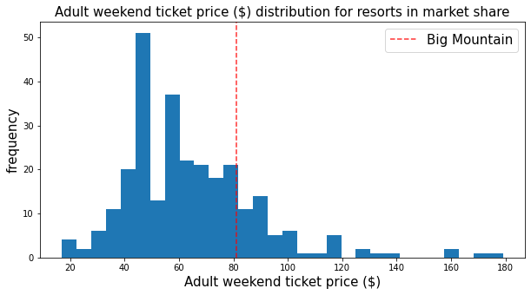
Where does Big Mountain Resort Stand in these Features?
92nd Percentile
93rd Percentile
98th Percentile
# of Fast Quads
# of Runs
Snow Making area (acres)
The weighted average of the top five features puts Big Mountain Resort at the 93rd percentile, while Price sits at the 81st percentile!
Clearly there is room to charge more!
Model predicts $96/adult as optimal.
90th Percentile
81st Percentile
Vertical drop (ft)
Ticket Price ($)

Slide 7
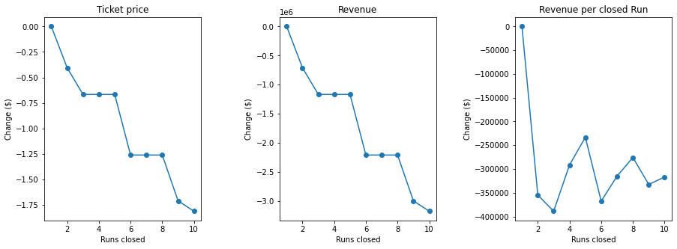
Scenario Analysis
Scenario 1: Closing runs
Closing the first run costs zero to ticket price
Closing the 4th, 5th, 7th, 8th runs are similarly free
Recommend closing either 1, 5, or 8 runs
Scenario 2: Investing in a run, a chair, and 150 ft of vertical drop
Model supports a price increase of $2/adult to $98/adult final price
This is $3.5MM/yr revenue with no change in # of visitors
Scenario 3: Scenario 2 + 2 acres of Snow Making area
Model does not support further increase in price
Scenario 4: +0.4 mi to longest run, +4 acres Snow Making area
Model does not support increase in price
Notes:
© Copyright Showeet.com – Free PowerPoint Templates

