Slide 1
파이썬을 이용한 Bioinformatics 기초 PART II Protein
2014.08.19
Eum Hyehyeon

Slide 2
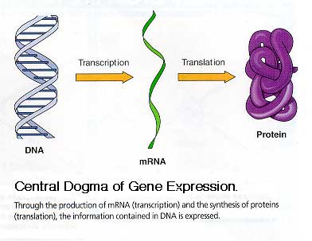
Central Dogma
the chief actors within the cell.

Slide 3
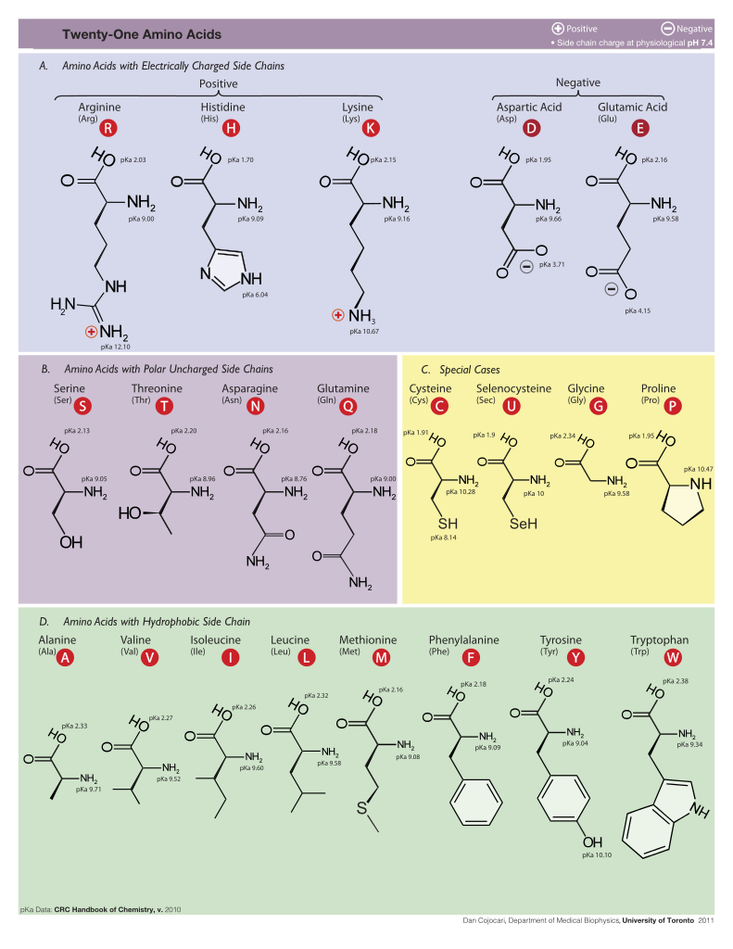
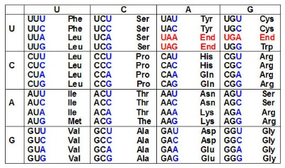
Triplet code

Slide 4
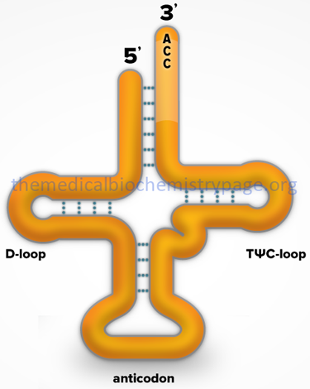
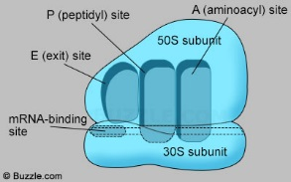
Ribosome & tRNA
<Ribosome, rRNAs & proteins>
<tRNA>

Slide 5
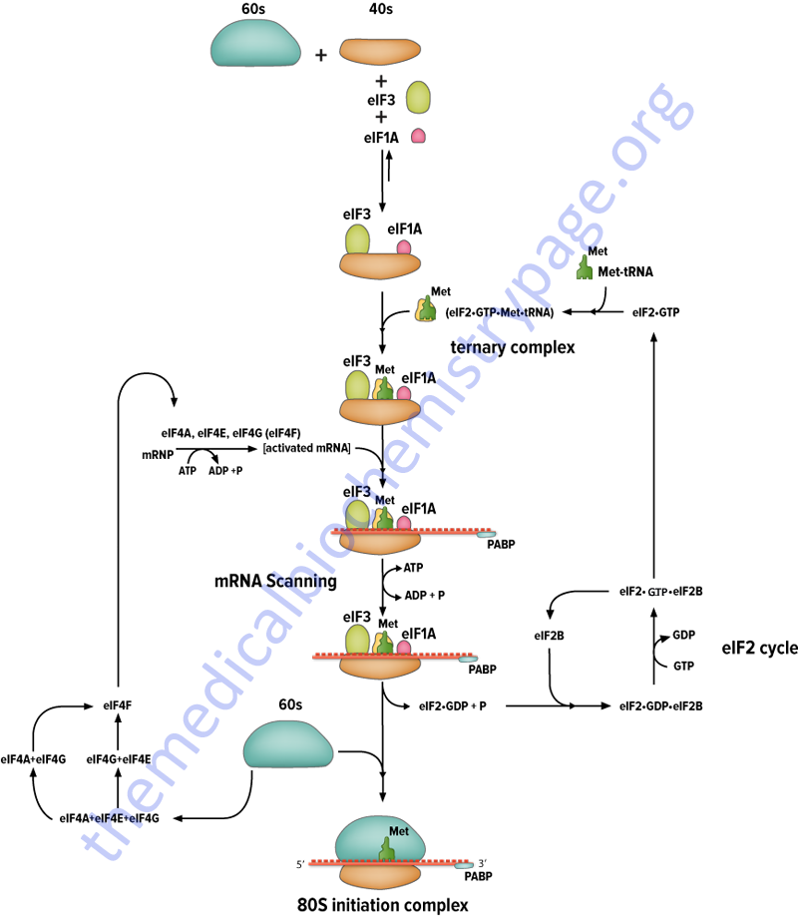
Translation 1. initiation
Ribosome
Small subunit : which reads the RNA
Large subunit : which joins amino acids to form a polypeptide chain

Slide 6
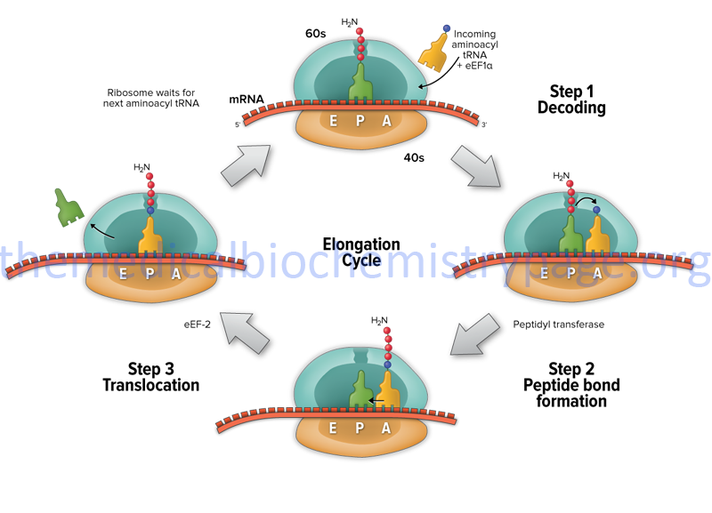
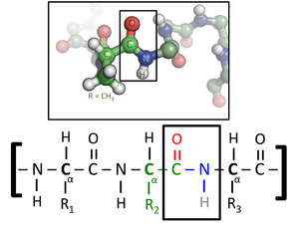
Translation 2. elongation

Slide 7
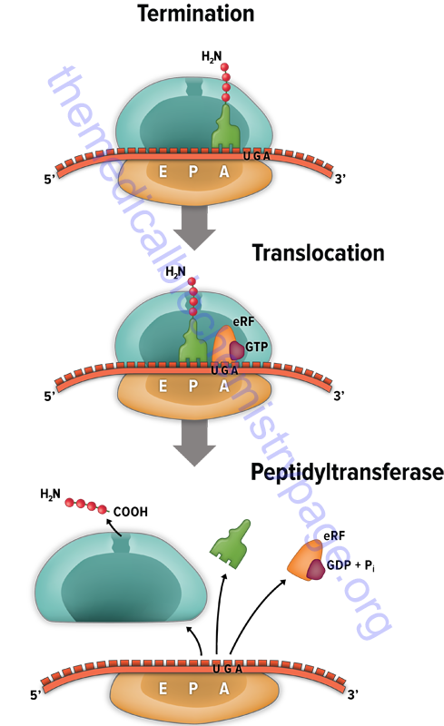
Translation 3. termination
eRF : Eukaryotic Releasing Factor

Slide 8
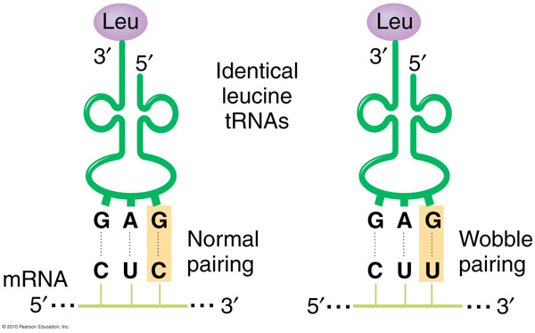
Wobble hypothesis
If each tRNA molecule paired with its complementary mRNA codon using canonical Watson-Crick base pairing,
then 61 types of tRNA molecule would be required. (64 codon – 3 stop codon)
But, it is not.

Slide 9
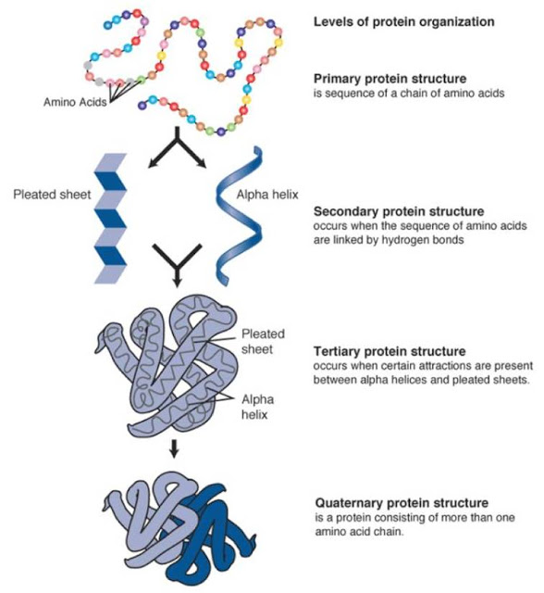
Structure
Important factors to protein structure :
pH, temperature, etc

Slide 10
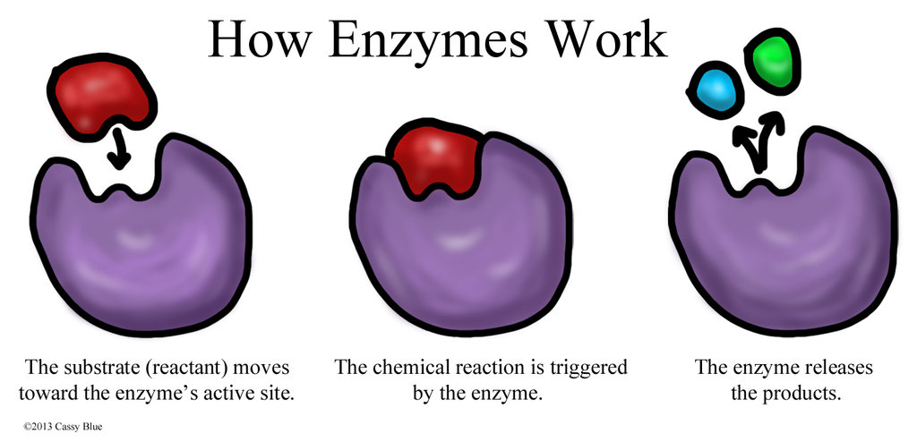
Enzyme
The best-known role of proteins is an enzymes, which catalyze chemical reactions.
Enzymes are usually highly specific

Slide 11
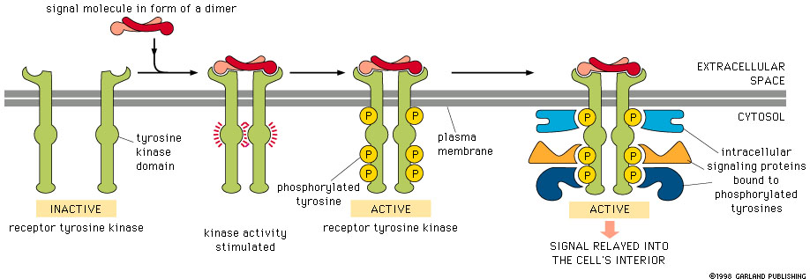
Cell signaling and ligand binding
Some proteins are extracellular proteins that transmit a signal (e.g., insulin)
Others are membrane proteins that act as receptors of signal (e.g., Ser/Thr receptor)

Slide 12
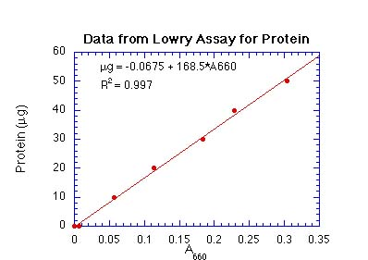
Lowry Assay
for determining the total level of protein in a solution
Is based on the reaction of Cu⁺, produced by the oxidation of peptide bonds, with Folin–Ciocalteu reagent
Get a standard curve using BSA
Measure extinctions of samples
Determine samples’ concentration
conc. = β + α*A660

