Slide 1
Introduction to RNA sequencing
Seulji Chang

Slide 2
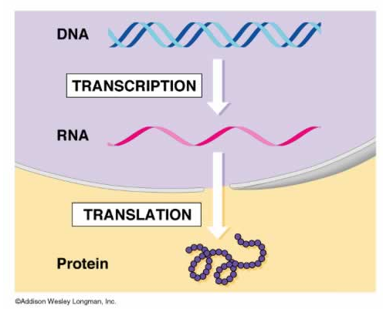
What is a RNA?
핵
세포질
DNA is the blueprint.
RNA in its various forms is the construction crew.
Proteins are the finished building.
Notes:
1. DNA is very very long. It is simply not efficient to translate proteins directly from DNA. We need a messenger to copy the information from the DNA in much more compact, manageable and short molecule, thus mRNA copies the code for a specific protein off the DNA, is exported from the nucleus and is then used as a template to create the protein. 2. Regulation. Having mRNA as an intermediate stage between the coding and the translation of the information into protein, enables fantastic and advanced control. a. It allows the sequestering of DNA into the nucleus. A tremendous advantage for regulation. b. It allows regulation on the transcriptional level by transcription factors - when and how much we end up with any specific protein. c. It enables alternative splicing - again another level of control, and adds options for diversity, These reasons are why RNA is necessary.

Slide 3
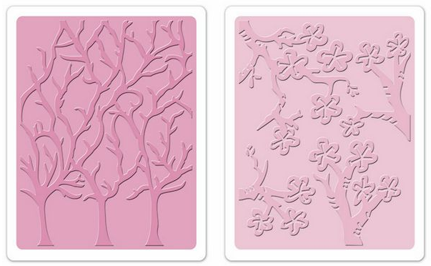
Why sequence RNA (versus DNA)?
Functional studies:
- The transcriptome of a cell is dynamic; it continually changes.
- Genome may be constant but an experimental condition has a pronounced
effect on “gene expression”.
e.g. Drug treated vs. untreated cell line,
Tumour vs. Normal
Some molecular features can only be observed at the RNA level:
- Alternative isoforms, fusion transcripts, RNA editing.
Notes:
양각판 위에 흰 종이를 놓고, 색연필로 색칠을 하면,
색칠을 하는 사람의 기분이나 상태, 주변 환경에 따라 흰 종이 위에 새겨지는 모양은 같아도 세기가 같지 않음.
캔서 연구에서 RNA sequencing을 하는 제 1의 목적은 특정 상황에 있는 유전자 발현을 설명하기 위함.

Slide 4
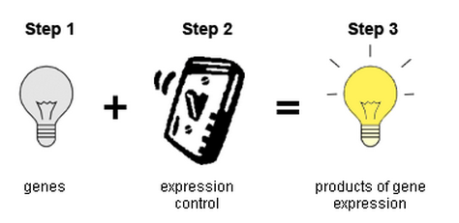
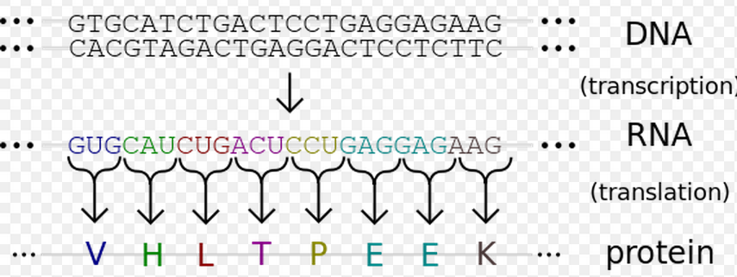
Gene expression
Genes are expressed by
being transcribed into RNA
Measuring gene expression
by mRNA quantification

Slide 5
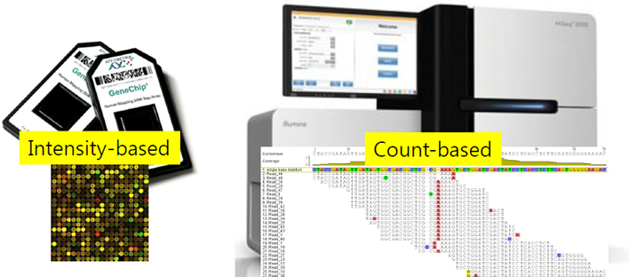
RNA-Seq VS microarray (advantages)
Technology | Microarry | RNA-Seq
Background noise | High | Low
Application | Gene expression | More than gene expression
Required amount of RNA | High | Low

Slide 6
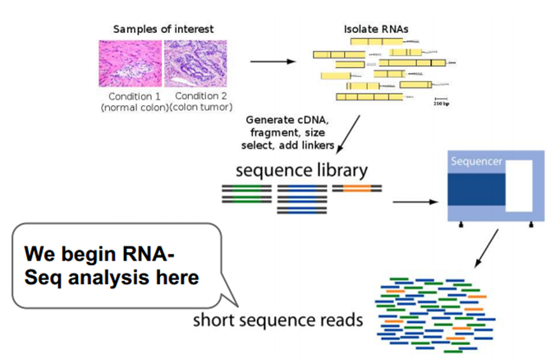
Introduction to RNA-Seq
RNA-seq, also called "Whole Transcriptome Shotgun Sequencing" ("WTSS"), refers to the use of high-throughput sequencing technologies to sequence cDNA in order to get information about a sample's RNA content.

Slide 7
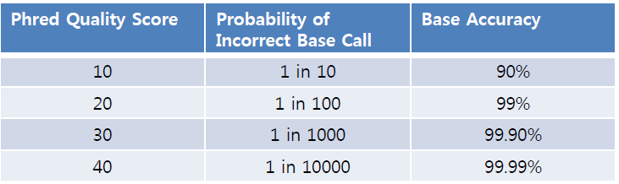
용어
Input: Fastq (sequence data)
FastQC: >30
TopHat: align Short RNA-Seq Reads to Reference
Output: SAM (mapping data)
SAMtools: BAM (compressed and more efficient for software to work with)
Gene expression unit
- RPKM: Reads Per Kilobase per Million mapped reads
- FPKM: Reads Per Kilobase per Million mapped fragments
- TPM: Transcript Per Million

Slide 8
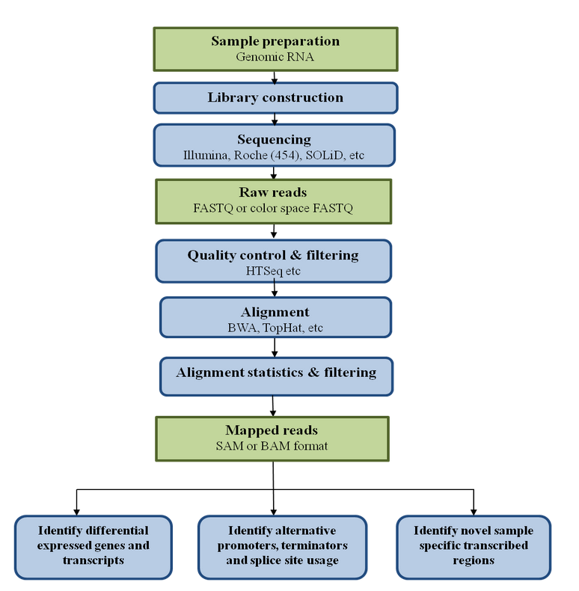
RNA-Seq-quantitative measurement of expression
Wilhelm, B. T. and J.-R. Landry (2009). "RNA-Seq--quantitative measurement of expression through massively parallel RNA-sequencing." Methods 48(3): 249-257.

Slide 9
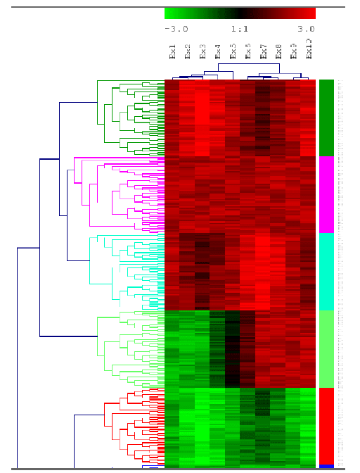
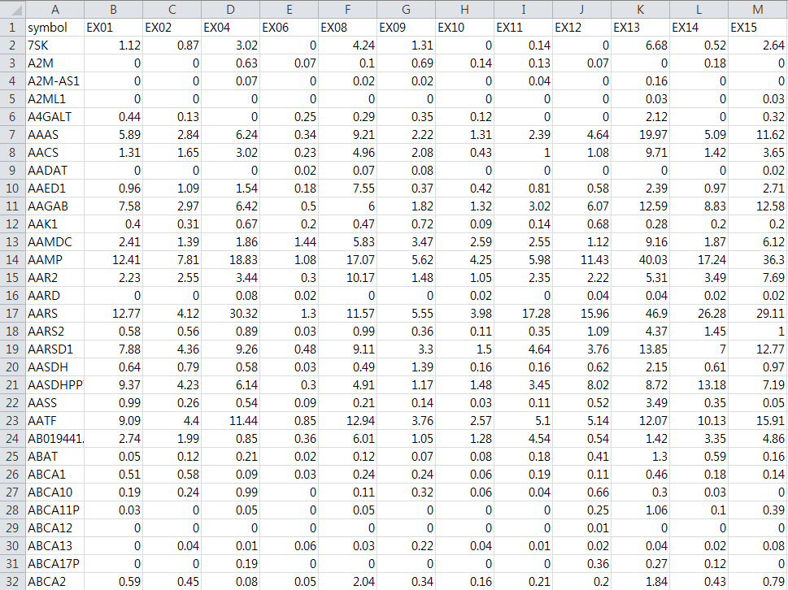
Example of RNA-seq analysis
Results.txt

