Slide 1
Pacman In Java
User Guide

Slide 2
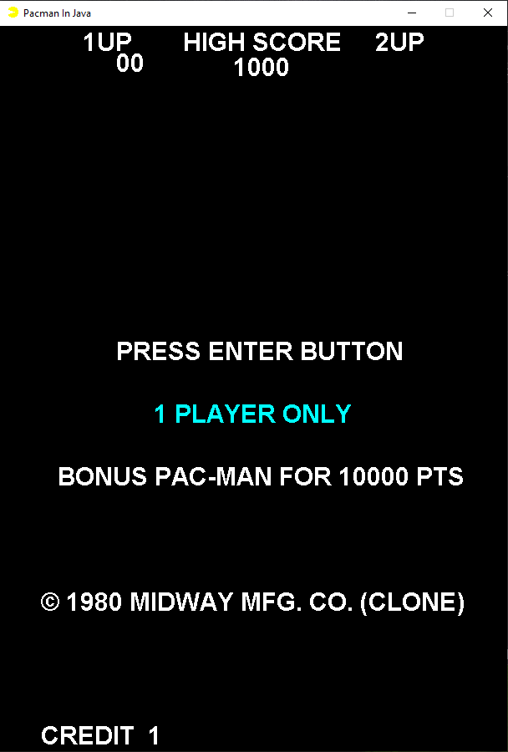
Getting Started
1) Run the Pacman.jar provided
2) After the intro sequence you are prompted to press the enter button.
3) Press enter to start a one player game.

Slide 3

Controls
Enter: Press to start the game when prompted
WASD: Move in all four directions
NOTE: Movement is in a free roam state, make sure to watch the corners so you don’t stop moving and get caught!

Slide 4
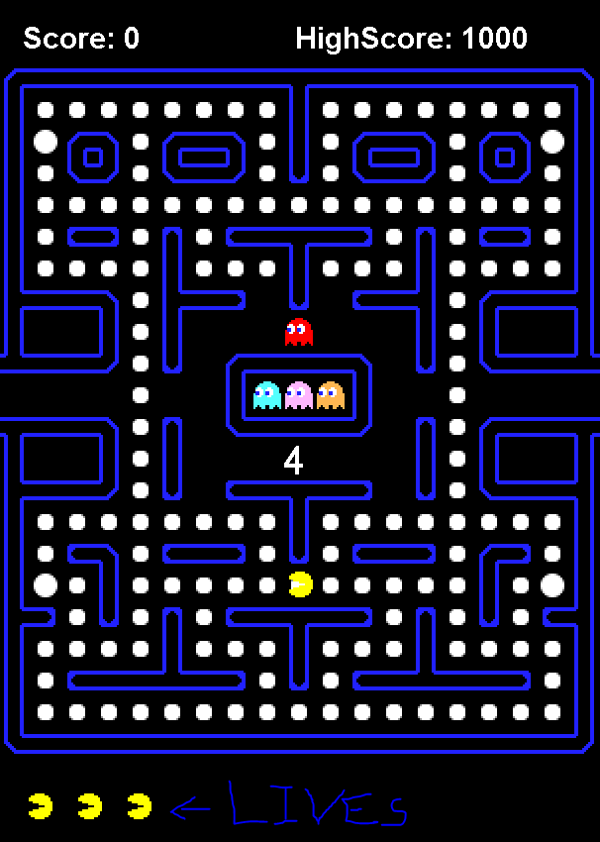
The Game Screen
Score: Indicates your current score
HighScore: Indicated the current high score.
Lives: Represented as pacman, represents your current lives.

Slide 5
Rules
Simple rules:
Your goal is to clear the entire maze by eating all the pellets
You start the game with 3 Lives and gain a life every 10,000 points
When a ghost catches Pac-Man, he loses a life
If all lives are lost the game is over!

Slide 6
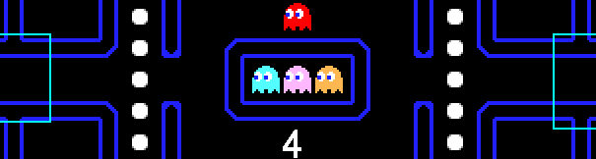

Tips and Tricks!
Power Pellets: Consuming a Power Pellet will cause the ghosts to change shape and run. In this weakened state they can be eaten! However, they are only vulnerable for a short time so be careful!
Warp Tunnels: Go through these tunnels to warp to the other side! Useful to lose a ghost hot on your tail.
Trick ghosts by leading them away from where you want to go, then get there fast!

Slide 7
Scoring
Pellets: 10 Points
Power Pellets: 50 Points
Ghosts: 100 Points
Extra Life: You gain an extra life for every 10,000 points!

