Slide 1
Stanford

Slide 2
학과
Chemical engineering: cheme
Bioengineering : bioengineering
Aeronautics and Astronautics : aa
Civil and Environmental Engineering : cee
Institute for Computational & Mathematical Engineering : icme
Computer science : cs
Electrical engineering : ee
Management Science and Engineering: msande
Materials Science and Engineering : mse
Mechanical Engineering : me

Slide 3
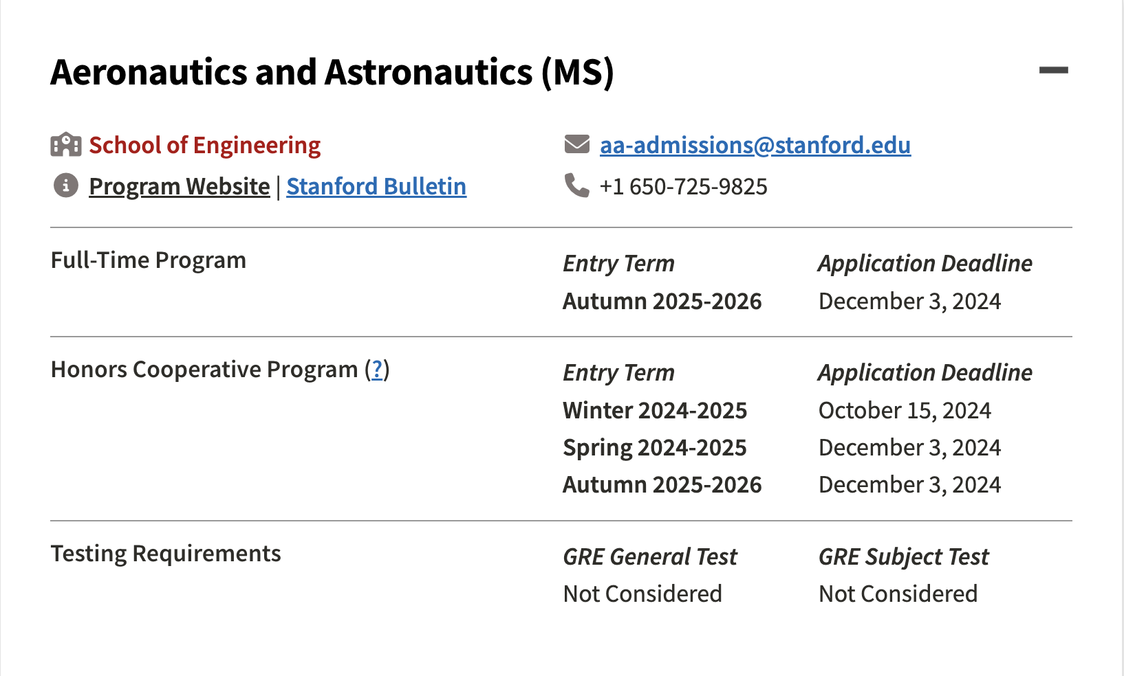
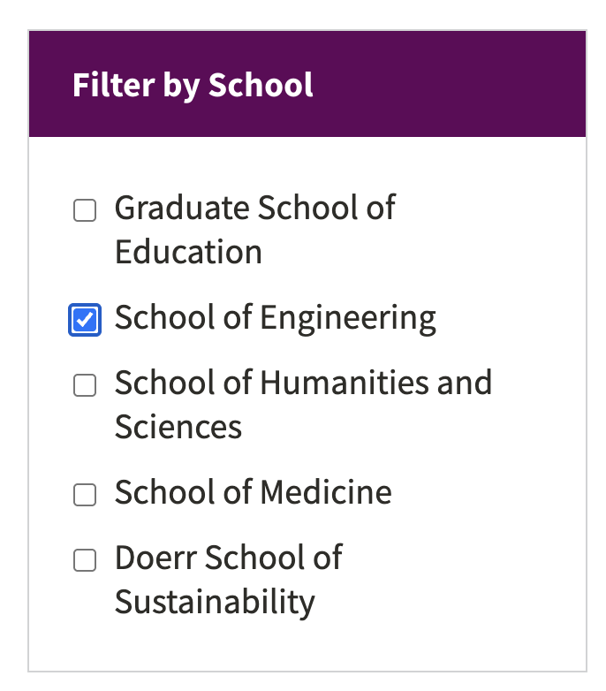
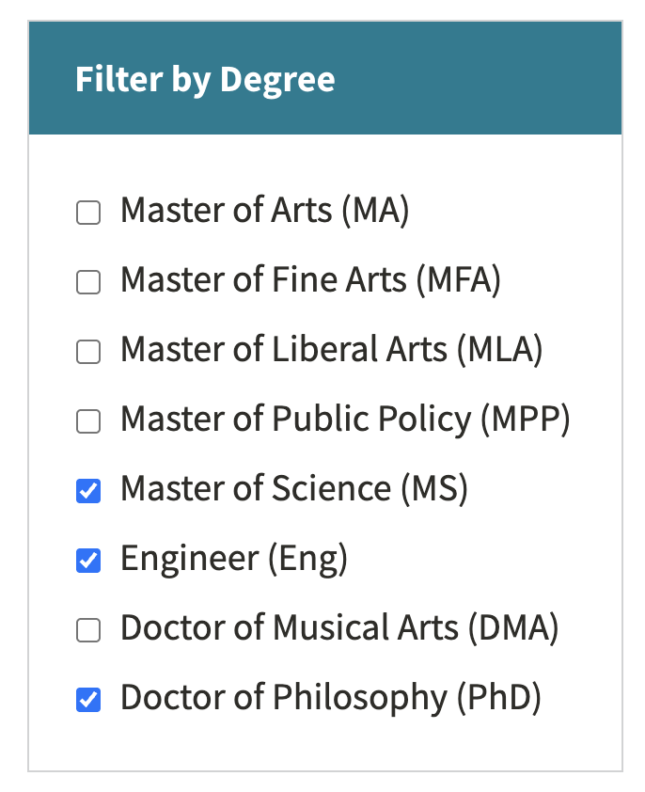
Start by filtering the major
Start from ↓
https://gradadmissions.stanford.edu/explore-programs
각 학과 웹사이트까지는 수동으로 url 얻기

Slide 4
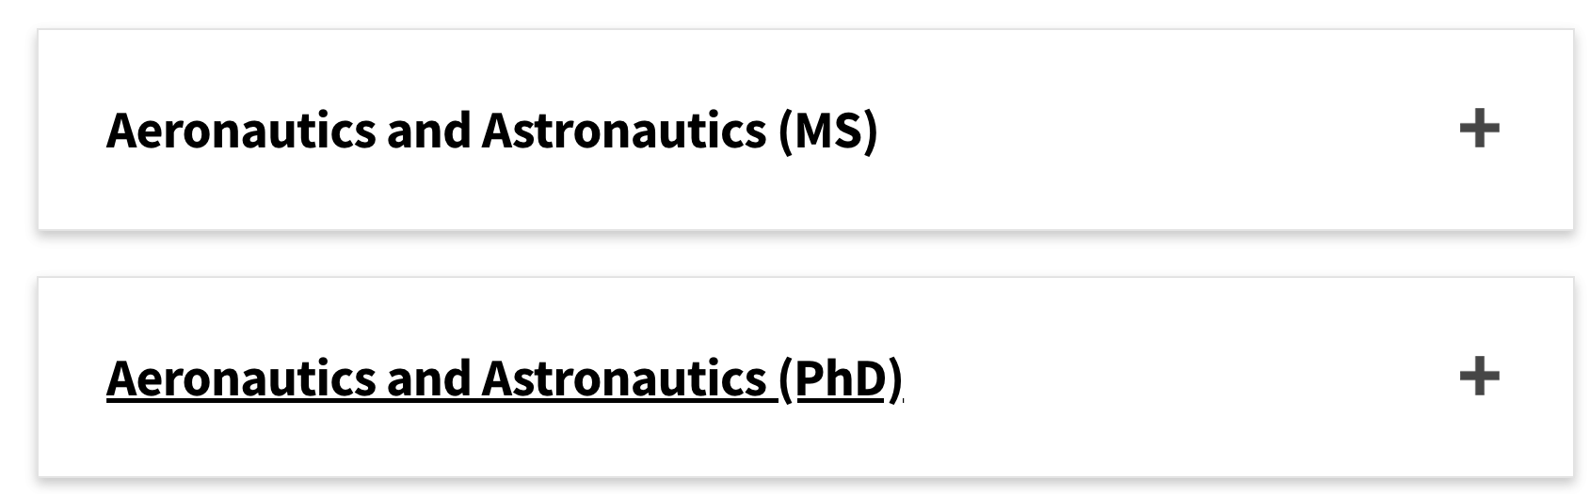
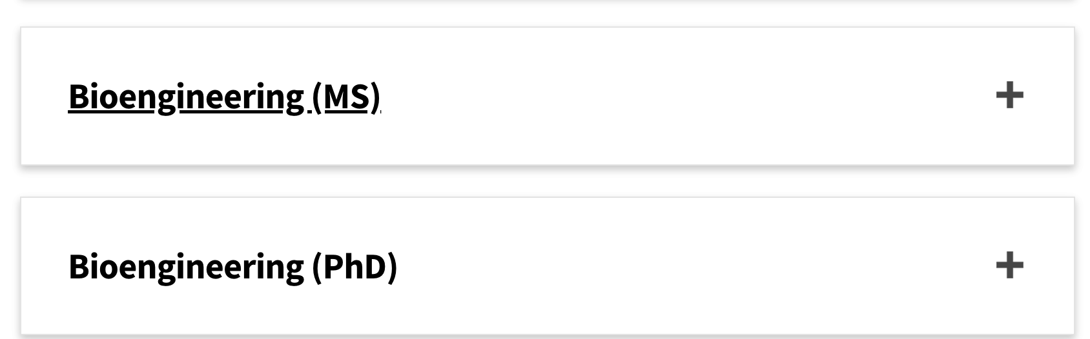
겹치는 것

Slide 5
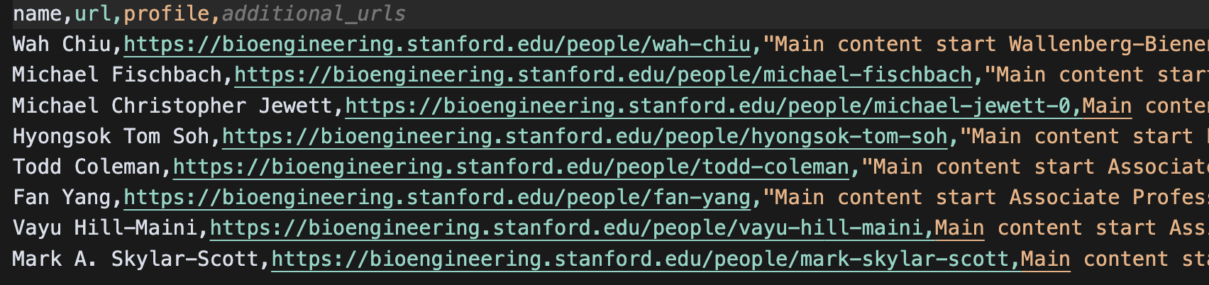
url 없는건 profile 카드 요약 위해 내용 긁어옴

Slide 6
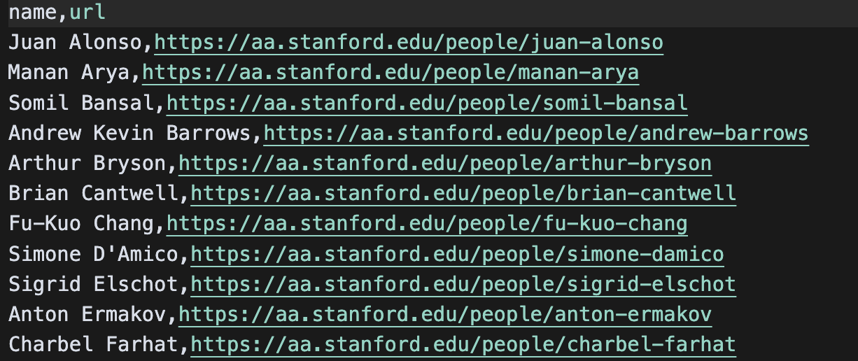
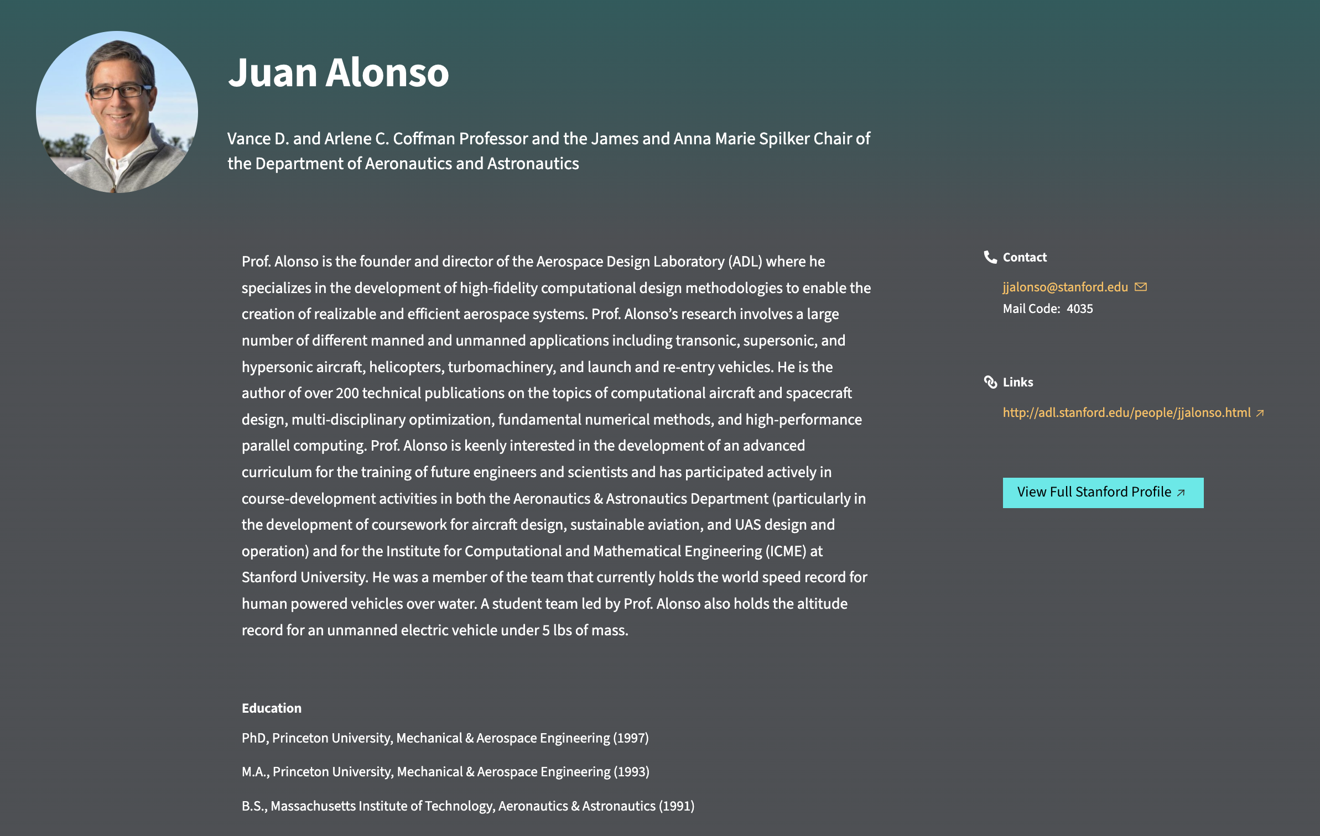
Step1: Faculty URL crawling
.
.
.
.

Slide 7
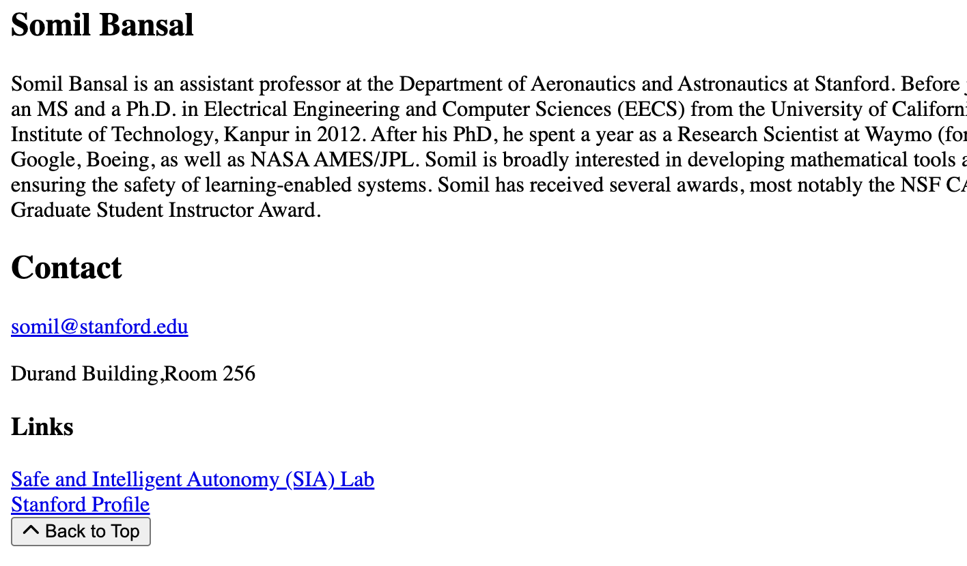
Step1.5 : Faculty profile
웹페이지의 <main> 태그 기준으로 긁어옴
BeautifulSoup의 find_next()로 link 바로 다음 긁어오게함.

Slide 8
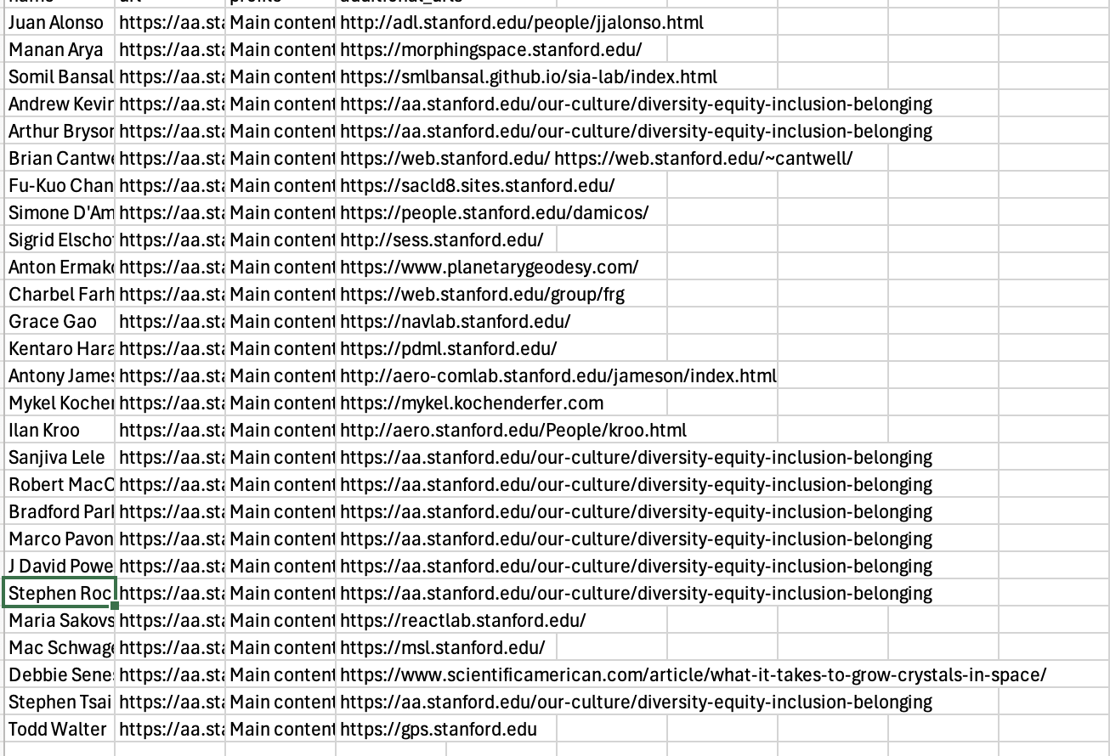
Failure.csv
url 존재하지 않는 사람들 : 바로 다음 링크 긁어옴 (제외하기)

Slide 9
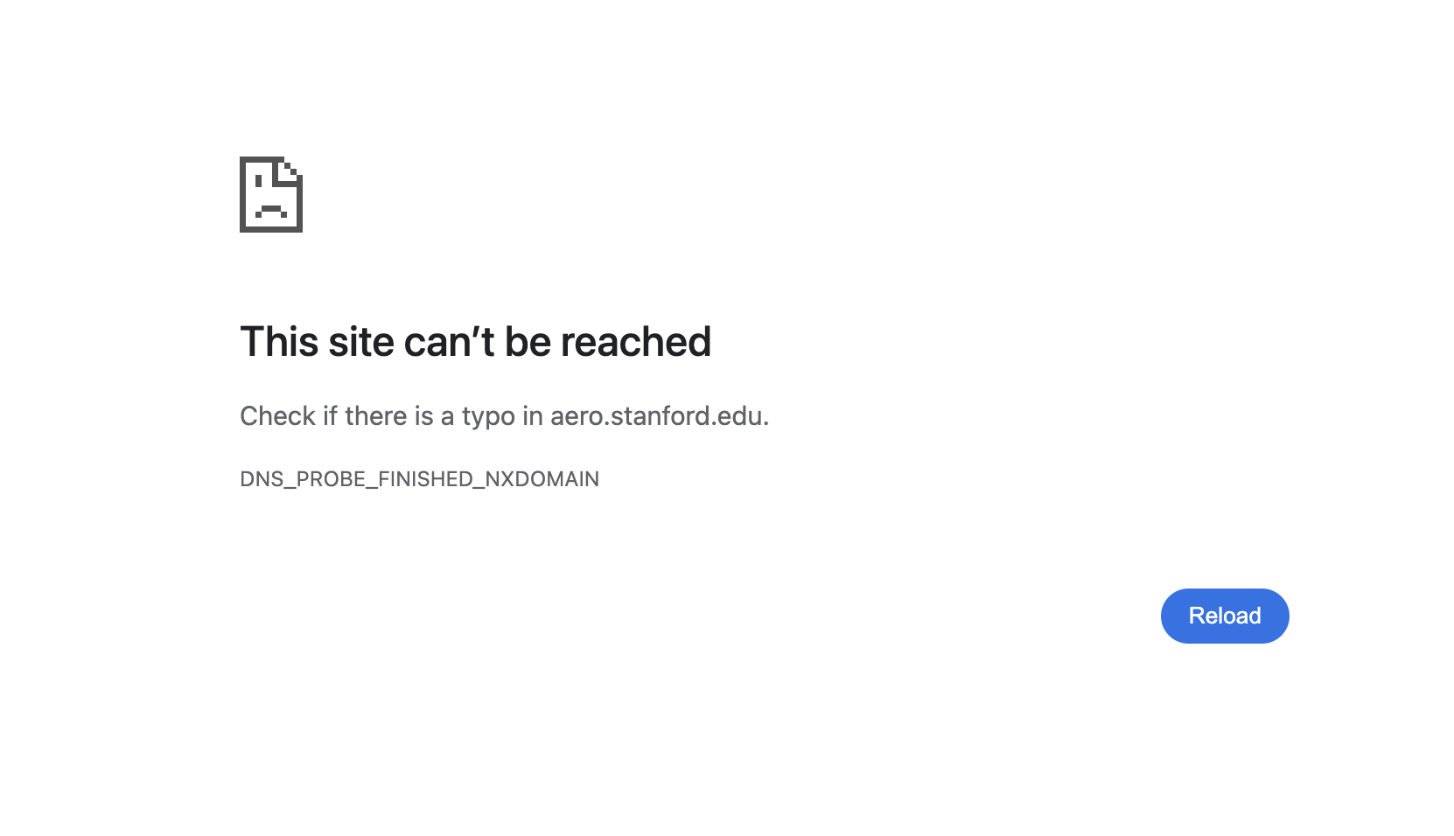
문제 1.
실제 열리는 웹사이트인지 확인 필요 / url 존재하나 열리지 않는 경우.

Slide 10
Step2 : Lab analysis
1. diversity-equity-inclusion-belonging＇ 링크 제외
2. 각 웹사이트의 내용 크롤링
3. Gemini API를 사용해 내용 분석
4. 결과를 lab_analysis_results.txt 파일에 저장 (출력 형태 참고)
==================================================
Professor: [교수 이름]
Analysis:
키워드: [키워드1, 키워드2, ...]
소개: [500자 소개]
Notes:
prompt = """
You are an AI research lab analyst. Your task is to analyze the following research lab website content and provide a structured analysis in English only.
Content to analyze:
{content}
Required output format (MUST be in English):
1. First, list exactly 20 research keywords that best represent the lab's research areas. Format as a comma-separated list.
2. Then, provide a comprehensive 500-word introduction of the research lab, focusing on their main research areas, methodologies, and contributions to the field.
Output format (copy and fill in the brackets):
Keywords: [keyword1, keyword2, keyword3, ..., keyword20]
Introduction: [Write a detailed 500-word introduction in English]
Important:
- All output must be in English
- Keywords should be technical and specific to the research field
- Introduction should be professional and academic in tone
- Maintain exactly 500 words for the introduction
- Do not include any Korean text in the response
"""

Slide 11
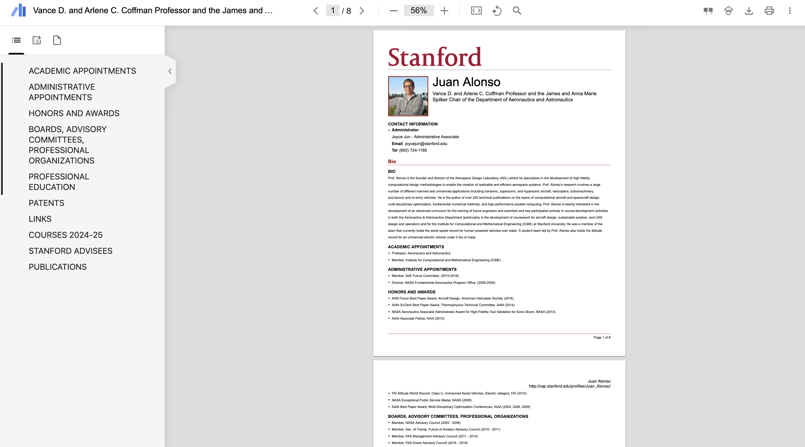
참고 ) 대체 방안
Cf. 보충 가능 url : https://profiles.stanford.edu/juan-alonso?releaseVersion=11.2.0
ORCID ID / Full profile 다운로드 가능.

