Slide 1
laB1
Kiho Choi
2021

Slide 2
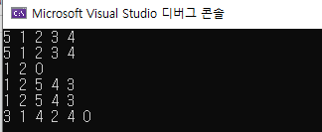
Lab information
Save Source File
lab_number.cpp (3 cpp files in total)
Lab1-1.cpp
Lab1-2.cpp
Lab1-3.cpp
Screen capture
Screen capture using input values
E.g.)
Make Zip Folder
학번_이름.zip (202111111_가천대.zip)
Submit the Zipped Folder to cyber campus

Slide 3
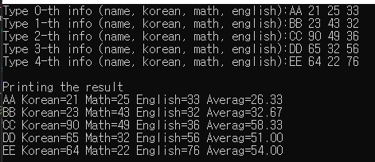
LAB1-1
Write a program to get student’s scores and print all the scores with average score each students
Input: Name, Korean, Math, English (5 students in total)
Output: All the information with average of all subject

Slide 4
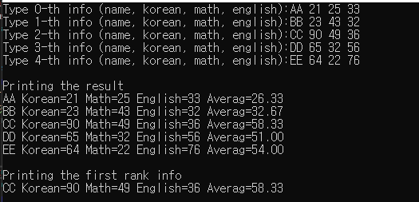
LAB1-2
Write a program to get student’s scores and print all the scores with average score each students. Additionally, print the first rank info based on average score.
Input: Name, Korean, Math, English (5 students in total)
Output: All the information with average of all subject, the first rank info

Slide 5
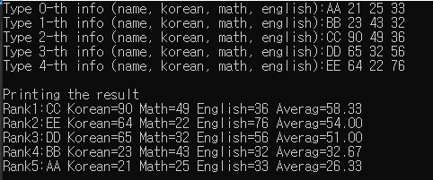
LAB1-3
Write a program to get student’s scores and print all the scores with average score each students. Additionally, print all the info according to ranking order
Input: Name, Korean, Math, English (5 students in total)
Output: All the information with average of all subject according to ranking order

Slide 6
