Slide 1
laB3
Kiho Choi
2021

Slide 2
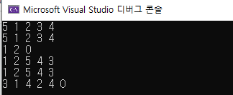
Lab information
Save Source File
  lab_number.cpp (1 cpp file in total)
    Lab3.cpp
Screen capture
  Screen capture using input values
    E.g.)
Make Zip Folder
  학번_이름.zip (202111111_가천대.zip)
Submit the Zipped Folder to cyber campus

Slide 3
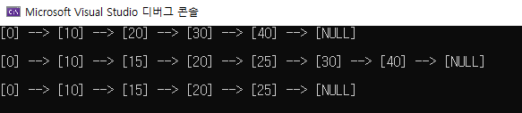
LAB3
Write a program to do the following procedures
  Make a linked list with the key values: 0, 10, 20, 30, 40
  Print the linked list
  Add the values (15 and 25) to the linked list with maintaining ascending order
  Print the linked list
  Delete the values (30 and 40) in the linked list
  Print the linked list
Output

