Slide 1
laB1
Kiho Choi
2021

Slide 2
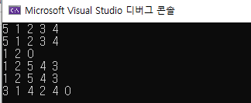
Lab information
Save Source File
lab_number.cpp (2 cpp files in total)
Lab2-1.cpp
Lab2-2.cpp
Screen capture
Screen capture using input values
E.g.)
Make Zip Folder
학번_이름.zip (202111111_가천대.zip)
Submit the Zipped Folder to cyber campus

Slide 3
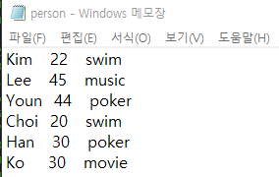
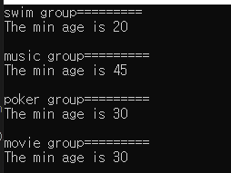
LAB2-1
Write a program to do the following procedures
read personal data from “person.txt” file
group the date based on hobby
print the lowest age in each group
Input: “person.txt” file (Assumption: #hobby = 4)
Output: the lowest age in each group

Slide 4


LAB2-2
Write a program to do the following procedures
read student’s scores from “sample_v1.txt” file
multiply the data with 1.5 times
write the updated data in “sample_v2.txt file
read “sample_v2.txt” file and calculate the average score without min and max values
print the average score without min and max values
Input: “sample_v1.txt” file
Output: the average score without min and max values

Slide 5
