Slide 1
Quorum Systems
Kotha Ravi Kanth
IDRBT, Hyderabad

Slide 2
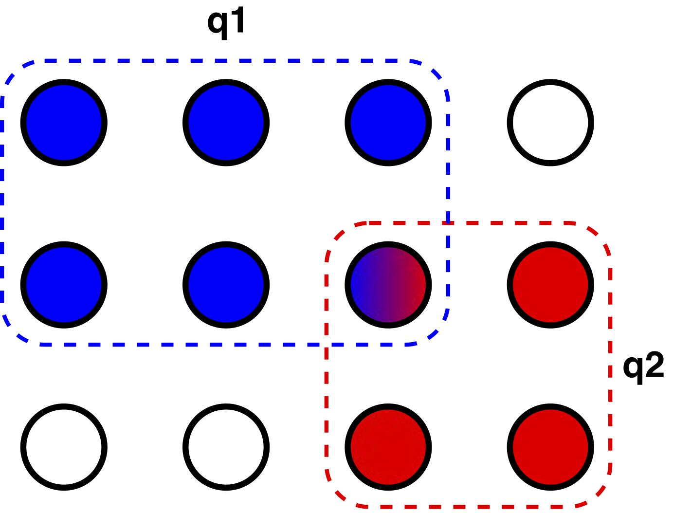
Let V = {v1,...,vn} be a set of nodes. A quorum Q ⊆ V is a subset of these nodes. A quorum system S ⊂ 2V is a set of quorums s.t. every two quorums intersect, i.e., Q1 ∩Q2 6= ∅ for all Q1,Q2 ∈S.

Slide 3
Types of Quorum Systems(1)
Coteries: No two quorums in a coterie are strict subsets of each other.
Read/Write Quorums: Quorums are classified into read/ write classes, where the intersection could only be between read class and write class.

Slide 4
Types of Quorum Systems(2)
Finite Projective Planes(FPP):
S contains n = k^2 +k+1 nodes, where k is a prime power, then a fpp of order k is a quorum system, in which
exactly k+1= O(√n) nodes,
every node is contained in exactly k+1 quorums
every two quorums intersect in exactly one node.

Slide 5
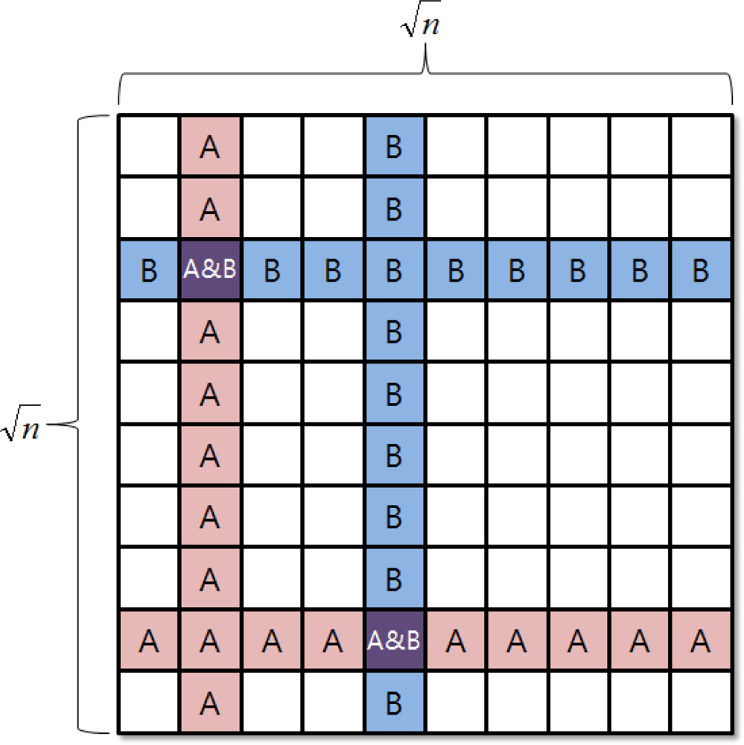
Types of Quorum Systems(3)
Grid Quorum:
- S contains K^2 nodes.
- Quorum (Qij) , ith row and jth column
- Size of the quorum is 2k-1 where k = √n

Slide 6
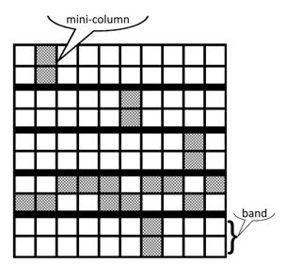
Types of Quorum Systems(3)
B Grid Quorum:
- Set S contains n = (col * band* rows/band)
- Quorum (Q) Size = col + (band * rows/band) -1
- Q consists of 1 mini-col and 1 element from each mini-col of 1 band

Slide 7
Byzantine Quorum Systems (1)
f-disseminating
(Q1 ꓵ Q2) contains f+1 nodes
For every set of ‘f’ byzantine nodes, there is at least one quorum without byzantine nodes.

Slide 8
Byzantine Quorum Systems (2)
f-masking
(Q1 ꓵ Q2) contains 2f+1 nodes
For every set of ‘f’ byzantine nodes, there is at least one quorum without byzantine nodes.

Slide 9
Byzantine Quorum Systems (3)
f- opaque quorum system:
((Q1 ꓵ Q2) – F) > |(Q2 ꓵ F) ꓴ (Q2 – Q1)| where F is set of all faulty nodes.
(F ꓵ Q) = Null Set for some Q belongs to S

Slide 10
Thank You

