Slide 1
Grunt
Part of the AngularJS presentation

Slide 2
What is Grunt?
Task runner that helps you automate common tasks like
Minification
Concatenation
Lint
Automated testing
etc
Installed using npm from NodeJS.
Simple configuration
Very active userbase

Slide 3
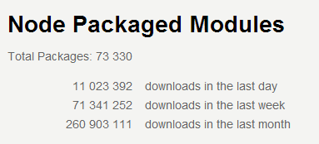
Getting started
Install NodeJS
npm install -g grunt-cli
Download our prepared Gruntfile.js and package.json from github
npm install
- Downloads everything in package.json

Slide 4
Using the prepared configuration
grunt
Runs tests, code analysis, contatenation, css/js/image minification
grunt test
Runs code analysis and runs tests using Jasmine and Karma
grunt watch
Keeps watch on your folders. As soon as you save a file code analysis and unit tests runs

Slide 5
Adding more plugins
Find the plugin you want.
Add the name of the plugin to package.json.
"grunt-pngmin" : ""
Add the name of the plugin to Gruntfile.js
grunt.loadNpmTasks('grunt-pngmin');
Add configuration to Gruntfile.js (usually documented on gruntjs.org)
Add the plugin to a task
grunt.registerTask('test', ['jshint', 'qunit']);

Slide 6
Backend
Backend för kvällen levereras av Azure
Azure Website (WebAPI)
Sql Server Azure
http://angularworkshop.azurewebsites.net/api/
All kod för backend finns på Github i samma repository som Angular-koden

Slide 7
Något helt annat…
Ett enkelt sätt att host:a sin website är att använda Python. Ladda hem, installera och starta i katalogen för din app:
Python 2:
python –m simplehttpserver
Python 3:
python –m http.server

Slide 8
Getting further
http://gruntjs.com/ - Great getting started guide and library of modules
https://github.com/softchris/WorkshopAngular/blob/master/Gruntfile.js - The grunfile for this workshop

