Slide 1


AngularJs
WORKSHOP
Christoffer Noring

Slide 2
The Agenda
- Food 18-1830
- CRUD 30 min 1830 -1900
- Coding 1900-2030
- Testing, Deployment 2030-2100

Slide 3
What is AngularJs?
DOM manipulation (move, create, replace, etc)
- Super heroic Javascript MVW Framework, Model View Whatever
- SPA, single page application
- Brings MVC capbability to javascript making it easier to test
- Angular deemphasizes DOM manipulation
- Angular is Test focused, support for unit
testing, ui testing mocking etc..
“DOM manip-way”
<div>
<span>content</span>
<span>new element</span>
</div>
“Angular-way”
<div ng-app>
<span ng-model=“name”></span>
</div>
Augmenting – add functionality to existing DOM

Slide 4
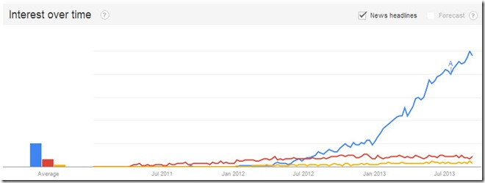
Why should you care?
AngularJS was originally developed in 2009 by Miško Hevery and Adam Abrons (google)
Started out as a business but went on to be open source framework, currently stable release at 1.2
AngularJs
Knockout

Slide 5
Angular MVW
controller
Controller
Decorates scope with primitives,
objects and callbacks. Responsible for
constructing a model
Scope
detect changes to model objects and
create an execution context for expressions
View
uses scope
Decorates
scope
model
view
Binds

Slide 6
Worlds smallest app
<script src="angular.js"></script>
<div ng-app>
{{ 1+2 }}
</div>
Include angular script
Create an angular application
Expression

Slide 7
Small app Example 1
<!DOCTYPE html>
<html xmlns="http://www.w3.org/1999/xhtml">
<head>
<title></title>
</head>
<body ng-app="app">
<div ng-controller="ProductCtrl">
{{test}}
<input type="text" ng-model="test" />
<button ng-click="save()">Save</button>
</div>
<script src="angular.js"></script>
<script src="app.js"></script>
<script src="ProductCtrl.js"></script>
</body>
</html>
var controllers = angular.module('controllers', []);
var app = angular.module('app', ['controllers','ngRouter']);
1-way binding
controllers.controller('ProductCtrl', function($scope) {
$scope.test = "A property";
$scope.save = function () {
console.log('save');
}
});
app
2-way binding
callback
callback

Slide 8
Small app Example 2
<!DOCTYPE html>
<html xmlns="http://www.w3.org/1999/xhtml">
<head>
<title></title>
</head>
<body ng-app="app">
<div ng-controller="ProductCtrl">
<div ng-show=”items.length == 0”>
No items to display
</div>
<table>
<tr ng-repeat=“item in items" >
<td>
{{item.Name}}
</td>
<td>
<a href=“#/ProductDetail/{{item.Id}}”> </a>
<td>
</tr>
</table>
</div>
<script src="angular.js"></script>
<script src="app.js"></script>
<script src="ProductCtrl.js"></script>
</body>
</html>
// app.js
var controllers = angular.module('controllers', []);
var app = angular.module('app', ['controllers','ngRouter']);
Conditional display
// ProductCtrl.js
var controllers = angular.module(’controllers’);
controllers.controller('ProductCtrl', function($scope) {
$scope.items = [
{ Name: ”CD”, Id:”1” },
{ Name: ”CD”, Id:”1” }
];
});
callback
Like a for-loop

Slide 9
Routing
Route Matches: /Persons/1…..n
// app.js
var app = angular.module('app', ['controllers','ngRouter']);
app.config(['$routeProvider', function ($routeProvider) {
$routeProvider.when(
"/Persons/:id",
{
templateUrl: "/partials/persons.html",
controller: "PersonCtrl"
}
);
$routeProvider.when(
"/Start",
{
templateUrl: "/partials/start.html",
controller: "StartCtrl"
}
);
$routeProvider.otherwise({ redirectTo: "/About" });
}]);
// index.html
<body ng-app="app">
<ul class=”menu”>
<li> <a href=”#/Persons”>Persons</a> <li>
<li> <a href=”#/Start”>Start</a> <li>
</ul>
<div ng-view> Here be dragons</div
<script src="angular.js"></script>
<script src="app.js"></script>
<script src="ProductCtrl.js"></script>
</body>
view
controller
ng-view makes routing work
Default : if nothing mathes url

Slide 10
Services
factory for creating objects
Good for creating objects
3 types of services
- factory(name, Function)
Returns an instance
- service(name, constructor)
Returns the value of the function
- providers
// declaration
someModule.factory(’User’,function(..dependencies){
function User(userDTO){
this name = userDTO.name;
}
User.prototype.hi = function(){ return ”hi” + this.name; }
return User;
);
// usage – for example when receiving response from $http
var usr = new User({ name : ’pelle’});
usr.hi();
service example
Good for utility functions
factory as a service
Can also be used as a service
// declaration
someModule.service(’CalvSrv’,function(){
this.name = ”pelle”; this.add = function(lhs,rhs){ return lhs.rhs; }
});
// usage
someModule.controller(’UserCtrl’,function($scope,CalcSrv){
console.log(CalcSrv.add(1,2));
}
// declaration
someModule.factory(’UsrSrv’,function(..dependencies){
return {hi : function(name){ return ”hi” + name };
);
// usage – same case as service
controller(’UserCtrl’,function($scope,UserSrv){
console.log(UserSrv.hi(”pelle”));
}

Slide 11
The app – normal flow
1) Route is hit ex ”/products”
View
{{products[0].Name}}
5) View is rendered
2) Controller asks productSrv for products
Controller
function(’productCtrl’,function($scope, productSrv){
$scope.products = [];
productSrv.getAll().then(function(result){
$scope.products = result.data
});
});
4) productSrv then-callback decorates scope
Service
services.factory(’productSrv’,function(){
getAll : function() { return $http.get(’api/products’); }
});
3) productSrv talks to backend

Slide 12
Backend wraps XMLHttpRequest
// GET,PUT,DELETE
var getPromise = $http.get('url', header);
//POST
postPromise = $http.post('url', data, header);
promise.success(function (data,status,header,config) {
console.log(data);
});
promise.then(function (result) {
console.log(result.data);
});
promise.error(function () {
});
Same signature for GET, DELETE
PUT,POST takes ”data” param
”then”, ”success”, similar callbacks
Handle error

Slide 13
Backend – Cache + Authentication
// CACHING, AUTHTOKEN, token param for example
getProducts : function(url){
return $http.get("api/Products",{ cache: true, headers: { 'AUTHTOKEN':'1212sdsadads2323' }});
}
First trip goes to backend
Second trip is loaded from cache
Specify a token in api call

Slide 14
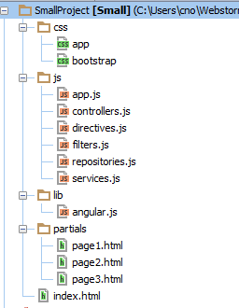
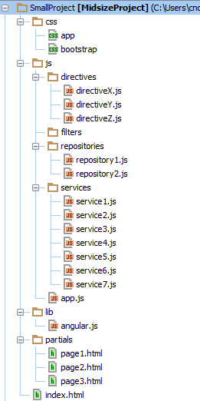
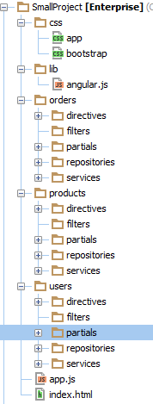
Organizing your code - templates

Slide 15
Useful directives
creates the app
creates a 2-way binding
points out a controller with its own scope
repeats data
renders a css class given a boolean expression ex
determines whether an element should be visible
ng-app
ng-repeat
ng-model
<ul><li ng-repeat="item" in items">{{item}}</li></ul>
<input type="text" ng-model="name" />
ng-class
ng-controller
list.length > 0 ? "show": "hide"
ng-show
<div ng-controller="userController">
</div>
<div ng-show=”hasErrors”>{{errorMessage}}</div>

Slide 16
Part II 2030 - 2100

Slide 17
Testing
Most things in Angular can be tested
controllers, services, factories, Directives, $http
There is good tooling support for unit testing and E2e (end to end aka UI testing) testing
Karma
Is a testrunner that
Can be extended with a lot of plugins
Needs a config file to run
Important properties
files
Browser
runOnce
Can run many different test frameworks
Jasmine
Qunit
etc..
Install
npm install karma –save-dev
Create config file
karma init <optional filename>
karma start
Jasmine -> BDD- style syntax
describe(’given a user has logged in’,function(){
it(’when user logs out ’,function(){
expect(userService.loggedInStatus).toBe(false)
});
})
Step 1, install
Step 2, config
Step 3, run

Slide 18
Testing – breakdown of a config file
// frameworks to use
frameworks: ['jasmine'],
// test results reporter to use
// possible values: 'dots', 'progress', 'junit', 'growl', 'coverage'
reporters: ['progress'],
// list of files / patterns to load in the browser
files: [
'lib/angular.js',
'lib/angular-mocks.js',
'lib/angular-route.js',
'app.js',
'services/*.js',
'controllers/*.js',
'test/services/*.js',
'test/controllers/*.js'
],
angular files
// enable / disable watching file and executing tests whenever any file changes
autoWatch: true,
browsers: ['Chrome'],
singleRun: false
});
};
your app
tests to run

Slide 19
Demo of a test and debug

Slide 20
Further reading
http://docs.angularjs.org/api
www.ng-newsletter.com
https://github.com/angular/angular-seed
http://egghead.io/
http://www.pluralsight.com
https://github.com/softchris/angulartemplate
Shameless self promotion ☺
www.google.com
Google is your friend

