Slide 1
Dockrize!
Belaid Moa
Compute Canada/WestGrid/University of Victoria
bmoa@uivc.ca

Slide 2
Agenda
Why dockers/containers?
Do researchers/scientist really need dockers?
Why not VMs?
The spectrum of deployments
Docker Elements
Docker Workflow
From Docker to HPC

Slide 3
Why Dockers/Containers?
Building, deploying, sharing, and running applications should be easy
“What? It is working on my machine!”
Updating the hosts should not break the applications running on them
The matrix of hell!
Getting the application up and running should be quick
Packaging and shipping the application should not too hard
Isolating different applications and their dependencies from each other
Dev/Test/Prod environments should not matter
But Isn’t virtualization enough? ….

Slide 4
Why NOT VMs?
VM
Hardware
OS
Hypervisor
Application
Bins/Libs OS
Application
Bins/Libs OS
…
Hardware
OS
Docker Engine
Application Bins/Libs
Application Bins/Libs
…
Docker
Virtualization
Dockerization

Slide 5
Do we really need Containers/dockers?
Researchers are interested in
long term reproducibility of results
their 10 year old applications must work
getting their jobs to run ASAP
using computational resources wherever they are available
Containers are here to the rescue!
Package your application into a container and get it deployed anywhere, anytime
Real stories
Magpy for geomagnetism
Mountain Legacy Project
Cyberhubs
Substance
BESOS

Slide 6
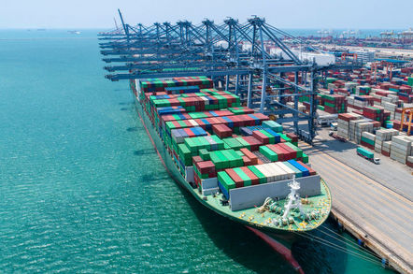
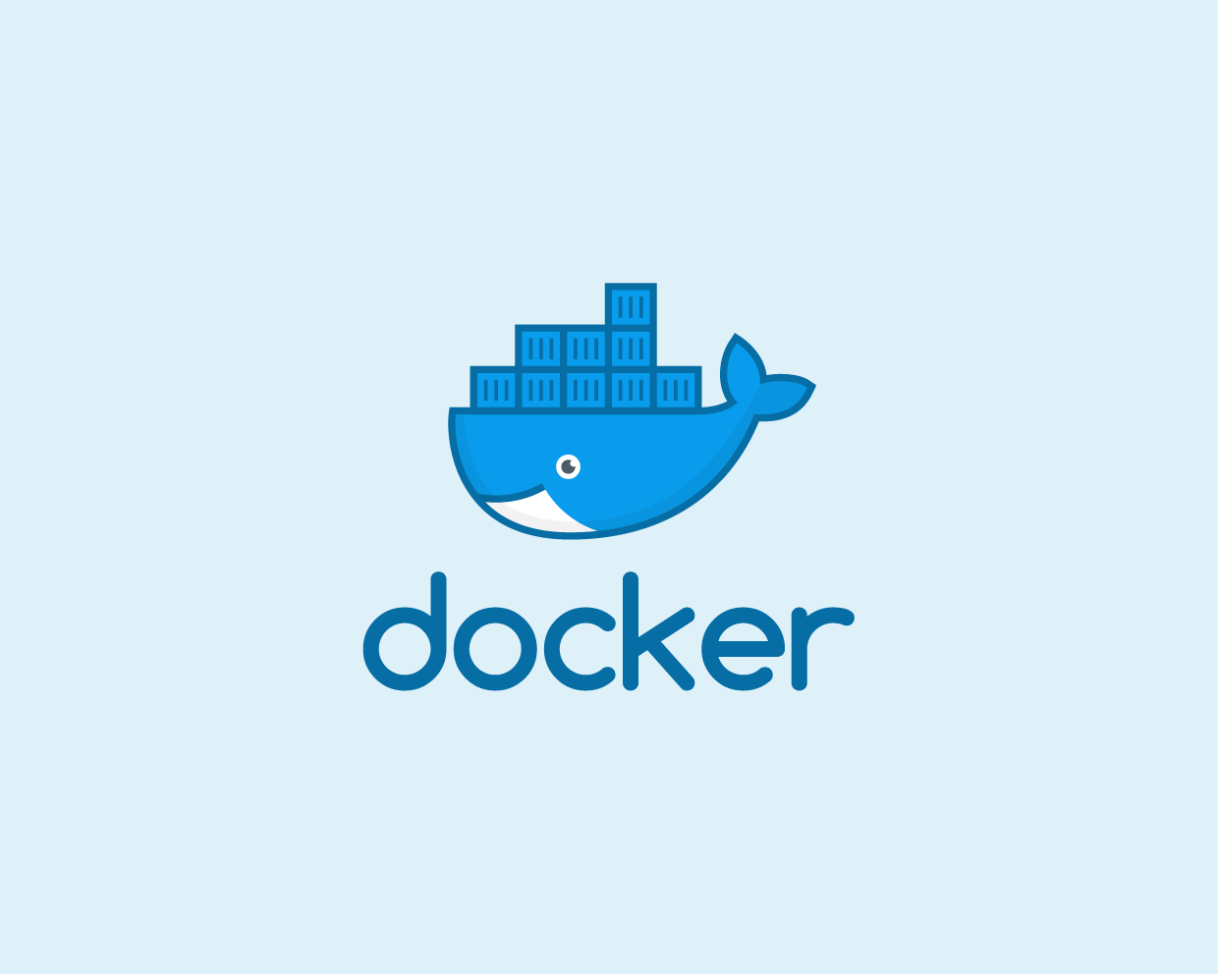
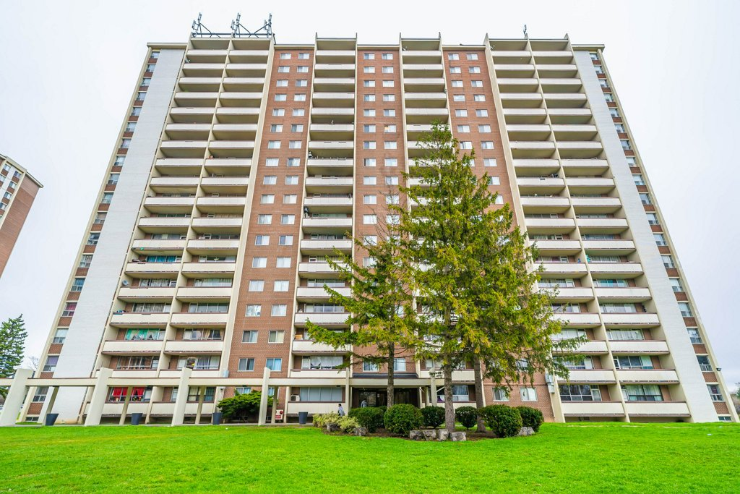
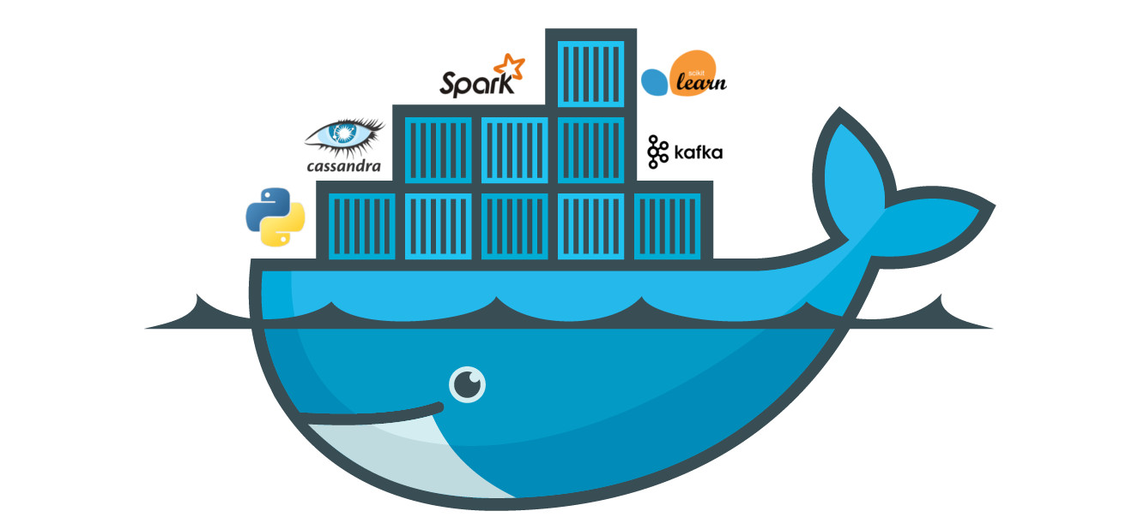

Slide 7
Spectrum of Application Delpoyment
Overhead
Virtual Machines
Containers
Manual Configuration
Portability

Slide 8
Why Dockers/Containers
Flexible: Unfriendly and complex applications can be easily dockerized.
Lightweight: Containers share and leverage the host kernel, and therefore they are much more efficient than virtual machines.
Portable: build locally and deploy anywhere.
Loosely coupled: Containers are highly self sufficient and encapsulated, allowing you to replace or upgrade one without disrupting others.
Scalable: You can increase and automatically distribute container replicas across a datacenter.
Secure: Containers apply aggressive constraints and isolations to processes without any configuration required on the part of the user.

Slide 9
Docker workflow
Code
Compile
Exec
Run
Hardware
OS
LIBs
Process
Applications
…
Hardware
OS
LIBs
Process
Applications
…
Machine 1
Machine 2

Slide 10
Docker workflow
Image
copy
Code
Dockerfile
Image
docker run
container
container
Exec
docker run
docker build
Libs/bins
Hardware
OS
Docker Engine
Process
Applications
Hardware
OS
Docker Engine
Process
Applications
Machine 1
Machine 2

Slide 11
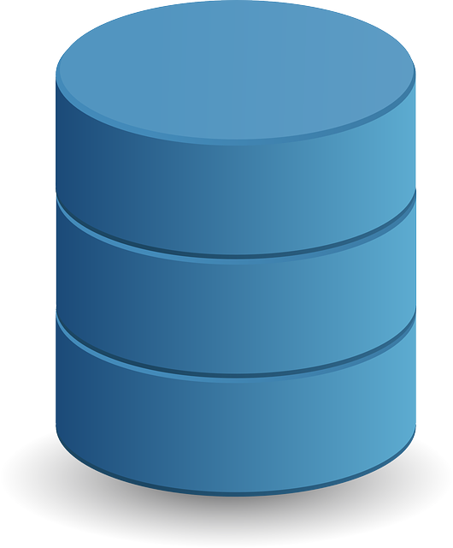
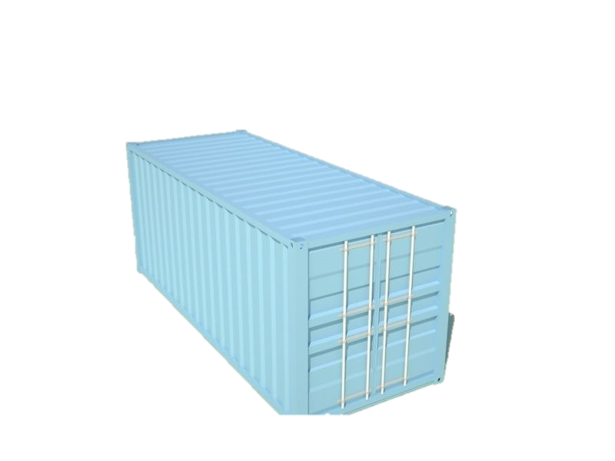

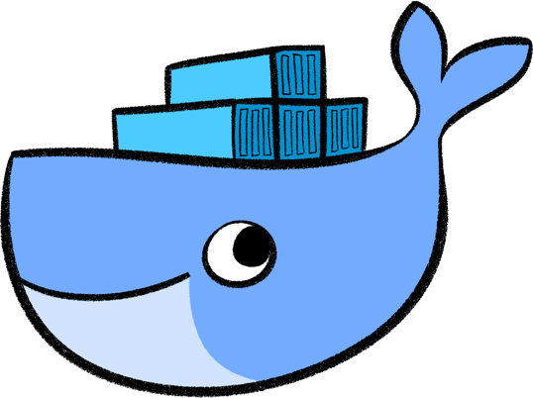
Docker Components
docker search …
docker push ..…
docker pull …...
Images Repository
docker run ……
docker exec ..…
docker stop …...
docker start …..
docker pause ….
docker ps ……..
docker rm ……
Containers
Images
Docker Client
docker images -a .....
docker rmi …..……
docker images purge
Docker Daemon

Slide 12
Docker Components
Images
They play similar role as VM images. There are templates, self-contained packages and read-only layers for running containers – they have everything you need to run your application. Usually each image fulfills a single task, and is generated from a dockerfile.
Dockerfile
A recipe for creating the layers of an image and assembling its content.
Docker-compose
Allows you to setup complex systems involving many containers; micro-services environments
Containers
Running instances of images. Each container has it is own isolated environment and processes. They are not persistent and volume are necessary if you want to store and keep the data.
Volumes, and Bind Mounts
External storage areas that you can mount to your containers to share and persist the data in your containers
Networks
Allows containers to communicate with other containers and processes. This is essential for micro-services deployments.

Slide 13
Dockerfile
A text file containing instructions allowing docker to create new images based on the existing one: docker build -t name:tag [-f /path/to/dockerfile] .
Dockerfile example:
ARG version=latest # --build-arg
FROM baseimage:$version
LABEL key=val …
ENV VAR1=VAL1 …
RUN cmd1 && cmd2 && …
COPY src dst
RUN more_commands …
EXPOSE port/protocol
USER …
ENTRYPOINT [“executable”, “param1”, …] #exec form
(OR ENTRYPOINT cmd param1 …) #shell form
CMD [“more param”, …] #exec form
(OR CMD param1 param2) #shell form
Use RUN to add layers to your image (install new packages on top)
Use ENTRYPOINT when a command has to be executed when running the image, and use CMD for the parameters that the user may want to change. Otherwise, use CMD.
RUM, CMD, and ENTRYPOINT come in shell and exec form
Shell form → cmd is executable under shell
Exec form → cmd is executed without shell
Important to know, especially when using environment variables.

Slide 14
Hands on
Getting started with Dockers

Slide 15
Docker INSTALLATION
ssh into your instance on the Arbutus cloud
ssh -Y -i [YOUR_PRIVATE_KEY] ubuntu@ipaddress
Update software repository
sudo apt update
Install docker
sudo apt install docker.io
Start the docker engine and enable it to do so as startup
sudo systemctl start docker
sudo systemctl enable docker
Add ubuntu user to docker users
sudo usermod -aG docker ubuntu
Check the installation
docker info
docker --version

Slide 16
Docker Challenge 1 – Hello world!
Hello world example with dockers!
docker run hello-world
Did you get any output?
Check whether the container run using ps or ls:
docker ps -a
docker container ls –a
What does “docker container ls -aq” do?
Run the container using start
docker start …
Did you see any output? Check the logs:
docker logs …
Remove the container using rm or prune
docker rm …
docker container rm …
docker container prune
docker container ls –a
Check the current images and remove them
docker image ls
docker images
docker rmi …
docker image prune –a
How to remove all containers without using prune?

Slide 17
Docker Challenge 2 – Ubuntu image
Search for a ubuntu image
docker search ubuntu
Pull the image
Run it
Check the status and logs of the container
Run the container with echo ‘hello world’ command
Run the container but attach to it
docker run -it ubuntu /bin/bash
run few commands inside the container

Slide 18
Docker Challenge 3 – Website using NGINX
Search for nginx and read how it is deployed
What to do to map the docker port to a port on the host?
Use -p option (or -P with docker port CID PORT)
Go to http://[your_ip_address]. Do you see anything?
Use a Dockerfile and change show Hello world instead?
mkdir -p nginx/www
cd nginx
echo ‘<h1>Hello world</h1>’ >> www/index.html
#Write Dockerfile and rebuild the image using
docker build -t myweb-nginx:v1 .
Launch your container and see why it is not working
Fixing, rebuild the image, launch it, and refresh the web page
FROM nginx:latest
LABEL maintainer=“xxx@yyy.zz”
COPY www /usr/share/nginx/html/
CMD ["nginx","-d", "daemon off;"]

Slide 19
Docker Challenge 4 – Website using NGINX
In the previous challenge, does changing www on the local host affects the content of nignx web page?
What should we do to avoid building the image each time www changes?
Think of volumes and bind mounts
What does the following command do:
docker run -d -v /home/ubuntu/winterschool/nginx/www:/usr/share/nginx/html:ro -p 8080:80 --name mynginx_mnt mynginxweb:v1

Slide 20
Docker & singularity Challenge
Run python:latest image
Which version of python it’s using?
Write a python script following the version of python above.
The python script file should be called src/mypyapp.py
It should print 'Running myapp using ‘ and the first argument we pass to it
Write a Dockerfile with a base image python:latest that
Copies src/ to /opt/app/bin
Adds /opt/app/bin to the path
Makes mypyapp.py executable
Runs the must command mypyapp.py
Supplies a default value to the first argument CMD
Build the new image and test it
Creates an image archive for it and upload it to where singularity is installed
Convert the image to singularity image using
singularity build mypyapp.sif docker-archive://mypyapp.tar
Run the singularity image and check the results
On our clusters, module load singularity
singularity run ./mypyapp.sif 123 or just ./mypyapp.sif 123
singulairty exec ./mypyapp.sif /opt/app/bin/mypyapp.py 123
Hints:
docker build -t mypyapp:latest ./
docker save mypyapp:latest -o mypyapp.tar
singularity build mypyapp.sif docker-archive://mypyapp.tar

Slide 21
Quiz
What’s docker?
Is it the only container technology?
Can a Windows docker image run on Ubuntu?
Why docker is becoming very useful in many deployments?
What are the main components of Docker?
How to manage each from the command line?
Which commands allow you to:
See the running dockers
See all dockers
See all images
Check the logs of a docker
Attach to a docker
Why should convert my docker to singularity? Is that really necessary?

Slide 22
Docker and Singularity resources
https://docs.docker.com/engine/reference/commandline/docker/
https://sylabs.io/guides/3.5/user-guide/
https://www.westgrid.ca/events/exploring_containerization_singularity
https://docs.computecanada.ca/wiki/Singularity
https://docker-curriculum.com/
https://github.com/cyberlaboratories/cyberhubs

