Slide 1
Virtualize!
Belaid Moa
Compute Canada/WestGrid/University Systems - RCS
bmoa@uvic.ca

Slide 2
Agenda
Who we are
Overview on Cloud Computing
Do we really need clouds?
Compute Canada Clouds
Access and Use
OpenStack
Demo

Slide 3
Who we are
RCS Team
Manage advanced research computing (ARC) at UVic
WestGrid
Regional organization for ARC
Compute Canada Federation
National organization for ARC
The east and the west clouds
All work together to manage, maintain and support many resources and services as well as to offer experts in different ARC areas

Slide 4
Theory
Embrace the clouds ☺

Slide 5
Overview on Cloud Computing Simple Definition …
Cloud computing is a utility computing paradigm for delivering services over the Internet

Slide 6
Overview on Cloud Computing Advanced Definitions …
Ian Forster:
“A pool of abstracted, highly scalable, and managed compute infrastructure capable of hosting end-customer applications and billed by consumption.”

Slide 7
Overview on Cloud Computing Advanced Definitions …
Redhat:
“Clouds are pools of virtual resources, storage, applications, and services that are managed by software so the resources can be accessed on demand.”

Slide 8
Cloud Computing Advanced Definitions …
NIST (National Institute for Standards and Technology)
“Cloud computing is a model for enabling ubiquitous, convenient, on-demand network access to a shared pool of configurable computing resources (e.g., networks, servers, storage, applications, and services) that can be rapidly provisioned and released with minimal management effort or service provider interaction. This cloud model is composed of five essential characteristics, three service models, and four deployment models …”

Slide 9
Characteristics
On-demand self-service
Provision and reconfigure computing capabilities as needed and automatically
Broad network access - ubiquity
Access the computing capabilities from anywhere, especially over the net (present from everywhere)
Resource pooling
Ability to share, assign and reassign physical and virtual resources while satisfying consumer demands
Rapid Elasticity
Capabilities can be expanded or released automatically
Scale up or down seamlessly, limitlessly, and in responsive user demands.
Measured service
Utility-like offering to monitor, control and report the usage of the capabilities.
Pay as you go and as you use

Slide 10
Service Models
SaaS
Use the applications offered by the provider
Google docs, different email providers, Zoho, icloud, salesforce.com, Compute Canada CVMFS software stack
PaaS
Design, develop and deploy applications using tools, libraries and programming languages supported by the provider
Google App Engine, Azure service platform, force.com, openshift, Heroku – Compute Canada-supported Jupyterhubs
IaaS
Provision computing resources to deploy arbitrary OSs and applications
EC2, S3, GoGrid, 3 tera, Compute Canada clouds

Slide 11
Deployment Models
Public
Open to the public on the internet and resource are pooled amongst the customers
AWS, Google, Microsoft, etc.
Private
Restricted to a single organization and the resources are dedicated to the users within the organization.
Community
Combines public with the other two forms of deployments
Hybrid
Shared between a group of organizations from the same community

Slide 12
Towards Practical Clouds
Clouds are real ☺

Slide 13
Do we Really Need Clouds?
Not all research computational workloads fit in the HPC realm
Where to host our research-related websites
What about our scientific gateways
What about license restricted software
What about running windows programs/software
What about deploying specific OS and changing the kernel
What about increasing the turn around of my processing
Urgent deadlines
Interactive use
What about Bigdata
Complete isolation from other jobs/tasks/processes
Enjoy managing your own resources
Create special environment with specific requirements
Create a cluster with specific resource manager
Create very old environment that a grad created 10 years ago

Slide 14
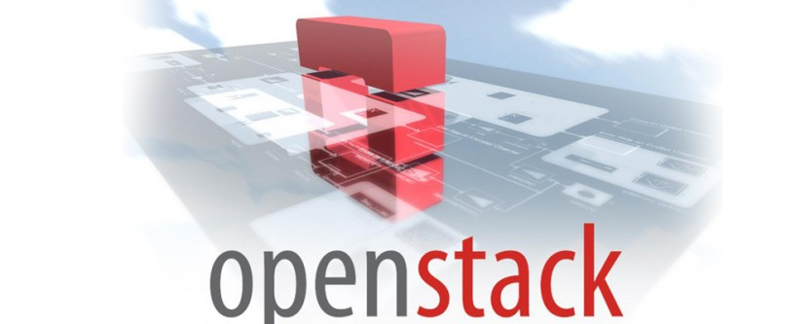
Compute Canada Clouds
We have a few clouds
West cloud (arbutus) hosted at UVic :
~20K cores
5 PB
East cloud at the Université de Sherbrooke
Each supercomputer has dedicated nodes for the cloud

Slide 15
Accessing Compute Canada Clouds
Have a Compute Canada account by filling the form
https://ccdb.computecanada.ca/
PI fills a RAS form
Persistent: 1 year, renewable
Compute: 1 year, 1 month, renewable
Once approved:
A tenant with the requested resources is created
Users can be added to the tenant as requested by the PI
Tenant members have access to the dashboard from which they can manage their virtual resources

Slide 16
Amount of Resources
Attributes | Compute Cloud | Persistent Cloud
Who can request | PIs only | PIs only
VCPUs (see VM flavours) | 80 | 10
Instances | 20 | 5
Volumes | 2 | 5
Volume snapshots | 2 | 5
RAM (GB) | 300 | 45
Floating IP | 2 | 2
Persistent storage (GB) | 10000
Default duration | 1 year, with 1 month wall-time | 1 year (renewable)\
Default renewal | April | April

Slide 17
Uses Cases
Persistent
Deploy web servers
Deploy scientific gateways
Jupyterhubs
Hubzero
Compute
Urgent and bursty computational needs
Match the increase of computational demands with the increase number of users
Jupyter notebooks/Dockers
User managed serial clusters
Contributed clusters

Slide 18
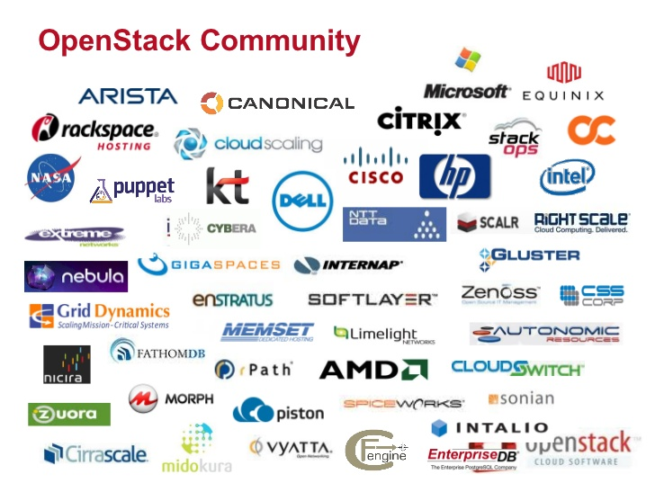
Cloud Stacks
Openstack
Apache cloudstack
OpenNebula
AWS (EC2 and S3)
Eucalyptus
Nimbus

Slide 19
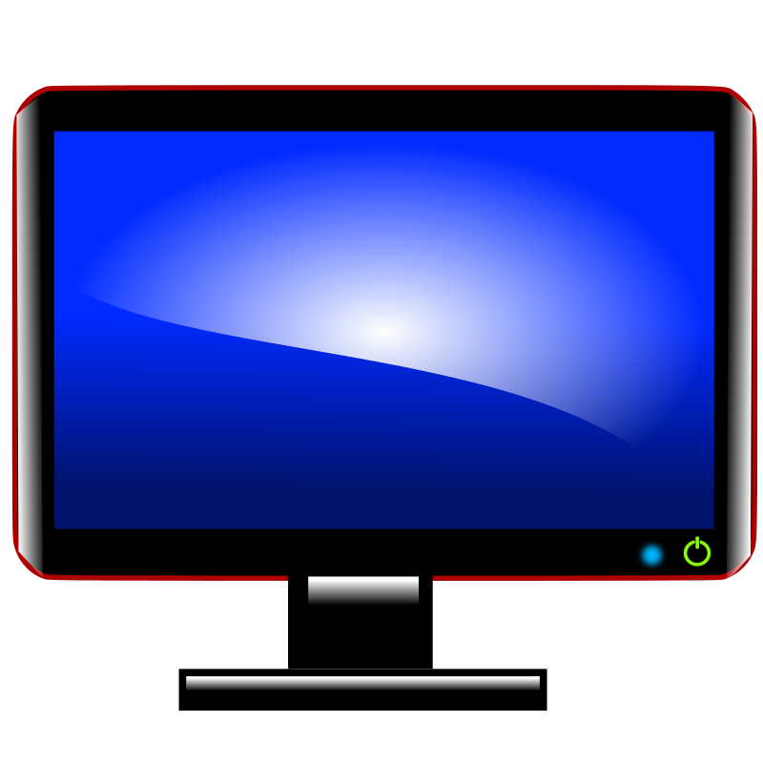


Openstack Horizon - Dashboard
Internet
Openstack
Dashboard
The CC Arbutus Cloud

Slide 20
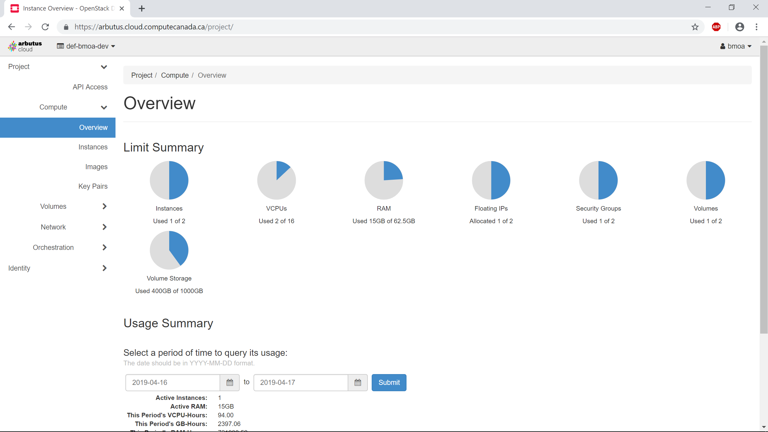

Slide 21
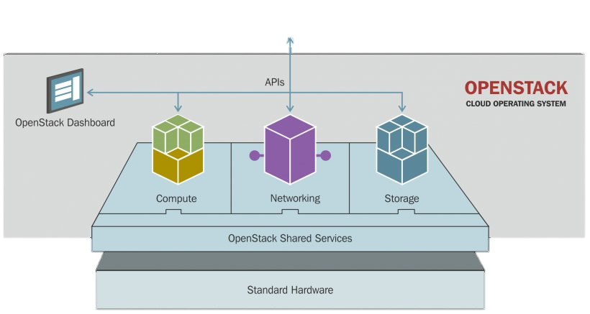
OpenStack Bird View
Users
Applications
Based on https://cloudarchitectmusings.com

Slide 22
Inside OpenStack
Horizon
Nova
for compute
Glance
for images
Neutron
for networks
Cinder
for volumes
Keystone
for identity
Swift/Ceph
Object storage
Heat Orchestration
Ceilometer
monitoring

Slide 23
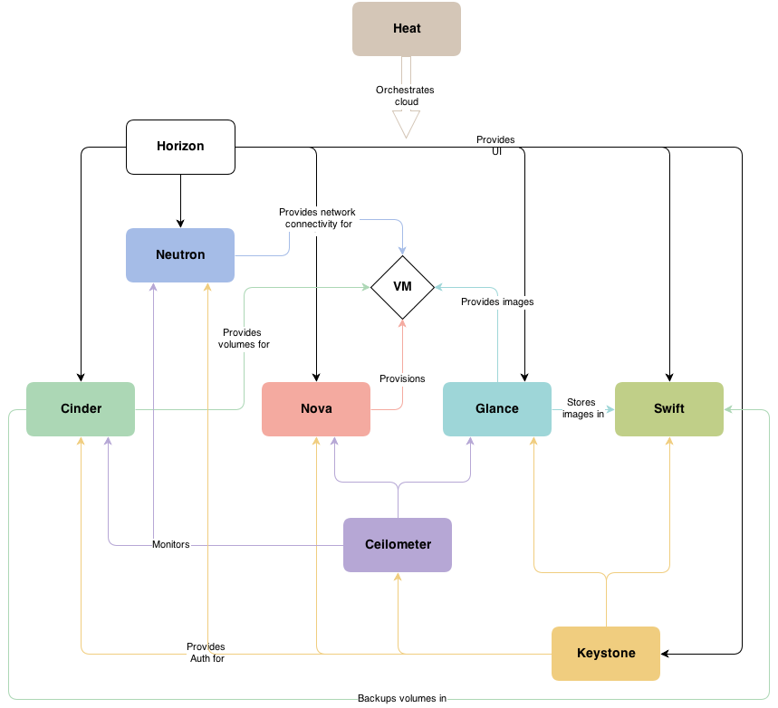
Inside OpenStack
From docs.openstack.org

Slide 24
Nova Compute Node
VM2
VM1
Hardware
Host OS
Hypervisor
…
….
Guest OS
Libs/Bins
Applications/Services
Guest OS
Libs/Bins
Applications/Services

Slide 25
Virtual Machine Main Components
Instance/VM
Network from Neutron
Provision by Nova Compute
Images
from Glance
Volumes
from Cinder

Slide 26
Virtual Machine Main Components
Volumes
Disk-like storage to be attached to/detached from VMs.
Can be persistent or ephemeral
Persistent: changes are saved
Ephemeral: changes are discarded once VM is deleted
Images
Blueprint for a specific operating system that you can use to create and rebuild a server
Think of ISO and bootable disk/live CD
Floating IP
IP address that you can associate/disassociate to an instance
It allows you to interact with the instance from the outside
Security groups
Specifies the network security settings to applied on instances
Look at this as an external firewall
Flavors
The specs of the instance to start: how many cores, how much memory, and ephemeral disk
Similar to the specs you provide when buying a machine
Key Pair
Allows you to create, import, and/or use the ssh keys to use for login to an instance
Snapshot
Allows you to create a point-in-time copy of a volume or image

Slide 27
Virtual Machine Deployment Cycle
Prepare the image
Prepare the volumes
Bootable volume from image
External volumes to attach to the machine
Launch the image
Specify the flavor
Compute: intensive CPU workload; CPUs are not oversubscribed
Persistent: website-like workload; CPUs are very oversubscribed; enough redundancy to keep the system running 24/7
Attach the volumes
Specify the floating IP
Specify the network security settings
Login into the machine
Do the admin tasks
Update to the latest
Take snapshots
Soft/hard reboot
Shutdown
Terminate

Slide 28
How to Deploy Services on OpenStack
GUI – Dashboard
Specify the requirements and launch the VM from the GUI
Log into the machine
Follow the usual admin tasks to deploy your services
CLI – OpenStack client
Install openstack client on the machine
Get and source the RC file
Specify the requirements and launch via command line
Log into to the machine
Follow the usual admin tasks to deploy your services
Both are tedious for large deployments
GUI and/or CLI with cloud-init
Automation of the admin tasks - configuration
GUI and/or CLI with heat or any other orchestration tool
Automation and the orchestration of many resources – configuration and orchestration
The configuration management or/and deployment automation tools such as Ansible, Chef, Fabric, Puppet, SaltStack, Terraform can be used with the above

Slide 29
Hands-on Challenges
Fly above the cloud ☺

Slide 30
Challenge 1 Embrace the Dashboard
Login into https://arbutus.computecanada.ca
Use your specific wgtrainingXX userID and the password provided during the session
Click on the tabs and associate the name to the content
Compute
Volume
Network
Orchestration
Identity
API Access
Setup ssh key pair

Slide 31
Challenge 2 The Beauty of the Cloud
Prepare a bootable volume of 50 GB with Ubuntu 18.04 as image
Launch the instance
Choose a name – use your name or userID to name your instance
Choose the volume you create
Specify the flavor c4-15gb-83
Use your public ssh key or create a new ssh pair and use that
Click ‘launch instance’
Check the instance by clicking on it, and see console and logs
Assign a floating IP to it
Check the network security settings
If you want, you can create a small volume and attach it to your machine
ssh to the machine and install the latest updates
Play with the machine
You can do many admin tasks on the machine from the dashboard
Create a snapshot for it but we will not do it
Soft or hard reboot it
Shut it down
Delete it

Slide 32
Challenge 3: Attaching a Volume Enjoy the System Admin Tasks
Create a small volume - 10 GBs from the Volumes tab
Attach the volume to your running instance
Go the machine – via ssh
Check whether you see the device using
sudo fdisk -l
Look in /dev/vd*
Partition the disk
sudo fdisk /dev/vdc
Create ext4 file system
sudo mkfs.ext4 /dev/vdc1
Make a directory for mounting the device
sudo mkdir /data
Mount it
sudo mount /dev/vdc1 /data
Check it
df –hT
Make directory for ubuntu user
sudo mkdir /data/ubuntu
sudo chown ubuntu.ubuntu -R /data/ubuntu
ln -sf /data/ubuntu data

Slide 33
Change 4: Running Services Towards Dockers
Login into your instace
Install docker
sudo apt update
sudo apt install docker.io
Add user to docker group
sudo usermod -aG docker Ubuntu
Logout and login again
Start docker services and enable its startup at boot
sudo systemctl start docker
sudo systemctl enable docker
Check that docker is running
docker info or docker --version

Slide 34
Change 5: CLI Towards Medium Deployments
Install openstack client
sudo apt install python
sudo apt install
sudo apt install python-dev python-pip
sudo pip install python-openstackclient
Download OpenStack RC v3 from API Access
Source it
Use openstack command to do the following:
List instances
List volumes
List images
Show details of your instance
Can you reboot the instance from CLI?

Slide 35
Quiz and Chat

Slide 36
Questions
List the OpenStack services and what they are for?
Why should we use clouds?
What’s cloud computing?
What cloud service model OpenStack offers?
What’s the different between Compute and persistent flavors?
What’s the difference between persistent and ephemeral volumes?
What’s the process to use CLI in OpenStack?
Give some examples for workloads for which you should use the cloud?

Slide 37
Resources
https://docs.openstack.org
https://docs.computecanada.ca/wiki/Cloud
https://docs.computecanada.ca/wiki/Automating_VM_creation
https://www.redhat.com/en/topics/cloud

