Slide 1
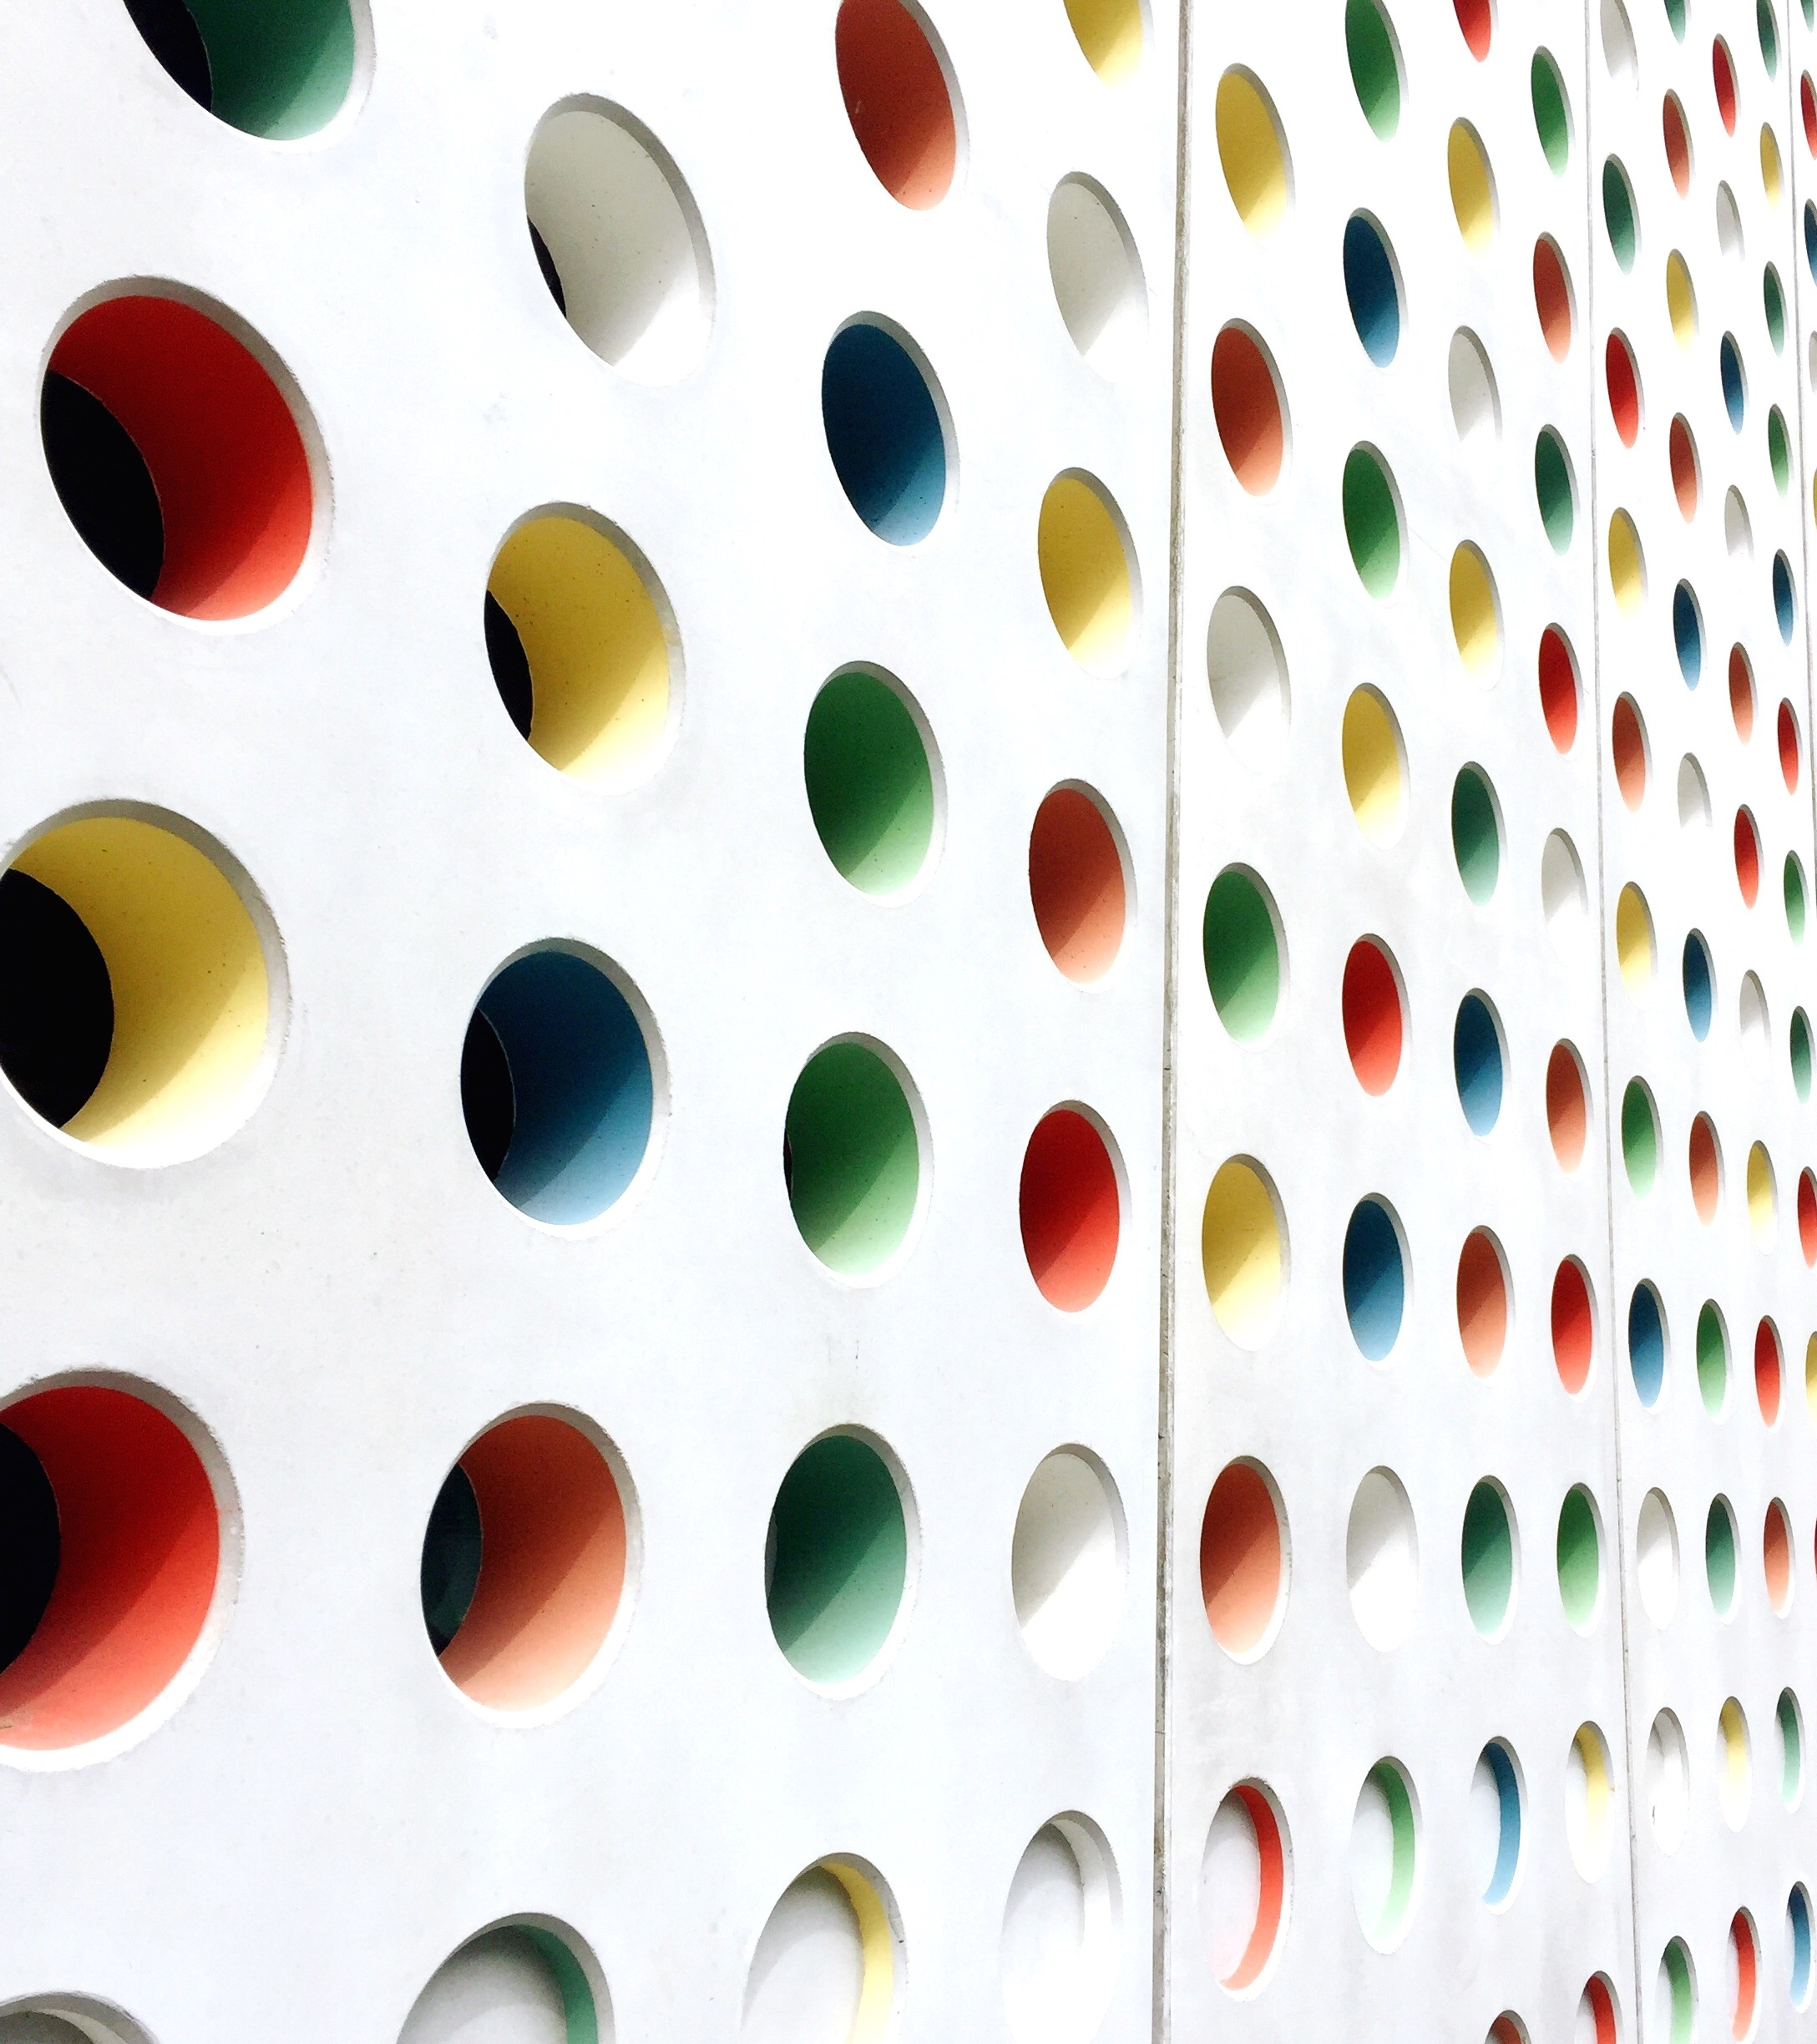

Camertaic
Social media platforms for sharing images.

Slide 2
Why Camertaic ?
we have many different types of images, for the advanced photographers.
It helps you to improve your photography skill, by dealing with many professional photographers.
Camertaic is a platform that helps photographers for sharing their works, which helps them to find new job oppuritinties.

Slide 3
technologies
Frontend | Backend
html 5 | MySQL
Css3 | PHP 8
Javascript | laravel9
Tailwind CSS | Sanctum API
React js

Slide 4
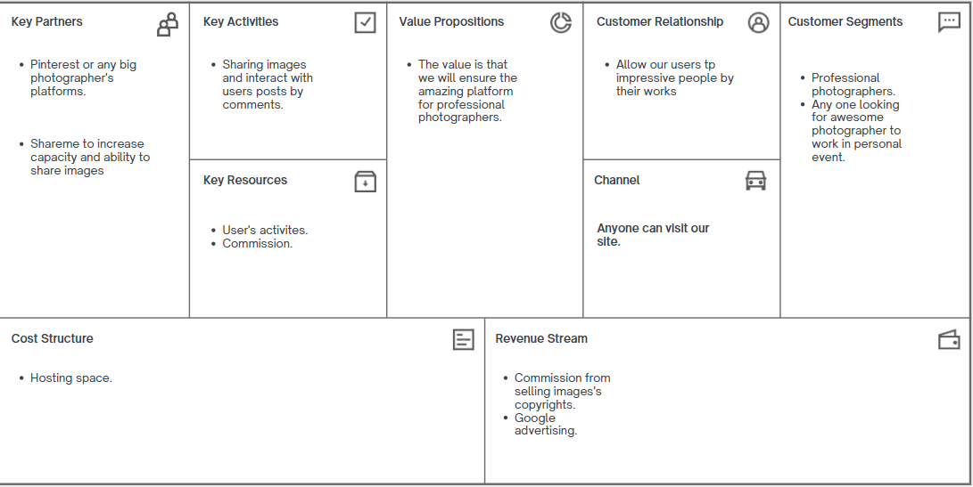
Business model

