Slide 1
DU × IGNYTE CHALLENGE · RESILIENCETECH
AqionLabs
Aqion Relay
Recover supply.
Protect operating cash.
A practical recovery copilot for UAE SME distributors.
LIVE MVP
https://aqionrelaydumvp.jafermn.workers.dev
GITHUB SOURCE
https://github.com/Jaferdecodesai/Relay_IgnyteDuChallenge
AQION RELAY / RESILIENCETECH
01
S01 · S08
Notes:
Aqion Relay helps a non-perishable goods distributor compare recovery purchases against an owner-defined cash floor. The public MVP uses fictional SME and supplier data. It trains a numerical forecast, evaluates feasible alternatives and saves an unsent draft only after owner confirmation. No order is sent and no funds move. The two cover links take judges directly to the public source and the verified live demonstration.
Sources: S01 · S08. See SOURCES.md for direct links and evidence scope.

Slide 2
THE PROBLEM
AqionLabs
A shipment slips.
Two commitments collide.
CUSTOMER COMMITMENT
CASH COMMITMENT
Keep customer
orders moving
Keep the business
operating
A delayed inbound shipment creates an immediate gap
in stock availability.
A replacement purchase must leave room for existing
payments and the owner’s cash floor.
Which recovery purchase is feasible — and worth approving?
Initial wedge: non-perishable packaging and general trading distributors; one SKU over 30 days.
AQION RELAY / RESILIENCETECH
02
Notes:
The initial segment is non-perishable packaging and general trading distributors. Relay starts with one SKU and a 30-day view. A delayed inbound shipment threatens fulfilment while a replacement order competes for cash reserved for existing obligations. This is the operational decision we will validate with consenting SMEs, not a claim of completed customer research.
Sources: Product proposition / proposed operating plan. See SOURCES.md for direct links and evidence scope.

Slide 3
WHY RESILIENCETECH
AqionLabs
One focused decision.
A strong fit with existing SME tools.
01 / RELEVANT
02 / COMPLEMENTARY
03 / DISTINCTIVE FOCUS
Disruption to decision
Works beside the ERP
Cash-aware recovery
Stress-test shipment delay,
demand and freight in one owner
workflow.
Read a normalized snapshot;
return a reviewable recovery draft.
Compare service impact and
minimum daily cash before
approval.
Positioning: a recovery decision layer for the tools SMEs already use.
AQION RELAY / RESILIENCETECH
03
S01 · S04 · S05
Notes:
We selected the ResilienceTech track. Inventory tools already support replenishment and purchase orders. Relay focuses on the decision between disruption and approved action: compare supply recovery under a daily cash constraint, then retain source-bound evidence. This complements existing systems. It is not a claim that the combination is globally unique. Liquidity finance is not the initial execution scope; Relay does not move funds.
Sources: S01 · S04 · S05. See SOURCES.md for direct links and evidence scope.

Slide 4
THE OWNER WORKFLOW
AqionLabs
From disruption to an auditable draft.
1
2
3
4
5
Read
Stress-test
Compare
Review
Approve
Stock, sales,
scheduled cash and
supplier terms.
Delay, demand and
freight under
owner-set limits.
Fulfilment, stockouts,
spend and daily cash.
Quantities, source
freshness and the
cash floor.
Save an unsent draft
and export its
evidence.
Every saved draft is bound to the reviewed source and scenario. The public MVP sends no order or payment.
AQION RELAY / RESILIENCETECH
04
S08
Notes:
The current MVP supports this complete sequence with synthetic records. The owner selects a fictional SME, adjusts the disruption, runs the scenario and compares stock and cash. A review dialog shows supplier quantities, costs and terms. Explicit confirmation creates an unsent synthetic draft. Approval rechecks the current snapshot, calculation version and constraints; duplicates return the existing result.
Sources: S08. See SOURCES.md for direct links and evidence scope.

Slide 5
MEASURED SYNTHETIC RESULT
AqionLabs
A recovery choice you can inspect.
SYNTHETIC SIMULATION
RECOVERY PURCHASE
PROJECTED UNITS FULFILLED
AED 7,887.50
Wait
990
400 units · arrival day 4
Recover
1,362
AED 28,112.50
372 additional units served in this scenario
minimum cash vs AED 24,000 floor
Synthetic packaging fixture · 7-day delay · demand +20% · freight +25% · 130 evaluated combinations
AQION RELAY / RESILIENCETECH
05
S08
Notes:
Reference fixture: packaging SME; shipment delay 7 days; demand increase 20%; freight increase 25%; cash floor AED 24,000. The model evaluates 130 combinations including baseline. Baseline fulfilment is 990 of 1,362 projected units with 9 stockout days. The recommended evaluated order is 400 units from fictional Oasis, arriving on day 4. It costs AED 7,887.50 including fictional VAT-inclusive item price and adjusted freight. It fulfils 1,362 projected units with zero stockout days and minimum projected cash AED 28,112.50. These are model outputs on fiction, not measured customer gains. Model assumptions include prepaid original inbound stock, recovery paid on day 1, scheduled receipts only and obligations before same-day receipts.
Sources: S08. See SOURCES.md for direct links and evidence scope.

Slide 6
TECHNOLOGY THAT EARNS TRUST
AqionLabs
Forecast numerically.
Decide within hard constraints.
01 / FITTED ML
02 / NUMERICAL ENGINE
03 / HUMAN AUTHORITY
Forecast with a
visible comparator
Simulate stock
and daily cash
Explain, review
and confirm
Weekday + trend ridge regression
versus seasonal naive; labelled
fallback for sparse history.
Bounded supplier combinations.
MOQ, pack, cap, lead time, quote
validity and cash floor.
Traceable assumptions and
version checks. The owner
confirms the unsent recovery
draft.
Forecast output informs a scenario; constraint checks and explicit owner approval control the action.
AQION RELAY / RESILIENCETECH
06
S08
Notes:
The forecast fits weekday and trend ridge regression to fictional fulfilled-sales history, comparing the last 14 days against a seasonal-naive baseline; it chooses the lower synthetic holdout-error method and refits as applicable. Short or constant histories use a labelled trailing-average fallback. The same holdout is used for model selection, so it is not an independent final quality test. Fulfilled sales may censor true demand. Candidate quantities obey approved-supplier status, quote expiry, MOQ, pack size, cap and lead time. Enumeration is bounded, at most 8,000 combinations in the current three-supplier slice, not a proof of a global optimum. Deterministic templates explain the calculation; no live generative model decides purchases.
Sources: S08. See SOURCES.md for direct links and evidence scope.

Slide 7
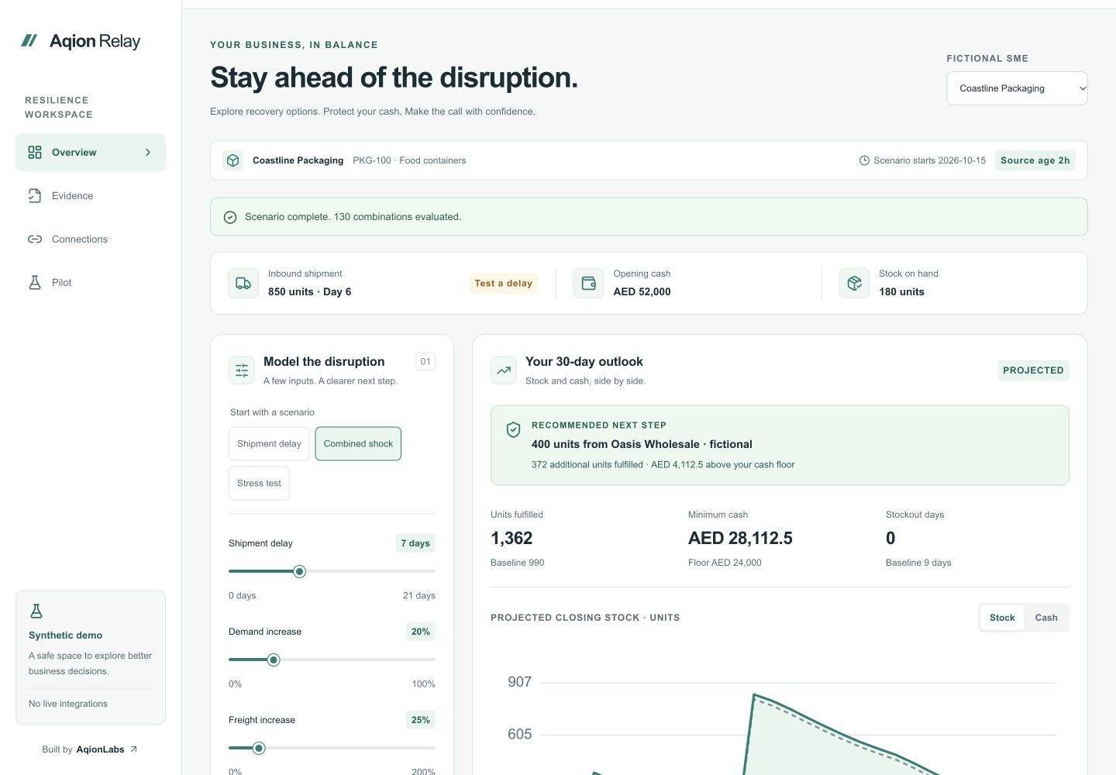
WORKING MVP
AqionLabs
A mobile workbench,
with a complete decision trail.
01
Compare clearly
Stock and cash curves, daily data and feasible options.
02
Review deliberately
Confirmation, stale-source blocks and duplicate protection.
03
Keep the evidence
Persisted drafts, readable audit history and portable JSON.
Live Cloudflare MVP · synthetic scenario
AQION RELAY / RESILIENCETECH
07
S08
Notes:
The implemented web MVP offers Overview, Evidence, Connections and Pilot views. It supports scenario controls, stock/cash charts, a 30-day data table, owner review, saved unsent drafts, cancellation, synthetic JSON import/export and per-SME reset. Anonymous browser sessions isolate demonstration workspaces. This is not enterprise identity. The running Cloudflare app is verified separately through the live cover link. Mobile and automated validation evidence is retained with the repository; exact test counts belong to current CI, not an evergreen claim on this slide.
Sources: S08. See SOURCES.md for direct links and evidence scope.

Slide 8
CLOUDFLARE MVP ARCHITECTURE
AqionLabs
One deployment.
Persistent, isolated demo workspaces.
MOBILE WEB
CLOUDFLARE WORKER
DURABLE OBJECT
Next / React UI
Assets + API routing
Engine + SQLite
Responsive workbench
Accessible table alternative
Serve the React workbench
Route the workspace request
Forecast, simulate, approve
Atomic state + draft + audit
Signed session + CSRF
Bounded input + safe errors
Version-bound approval
Human confirmation
Live scope: synthetic data and unsent drafts. Enterprise identity, ERP credentials and live writes enter through pilot gates.
AQION RELAY / RESILIENCETECH
08
S06 · S07 · S08
Notes:
The production deployment uses a static-export Next.js/React frontend served as Cloudflare Worker assets. The API, numerical engine and domain services run inside a native SQLite-backed Durable Object, using transactionSync for atomic draft, audit and version checks. Signed anonymous sessions, same-origin/CSRF controls and bounded inputs guard the public synthetic workflow. A workspace transaction preserves approval and audit integrity. This is not enterprise tenant IAM; the production-pilot roadmap adds authenticated roles, approved processing/data location, connector credentials and operational restore acceptance. No local filesystem database or Hostinger/MySQL service is required for the Cloudflare release.
Sources: S06 · S07 · S08. See SOURCES.md for direct links and evidence scope.

Slide 9
TECHNOLOGY INTEGRATION ROADMAP
AqionLabs
Read first. Reconcile every write.
Then expand through du.
WEEKS 1–2
WEEKS 3–4
WEEKS 5–6
WEEKS 7–8
Map + authorize
Connect
read-only
Draft + reconcile
Enable
distribution
Consented snapshots,
terms and source IDs
Zoho stock, sales and
scheduled cash
mapping
Owner approval, ERP
outbox and
idempotency
Agreed du interfaces,
support and monitoring
Gate: data + security sign-off
Gate: source reconciliation
Gate: sandbox failure tests
Gate: sponsor acceptance
Accountability: AqionLabs builds · SME owner validates · du sponsors integration and acceptance
AQION RELAY / RESILIENCETECH
09
S05 · S09
Notes:
Proposed eight-week integration preparation, with responsibilities and acceptance gates. Weeks 1–2: AqionLabs maps consented snapshots, SME owners verify terms and the du sponsor approves scope; gate is required-field coverage and approved processing/security design. Weeks 3–4: AqionLabs builds a scoped read-only Zoho adapter using organization and region context; reconcile normalized snapshot against source totals and handle event IDs/revisions. Weeks 5–6: add owner-authorized ERP drafts with idempotency/outbox and reconciliation, sandbox-tested; ambiguous writes remain pending reconciliation. Weeks 7–8: configure sponsor-agreed du identity/billing/distribution interfaces and operational monitoring; no du interface is claimed connected. Each period starts when its dependencies are approved. Pilot comparison begins only after acceptance. Odoo is a subsequent adapter subject to exact version/plan, not a prerequisite for the first pilot.
Sources: S05 · S09. See SOURCES.md for direct links and evidence scope.

Slide 10
PILOT EXECUTION PLAN
AqionLabs
160 SMEs. Four waves.
A credible comparison.
1
2
3
4
5
6
7
8
9
10
11
12
160
Wave 1
2w
6-week comparison
Wave 2
2w
6-week comparison
Enrollment target
Wave 3
2w
6-week comparison
4 × 40
20 immediate +
20 delayed per wave
Wave 4
2w
6-week comparison
Common baseline
Immediate vs delayed access
Week 12 analysis
Proposed 12-week pilot after integration acceptance · enrollment minimum 150 · SME is the randomization unit
AQION RELAY / RESILIENCETECH
10
S01 · S09
Notes:
Proposed enrollment: 160 consenting non-perishable-goods distributors; at least 150 enrolled before intervention. du sponsors recruitment; AqionLabs operates onboarding, support and analysis; an evaluation lead preregisters outcomes and completes power/MDE analysis before intervention. Four waves of 40 start in pilot weeks 1,2,3,4. Each receives two common baseline weeks then six comparison weeks; within each wave and sector/size/ERP strata, randomize 20 immediate and 20 delayed-access SMEs. The last comparison ends in week 11, analysis occurs in week 12. Delayed access follows its comparison window. Enrollment begins after the integration and operational acceptance gates, not during an unsafe live-write trial. Record screened, enrolled, randomized, activated, completed, withdrawn and missing-data counts; do not replace dropouts after randomization. A 160-SME feasibility cohort alone does not establish statistical power.
Sources: S01 · S09. See SOURCES.md for direct links and evidence scope.

Slide 11
PILOT SCORECARD · TARGETS
AqionLabs
Measure better decisions.
Keep operational guardrails absolute.
40%
90%
70%
Faster feasible planning
Feasible-plan rate
Weekly workflow use
Primary target: common disruption
drill to owner-approved,
rubric-passing plan.
Target share of assigned drills with
an approved plan passing blinded
scoring.
Target share of SMEs with access
reviewing at least one scenario each
week.
STOP RULES / Projected cash-floor breach · unauthorized write · duplicate external effect
Pilot targets, not measured benefits. Pre-register analysis; report effect sizes, confidence intervals, attrition and deviations.
AQION RELAY / RESILIENCETECH
11
S09
Notes:
All percentages on this slide are prospective pilot targets, not achieved customer outcomes. Primary outcome: time from equivalent disruption brief to owner-approved plan that passes a predetermined blinded feasibility rubric. Use baseline-adjusted log-time comparison with SME assignment, wave/calendar and strata; report effect and 95% interval plus raw medians. Include non-completion under a preregistered capped-time rule with sensitivity analysis. Target 40% shorter time. Secondary feasibility target: at least 90% rubric-passing approved plans, all assigned drills in denominator. Adoption target: 70% of SMEs with access review at least one scenario per week, reporting opportunity and reasons for non-use. Exploratory stockout target is 15% reduction, reported separately with uncertainty and no causal before/after shortcut. Zero projected floor breaches, unauthorized external writes and duplicate external effects are stop rules for the later live pilot, not claims that predicted cash guarantees actual cash. Monitor source completeness and reconciliation latency. Independent baseline variance/power analysis determines whether efficacy or feasibility interpretation is justified.
Sources: S09. See SOURCES.md for direct links and evidence scope.

Slide 12
SCALE AND COMMERCIAL MODEL
AqionLabs
A narrow wedge.
A repeatable route through du.
160
1,000
40,000+
Pilot cohort target
Controlled rollout
Scale ambition
Validate decision value, source
quality and support demand.
Standardize connectors and
onboarding; enforce cost limits.
Partition workloads; prove peak
load, isolation and restore.
Commercial offer
Per-SME subscription + agreed connector onboarding, distributed through du.
Scale sequence and subscription are proposals. Expansion follows measured adoption, unit cost, isolation and recovery acceptance.
AQION RELAY / RESILIENCETECH
12
S02 · S03
Notes:
Commercial proposal: a per-SME subscription distributed through du, with connector onboarding and service scope agreed before offer. No price, revenue, customer count or commercial commitment is claimed. Measure onboarding time, weekly use, support minutes and total cost per active SME in the pilot; scale only within a sponsor-approved unit-cost ceiling. Engineering scale path: 160-SME pilot, a 1,000-SME controlled rollout, then load/isolation/restore acceptance for the 40,000+ ambition. An illustrative engineering envelope assumes 1,000 normalized events and four scenarios per SME per day: 40m events/day at 40,000 SMEs, 463 average events/s, 4,630/s at ten-times peak, and 160,000 scenarios/day (1.85 average/s). These are arithmetic assumptions, not measured capacity. Proposed service targets such as p95 scenario latency <5s, availability 99.9%, RPO<=15m and RTO<=4h require sponsor agreement and separate acceptance tests; they are not current contractual SLAs.
Sources: S02 · S03. See SOURCES.md for direct links and evidence scope.

Slide 13
DELIVERY CONTROLS
AqionLabs
Make the safe action
the easiest action.
Input quality
Freshness, required fields and valid supplier terms
Block stale or incomplete approval
Execution integrity
Human confirmation, version checks and
idempotency
ERP outbox + reconciliation gate
Data protection
Isolated demo state; signed session + CSRF
Pilot IAM, approved processing and
restore test
Model reliability
Comparator, fallback and visible assumptions
Monitor forecast error and rejected
scenarios
Accountable operations: monitor exceptions · pause writes on a material breach · reconcile before resuming
AQION RELAY / RESILIENCETECH
13
S06 · S08 · S09
Notes:
Current synthetic MVP controls include validation, source-age and quote checks, scenario/version binding, signed anonymous sessions, same-origin/CSRF checks, bounded input, persistent draft/audit transactions, human confirmation and duplicate protection. These do not constitute enterprise acceptance. Pilot release gates add tenant IAM/roles, approved processing and data location, scoped connector secrets, encryption and restore testing, ERP outbox/reconciliation and incident ownership. Daily monitoring reviews source lag, invalid fields, rejected approvals, write ambiguity and reconciliation age. A material floor/authorization/duplicate violation pauses writes; the operator investigates and the sponsor approves resumption. Forecast error is monitored against naive baseline, sparse histories fall back visibly. No autonomous buying or funds movement is included.
Sources: S06 · S08 · S09. See SOURCES.md for direct links and evidence scope.

Slide 14
THE ASK
AqionLabs
Launch the du recovery pilot.
A working product.
A measurable pilot.
A clear path to SME scale.
01
Sponsor + recruit
160 consenting SMEs; minimum
150 enrolled.
02
Connect + operate
Named du technical owners and
approved interfaces.
03
Evaluate + expand
Joint scorecard, delivery gates
and cost ceiling.
NEXT MILESTONE / Pilot charter + named owners
Aqion Relay / Recover supply. Protect operating cash.
AQION RELAY / RESILIENCETECH
14
S01 · S09
Notes:
We seek a du sponsor, recruitment of 160 consenting eligible SMEs with at least 150 enrolled before intervention, technical owners for approved read-only and draft interfaces, and a joint evaluation lead. AqionLabs delivers the working MVP, phased connector engineering, onboarding and pilot evidence. Before pilot week 1, agree success thresholds, processing/security controls, support ownership and the cost ceiling. This is a concrete pilot proposal, not a claim of customers, commercial acceptance, production certification or submitted application. Close by opening the live MVP and showing the default scenario, then the explicit unsent draft review.
Sources: S01 · S09. See SOURCES.md for direct links and evidence scope.

