Slide 1
BUILDING SERVICES
Jahid Hasan
Assistant Professor
Dept. of Department of Industrial and Production Engineering
Shahjalal University of Science & Technology (SUST),
Sylhet, Bangladesh

Slide 2
Topics:
Basic Concepts and Definitions
Applications of Air-conditioning
Psychometry
Air conditioning systems
Cooling load calculations
Air handling and distribution
Duct design
Air-conditioning equipment

Slide 3
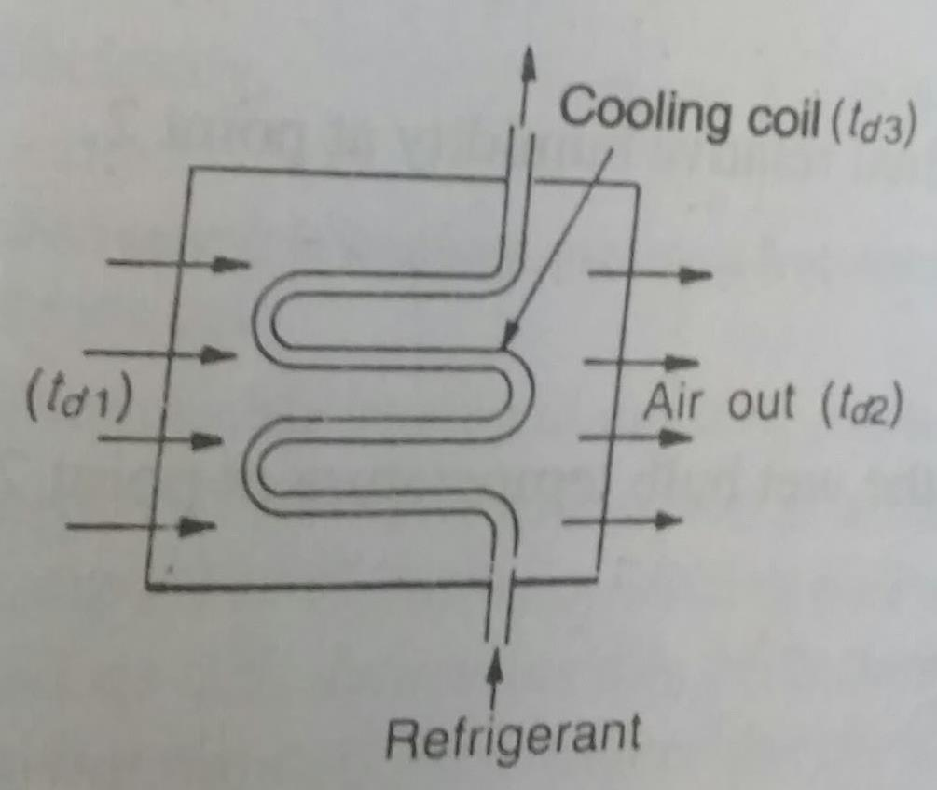
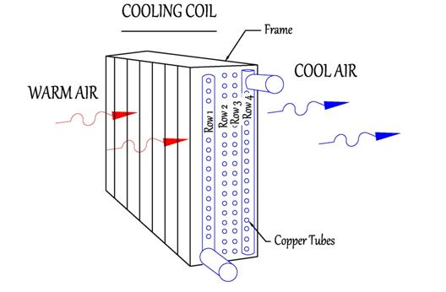
Air Conditioning System & Cooling Load Calculation Wet bulb temperature or adiabatic saturation temperature
Under ideal conditions:t_{d2}= t_{d3}
Due to the inefficiency of the cooling coil, By pass factor (B.P.F.) is defined by the equation below
B.P.F. = (t_{d2} - t_{d3})/(t_{d1} - t_{d3})

Slide 4
HEAT GAIN: The heat gain is the rate at which heat is transferred to or generated in a space.
COOLING LOAD: It is the rate at which the cooling equipment would have to remove thermal energy from the air in the space in order to maintain constant temperature and humidity. (This is for summer)
HEATING LOAD: It is the rate at which the heating equipment would have to produce and release thermal energy to the air in the space in order to maintain constant temperature and humidity. (This is for winter)

Slide 5
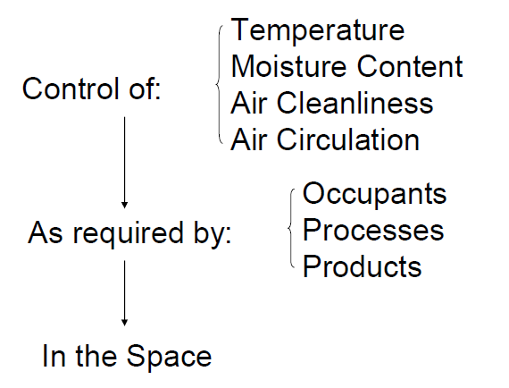

Slide 6
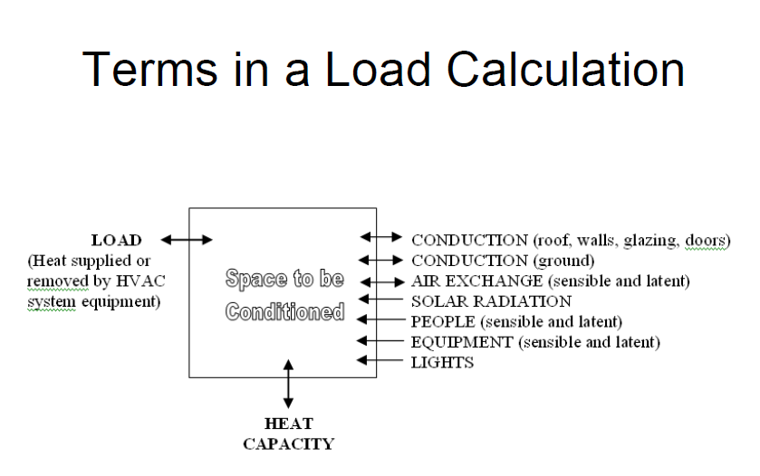

Slide 7
Cooling Load Calculation Process
Select outdoor design weather conditions.
Select indoor design conditions.
Develop zoning plan for the building. Building Construction
select or compute heat transfer coefficients for outside walls, roof, doors, windows, etc.
Determine corresponding areas for outside walls, roofs, doors, windows, etc.
Determine building location, orientation, and external shading.
Obtain schedule of lighting, occupants, internal equipment, appliances, and processes that would contribute to the internal loads.

Slide 8
Cooling Load Calculation Process(cont’n)
8. - Calculate peak cooling load due to conductive and solar effects (rooms 1st, zones 2nd, total last) .
Calculate conductive heat gains through walls, roof, glazing, etc.
Calculate solar gains through glazing (windows).
Compute heat gains due to air exchange (infiltration / ventilation).
10. Calculate internal heat gains due to people, equipment, lights, etc.
11. Sum all heat gains for peak zone loads.
Determine the building peak load.
13. Adjust as necessary to account for building diversity, setback recovery, etc.

Slide 9
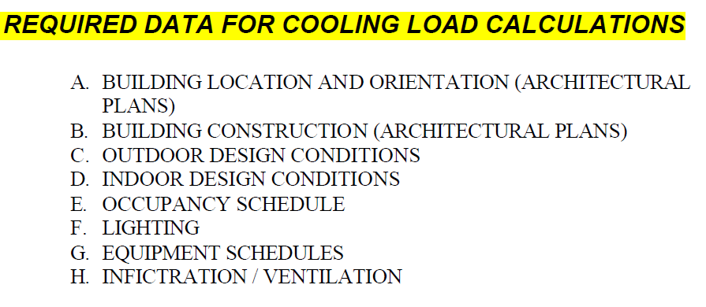

Slide 10
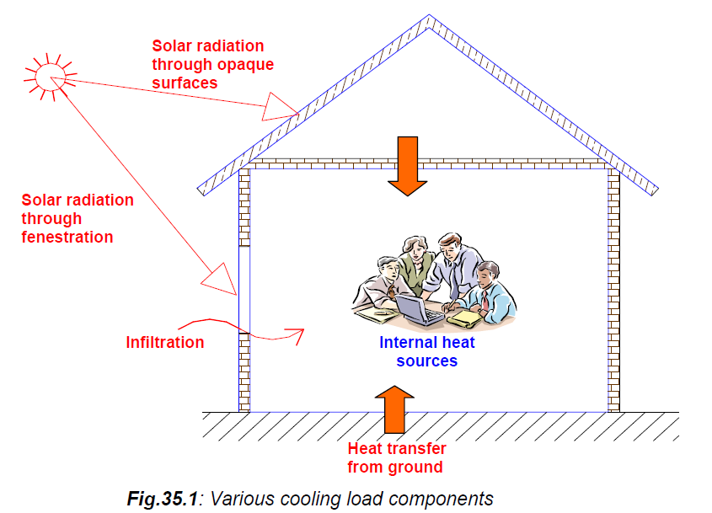

Slide 11
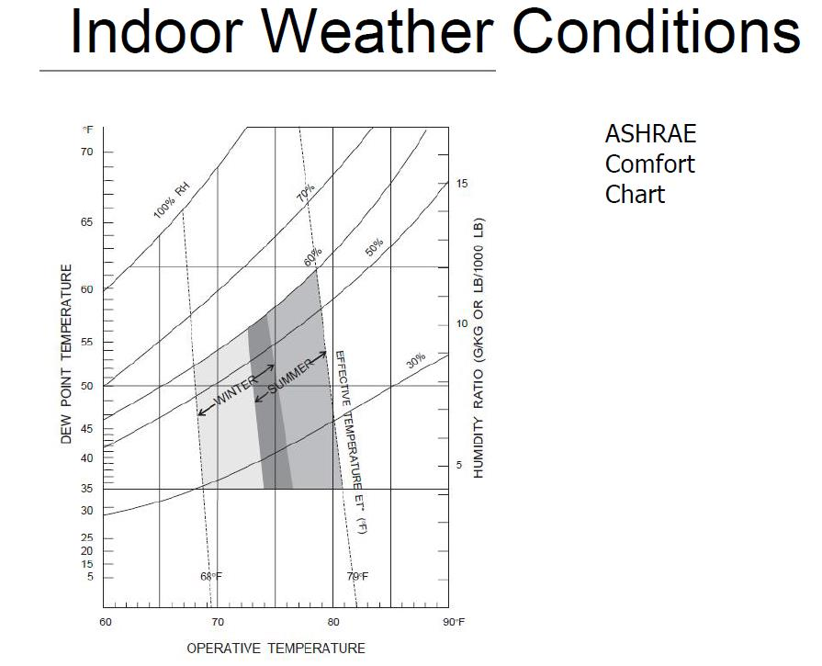

Slide 12
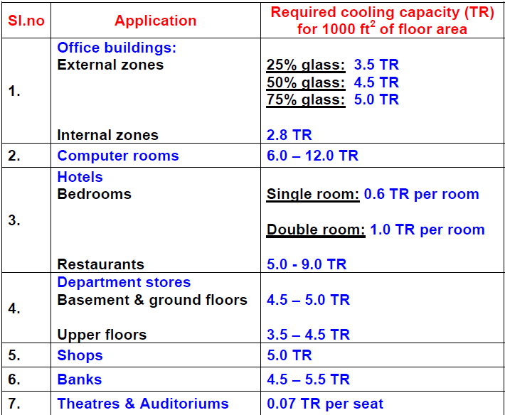

Slide 13
The total cooling load is the sum of the heat transferred through the building envelope such as walls, roof, floor, windows, doors etc. and the heat generated by occupants, equipment and lights.
The heat transfer through the envelope is called as external loads, while all other heat added are called as internal loads.
The proportion of external to internal load varies with building types, site climates, and building designs.
The total cooling load on any building consists of both sensible and latent load components.
The sensible load influences dry bulb temperature, while the latent load affects the moisture content of the conditioned space

Slide 14
Buildings may be externally loaded and internally loaded.
In externally loaded buildings, the cooling load is mainly due to heat transfer between the surroundings and the internal conditioned space. The cooling load of an externally loaded building varies widely.
In internally loaded buildings the cooling load is mainly due to internal sources such as occupants or appliances or processes. In general the heat generation due to internal heat sources may remain fairly constant, and since the heat transfer from the variable surroundings is much less compared to the internal heat sources, the cooling load of an internally loaded building remains fairly constant.

Slide 15

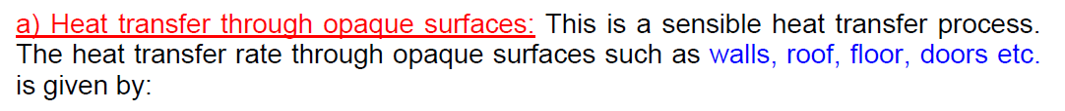

where U is the overall heat transfer coefficient and A is the heat transfer area of the surface on the side of the conditioned space.
CLTD is the cooling load temperature difference.
-For sunlit surfaces, CLTD has to be obtained from the CLTD tables.
For surfaces which are not sunlit or which have negligible thermal mass (such as doors), the CLTD value is simply equal to the temperature difference across the wall or roof.
For example, for external doors the CLTD value is simply equal to the difference between the design outdoor and indoor dry bulb temperatures, Tout-Tin.
For sunlit surfaces, CLTD has to be obtained from the CLTD tables. For surfaces which are not sunlit or which have negligible

Slide 16

b) Heat transfer through fenestration: Heat transfer through transparent surface such as a window, includes heat transfer by conduction due to temperature difference across the window and heat transfer due to solar radiation through the window. The heat transfer due to solar radiation through the window is given by:
where A unshaded is the area exposed to solar radiation, SHGFmax and SC are the maximum Solar Heat Gain Factor and Shading Coefficient, respectively, and CLF is the Cooling Load Factor.
c) Heat transfer due to infiltration: Heat transfer due to infiltration consists of both sensible as well as latent components. The sensible heat transfer rate due to infiltration is given by:

Slide 17
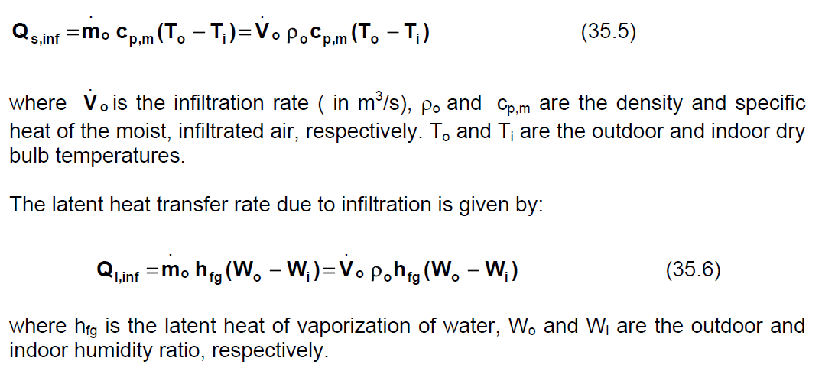

Slide 18
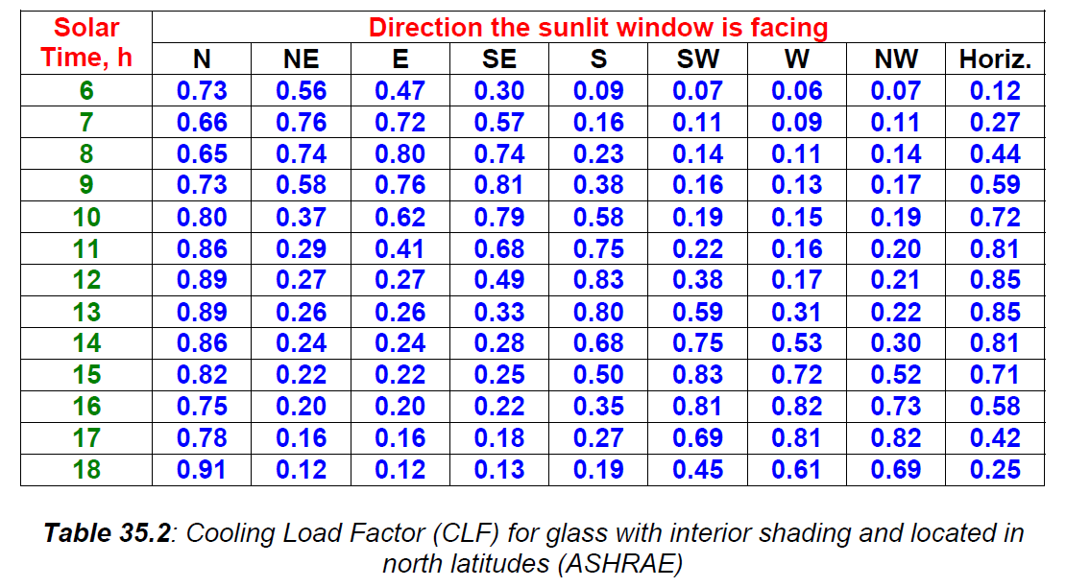

Slide 19
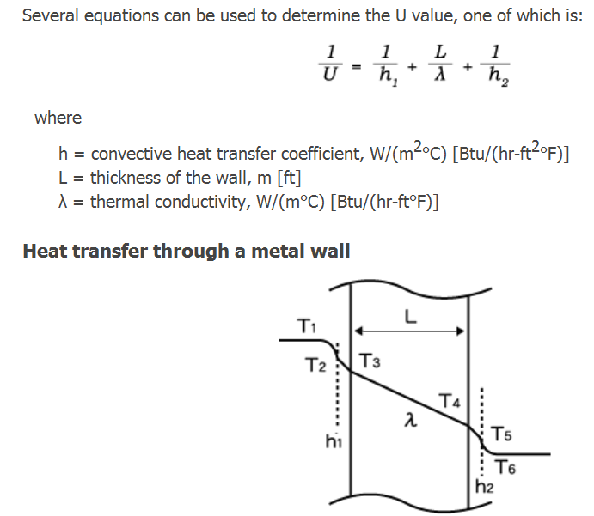

Slide 20
d) Miscellaneous external loads:
The sensible and latent heat transfer rates due to the by- passed ventilation air.
In addition to this, sensible and latent heat transfer to the building also occurs due to heat transfer and air leakage in the supply ducts.

