Slide 1


Slide 1
Quantum Markets Ltd
Investor Presentation and Analysis

Slide 2
Experience, Investment & Innovation
Quantum Markets provides a full investment management solution for individuals and firms seeking to add value to their portfolios.
The strongest performing foreign exchange trading strategies are optimally combined into dynamic multi manager portfolios, executed seamlessly onto client accounts. This diversified approach yields smooth, consistent returns in any market conditions while our oversight allows for seamless portfolio optimisation and adjustment through our deep talent pool.
Through our unparalleled money manager and investment network, the highest potential trading strategies both present and future are at your fingertips.
Our innovative offering provides a fully outsourced investment management solution, reducing overheads substantially and allowing you to focus on growth and building the business your portfolio. Quantum Markets sources the investment opportunities, performs full due diligence on each, then oversees the portfolio on an ongoing basis.

Slide 3
Our Solution
Flexibility
Risk Appetite
We can tailor our risk profiles based on a specific clients investments objectives. This allows us to handle multi level clientele seamlessly.
Transparency
We are able to operate within the guidelines of a firms existing framework in order to reduce potential issues.
Reporting
All clients will be provided with total transparency. Clients will be allocated a “investor” password which is a read-only password that allows them to track their investments any time of the day in real time.
Custom reports are available on request with a breakdown of where we are with your investment and also where we expect to go in the future.

Slide 4
Strategy Optimization & Selection
Filter
Ranking Process
Our proprietary strategy performance metric, the Chrome Score, ranks strategies using factors which our experience and research have proven to be the most effective indicators of long term outperformance.
Research and Due Diligence
Our systemized screening process allows us to focus on profitable strategies which meet our strict criteria and performance specifications.
Tracking Process
Extensive background research and due diligence on the strategies as well as their managers ensures credibility, verifies performance and gains an even deeper understanding of the strategy itself.
Each strategy is traded on our capital prior to inclusion in the portfolios. This allows us to closely observe strategy performance in real time, getting a better feel for trading methodology, style as well as risk control.

Slide 5
Strategy Network and Our Edge
Sourcing consistent and robust investment strategies is becoming increasingly challenging and time consuming for wealth management firms. Quantum Markets provides a gateway to our extensive global strategy network. Through partnerships with educational groups, trading portals, service providers as well as contacts in banking, recruitment and the investment management industry as a whole, we are introduced to some of the most consistent traders in the world.
Capital preservation of the initial investment is enhanced by commencing more conservatively then incrementally growing once in profit. Sophisticated, multi-stage risk management then minimizes downside potential without limiting returns.
The diversification achieved through multi manager portfolios yields even smoother, more consistent returns than the individual strategies. Non-correlated strategies with a diverse range of investment approaches allow for positive returns in any market conditions, while capital allocation algorithms ensure that the top performing strategies are given additional emphasis at the right time.

Slide 6
Slide 6
QUANTUM FREQUENCY
Trading Style
Systematic
£ 32,575,000
£ 5,000
Execution
Automated
Average Return
+ 14.78%
Under Management
Profit Factor
8.20
Minimum Entry Requirement
Trade Win %
80.69%
INCOME COMPARISON
The table on your right is a direct comparison between Quantum Markets total returns portfolio compared to Barclays Hedge 250 Index
118.3% YTD

Slide 7
Slide 8
Data Recorded From Existing Investors
Client Geographic Location by %

Slide 8

Slide 10
Superior Risk Management
Portfolio Risk Management
Strategy Risk Management
Our multi-stage risk control protocols ensure that any potential risk is limited without constraining upside potential.
Circuit-breakers integrated into our infrastructure provide additional control on top of manager imposed risk limits.
A focus on short term systematic strategies minimizes the open risk at any given time.
Customizable risk parameters mean that investors can tailor their investment solution based on their risk appetite.
Trade Risk Management

Slide 9
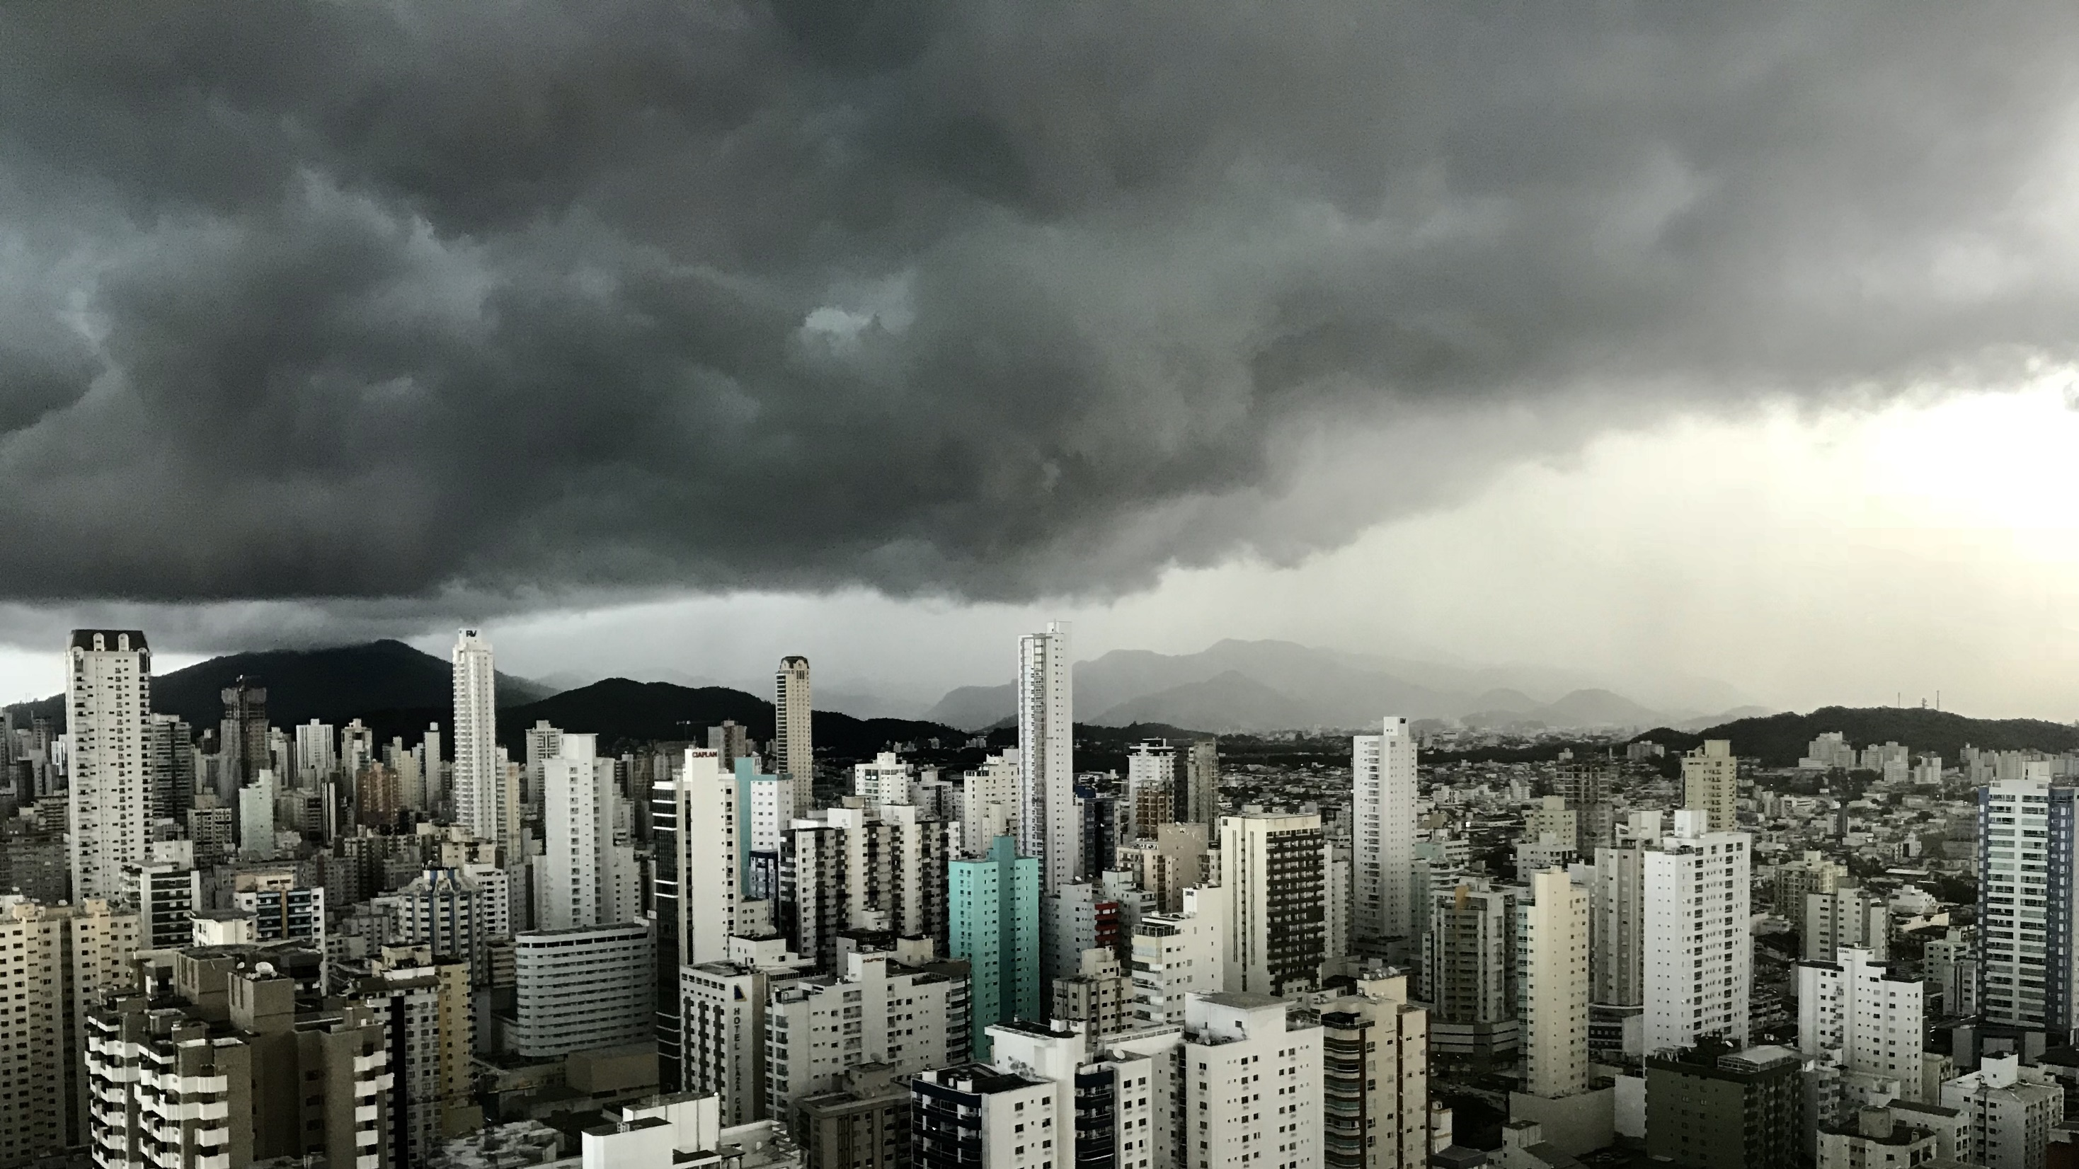
Slide 11
THANK YOU
Quantum Markets Ltd. A company registered in England and Wales under Companies House No: 12346505

