Slide 1

Data Analysis With Python
Instructor:
Dr. Mohammad Rezwanul Huq
Assistant Professor
Department of CSE
East West University
Presented By:
Hossain Abedy
ID: 2014-1-60-080
Jafrul Hossain
ID: 2013-3-68-037
Nazmul Hasasn
ID: 2014-2-60-063

Slide 2
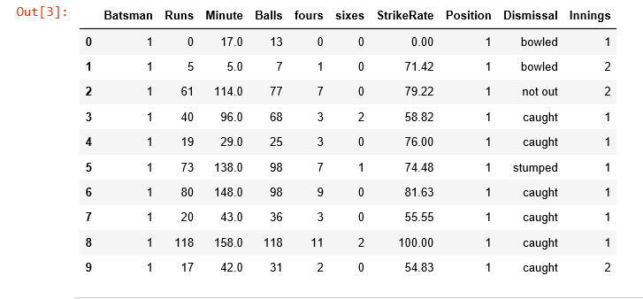
Dataset

Slide 3
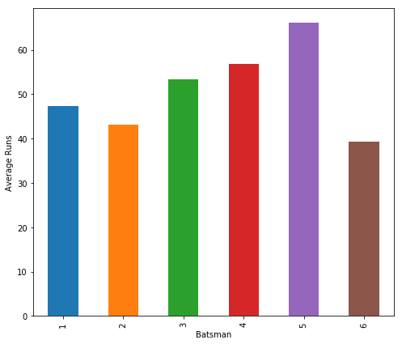
Average Runs

Slide 4
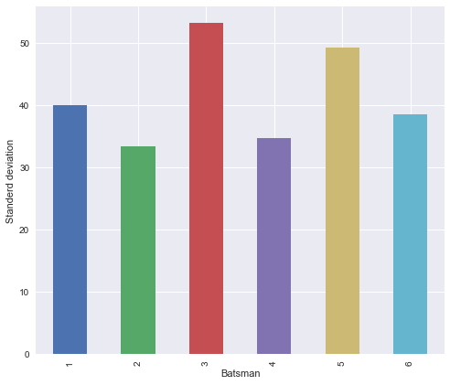
Comparison of Standard Deviation of Runs

Slide 5
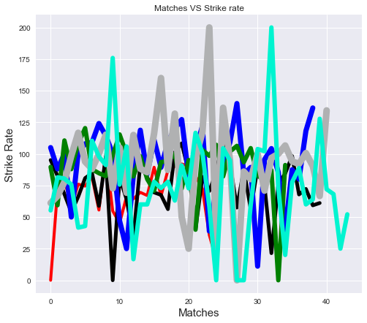
Carrier Strike Rate

Slide 6
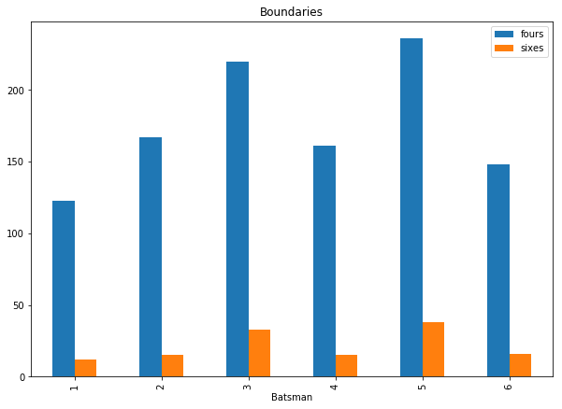
Comparison of Percentage of Runs with Boundary

Slide 7
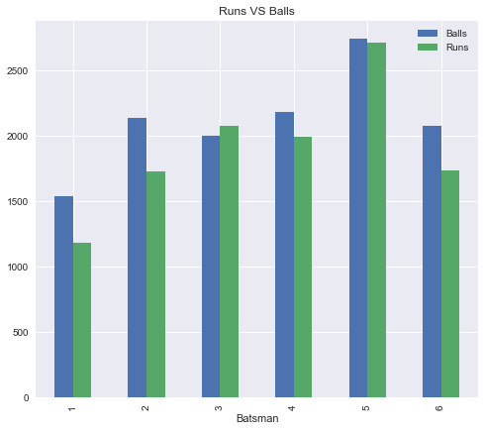
Runs vs Balls

Slide 8
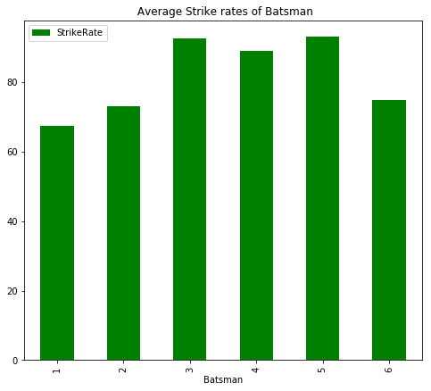
Comparison of Strike Rate

Slide 9
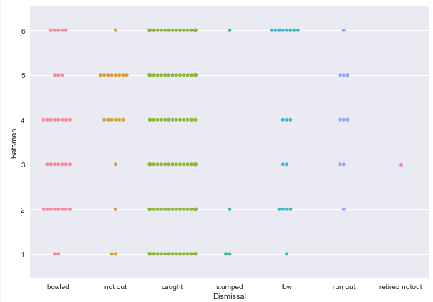
Bee swarm plot of Dismissals

Slide 10
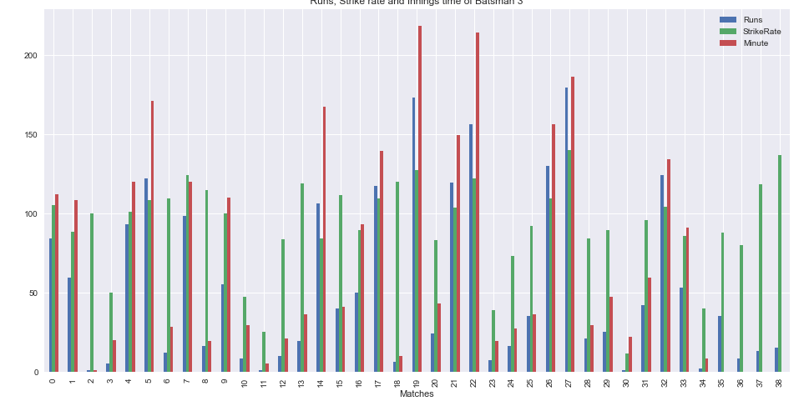
Runs, Strike rate and Dismissals

Slide 11
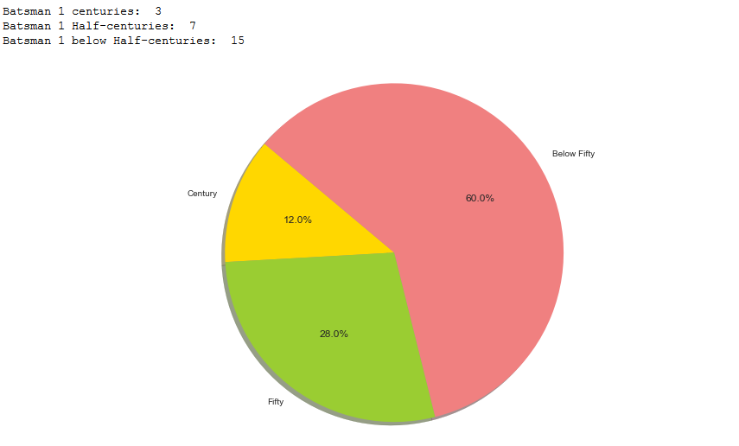
Runs scored by centuries and half centuries

Slide 12
Prediction of Average using Normal Distribution
Batsmen | Confidence Interval | Comment
1 | [63.12,31.76] | 95% of the time Batsman1 average will be between 63.12 to 31.76
2 | [53.65,32.65] | 95% of the time Batsman2 average will be between 63.65 to 30.94
3 | [70.28,36.38] | 95% of the time Batsman3 average will be between 70.28 to 36.38

Slide 13
Prediction of Average using t-Distribution
Batsmen | Confidence Interval | Comment
1 | [63.65,30.94] | 95% of the time Batsman1 average will be between 63.65 to 30.94
2 | [54.00,32.31] | 95% of the time Batsman2 average will be between 54.00 to 32.31
3 | [70.85,35.82] | 95% of the time Batsman3 average will be between 70.85 to 35.82

Slide 14
Identifying Players
Tamim Iqbal
Kane Williamson
David Warner
Joe Root
Virat Kohli
Steven Smith

Slide 15

Any questions?

Slide 16

Thank You

