Slide 1
Can a Model Tell Cause from Correlation?
A
B
C
Neuro-symbolic causal inference on Corr2Cause, from text to Bayesian network
D
E
Chaitanya Sai Meka · Rakshita · Dhanvin Vadlamudi
Kasula Lalithendra · Jagruthi Pulumati
CSAI Project, Phase 1 (Machine Learning) · github.com/Jag2007/AI_ML_Project
Notes:
Presenter: Dhanvin (or whoever opens). One line: we check whether a causal claim follows from correlation facts written in text, by turning the text into a causal graph and reasoning on it. Five steps, one notebook per person.

Slide 2
Does a causal claim follow from correlations?
THE TASK
Premise
A closed system of 3 variables, A, B and C. A correlates with C. B correlates with C. However, A is independent of B.
Hypothesis
A directly causes C.
Label
1, valid: the only graph that fits is A → C ← B
A
B
C
A claim is valid only if it holds in every causal graph that fits the premise.
Corr2Cause (Jin et al., ICLR 2024): 206K train, 1,076 validation and 1,162 test claims, 2–6 variables, 6 claim types.
Notes:
Explain the dataset with this example. A and B are independent but both correlate with C, so C must be a common effect (collider). The label is 1 only if the claim is true in every DAG that fits the premise, which is the Markov equivalence class. Splits: 206K train rows (we sample 400 premises), 1,076 validation, 1,162 test.

Slide 3
The text proposes, the graph decides
OUR APPROACH
01
02
03
04
05
Clean & explore
Chaitanya
Parse & run PC
Rakshita
Build features
Dhanvin
Train & evaluate
Lalithendra
DAG & what-if
Jagruthi
Language side
Regex parser and TF-IDF read the premise and the claim. Classifiers learn which facts make a claim valid.
Symbolic side
PC builds the causal graph. The DAG stage blocks cycles and self-loops. The Bayesian network answers do(X) questions.
Notes:
Walk through the five notebooks and who owns each. The brief's 'gap': text extraction can propose relations but cannot enforce acyclicity, quantify uncertainty or answer interventions. So we keep the two sides apart: language proposes, the graph decides.

Slide 4
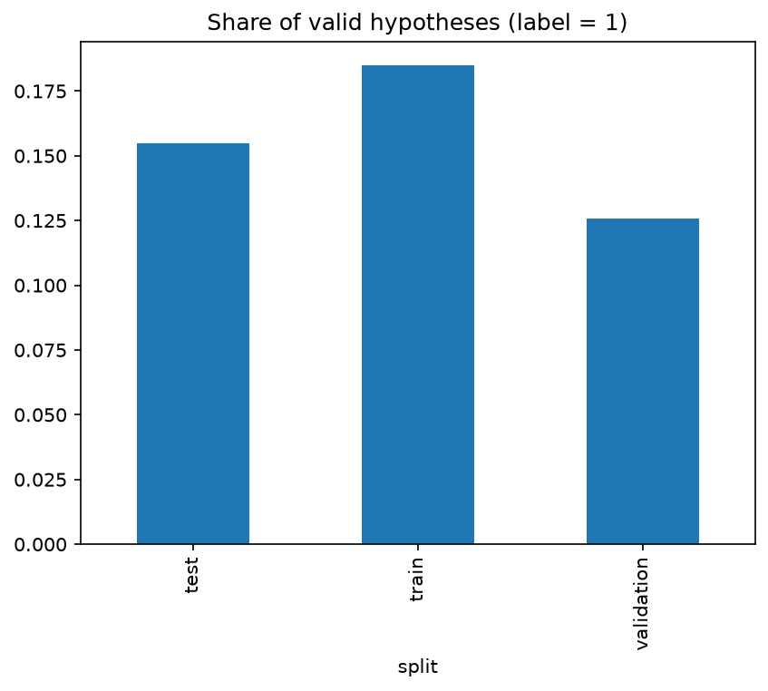
Clean splits with no premise leakage
01 · DATA AND EDA · CHAITANYA SAI MEKA
Split | Rows | Premises
Train (sampled) | 35,340 | 400
Validation | 1,026 | 19
Test | 1,162 | 21
Split each input into premise and hypothesis; give every premise an ID
5 premises appeared in two splits; we removed them from train and validation
Sampled 400 whole premises (seed 42); valid share stays 18.5%
Only 13–19% of claims are valid in each split
Notes:
Presenter: Chaitanya. Official Hugging Face splits. No missing values or duplicates. The same premise is reused with up to 90 hypotheses, so leakage happens at premise level: 2 premises shared train/validation, 3 validation/test. Test kept as is. Train is 206K rows, so 400 whole premises sampled, label share unchanged.

Slide 5
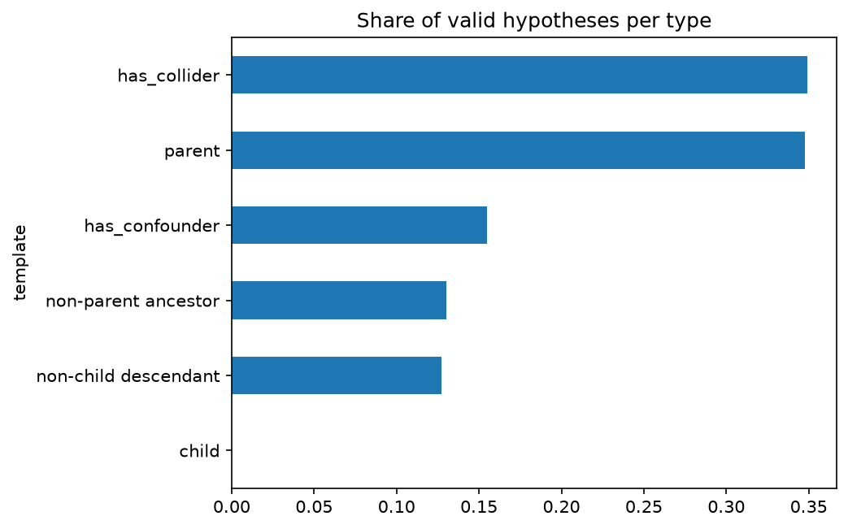
Three findings that shaped the design
01 · DATA AND EDA · CHAITANYA SAI MEKA
1
Few valid claims
Accuracy misleads, so we report precision, recall and F1 and use class weights
2
“Child” is never valid
Its text reads like “parent”, so the template column leaks the label and is never a feature
3
Premises repeat; train is 5–6 variables
Up to 90 claims per premise, so splits, CV and bootstrap all group by premise
Share of valid claims per claim type (train)
Notes:
Presenter: Chaitanya. Explain each finding and what it changed downstream. Also: validation and test include 2 to 4 variable graphs that train never has, a harder test.

Slide 6
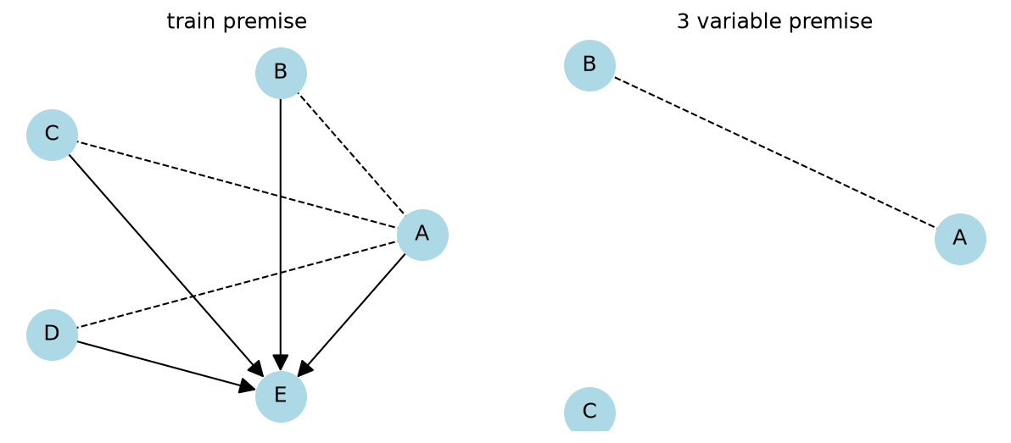
From text to a causal graph
02 · PARSER AND PC ALGORITHM · RAKSHITA
1
Regex parser
Claim type and the two variables X, Y; templated text, so 0 parse failures
2
Schema checks
Only A–F, no self-loops, both variables in the premise
3
PC algorithm
pgmpy PC reads the premise's independences directly
mec_support = share of fitting DAGs where the claim is true
4
Equivalence class
Try both directions of every undirected edge: 1 to 144 DAGs per premise
1 means true in every fitting graph, which is the definition of valid
Notes:
Presenter: Rakshita. PC: start fully connected, remove edges between independent pairs, orient colliders X->Z<-Y, then Meek rules. Undirected edges mean the direction cannot be known. All fitting DAGs form the Markov equivalence class: same skeleton and same colliders. mec_support is computed with no labels, so it is not leakage.

Slide 7
Matching the dataset generator's definitions
02 · PARSER AND PC ALGORITHM · RAKSHITA
Claim | Some path from X to Y
Directly causes | X → Y
Causes something else which causes | X → … → Y, 2+ arrows
Collider (common effect) | X → … → Z ← … ← Y
Confounder (common cause) | X ← … ← Z → Y
Read from the authors' code (data_gen.cpp). Our first, textbook definitions disagreed on longer paths.
Notes:
Presenter: Rakshita. Our first rule matched 93.7% of train labels. Reading the generator: 'causes something else which causes Y' only needs a 2+ arrow path even if X->Y also exists; colliders and confounders can use longer paths; a loop bug (i++ instead of i--) means a confounder only counts when the common cause is next to Y. Now 98.5% on test. 41% of remaining mismatches are 'parent' claims every fitting DAG supports but labelled 0: label noise. Also: letters follow causal order, so 'child' claims are never valid.

Slide 8
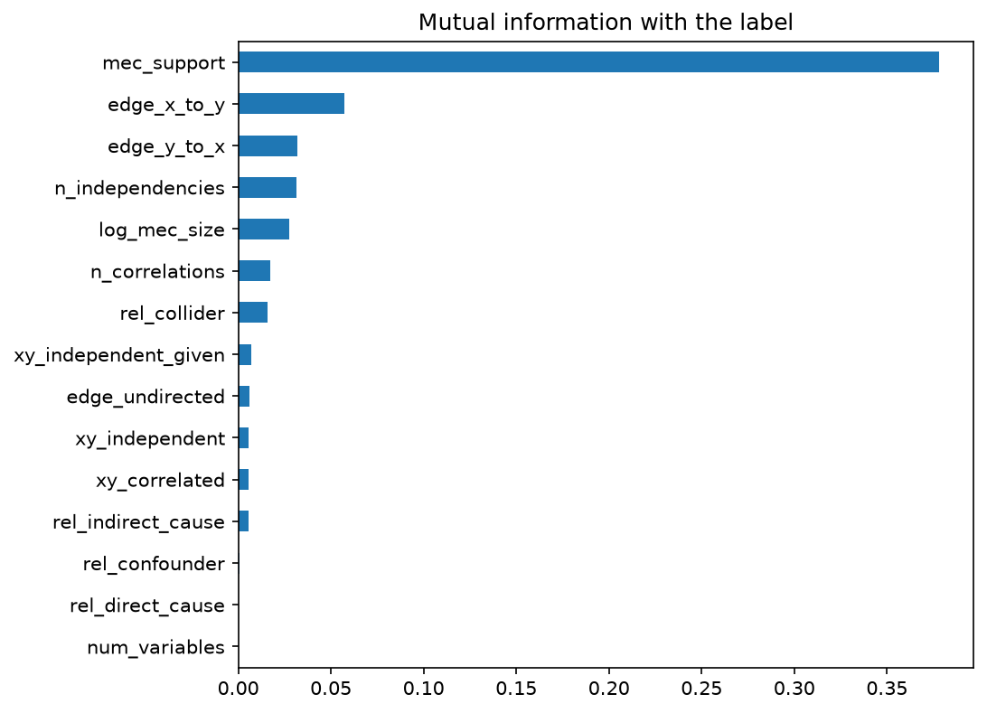
Turning each claim into 256 numbers
03 · FEATURE ENGINEERING · DHANVIN VADLAMUDI
Text: TF-IDF, 241 terms
Premise and hypothesis, unigrams and bigrams, one-letter tokens kept for A–F, fitted on train only
Structured: 15 features
Claim type, one-hot
What the premise says about X and Y
PC edge direction X→Y, Y→X, undirected
Log size of the equivalence class
mec_support
Mutual information with the label (train)
Notes:
Presenter: Dhanvin. TF-IDF weighs a word by how often it appears here and how rare it is overall; sublinear tf. Default token pattern drops one-letter words, but A-F are the variables. Structured features scaled with StandardScaler fit on train. Mutual information: 0/1 and count columns treated as discrete. mec_support is far ahead, then the edge-direction features.

Slide 9
Graph features, not words, carry the reasoning
03 · FEATURE ENGINEERING · DHANVIN VADLAMUDI
1
TF-IDF fails
Calls almost everything valid: recall 0.95, precision 0.31
2
mec_support dominates
LR weight +4.9 and 71% of Random Forest importance
3
The rule still wins here
A linear model can't copy the step at 1; tuned trees do (next)
Notes:
Presenter: Dhanvin. Same logistic regression, three feature sets, plus the no-learning rule for honesty. Bag of words cannot tell 'A causes B' from 'B causes A' and cannot link the hypothesis pair to the premise. Balanced class weights trade precision for recall, so the linear model scores below the rule. Feature selection (top 80 terms) changed F1 by only 0.02, within noise on 19 premises.

Slide 10
Tuned with GroupKFold, chosen on validation
04 · MODELS AND EVALUATION · KASULA LALITHENDRA
Model | Val F1 | Test P | Test R | Test F1
Logistic Regression | 0.878 | 0.922 | 0.983 | 0.952
Random Forest (chosen) | 0.929 | 0.927 | 0.989 | 0.957
Gradient Boosting | 0.879 | 0.927 | 0.989 | 0.957
Rule, no learning | 0.906 | 0.922 | 0.983 | 0.952
0.921 – 0.982
95% CI of test F1, bootstrap over whole premises
Honest reading
The model beats the rule by 0.005, inside the CI. The symbolic step does most of the work.
256 features: TF-IDF + structured. 5-fold GroupKFold keeps every premise in one fold. Test used once.
Notes:
Presenter: Lalithendra. GridSearchCV over C for LR, depth and leaf size for RF, learning rate and leaves for gradient boosting. Random Forest has the best validation F1, so it is the final model; gradient boosting ties on test but we never switch after seeing test. Bootstrap resamples premises, not rows, because rows of one premise are not independent.

Slide 11
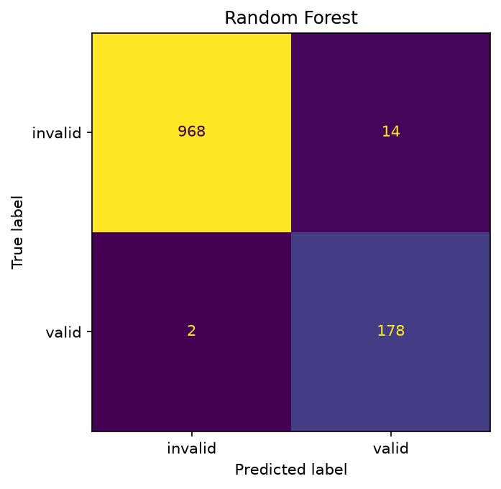
Only 16 mistakes in 1,162 test claims
04 · MODELS AND EVALUATION · KASULA LALITHENDRA
968
correctly invalid
178
correctly valid
14
false alarms
2
missed valid
8 of 16 mistakes are “parent” false alarms, the label disagreements found in step 02
Graphs with 2–4 variables, never seen in training: 1 mistake in 126 rows
Notes:
Presenter: Lalithendra. Read the confusion matrix. Error analysis by claim type and by number of variables. Small graphs do well because the features come from the parser and PC, not memorised sentences.

Slide 12
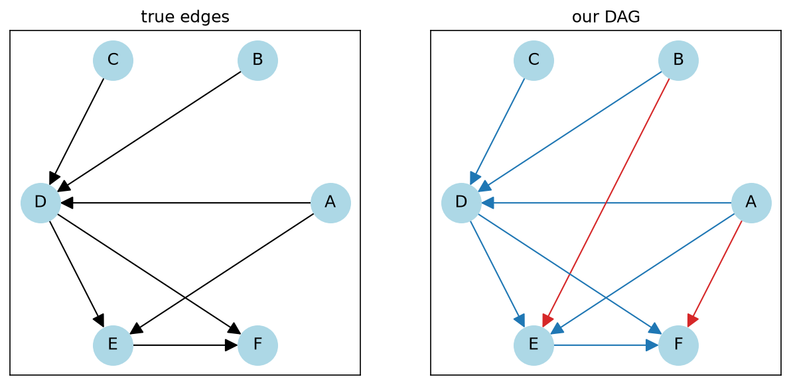
From predicted claims to a valid DAG
05 · DAG AND BAYESIAN NETWORK · JAGRUTHI PULUMATI
1
Most confident first
Every “X directly causes Y” predicted valid becomes an arrow
2
Safety rules
Skip self-loops, unknown variables and any arrow that closes a cycle
3
All 21 test graphs are DAGs
Edge precision 0.89 (65 of 73), recall 1.00
Red arrows: drawn by us and supported by PC, but labelled not valid in the dataset
Notes:
Presenter: Jagruthi. This is where the symbolic side enforces what text cannot: no cycles, no self-loops, only known variables. All 8 wrong arrows are also in the PC graph, so they come from the same label disagreement.

Slide 13
Asking “what if” with a Bayesian network
05 · DAG AND BAYESIAN NETWORK · JAGRUTHI PULUMATI
effect = P(Y=1 | do(X=1)) − P(Y=1 | do(X=0))
P(Y=1 | do(X=1)) chance that Y is 1 when we force X to 1
do(X) means we set X ourselves and cut the arrows into X. It is not the same as just seeing X.
P(Y=1 | do(X=0)) chance that Y is 1 when we force X to 0
effect the gap: how much X changes Y. 0 means no effect
1
Simulate data
Corr2Cause has no numbers, so we give a fully known test graph random tables P(node = 1 | parents) and draw 5,000 rows of 0/1.
Why direction matters: true graph A → B → C
do(A) on C
do(C) on A
True graph
A
B
C
0.490
0.000
2
Fit with pgmpy
pgmpy learns the tables of our predicted DAG, and of the same DAG with every arrow reversed, from the same 5,000 rows.
Our DAG (fitted)
A
B
C
0.498
0.000
Intervene and compare
Ask do(X) on Y for every pair of variables and compare each graph's effect with the true effect.
Reversed DAG
A
B
C
0.000
0.514
3
Forcing A changes C, forcing C does not change A. The reversed graph fits the same data but gets both answers wrong.
On 5 fully known test graphs (96 queries, 32 with a real effect): our DAG 28 / 32 · reversed 0 / 32 · empty graph 0 / 32
A query counts only if the graph gets “is there an effect?” right and the size within 0.05. All 96 queries: 92 vs 36 vs 64.
Notes:
Presenter: Jagruthi. A Bayesian network is a DAG where every node has a probability table: the chance it is 1 given its parents. Corr2Cause is only text, so there are no numbers to learn from. We take the test premises where PC knows the full graph (only one DAG fits, 5 premises), give that true graph random tables, and simulate 5,000 rows of 0/1. Then pgmpy fits our predicted DAG, and the same DAG with all arrows reversed, on those rows. do(X) means we set X ourselves, which cuts the arrows into X; this is different from just observing X. Effect = P(Y=1 | do(X=1)) minus P(Y=1 | do(X=0)). Chain example: the true effect of A on C is 0.490 and our graph gives 0.498; the reversed graph gives 0.000 and wrongly says C affects A (0.514). On the test graphs we ask every ordered pair: 96 queries, 32 with a real effect. Our DAG gets 28 of 32; reversed and empty graphs get 0.

Slide 14
What we showed, and what comes next
Text features alone reach only 0.47 F1. Formal causal reasoning cannot be replaced by word counts.
1
Limitations
Templated text and letters in causal order; train has only 5–6 variable graphs; Bayesian network data is simulated.
Parser + PC with the generator's definitions explain 98.5% of test labels; the model reaches 0.957 F1.
2
Phase 2
A fine-tuned transformer reads paraphrased text, PC keeps the reasoning, tested on reworded and renamed-variable data.
Correct arrows give correct what-if answers: 28 of 32 real effects, against 0 for the baselines.
3
Code, notebooks, tests and report: github.com/Jag2007/AI_ML_Project
Notes:
Presenter: Dhanvin or Jagruthi. Three takeaways, then limitations and the Phase 2 plan. Then open for questions.

