Slide 1

CSA15 | Cloud Computing and Big Data Analytics
CSA15 Cloud Computing and Big Data Analytics
Presenter Details
Student Name:Jagadeesh A
Register Number:192521294
Class / Section / Slot:C
Capstone Title: MedAdhere - Cloud Care Companion Using Non-Adherence Risk Prediction
Selected SDG Goal(s): SDG 3 - Good Health and Well-Being
Cloud Platform / Tools: Managed cloud PaaS/IaaS, Flutter, Python (ML), PostgreSQL, REST API
Capstone Cloud Technical Presentation
Individual Student Presentation Deck
Presentation Focus
Present your capstone as a cloud-backed product. Explain the problem, architecture, service choices, evidence, and CO1 learning clearly.
Individual student submission template | Department of Computer Science and Engineering
CO1 AT3 | 01
Notes:
Open by naming the capstone problem and the cloud product objective. Keep the title slide uncluttered and clearly identify the individual presenter.

Slide 2
CSA15 | Cloud Computing and Big Data Analytics
Problem Context and Stakeholder Mapping
Our capstone begins with a real problem to solve
Problem Statement
Target Users
Many patients on long-term medication miss doses without warning, leading to preventable health complications.
Patients get reminders and simple dose logging; caregivers and clinicians get an early, risk-ranked view of who is likely to miss doses.
SDG Fit
Product Boundary
SDG 3 - Good Health and Well-Being, by improving medication adherence and reducing preventable complications.
Mobile dose logging and reminders, a caregiver dashboard, and a non-adherence risk score for each patient.
Individual student submission template | Department of Computer Science and Engineering
CO1 AT3 | 02
Notes:
Do not start with technology. First make the need clear, then connect it to cloud-enabled scale, reach, or reliability.

Slide 3
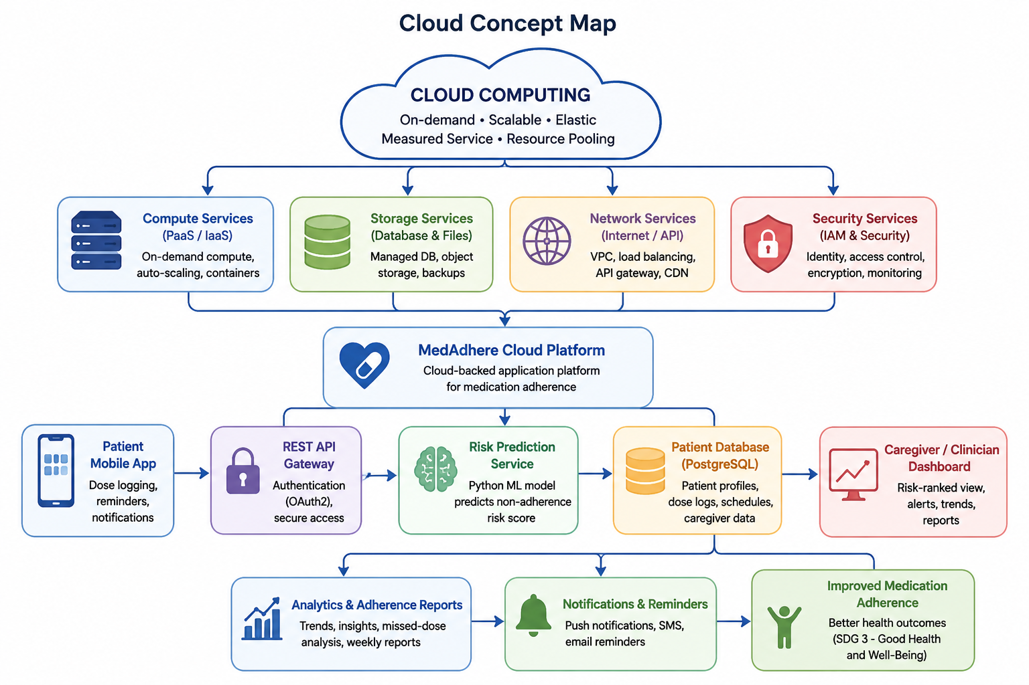
CSA15 | Cloud Computing and Big Data Analytics
Cloud Adoption Rationale and Concept Map
The problem needs cloud support to become a usable product
Cloud Definition
Cloud Concept Map
For MedAdhere, cloud computing means renting on-demand compute, storage, and ML services so the app serves patients and caregivers anytime without us running our own servers.
Cloud Characteristics
Elasticity, scalability, measured service, resource pooling.
Individual student submission template | Department of Computer Science and Engineering
CO1 AT3 | 03
Notes:
Students should explain the concept map as a reasoning artifact, not as decoration.

Slide 4
CSA15 | Cloud Computing and Big Data Analytics
Capstone Cloud Architecture
Our cloud architecture connects the user action to services
Scaling point
Patient Mobile App
OAuth2 Auth + API Gateway
Risk-Prediction Service (PaaS)
Patient DB + Storage
Security boundary
Adherence Analytics
Individual student submission template | Department of Computer Science and Engineering
CO1 AT3 | 04
Notes:
Walk from user request to API, compute, data, storage, analytics, monitoring, and security boundary.

Slide 5
CSA15 | Cloud Computing and Big Data Analytics
Cloud Service Model Responsibility Matrix
Each service model defines what we control and what cloud manages
Service area
Model
Provider manages
Student team manages
Why this fits
SaaS
Hosting & CDN
UI & user flows
Always-on patient access
Frontend hosting
PaaS
Runtime & auto-scaling
Risk logic & APIs
Focus on adherence logic
Backend/API
Managed PaaS DB
Backups & patching
Schema & queries
Reliable patient records
Database
IaaS storage
Durability & redundancy
Retention rules
Cheap, durable file storage
Storage
PaaS monitoring
Metrics & dashboards
Alert thresholds
Early failure detection
Monitoring / logs
Managed IAM
Token issuance, MFA
Role permissions
Strict, auditable access
Security / IAM
Individual student submission template | Department of Computer Science and Engineering
CO1 AT3 | 05
Notes:
Ask the student to defend provider responsibility and student responsibility for the selected service models.

Slide 6
CSA15 | Cloud Computing and Big Data Analytics
Data Flow and Analytics Pipeline
The product data moves from user activity to useful insight
Collect
Ingest
Store
Process
Visualize
Data Requirements
Analytics Requirement
Proof Required
Daily dose-log events, reminder responses, medication schedules, and caregiver dashboard requests.
Non-adherence risk score per patient, missed-dose alerts, and weekly adherence trend charts for caregivers.
Input: 30 days of dose logs for one patient. Output: a risk score of 0.78 (high). Insight: doses are most often missed on weekends.
Individual student submission template | Department of Computer Science and Engineering
CO1 AT3 | 06
Notes:
Big data analytics is optional, but a thoughtful data path is expected.

Slide 7
CSA15 | Cloud Computing and Big Data Analytics
Python / AI Module Integration
Python or AI adds intelligence where the product needs it
Python Role
Input and Output
Prediction: a classification model estimates each patient's non-adherence risk from recent dose-logging behaviour.
Input: adherence history, dose timing, demographics. Output: a 0-1 risk score and a risk band (low/medium/high).
Execution Point
Product Value
A scheduled serverless function recomputes the risk score after every logged dose and nightly for all patients.
Caregivers see who needs attention first instead of checking every patient manually, enabling earlier intervention.
Individual student submission template | Department of Computer Science and Engineering
CO1 AT3 | 07
Notes:
If AI is not required, students can present a Python automation or analytics module instead.

Slide 8
CSA15 | Cloud Computing and Big Data Analytics
Security, Scalability, Privacy and Cost Design
Security, scale, privacy and cost shape the final design
Security
Privacy
OAuth2 login with role-based access for patient, caregiver, and clinician; every dose-log entry is timestamped and audit-logged.
Patient health data is encrypted at rest, caregiver access requires patient consent, and analytics reports use anonymised, aggregated data.
Scalability
Cost Awareness
Auto-scaling backend instances and a read-replica database absorb growth from hundreds to thousands of patients without redesign.
Managed free/low-cost tiers for compute and database during pilot, moving to usage-based scaling once patient numbers grow.
Individual student submission template | Department of Computer Science and Engineering
CO1 AT3 | 08
Notes:
This slide is where students show engineering judgment instead of simply listing services.

Slide 9
CSA15 | Cloud Computing and Big Data Analytics
Implementation Stack and Deployment Evidence
Our implementation stack shows how the design will be built
Mobile / Web Layer
Cloud Services
Flutter cross-platform mobile app for patients; web portal for caregivers and clinicians.
PaaS compute for the API and risk-prediction service, managed relational database, object storage, and managed authentication.
Evidence
Version Control
GitHub repository with source code, deployed API endpoint, cloud monitoring dashboard screenshot, and sample request/response logs.
Organised folders for mobile app, backend, and ML model, with regular commits, a main/dev branch split, and a clear README.
Individual student submission template | Department of Computer Science and Engineering
CO1 AT3 | 09
Notes:
Evidence should be specific and inspectable, not a generic list of tools.

Slide 10
CSA15 | Cloud Computing and Big Data Analytics
Demo Storyboard and User Journey
A complete user journey proves the product flow
Scene 1
Scene 2
Scene 3
Patient taps 'Taken' after the morning dose -> app logs the dose -> API Gateway + Adherence Service
Patient misses the evening dose window -> risk model recomputes the score -> ML/PaaS risk-prediction service
Risk score crosses the threshold -> reminder notification is sent -> Notification service
Scene 4
Scene 5
Scene 6
Caregiver opens the dashboard -> sees the patient flagged high-risk -> SaaS dashboard + database
Caregiver calls the patient and logs a note -> note saved -> backend API + database update
Weekly report auto-generates -> clinician reviews the adherence trend -> analytics/reporting service
Individual student submission template | Department of Computer Science and Engineering
CO1 AT3 | 10
Notes:
A storyboard helps the faculty see whether the cloud architecture is connected to actual use.

Slide 11
CSA15 | Cloud Computing and Big Data Analytics
Evaluation Readiness Checklist
Our evidence confirms that the presentation is ready
Cloud ecosystem and service model explained
Elasticity and scalability decisions are visible
REST/SOAP/API role connected to capstone
GitHub and cloud evidence are inspectable
Architecture has compute, data, storage, security, monitoring
References and integrity statement are included
Evaluator Focus
CO1 is verified through cloud design reasoning, service choices, evidence, and individual explanation.
Individual student submission template | Department of Computer Science and Engineering
CO1 AT3 | 11
Notes:
Students can use this as the self-check slide before presenting the conclusion.

Slide 12
CSA15 | Cloud Computing and Big Data Analytics
Conclusion, Limitations and Future Scope
We close with learning, limitations and next steps
Learning Outcome
Limitations
Building MedAdhere made the shared-responsibility model, elasticity, and REST-based service integration concrete rather than theoretical.
Multi-language reminders and deeper model validation across larger, more diverse patient data are not yet complete.
Future Improvement
Integrity Statement
Add automated tests for the risk-prediction API and expand monitoring alerts before the final review.
Built with Flutter, a managed cloud PaaS/IaaS platform, and a Python ML model; course concepts and any AI assistance used are acknowledged per academic policy.
Individual student submission template | Department of Computer Science and Engineering
CO1 AT3 | 12
Notes:
The ending should synthesize learning, not just say thank you.

