Slide 1
Cs-84 FINAL PROJECT PRESENTATION 2020 electıon predıctıon
States : Hawaii, North Dakota
Author : Jaga Ramesh

Slide 2
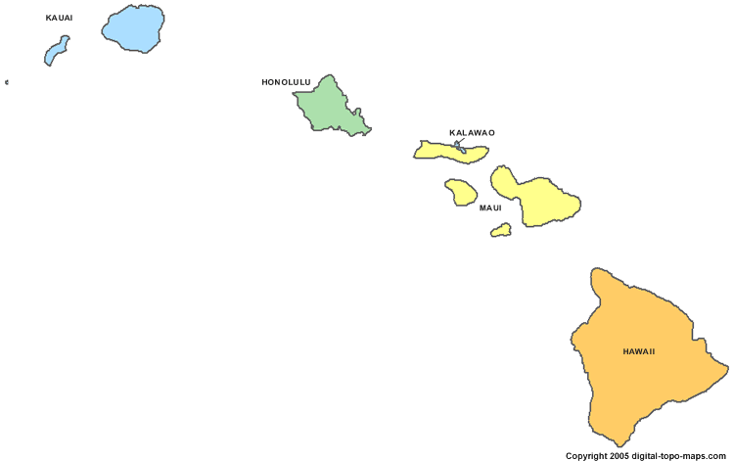
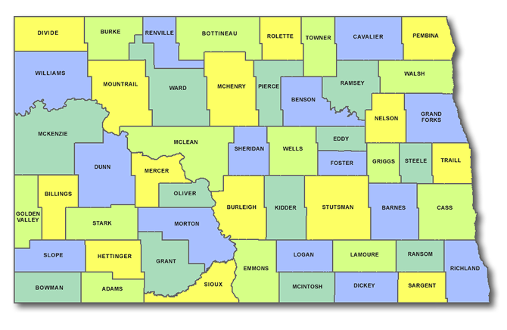
STATES : HAWAII & NORTH DAKOTA
State of Hawaii & North Dakota
Analyzed by Jaga Ramesh

Slide 3
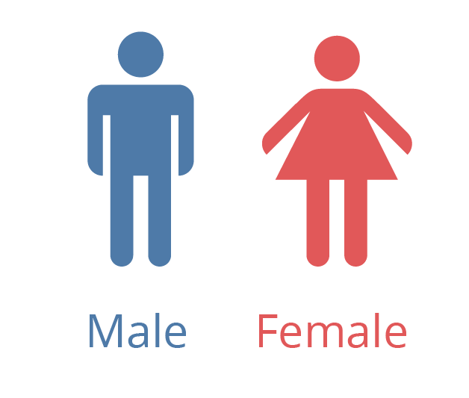
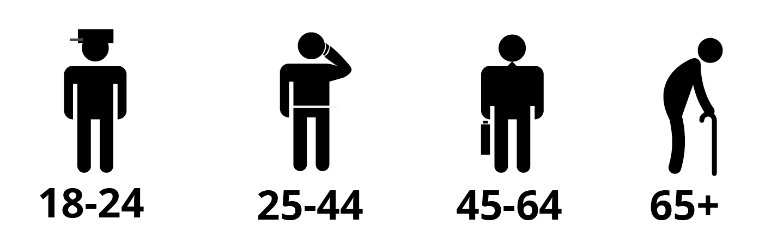

HAWAII : OVERVIEW
Electoral votes : 4
Culturally diverse with Asian (~40%), Multi race (~30%), White (~30%)
Counties : 4
Main source of income : Tourism
Lowest voter turnout in US : 39% of total Population
Male : 48-51%
Female : 49-52%
10-12%
32-39%
31-36%
18-23%
40-51%
2-3%
3-8%
22-29%

Slide 4

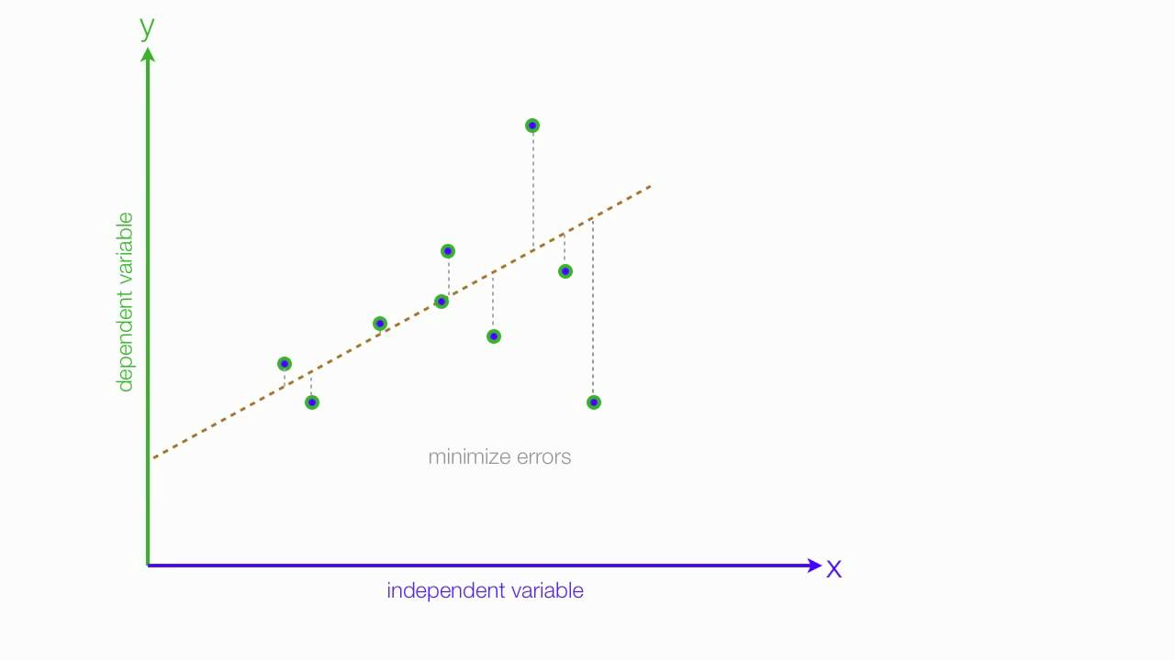
HAWAII : METHOD
Hawaii favored Democrats in elections 2000 to 2016
Voter turnout to determine Democrat Vs Republic votes
Linear Regression Model
R Programming
Box plot to display the range of Democrat / Republic / Other party votes with 95% confidence interval

Slide 5
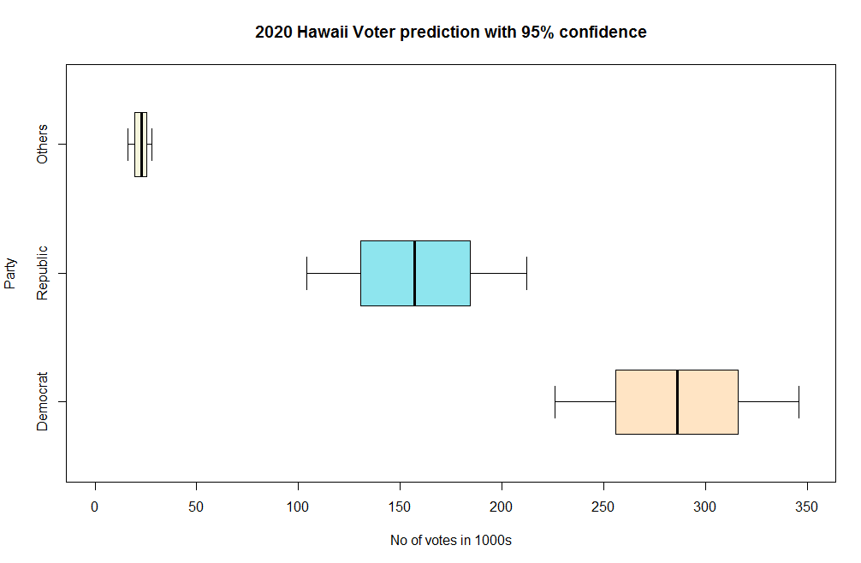
HAWAII : FINDINGS
Statistical analysis : Republican Party loses in Hawaii in 2020
Democrat: 285,936 votes
(95% conf int : 226,287 and 345,586)
Republic: 156,643 votes
(95% conf int : 103,857 and 211,574)
Others : 22,956 votes
(95% conf int : 16,092 and 27,674)

Slide 6
NORTH DAKOTA : OVERVIEW
Electoral votes : 3
White dominant population (~89%)
Counties : 53
Main industries: Agriculture, Oil
Voter turnout : 61 – 65% of voting population
Male : 49-50%
Female : 50-51%
13-17%
31-39%
30-37%
16-19%
0.5-1%
0.5-1%
1-3%
89-95%

Slide 7

NORTH DAKOTA : METHOD
North Dakota favored Republicans in elections 2000 to 2016
Historical Voter turnout %, Democrat vote%, Republic vote % to statistically predict 2020 votes
Monte Carlo Analysis
R Programming
Histogram to display the range of Democrat / Republic / Other party votes

Slide 8
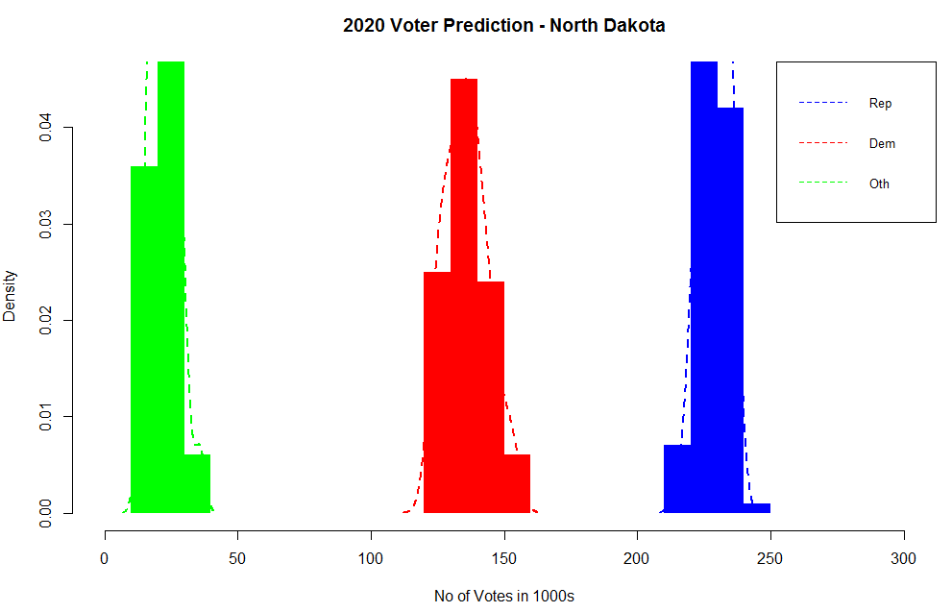
NORTH DAKOTA : FINDINGS
Statistical Finding : Republican Party wins in North Dakota in 2020
Republic: 227,200 votes
(Range: 206,000 and 240,400)
Democrat: 135,900 votes
(Range: 110,500 and 157,400)
Others : 22,560 votes
(Range: 11,920 and 34,120)

Slide 9
THANK YOU!
Meltem Oktay (meltemoktay@outlook.com)
Jaga Ramesh (jagadeeswari.ramesh@gmail.com)
Sojung Kim (email)

