Slide 1


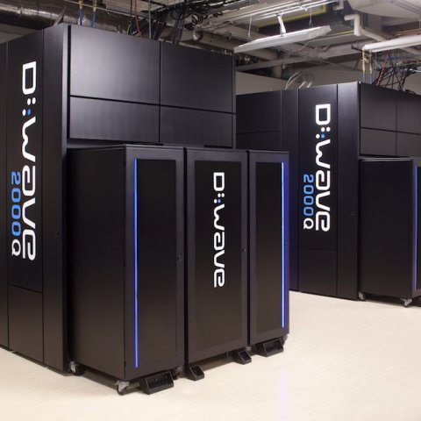
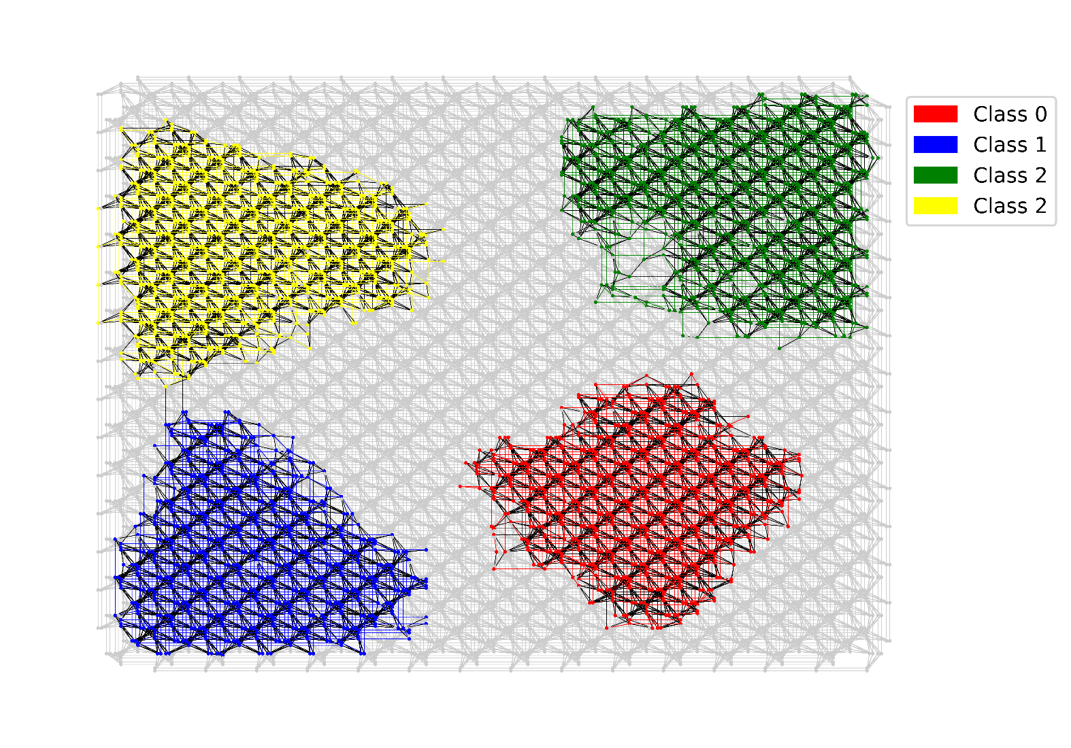

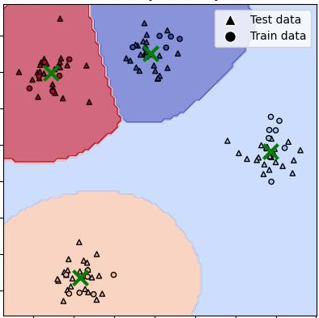
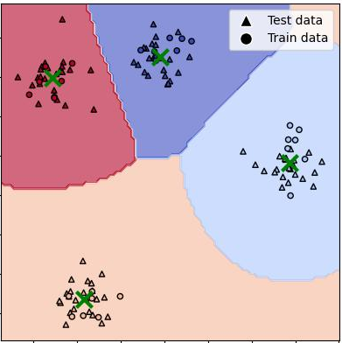
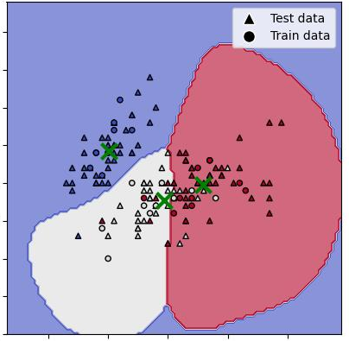
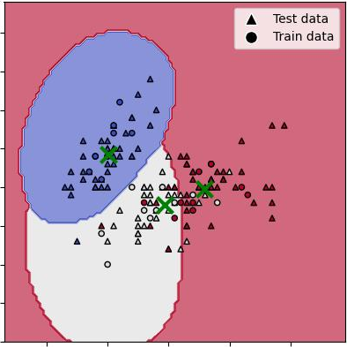
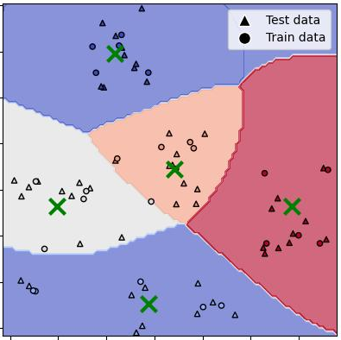
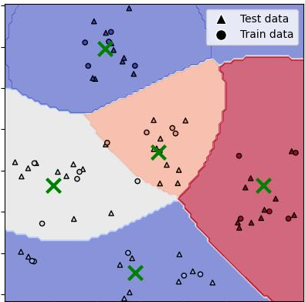
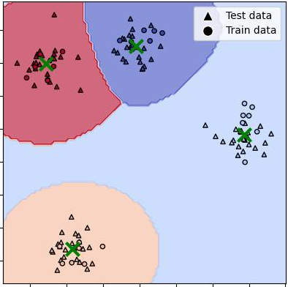
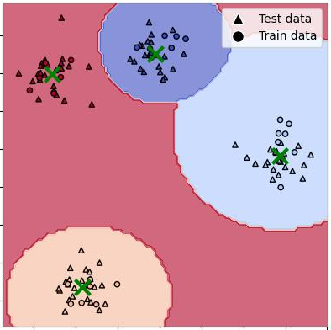
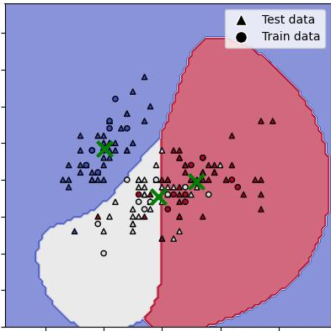
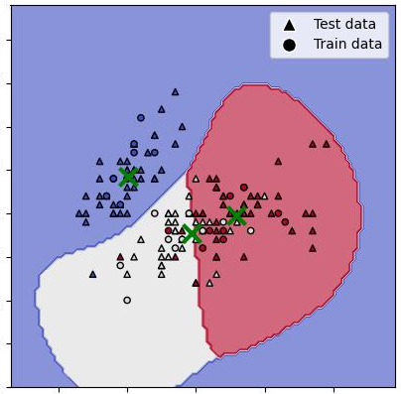
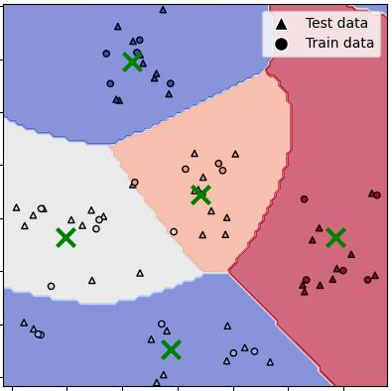
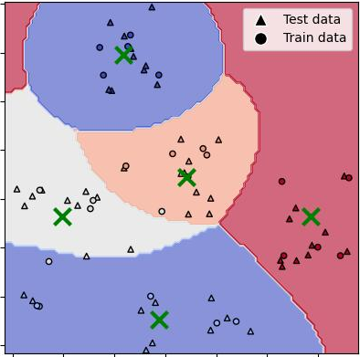






https://www.tuat.ac.jp/~nanotech/index.htm
Multi-Task Quantum Annealing for Rapid Multi-Class Classification
Artag Jargalsaikhan, Moe Shimada, and Jun-ichi Shirakashi
Department of Electrical Engineering and Computer Science, Tokyo University of Agriculture and Technology
2-24-16 Nakacho, Koganei, Tokyo 184-8588, Japan
1. Introduction: Quantum annealing and Support Vector Machines
Quantum annealing
Multi-Class Classification SVMs
D-Wave Systems:
Binary Classification
Multi-Class Classification
Flux Quantum Bits
0
1
0
Class 1
Class 1
Ultra Low Temperature
1
More Than 5000 Qubits
Super Position
state
Quantum
tunneling
Global
minimum
S. Boixo et al., Nature Phys. 10 (2014) 218.
Quantum Annealing
Class 2
Mathematical
Modeling
Quantum
Annealer
Real-World
margin
Class 2
Class 3
Real-World
We employed OnevsRest strategy.
2. Rapid Multi-Class Classification Using D-Wave Quantum Annealer
SVM Quantum formulation
Multi-tasking Quantum Annealing
Real value to Binary encoder:
OneVsRest strategy:
Parallel Quantum Annealing
Sequential Quantum Annealing
$$α_{n}=\sum_{k=0}^{K−1}{2^{k}a_{Kn+k}}$$
“Winner-takes-all”
QA runs with the same embedding allocation for each classifier. In total, N run for training.
$a_{Kn+k}ϵ\{0,1\}$: Binary Variable
Classifier
Output
3
Example on left
$y_{i,j}$ is class label, $k\left(x_{i}​,x_{j}​\right)$ is the kernel function
C1 vs Rest
Not C1
QUBO (Quadratic Unconstrained Binary Optimization):
C2 vs Rest
Not C2
Class 0 vs Rest
$$\sum_{i=1}^{N}{α_{i}}−\frac{1}{2}\sum_{i,j=1}^{N}{y_{i}y_{j}α_{i}α_{j}k\left(x_{i},x_{j}\right)}+{\left(\sum_{i=1}^{N}{y_{i}α_{i}}\right)}^{2}$$
C3 vs Rest
C3
Class 1 vs Rest
QA run 4 times
Result
C3
Class 2 vs Rest
maximizing the margin
class constraints
Classifier
Output
Class 3 vs Rest
$y_{i,j}$ is class label
C1 vs Rest
-120
$k\left(x_{i}​,x_{j}​\right)$ is the kernel function, we used rbf kernel
C2 vs Rest
-100
Hamiltonian combining into one:
Decoding into each classifier
N is class number
C3 vs Rest
Not C3
$$H_{total}=\left[\begin{matrix}H_{1} & 0 & 0 & 0 \\ 0 & H_{2} & 0 & 0 \\ 0 & 0 & H_{3} & 0 \\ 0 & 0 & 0 & H_{4}\end{matrix}\right]$$
For each classifier in our study, a Quadratic Unconstrained Binary Optimization (QUBO) problem is formulated. This QUBO is then mapped directly onto a quantum annealer, allowing us to leverage the device's capabilities to optimize the solution. This process ensures that each classifier is efficiently tailored to maximize classification accuracy by finding the optimal hyperplane in the high-dimensional space.
Result
C1
$$\left[H_{1},H_{2},H_{3},H_{4}\right]$$
Need to train N (number of classes) classifiers
The processes of combining and decoding are performed on the CPU for computation.
3. Experimental Results
Synthetic data: Blob
Iris
Handwritten Digit
SMO
SA
SMO
SA
SMO
SA
QA
MTQA
QA
MTQA
QA
MTQA
In the Blob dataset with four classes, MTQA matched the perfect 100% accuracy achieved by SMO, SA, and QA, confirming its capability to efficiently manage straightforward classification tasks without compromising on performance.
Despite the challenging nature of the Iris sepal dataset, MTQA closely approached the accuracy levels of SMO and SA, with slight reductions in testing accuracy suggesting areas for further optimization and robustness in feature-sensitive datasets.
For the handwritten digits 0 to 4, MTQA showcased a strong performance, aligning closely with SMO and SA in accuracy while demonstrating its potential to efficiently handle more complex, multi-class recognition tasks in real-world applications.
4. Conclusions
➣ Efficiency Enhanced: Multi-tasking Quantum Annealing (MTQA) significantly reduces quantum processing cycles required for multi-class SVM classification, enhancing computational efficiency.
➣ Accuracy Maintained: MTQA maintains accuracy levels comparable to traditional methods, effectively handling multiple classification tasks simultaneously on quantum hardware.
➣ Future Potential: The success of MTQA in this study demonstrates its potential to transform machine learning applications, paving the way for advanced quantum computing solutions in complex data classification.
https://www.tuat.ac.jp/~nanotech/index.htm

