Slide 1


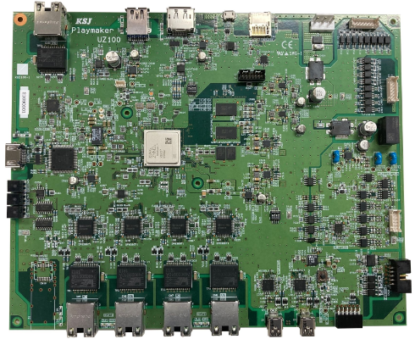
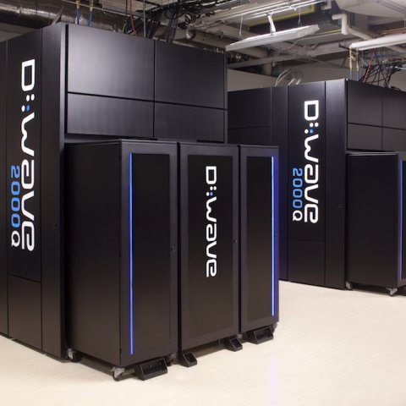
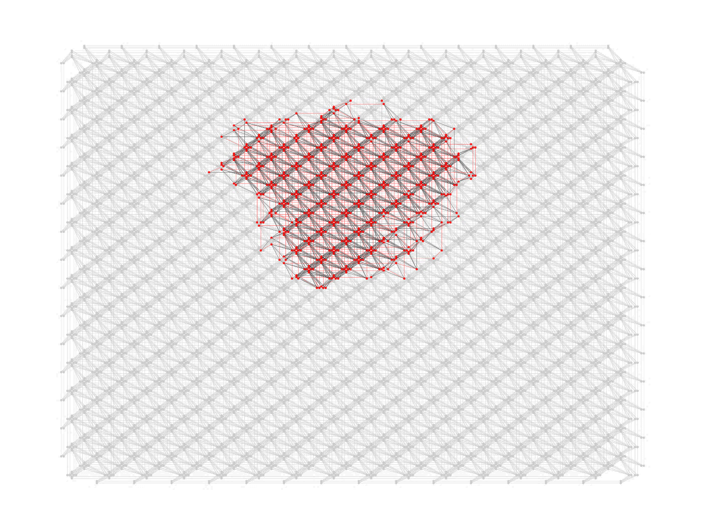
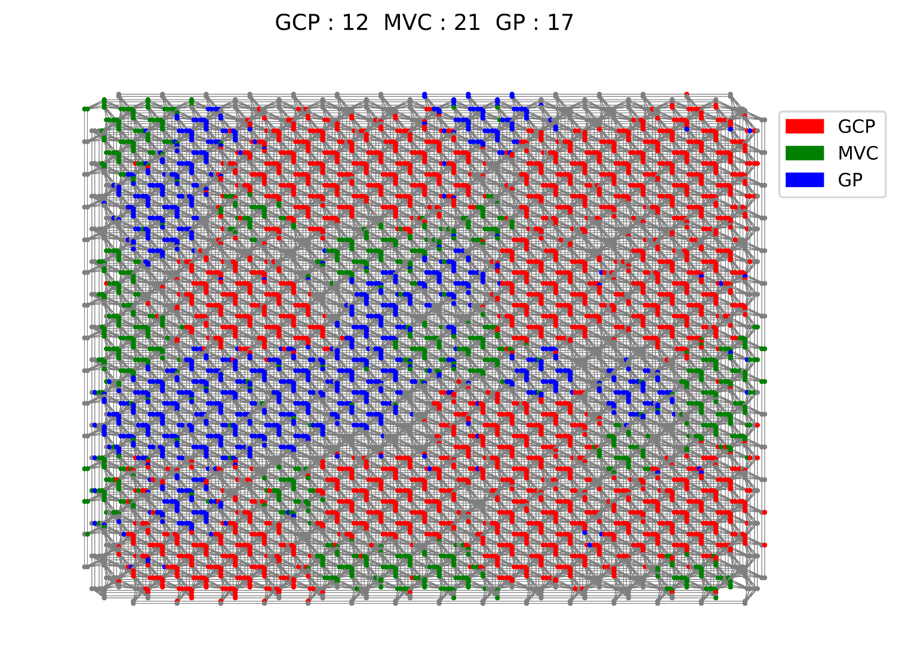
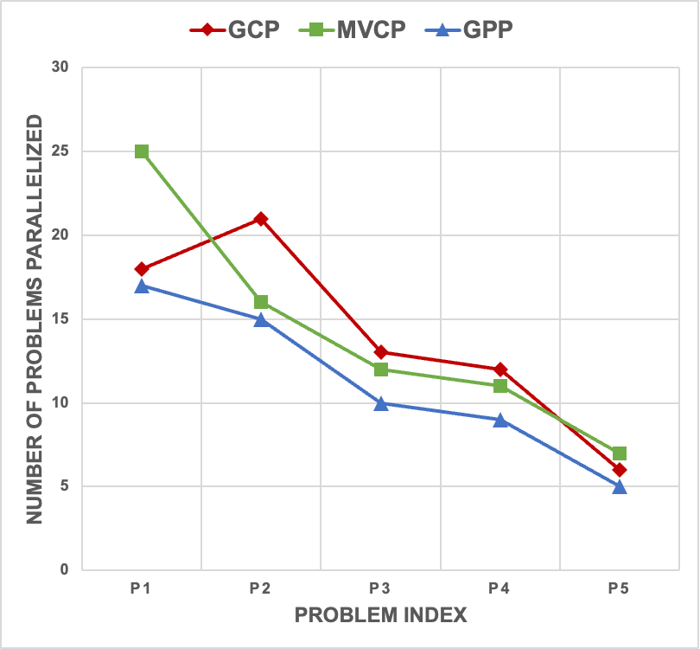
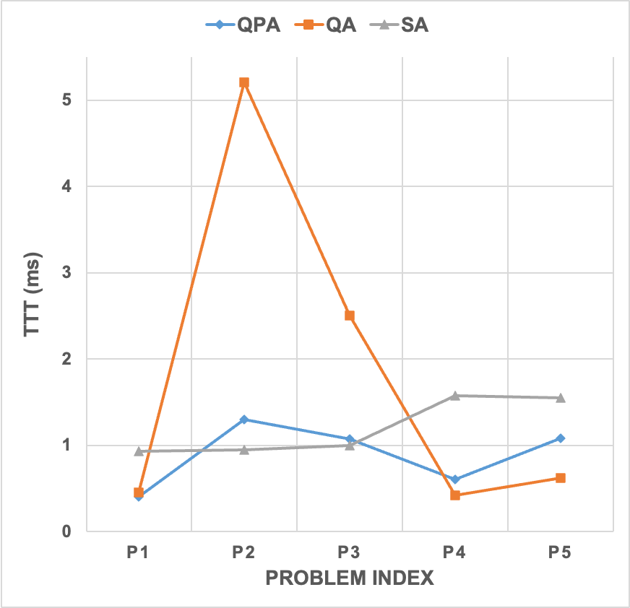
















https://www.tuat.ac.jp/~nanotech/index.htm
Parallel Quantum Annealing:
A Novel Approach to Solving Multiple NP-Hard Problems Concurrently
Artag Jargalsaikhan, Moe Shimada, and Jun-ichi Shirakashi
Department of Electrical Engineering and Computer Science, Tokyo University of Agriculture and Technology
2-24-16 Nakacho, Koganei, Tokyo 184-8588, Japan
1. Introduction: Solving Combinatorial Optimization Problems
♦ Combinatorial Optimization for Real-World Problem
♦ Three graph problems that are relevant to IC design
✓ Combinatorial optimization techniques can be applied to IC layout to address
various optimization problems that arise during the design process.
✓ Using combinatorial optimization algorithms, IC layout problems can be efficiently solved,
exploring large solution spaces for near-optimal or optimal solutions.
IC layout:
D-Wave Systems:
Graph Coloring Problem (GCP)
Minimum Vertex Covering Problem (MVCP)
Graph Partitioning Problem (GPP)
Dead Space Minimization
Flux Quantum Bits
GCP aims to assign unique colors to adjacent vertices in an undirected graph G = (V, E) while using the fewest colors possible.
MVCP aims to find the smallest subset V′ of vertices in an undirected graph G = (V, E) such that each edge (u, v) has at least one endpoint in V′.
GPP seeks to divide the vertices of an undirected graph G = (V, E) into k nearly equal (or as equal as possible) sets, minimizing inter-set edge crossings.
Wirelength Minimization
Ultra Low Temperature
Applications:
Register Allocation
Signal Routing Optimization
Parallel Task Scheduling
1
2
Applications:
Network Design
Optimizing Resource Allocation
Processor Allocation in Parallel Computing
1
2
1
2
Floor Planning Optimization
More Than 5000 Qubits
Applications:
Load balancing in parallel computing
Image and data segmentation
Network Clustering
t-ksj.co.jp
Routing Optimization
S. Boixo et al., Nature Phys. 10 (2014) 218.
Quantum Annealing
3
4
3
4
3
4
Real-World
Mathematical
Modeling
Quantum
Annealer
Real-World
5
6
5
6
5
6
2. Solving Multiple NP-Hard Problems Simultaneously Using D-Wave Quantum Annealer
Quantum Annealing
➣ Conventional Quantum Annealing
Parallel Quantum Annealing
➣ Number of Problems within
Same Quantum Annealer
Quantum Annealing, inspired by metallurgical annealing, is a computational technique with promising capabilities in solving optimization problems.
The D-Wave Advantage is providing a more extensive and denser programmable quantum mode comprising over 5000 qubits. This advanced hardware is purposefully designed to harness the potential of quantum annealing for solving complex computational challenges, particularly those that can be formulated as Quadratic Unconstrained Binary Optimization (QUBO) problems or Ising models.
➣ Parallel Quantum Annealing
GPP 70 nodes and 0.8 density
GCP: 12 MVCP: 21 GPP:17
Objective function that Quantum Annealer can solve:
Ising Hamiltonian:
QUBO (Quadratic Unconstrained Binary Optimization):
$$H=\sum_{i}{h_{i}σ_{i}}−\sum_{<i, j>}{J_{ij}σ_{i}σ_{j}}$$
$$Q=\sum_{i}{d_{i}x_{j}}+\sum_{˂i,j˃}{d_{ij}x_{i}x_{j}}$$
QUBO for each problem:
Solution for GCP
$J$: Exchange Interaction Coefficient
$d$: User-Specified Weights
$$\begin{aligned}Q_{GCP}=\sum_{i=1}^{n}{\sum_{k=1}^{K}{x_{ik}}}+P\sum_{\left(i,j\right)∈E}{\sum_{k=1}^{K}{\left(1−x_{ik})(1−x_{jk}\right)}}\end{aligned}$$
Combining
Combined QUBO
Decoding
$h$: External Magnetic Field
x$ϵ\{0,1\}$: Binary Variable
$$x=\frac{1−σ}{2}$$
$$Q_{MVCP}=\sum_{i=1}^{n}{x_{i}}+P\sum_{\left(i,j\right)∈E}{\left(1−x_{i})(1−x_{j}\right)}$$
Solution for MVCP
$σϵ\{±1\}$: Spin State
Relation between $σ$ and x:
$$\begin{aligned}Q_{combined}=Q_{GCP}+Q_{MVCP}+Q_{GPP}+…\end{aligned}$$
Enhancement: We have the potential to utilize all available qubits on the D-Wave's Quantum Annealer. This approach allows for concurrent problem-solving, leading to more efficient utilization of resources and an increase in overall computational efficiency.
$$Q_{GPP}=\sum_{i=1}^{n}{\sum_{j=1}^{n}{q_{ij}x_{i}x_{j}}}$$
The processes of combining and decoding are performed on the CPU for computation.
Solution for GPP
3. Experimental Results
♦ Evaluation Metrics in Our Research: Time-To-Target (TTT)
♦ Analysis: Evolution of TTT Varying Test Problem Sets (P1-P5)
TTT: Performance measure for evaluating Quantum Annealing. This metric estimates the time required to locate a solution that is at least 99% as good as the optimal classical solution, accounting for the probabilistic nature of quantum annealing, which does not guarantee finding the absolute best solution every run.
Evolution of TTT for GCP:
Number of colors used are minimized.
Evolution of TTT for MVCP:
Number of covered vertexes are minimized.
Evolution of TTT for GPP:
Number of cut edges are minimized.
The probabilities of finding an optimal solution is recorded for each problem. These probabilities are averaged to derive the value of $p_{K}$, as follows:
$$p_{K}= \frac{1}{K}\sum_{i=1}^{K}{p_{i}}$$
$p_{i}$ : The probability of finding a solution that's at least
99% as good as the classical solution in a single run.
K: The number of problems that are being solved
concurrently.
We use this average success probability to calculate the TTT for solving all the problems concurrently (TTTens):
$$TTTens=\frac{1}{A}\left(\frac{T_{\text{QPU}}+T_{\text{CPU}}}{K}\right)\frac{\log\left(0.01\right)}{\log\left(1−p_{K}\right)}$$
where A is the number of anneals, $T_{QPU}$ is the quantum processing unit's processing time, and $T_{CPU}$ is the time the classical computer spends on combining QUBOs and decoding the results.
Test problem sets: Nodes in The Problems
✓ Our research represents an extended exploration into application of PQA for simultaneously addressing distinct NP-hard problems (IC design), showing a significant increase in TTT performance compared to traditional QA and SA methods.
Prob. | GCP | MVCP | GPP
P1 | 10 | 20 | 20
P2 | 10 | 25 | 25
P3 | 12 | 30 | 30
P4 | 12 | 35 | 35
P5 | 14 | 40 | 40
✓ We observed a consistent outperformance of PQA over QA, and results were either comparable or superior to SA.
This metric demonstrates the efficiency of our approach and demonstrates the potential of PQA in tackling complex, real-world problems.
✓ The PQA method was used to calculate the solutions of the three problems concurrently, while the QA and SA solutions were calculated one by one.
4. Conclusions
➣ This preliminary study offers a promising but exploratory application of Parallel Quantum Annealing (PQA) to
concurrently solve multiple NP-hard problems.
➣ Our work shows that using qubits can make problem-solving faster and more efficient with quantum annealing.
➣ While our findings show promise, we believe that additional studies are essential to fully realize the potential of
PQA in practical applications like IC design layout.
https://www.tuat.ac.jp/~nanotech/index.htm

