Slide 1
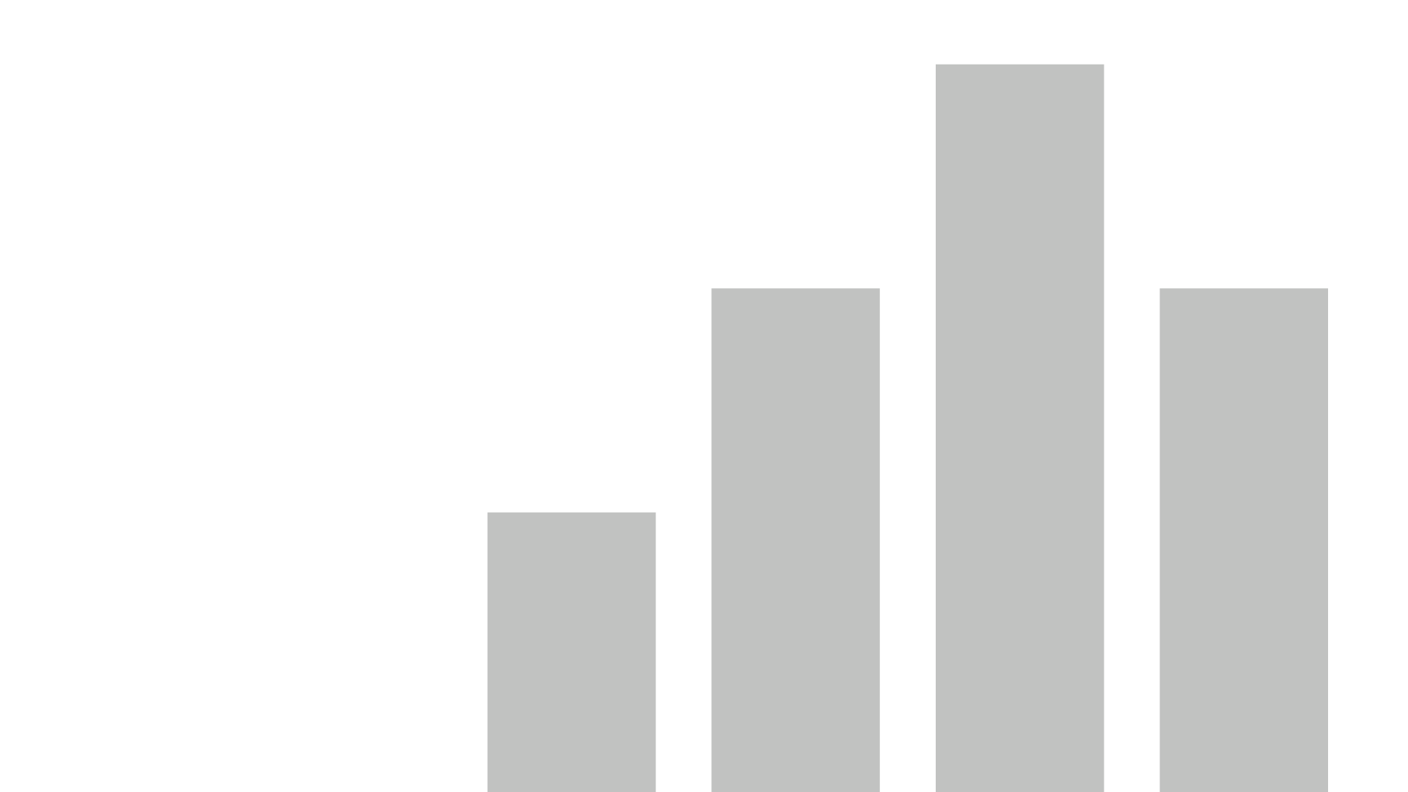

Dcube_Executive_Slide_deck
View in Power BI

Slide 2
Executive Summary
ABC Inc’s Strategy to Launch with products in GLP1 and SGLT Classes is a prudent one as both have a growth of about 46%. The combined Market is about 17 B$, There is a great potential to gain existing and emerging market share.
One other recommendation for ABC Inc is to consider the generic Drug Metformin for its future launch. It is a 6.5 Billion $ market with a growth rate of 60%, it is almost 83% of the Generic drug market with new prescriptions at 93 million and total at 239 Million.
Of course to do a more comprehensive analysis, CostToProduce data will also be useful, and other overhead data to ascertain the profitability of This venture.
From a revenue perspective, The launch has all good market indications.

Slide 3
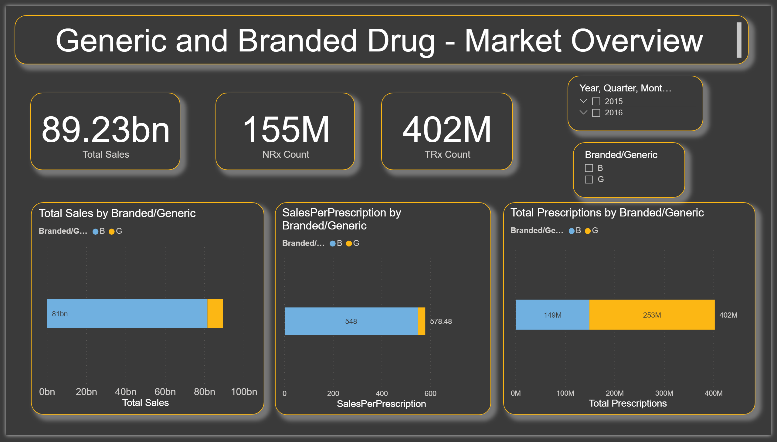
Market Overview
2-year Branded Drug Market – 81.5 Billion (90%), Generic Drug Market – 7.8 billion
YOY Change – Branded +14%, Generic Drug +45%
SGLT and GLP1 class is a 17-billion $ market, about 20% of the Branded drug market, both saw yoy change of about +46%, thus validating the company’s Strategy to enter this market.
Branded Sales per prescription is 547$ while Generic sales per prescription is 31$
Branded Num of prescriptions is 149 Million, while Generic Num of prescription is 253 Million

Slide 4
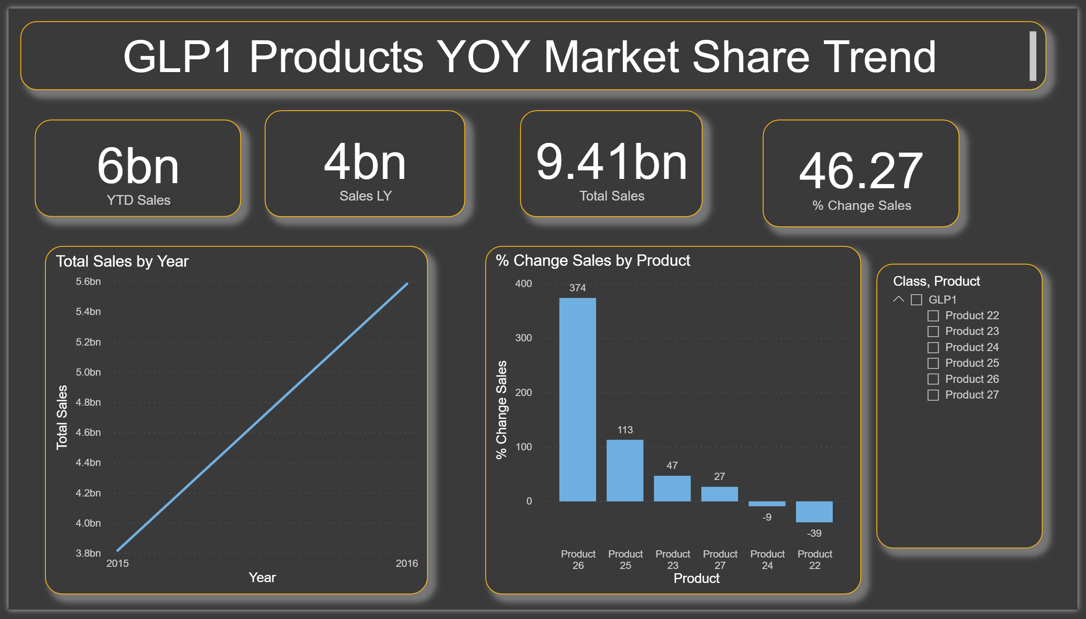
GLP Class Overview
GLP Class product has an overall Growth Rate of 46%, with sales of 9.5 B$ over two years.
Its top products are 26 at the highest Growth Rate of 374%, 25 at 113% 23 is at 47%, and 27 is at 27%
Product 22 has a decline of -39% and 24 is at -9%
Average Annual Cost of Therapy across this class is 740$

Slide 5
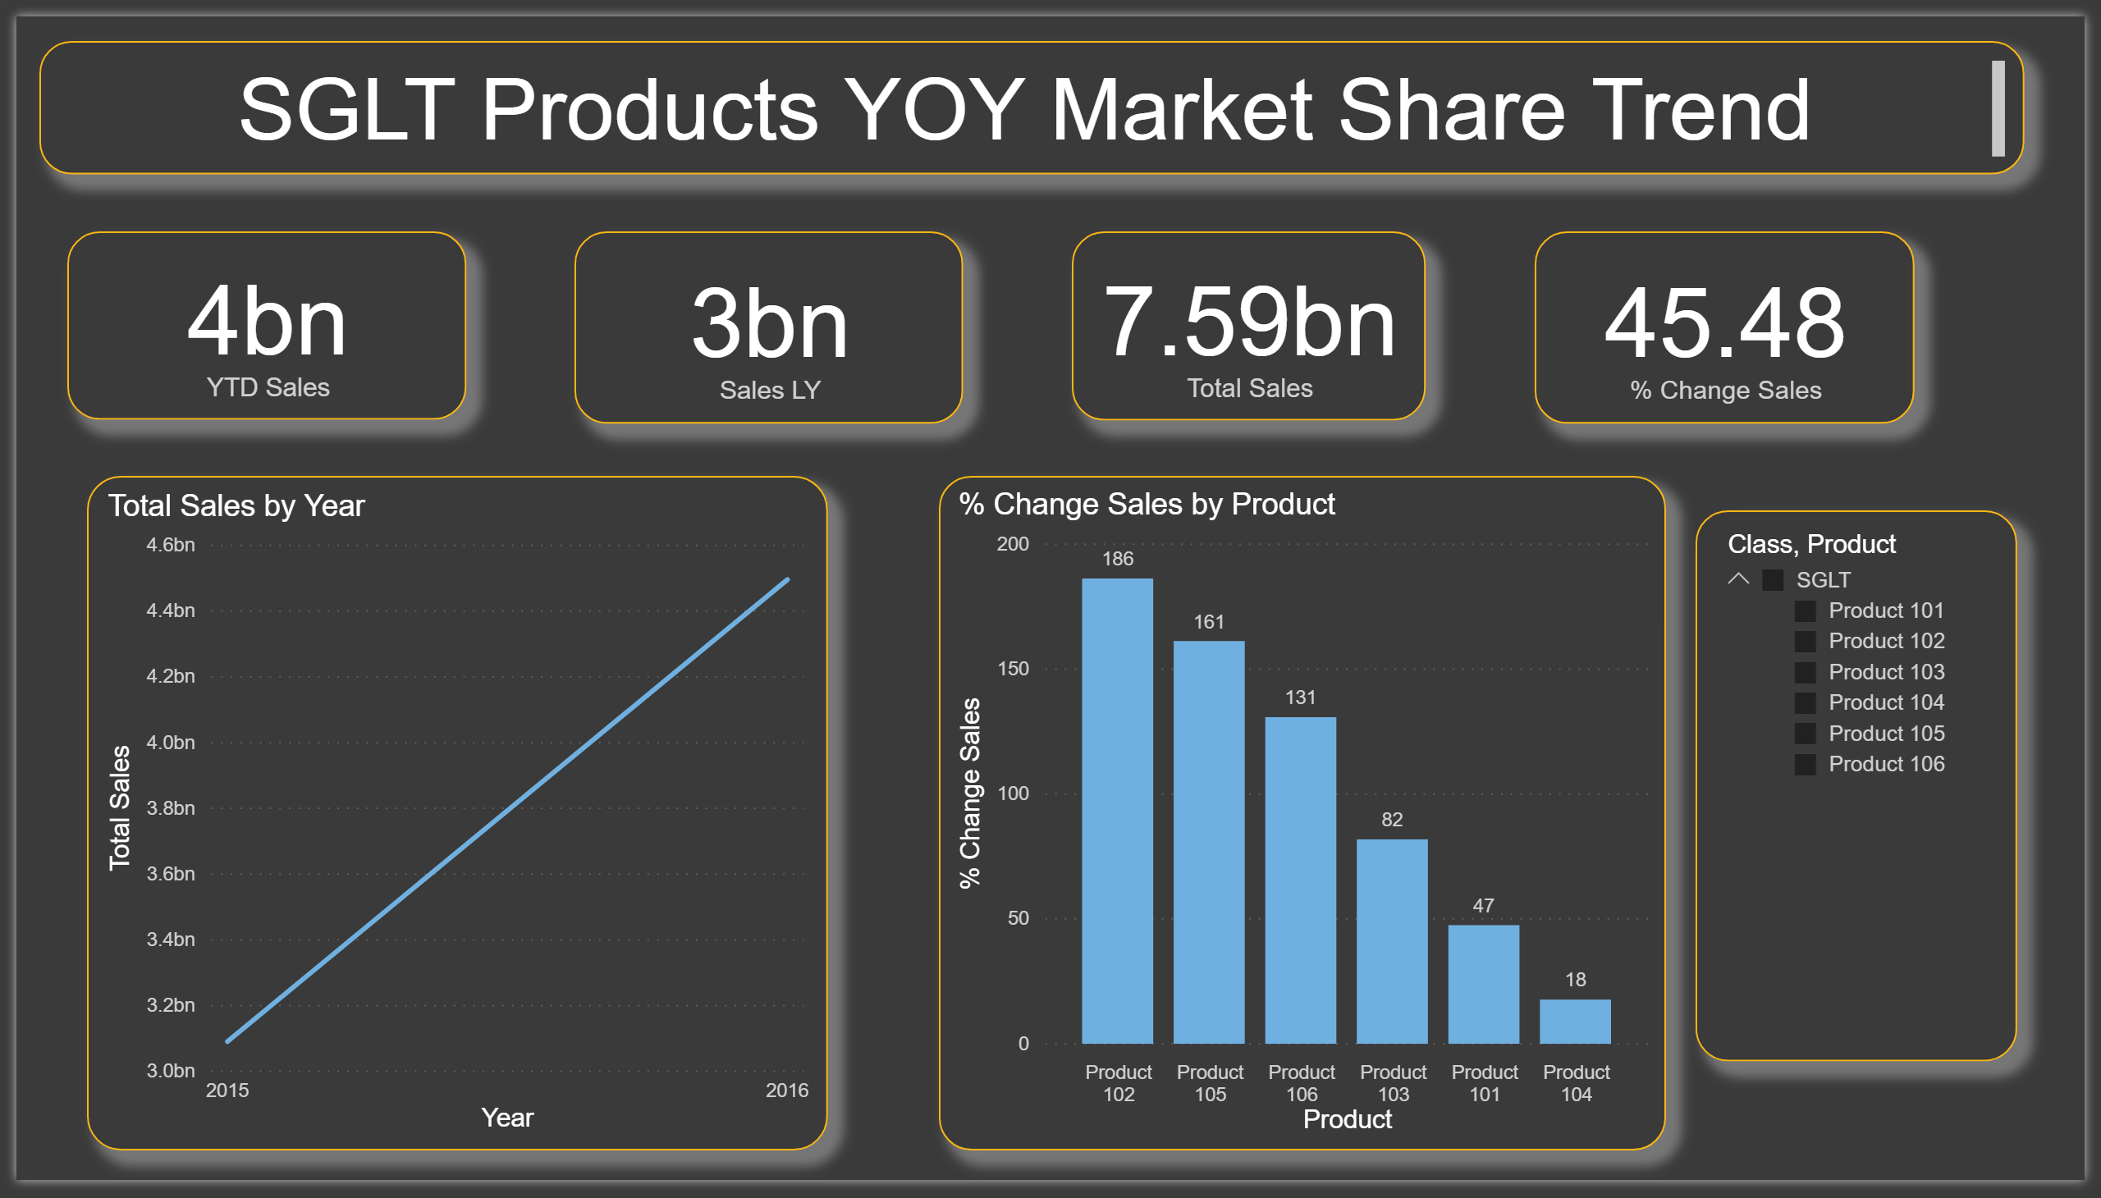
SGLT Class Overview
SGLT Class product has an overall Growth Rate of 45.5%, with sales of 7.6 B$ over two years.
Its top products are 102 at the highest Growth Rate of 186%, 105 at 161%, 106 is at 131%, and 103 is at 82%
Average Annual Cost of Therapy across this class is 466$

Slide 6
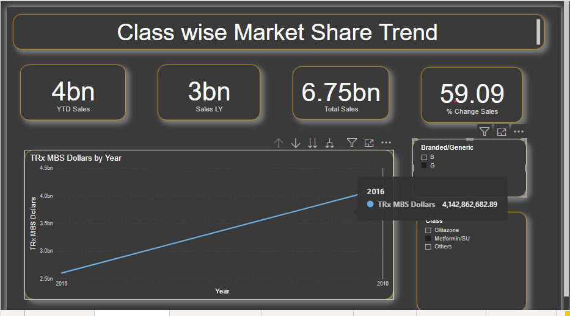
Metformin
Generic Metformin, YOY change 59%, 2-year sales 6.75 billion, 83% of Generic Drug Sales.
Branded Metformin sales fell by 45% from 922 million to almost 500 million in the same time period.
Metformin is at 239M total prescriptions and 93 million new prescriptions

