Slide 1
Capstone 2 Real Estate Price Predictor – Non Technical Presentation
Date: July 20, 2020
Presenter: Jagat Jonnalagedda

Slide 2
Design a Multi Variate Linear Regression Model (MLR) Real Estate House Price Predictor which will accurately predict house prices (within acceptable statistical standards) 80-90% accuracy. By designing an MLR, undervalued properties can be identified, and investment strategies can be developed to increase the ROI by at least 10%
!
Identify the key variables that are correlated with house price.
Through Statistical Analysis such as Box Plots, Scatter Plots, Histograms, Bar Plots and Correlation Matrix identify key variables correlated to the house price
!
Create a Linear Regression equation to identify a model for the house price prediction and the variables related to it.
This model can be used for the house price predictive analytics.
!
By designing an accurate Real Estate House Price Predictor, undervalued properties can be identified, and investment strategies can be developed to increase the ROI by at least 10%.
Potential ROI by investing in properties that the MLR identifies as being undervalued, i.e the predicted value is larger than its historical sale price
Notes:
Problem Summary

Slide 3
Identify the key variables correlated with the house price and fashion a linear regression equation to model the house price. This MLR then can be used to accurately predict house prices within acceptable industry and statistical standards (80%-90%)
Create a Multi Variate Linear Regression Model to predict the house price
Descriptive Statistics :
Boxplots, Scatter Plots, Histogram Plots, Bar Plots
Inferential Statistics : Correlation Matrix, Strongest Correlation Bar Plots, Linear Regression Equation

Slide 4
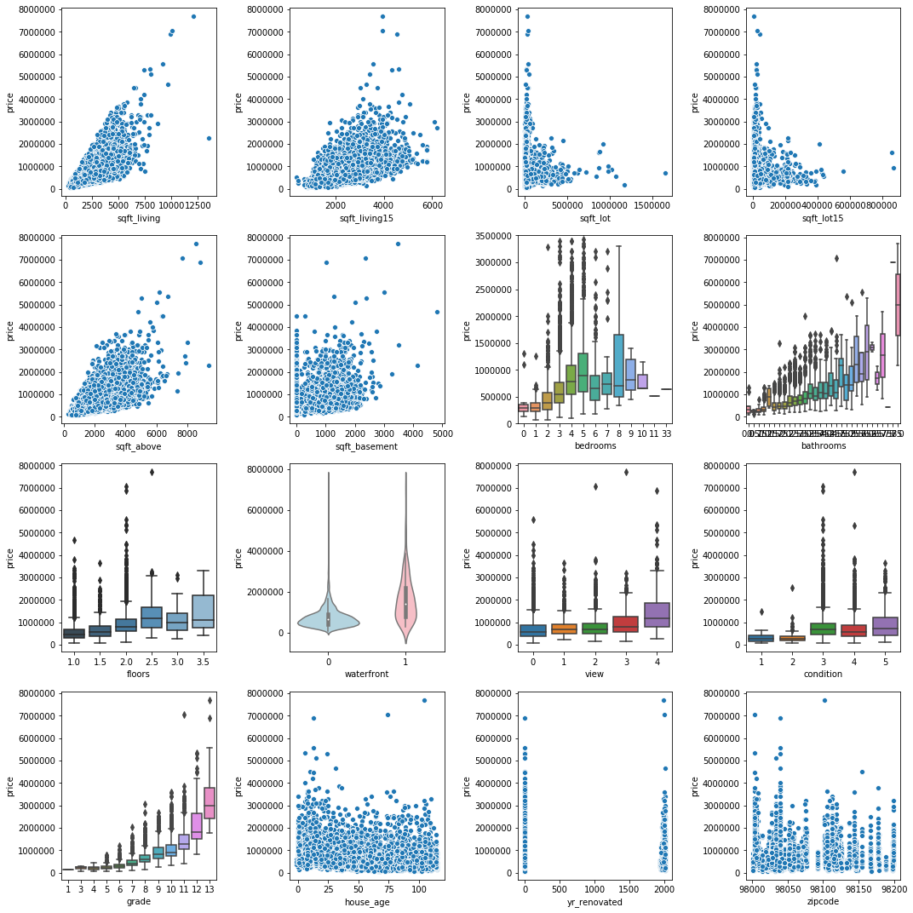
Using descriptive statistics on the entire data frame, we identiﬁed the key variables that correlated strongly with house price, paving the way for the development of a multivariate equation capable of accurately predicting the house price.
Key Insights:
From the Visual on the left, we can infer that sqft_living (1), sqft_living15 (2), sqft_above (5), bedrooms (7), bathrooms (8), view(11), condition (12) and grade (13) are correlated with price.
Source: Southern Water Corp Statistical Records
Notes:
Executive Summary

Slide 5
Further analysis of the full dataset using inferential statistics yielded these variables, the same ones found in Descriptive Statistics above thus corroborating our findings in descriptive statistical analysis.
Key Insight
Through Descriptive and Inferential Statistical analysis, a highly accurate predictive linear regression model can be arrived at for the full data frame.
This predictive model can accurately predict the house price.
Notes:
Supporting slide #2 - Inferential Statistics Analysis

Slide 6
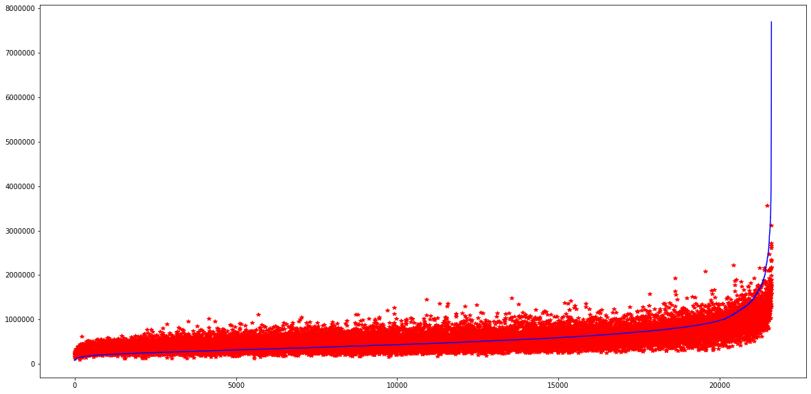
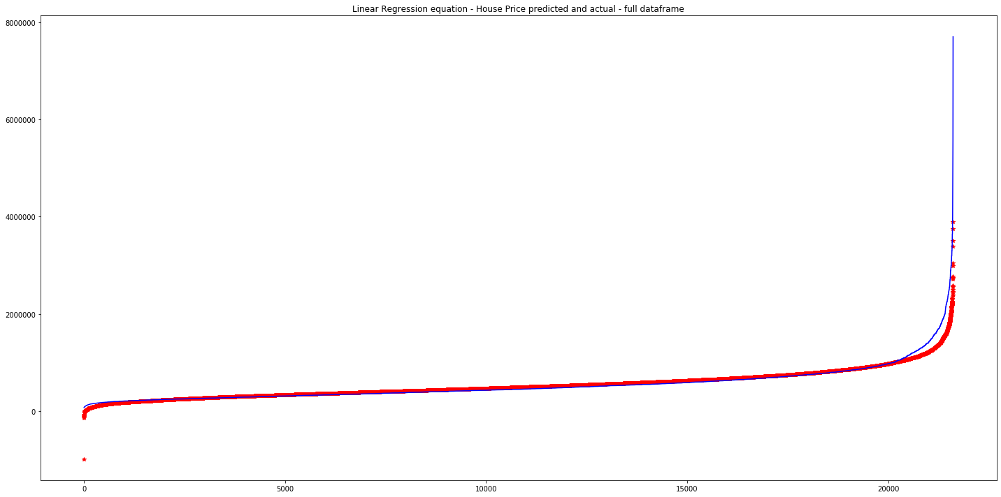

Using the OLS Regression Model create a regression equation that models the House Price (Y-Variable) against all our independent variables for the full dataframe
Key Insight
When we use all of the independent variables, the R2 value is .900, with a first level filter, the R2 value is .887 and with the strongest six only, the R2 is .854. So, I select the mid level filter which accounts for an optimum number of independent variables which are not strongly cross-correlated either.
Notes:
Supporting slide #2 - Inferential Statistics Analysis

Slide 7
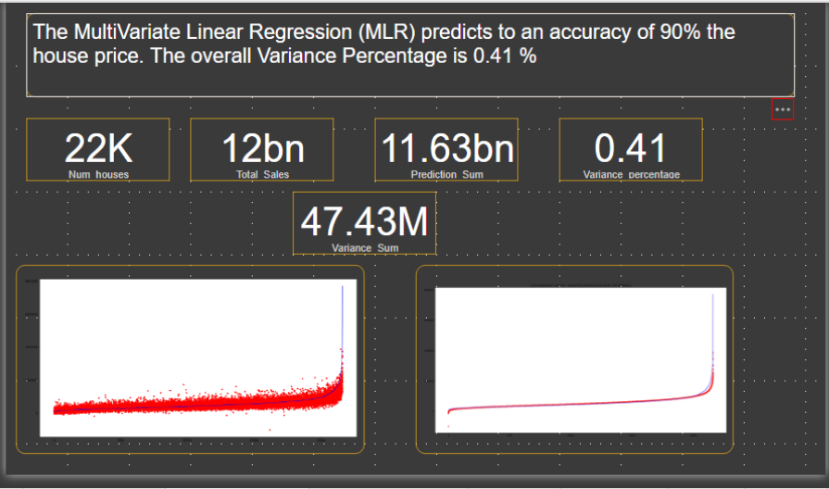
The MLR model predicts to an accuracy of 90% the house price. The overall Variance percentage of all the 22K properties in the King County data Set is about 0.41%
Real Estate House Price - actual and Real Estate House Price – actual and predicted
Trained Plot
Notes:
Supporting slide #2 - Inferential Statistics Analysis

Slide 8
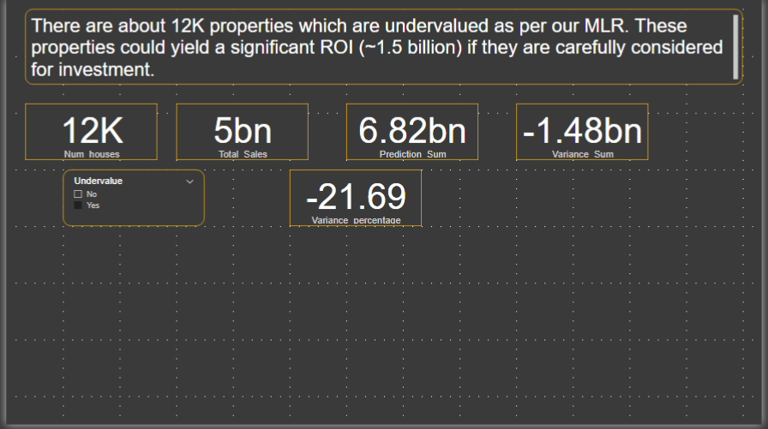
Using the MLR identify the undervalued properties. Devise strategies to invest in these undervalud properties.
Notes:
Supporting slide #2 - Inferential Statistics Analysis

Slide 9
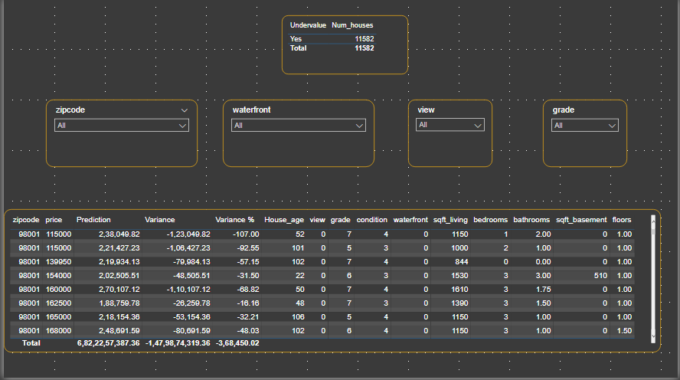
Four Investment Strategies – by Zip code, by Waterfront, by View and by Grade could be explored to identify the undervalued properties. The Power BI designed house finder can identify those properties.
Notes:
Supporting slide #2 - Inferential Statistics Analysis

