Slide 1

Introduction to Genetic Algorithms

Slide 2
Genetic Algorithms - History
Pioneered by John Holland in the 1970’s
Got popular in the late 1980’s
Based on Darwin’s evolution theory “survival of the fittest”. In nature, competition among individuals for meagre resources results in the fittest individuals dominating over the weaker ones.
Can be used to solve a variety of problems that are not easy to solve using other techniques.

Slide 3
The Basic Concept of GA
GAs are the ways of solving problems by mimicking the process nature uses, i.e. selection, crossover, and mutation.
GAs are adaptive heuristic search based on evolutionary ideas on natural selection and genetics.
In GAs, solving problems becomes looking for solutions which is best among others.

Slide 4
A General Genetic Algorithm
g = 0; // generation number
Initialize Population ₀;
while(terminal condition isn’t met) {
Evaluate fitness of each individual in Population _{g};
Create Population _{g+1}{
Based on fitness, select individuals for reproduction;
Perform crossover and mutation on the selected individuals.
}
g++;
}
Return the best solution in the current generation.

Slide 5
Implementation Details
How to represent an individual, i.e. solution.
Determine the size of the population (a collection of individuals).
How to initialize the population.
How to evaluate fitness.
How to select individuals for reproduction.
How to perform crossover.
How to perform mutation.
Determine the crossover rate and mutation rate.
Decide when to terminate.

Slide 6
Encoding of a Chromosome (Representation of a solution)
1. Binary encoding (1011 ... 0100)
2. Value encoding (19.3, 45.1, -12.9, ... 6.2)
3. Permutation encoding (1,4,2,7,5,9,3,6,8)

Slide 7
Cross Over
Crossover selects genes from parent chromosomes and creates a new offspring.
Two-point crossover
10101011  10011011
11011001 11101001
One point crossover
10101011  10011001
11011001 11101011

Slide 8
Cross Over conti.
Order Crossover
parents children
P₁:[2 1 3 9 5 4 8 7 6]  C₁:[6 8 7 9 5 4 1 3 2]
P₂:[5 3 2 6 8 9 7 1 4] C₂:[5 4 7 6 8 9 2 1 3]
P₂:[5 3 2 6 8 9 7 1 4]  [3 2 6 8 7 1]  [1 3 2 6 8 7 ]
Remove 9, 5, 4 from P₂
Rotate.
Insert “954” to the resulting list.

Slide 9
Mutation
Mutation is to prevent solutions in the population from falling into a local optimum of the solved problem.
Mutation changes the new offspring randomly. For the binary encoding, with a mutation probability, we randomly flip bits.
00110101  00011101
For permutation encoding
Randomly interchange a pair of numbers.
Randomly reverse a segment of the permutation.

Slide 10
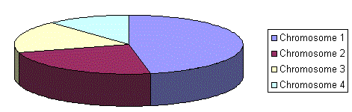
Selection
Roulette Wheel Selection
Parents are selected according to their fitness. The better the chromosomes are, the more chances to be selected they have. Imagine a roulette wheel where are placed all chromosomes in the population accordingly to their fitness functions, like on the following picture.
Then a marble is thrown there and selects the chromosome. Chromosomes with bigger fitnesses will be selected more times.

Slide 11
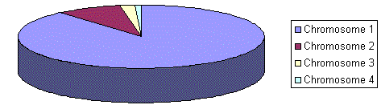
Selection conti.
Rank Selection
When the fitnesses differ very much, e.g. if the best chromosome fitness is 90% of all the roulette wheel then the other chromosomes will have very few chances to be selected.
Rank selection first ranks the population and then every chromosome receives fitness from this ranking.
The worst will have fitness 1, second worst 2 etc. and the best will have fitness N (number of chromosomes in population).

Slide 12
Selection conti.
Elitism
When creating a new population by crossover and mutation, we have a big chance, that we will loose the best chromosome.
Elitism is name of method, which first copies the best chromosome (or a few best chromosomes) to new population. The rest is done in classical way.
Elitism can very rapidly increase performance of GA, because it prevents losing the best found solution.

Slide 13
An Illustrative Example
To find the value of x, 0 ≤ x ≤ 255, that maximize
f(x) = sin(x* π/256).
Represent solutions to the problem
Binary encoding.
Since a solution is a number between 0 and 255, we can represent each individual using 8 bits. For example, 189 is represented as 10111101.

Slide 14
Determine the size of a population
In general, it could be thousands. In this simple example we use 8.
How to evaluate fitness
Since our goal is to maximize f(x), we use f(x) as the fitness of individual x.
Numbers with bigger f values are more fit.

Slide 15
Select individual for reproduction
Roulette Wheel Selection.
Since it’s a probabilistic selection, best is not always pick and the worst is not necessarily excluded.
In our example, we use cumulative normed f(x) to determine individuals’ probabilities.
Individual | X | f(x) | Normed f(x) | Cumulative normed f(x)
10111101 | 189 | .733 | .144 | .144
11011000 | 216 | .471 | .093 | .237
01100011 | 99 | .937 | .184 | .421
11101100 | 236 | .243 | .048 | .469
10101110 | 174 | .845 | .166 | .635
01001010 | 74 | .788 | .155 | .790
00100011 | 35 | .416 | .082 | .872
00110101 | 53 | .650 | .128 | 1.00

Slide 16
How to do crossover
With a crossover possibility, crossover the parents to form new offspring. If no crossover was performed, offspring is the exact copy of parents.
Two-point crossover
10101011  10011011
11011001 11101001
One point crossover
10101011  10011001
11011001 11101011

Slide 17
How to do mutation
With a mutation probability, randomly flip every bit.
00110101  00011101

Slide 18
Another Example: TSP
Given a finite number of "cities" along with the cost of travel between each pair of them, find the cheapest way of visiting every city once and only once and returning to the starting city.
Represent solutions to the problem
A solution is a tour, i.e. a sequence of cities. So, we represent a solution as a permutation of cities.
[c₁, c₂, c₃, .... c_{n}]

Slide 19
Select individual for reproduction
How to evaluate fitness
The fitness is the cost of the tour.
Tours with smaller costs are more fit.
Roulette Wheel Selection.
As before, better the fitness, bigger the chance to be selected.

Slide 20
How to do crossover
Order Crossover
parents children
P₁:[2 1 3 9 5 4 8 7 6]  C₁:[6 8 7 9 5 4 1 3 2]
P₂:[5 3 2 6 8 9 7 1 4] C₂:[5 4 7 6 8 9 2 1 3]
P₂:[5 3 2 6 8 9 7 1 4]  [3 2 6 8 7 1]  [1 3 2 6 8 7 ]

Slide 21
How to do mutation
Randomly interchange a pair of vertices.
Randomly reverse a segment of the tour.

Slide 22
Another Example: 0/1 Knapsack
Binary encoding.
Fitness function: Summing the weights and values if the gene is turned on for the current item. If the weight totals more than the knapsack capacity then the value is set at zero, otherwise it is the value of the sum of the values of the items in the knapsack.
Selection: Roulette wheel + Elitism.
Crossover: two-point or single-point crossover.
Mutation: Randomly flip every bit.

Slide 23
Genetic Programming
When the chromosome encodes an entire program or function itself this is called genetic programming (GP)
In order to make this work encoding is often done in the form of a tree representation
Crossover entails swapping subtrees between parents

Slide 24
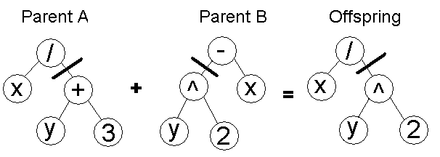
Genetic Programming
It is possible to evolve whole programs like this but only small ones. Large programs with complex functions present big problems

Slide 25
Programming project (Part of your final)
Implement the 0/1 Knapsack genetic algorithm discussed in this lecture, with the following parameters:
Population size : input.
Mutation rate: 0.05
Crossover rate: 0.95
Terminal condition: an input number of generations.

Slide 26
Programming project conti.
Notes:
Your program should be able to handle Knapsack problems with 64 items, i.e. each individual should be represent by a 64-bit integer.
Use comments to indicate where in your program you do
Create initial population.
Select individuals for reproduction.
Crossover.
Mutation.
You need to turn in hardcopies of your source code and sample outputs.
You need to email a softcopy of your source code to the instructor.

