Slide 1
Numerical algorithms
Algorithms for solving numerical problems in mathematics, engineering, and science, e.g.
1. Roots of equations.
2. Evaluation of polynomials.
3. Evaluation of mathematical functions.
4. Numerical integrations.
etc.

Slide 2
Major issues
1. Speed
2. Accuracy: absolute & relative errors.
3. Source of errors: rounding and
truncation.
How to make a numerical program faster and more accurate?
Reduce the number of operations.

Slide 3
Not all real numbers can be represented exactly on a digital computer.
for (x=0.0; x!=1.0; x+=0.1) {
…
}

Slide 4
Roots of equations
Newton's method.
Interpolation.
Other iterative procedures, e.g. interval halving.

Slide 5
Newton's method
The first-order Taylor expansion of the equation f(x)=0 is
f(x₀)+(x-x₀)f’(x₀) = 0
An estimate of the root, x₁, can be found from values of the function and its derivative:
x₁= x₀ – f(x₀)/f’(x₀)
The formula can then be used iteratively to obtain improving estimates of the root:
x_{n+1} = x_{n}– f(x_{n})/f’(x_{n})

Slide 6
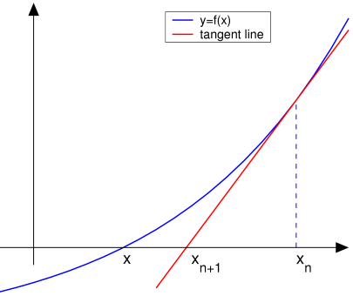
Newton's method conti
X_{n+2}
x_{n+1} = x_{n}– f(x_{n})/f’(x_{n})

Slide 7
Evaluation of polynomials
To evaluate p(x) = 3x⁷+10x⁶+32x⁵+21x⁴+8x³+12x²+6x+5
Brute force method
p(x) = 3*x*x*x*x*x*x*x + 10*x*x*x*x*x*x + 32*x*x*x*x*x
+ 21*x*x*x*x + 8*x*x*x + 12*x*x + 6*x + 5
Horner’s method
p(x) = ((((((3*x+10)*x+32)*x+21)*x+8)*x+12)*x+6)*x+5

Slide 8
Evaluation of mathematical functions
Use power series expansion (slow)
sin x = x - x³/3! + x⁵/5! - x⁷/7! + ...
2. Polynomial approximation

Slide 9
Numerical integrations
Mid-point rule
Trapezoidal rule
Simpson rule
Monte Carlo method
Etc.

Slide 10

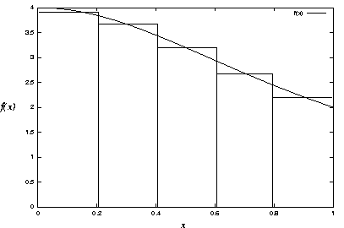
Mid-point rule
The simplest numerical integration method.
Approximates the area under the curve by the sum areas of rectangles centered at the midpoint of intervals.

Slide 11

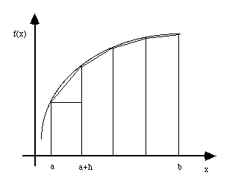
Trapezoidal rule
Approximates the area under the curve by the sum of areas of trapezoids.

Slide 12
Simpson rule
Approximates the area under the curve by the sum of areas under quadratic interpolations of intervals.
Simpson rule is popular because of high accuracy compared to the trapezoidal rule.

Slide 13
Monte Carlo Method
In order to compute the area of a complicated domain D, Monte Carlo method picks random points over some simple domain D’ which is a superset of D, checks whether each point is within D, and estimates the area of D as the area of D’ multiplied by the fraction of points falling within D.

Slide 14
Programming project (Part of your final)
Use the power series expansion method to implement sqrt(x).
Use the four numerical integration method to compute
∫
1
4
π =
dx
1+x²
0

Slide 15
Programming project conti.
Notes:
You can only use float variables to compute pi.
Use the Trapezoidal method to find the maximum number of intervals and then apply that number of intervals on the mid-point and Simpson’s methods.
Your sqrt function should work for any input number.
Demo your sqrt function with some very good and some not very good input numbers.
Your programs should produce outputs similar to the instructor’s sample programs.
The accuracies of your programs should be close to the instructor’s sample programs.
Email the instructor softcopies of your programs.
Turn in hardcopies of your source code and sample outputs.

