Slide 1
RESEARCH AGENT
CAPSTONE PROJECT
Presented By:
1. JEELUGU JAGADEESH – Raghu Institute of Technology – CSE (AI & ML)

Slide 2
OUTLINE
Problem Statement
Proposed System/Solution
System Development Approach
Algorithm & Deployment
Result
Conclusion
Future Scope
References

Slide 3
Problem Statement
A Research Agent is an AI system designed to assist with academic and scientific research tasks. It autonomously searches for literature, summarizes papers, and organizes references. Using natural language processing, it understands research questions, retrieves relevant information, and can generate reports, suggest hypotheses, and draft research paper sections. It saves time by automating repetitive tasks like citation management and data extraction, enhancing efficiency, accuracy, and innovation in research.

Slide 4
Proposed Solution
We propose a Research Agent, an AI system that:
Understands natural language queries.
Searches for academic papers and news articles.
Summarizes and organizes research findings.
Generates hypotheses and drafts report content.
Automates citation management and data extraction.
Key Tools:
IBM Watsonx
LangGraph + ReAct
Web Search APIs (Google, DuckDuckGo, Wikipedia, Webcrawler)

Slide 5
System Approach
System Requirements:
IBM Cloud Lite
IBM Watsonx Studio
LangGraph Framework
ReAct Architecture
Tools: Google, DuckDuckGo, Wikipedia, Webcrawler
Libraries Used:
Python (Requests, BeautifulSoup)
OpenAI LangGraph SDK
JSON/XML APIs for Web Crawling

Slide 6
Algorithm & Deployment
Architecture: ReAct (Reasoning + Action)
Combines reasoning and tool usage.
Modular execution via LangGraph workflows.
Flow:
Accepts natural language queries.
Uses web search tools to fetch info.
Summarizes or lists findings.
Generates citations and formats.
Deployment Details:
IBM Watsonx Cloud
Model: llama-3-3-70b-instruct
Runtime: Python 3.11
Deployed Agent: watsonx Agent

Slide 7
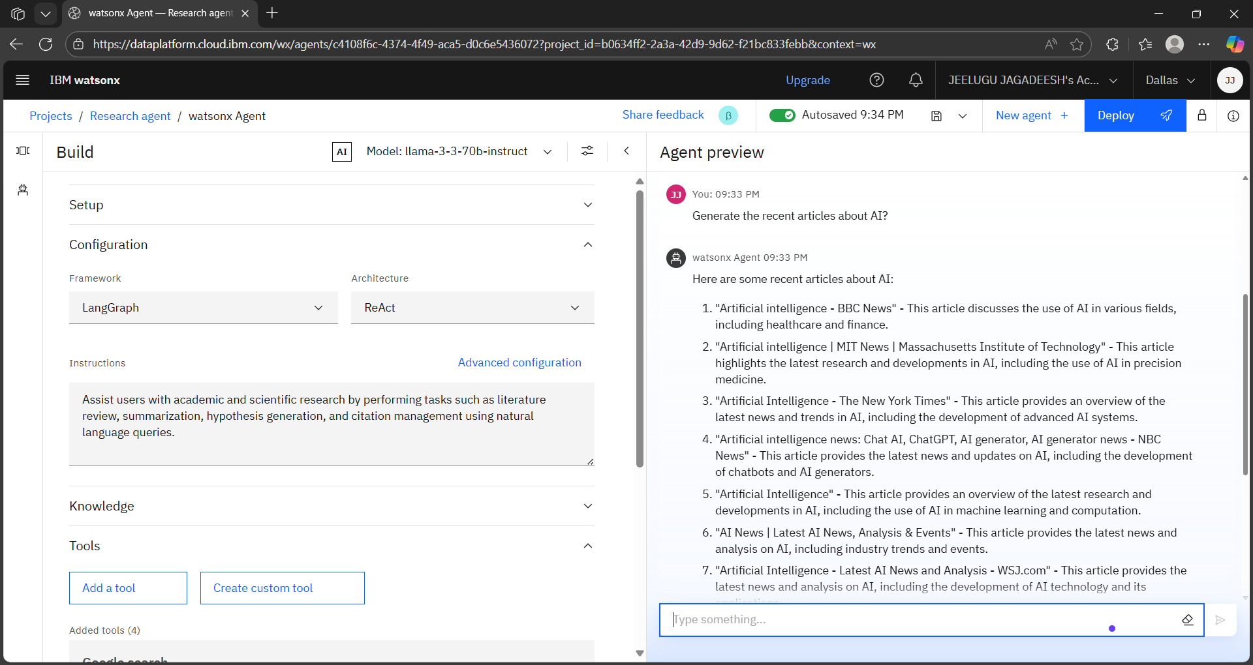
RESULT 1.1

Slide 8
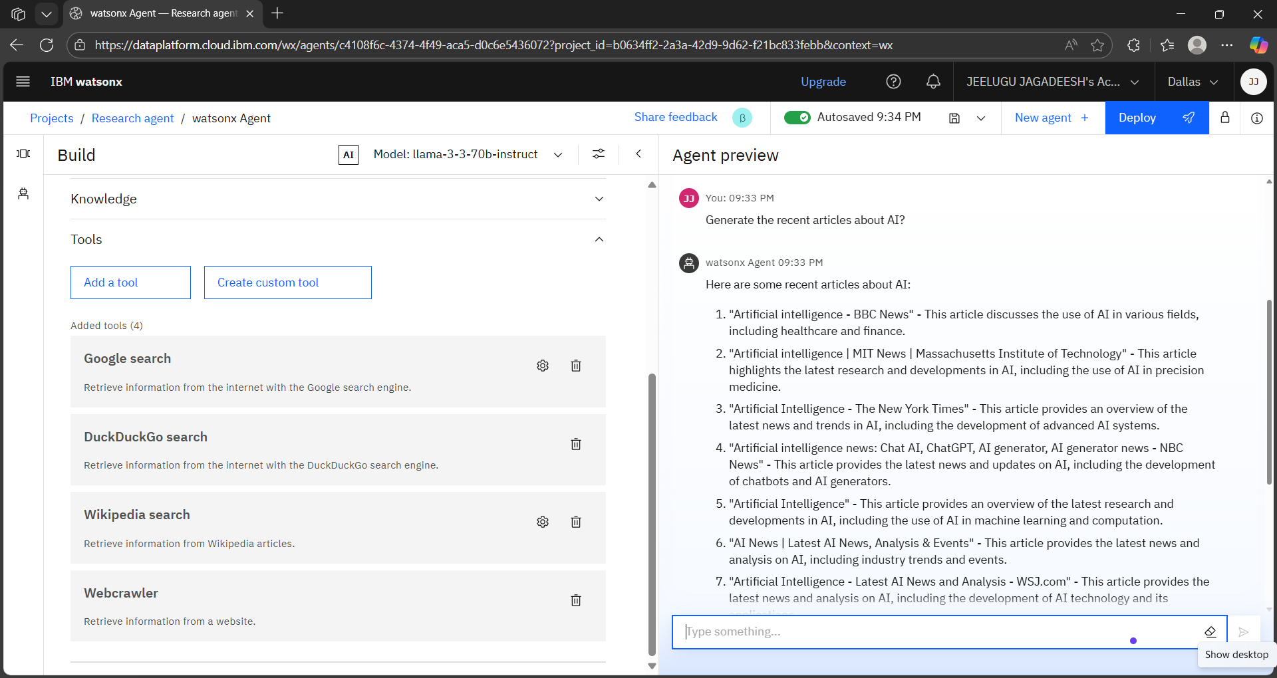
RESULT 1.2

Slide 9
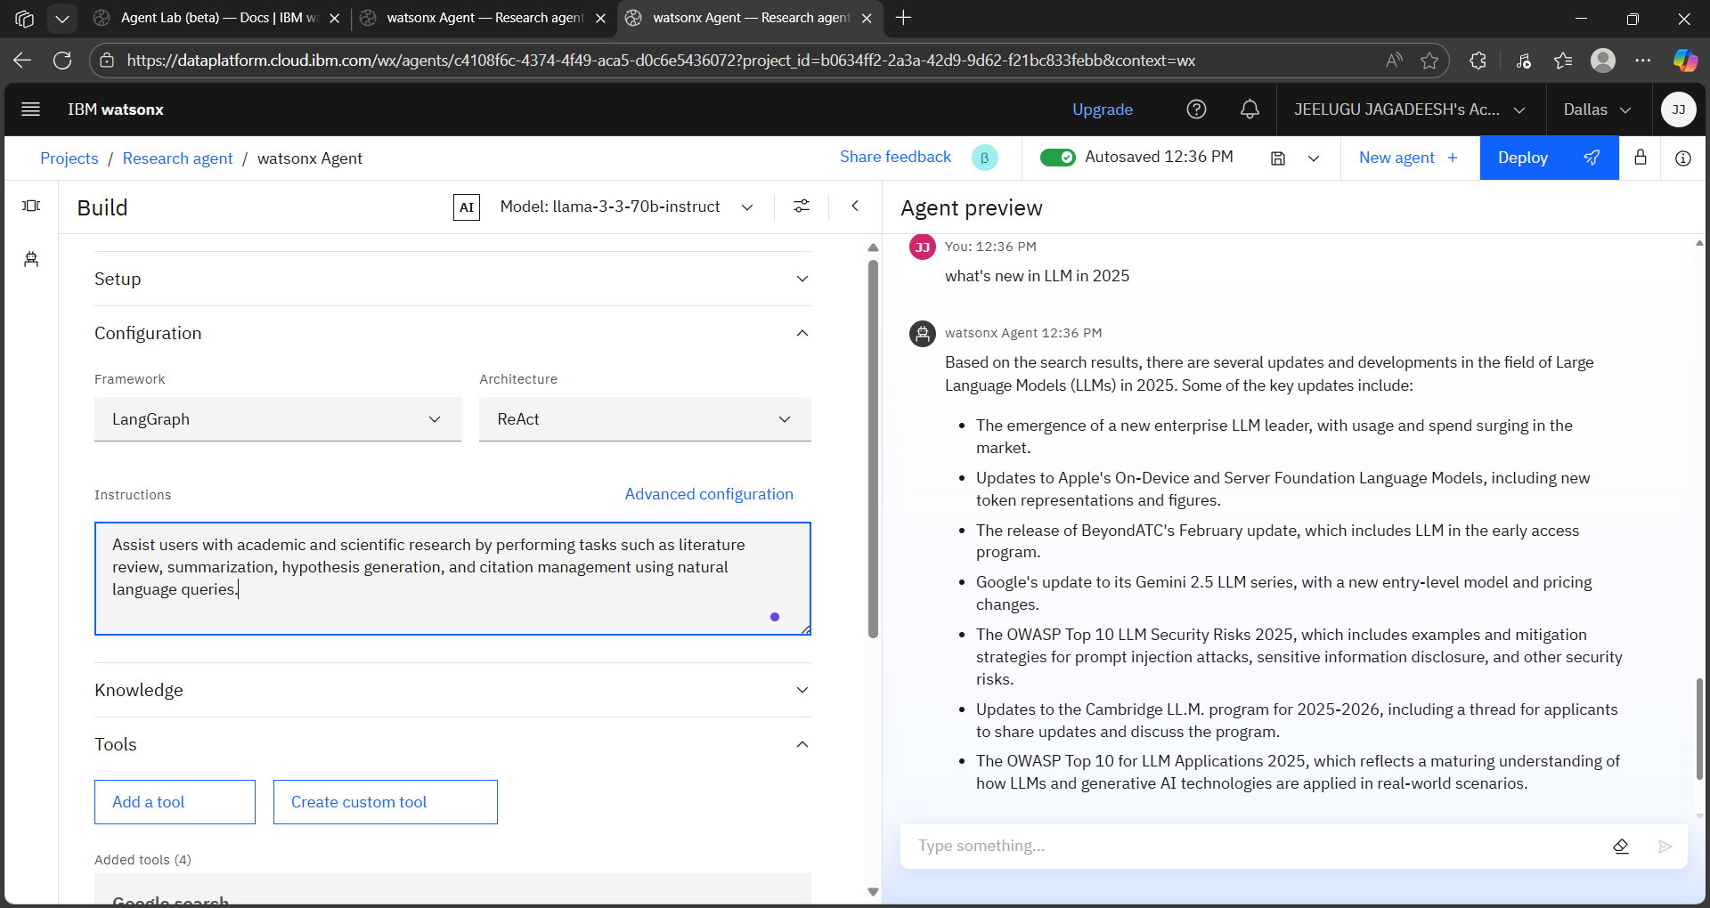
Result 1.3

Slide 10
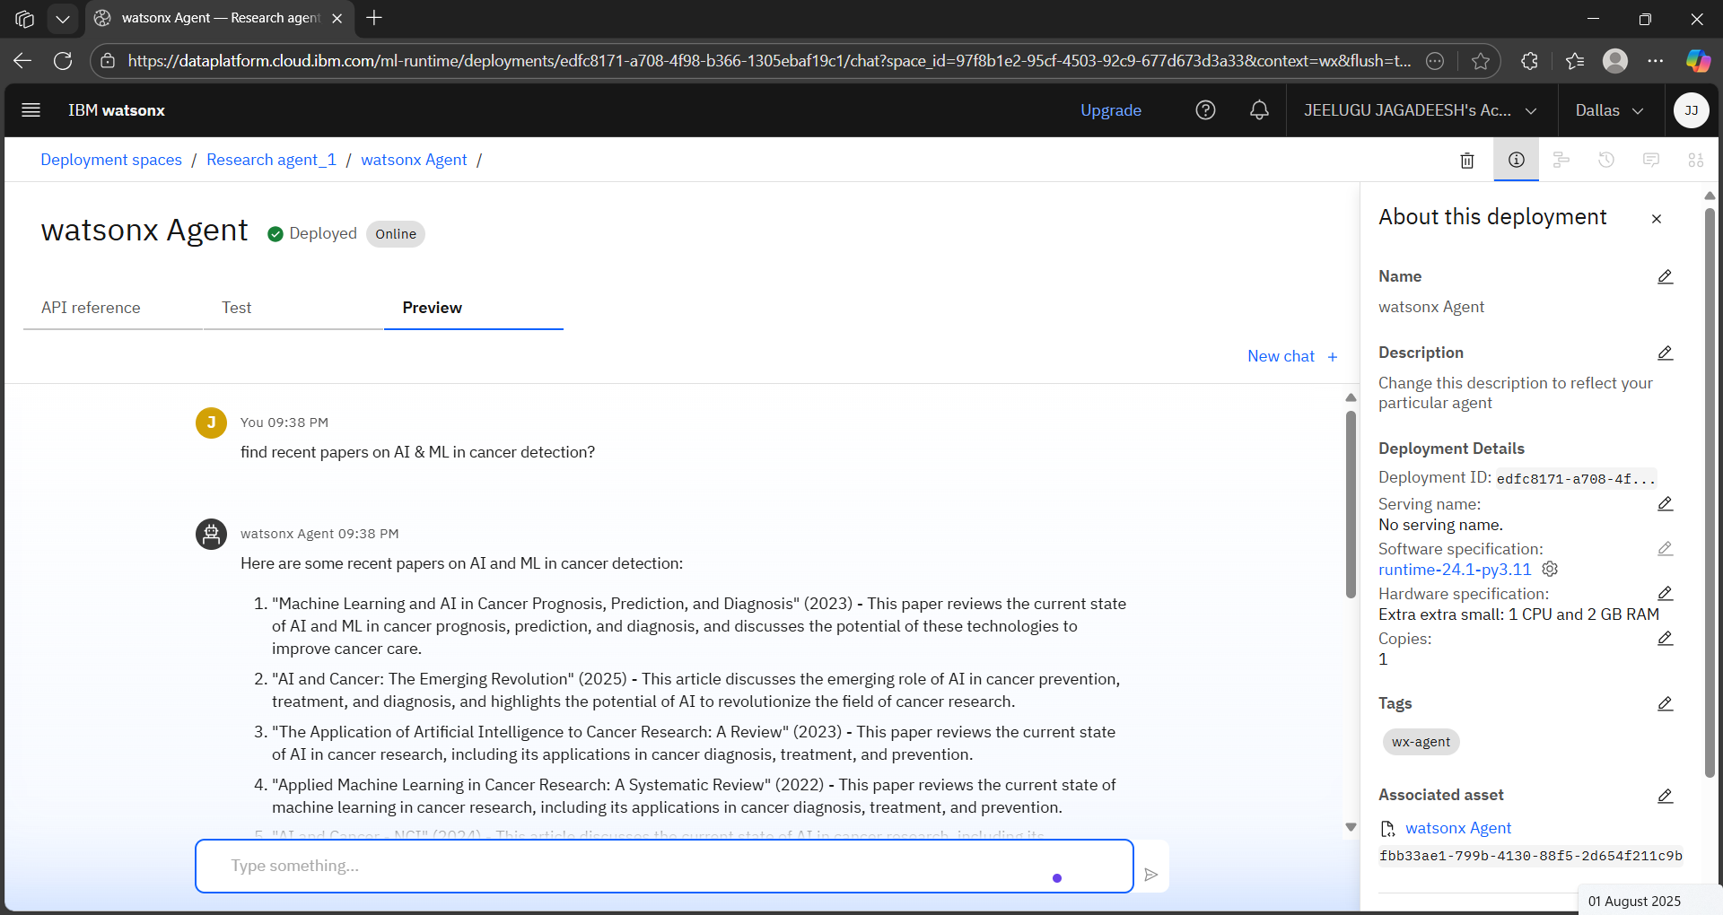
RESULT 1.4

Slide 11
Conclusion
The Research Agent demonstrates the capability to assist with academic queries using natural language. It efficiently retrieves and processes research content, generating human-like responses with references. The system greatly reduces time and effort for students, educators, and researchers.

Slide 12
Future scope
Integrate with academic databases like IEEE Xplore, Springer, and PubMed.
Add PDF parsing and annotation capabilities.
Voice interaction using IBM Watson Speech-to-Text.
Enable offline knowledge storage (local knowledge base).
Connect with LaTeX/BibTeX tools for paper drafting.

Slide 13
References
IBM Watsonx Documentation
LangGraph and ReAct Architecture Papers
Research articles on AI in Cancer Detection
News sources: BBC, MIT, NYT, WSJ, NBC
Tools: Google Search API, DuckDuckGo API, Wikipedia API

Slide 14
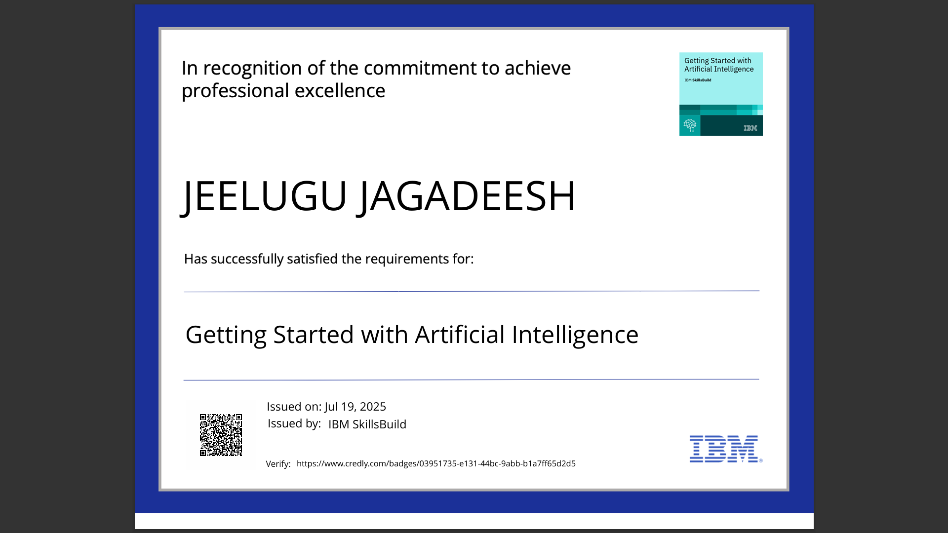
IBM Certifications

Slide 15
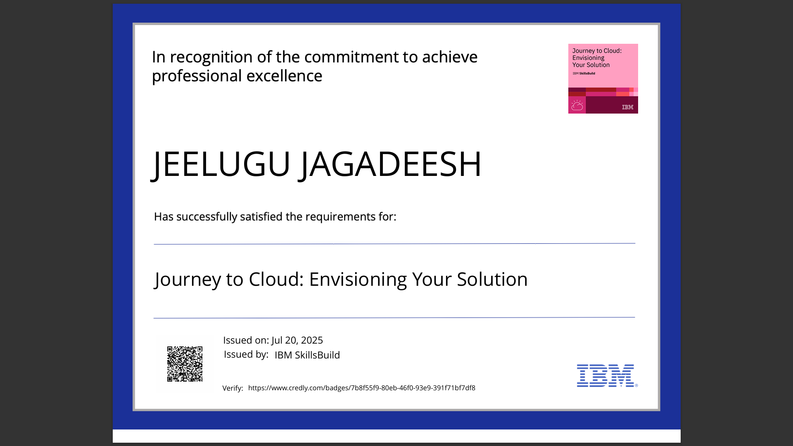
IBM Certifications

Slide 16
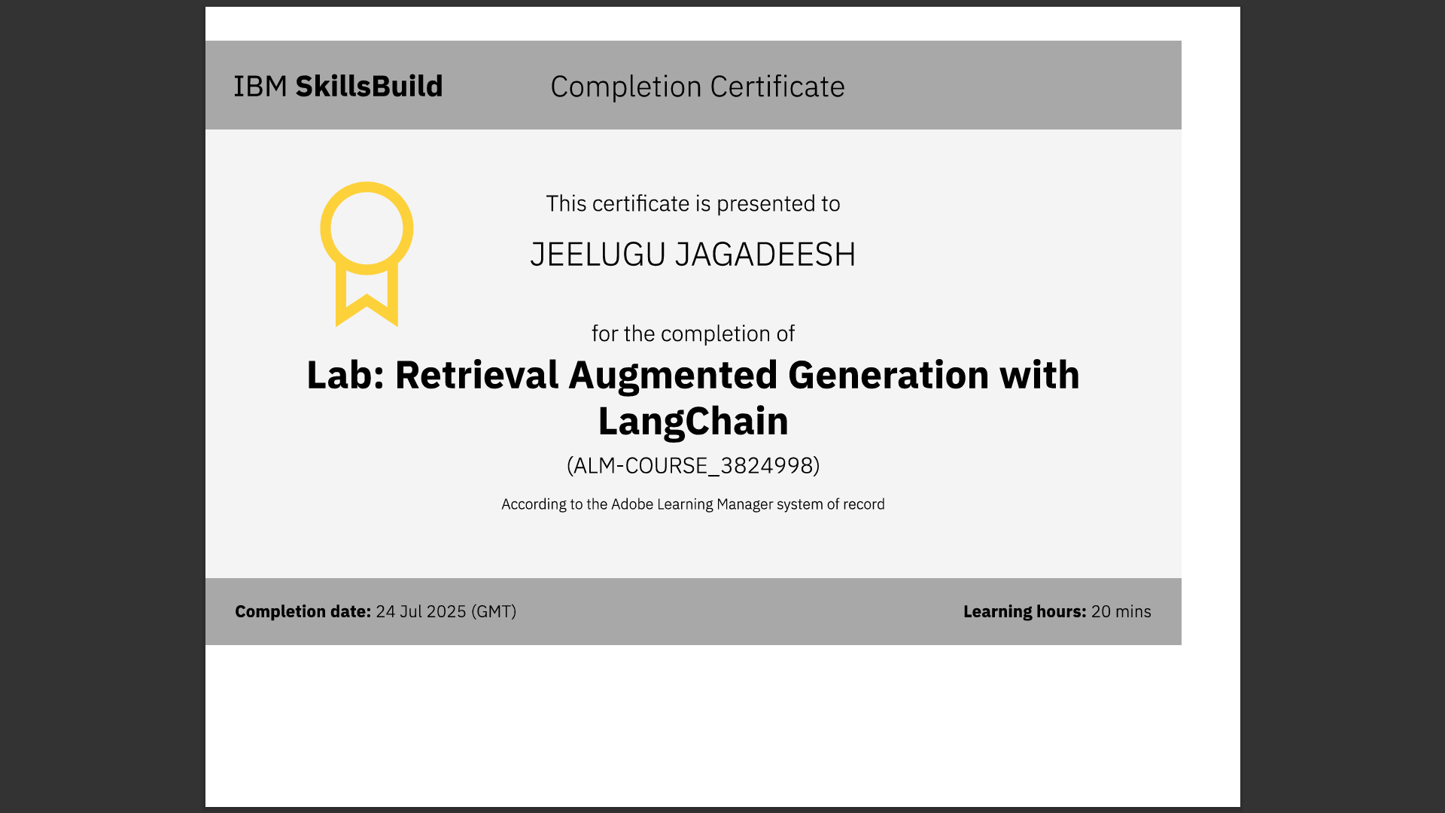
IBM Certifications

Slide 17
THANK YOU

