Slide 1

RICE LEAF DISEASE DETECTION USING DEEP LEARNING
Under The Supervision of
MR. Md. SHAKEEL AHMED
Associate Professor
Presented By
BATTULA JAGADEESH -20BQ1A1217
GADIYAM UDAY SANKAR REDDY-20BQ1A1255
ALLURI UMESH CHANDRA -20BQ1A1205
GUNTI SATISH -20BQ1A1261
CHATLA PRAKASH -20BQ1A1234
Department of Information Technology
Vasireddy Venkatadri Institute of Technology
Pedakakani Mandal, Nambur, Guntur-522508

Slide 2
Contents
Abstract
Introduction
Existing System with references
Proposed System with advantages
Software Requirements
Hardware Requirements
Functional Requirements
Non Functional Requirements
System Architecture
System Design
Output Screens
System Testing
Conclusion
Future Scope

Slide 3
Abstract
Rice, one of the world's most crucial staple crops, faces significant threats from various diseases affecting leaf health and yield. In response to this agricultural challenge, our project aims to develop an efficient rice leaf disease detection system using deep learning models.
The project utilizes a dataset comprising images of rice leaves afflicted with four prevalent diseases: bacterial blight, blast, tungro, and brown spot. We employ a range of deep learning architectures including Simple CNN, ResNet, Inception, and LeNet to train models capable of accurately classifying these diseases. Through rigorous experimentation and evaluation, we identify the model achieving the highest accuracy on the validation dataset.
Leveraging the Streamlit library, we deploy the selected model to create a user-friendly frontend interface. This interface allows users to upload images of rice leaves, enabling real-time prediction and identification of the specific disease present. By combining advanced deep learning techniques with accessible user interaction, our project offers a practical solution for farmers and agricultural experts to swiftly diagnose and address rice leaf diseases, ultimately contributing to enhanced crop management and increased agricultural productivity.

Slide 4
INTRODUCTION
Rice leaf diseases are a big problem, causing major losses in crops worldwide.
Current methods for spotting these diseases are slow and rely on human judgment, calling for a quicker and more reliable solution.
The current approach, using textual datasets and SVM/KNN algorithms, faces difficulties with image complexity, potentially leading to suboptimal classification.
Recent technological advances enable automated disease detection using image processing techniques.
Our project is centered on enhancing the accuracy and efficiency of rice leaf disease prediction through the integration of deep learning techniques like Convolutional Neural Network(CNN).

Slide 5
The project directly addresses the pressing issue of rice leaf diseases, offering a practical tool for farmers to enhance disease management and minimize crop losses.
our system aims to provide farmers with a user-friendly tool for predicting and managing rice leaf diseases conveniently.
The integration of CNN models not only addresses rice leaf diseases but also showcases the potential of deep learning in solving complex challenges in agriculture.

Slide 6
Purpose & Objectives
Early and Accurate Disease Detection: The project aims to achieve early and accurate detection of rice leaf diseases by integrating Convolutional Neural Networks (CNN) into the predictive model, enhancing the efficiency of disease prediction in agriculture.
Efficient Disease Detection: We want to make disease detection quicker and more efficient by moving away from time-consuming methods that rely on visual inspection.
Improved Precision with Deep Learning: The project focuses on making disease prediction more precise by using advanced deep learning techniques. We plan to shift from traditional methods to using image datasets and advanced CNN models for better disease identification.

Slide 7
Effective Disease Management: Our project aims to contribute to better strategies for managing rice diseases. We want to develop a predictive model that captures detailed visual information, helping the system provide precise and reliable disease classification for farmers.
Empowering System Use: Our goal is to empower the system to use visual information effectively for disease prediction. We plan to demonstrate a significant improvement by integrating CNN models, contributing to precision agriculture efforts and highlighting the potential of deep learning in agriculture.

Slide 8
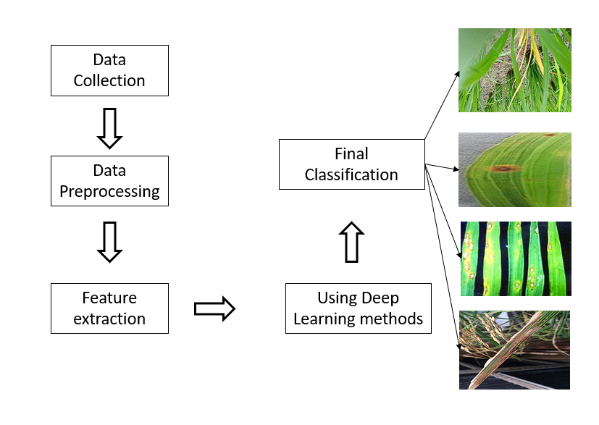
EXISTING SYSTEM

Slide 9
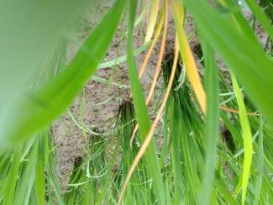
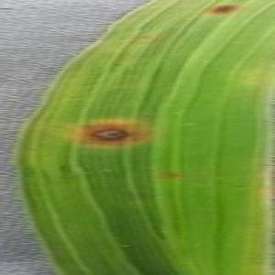
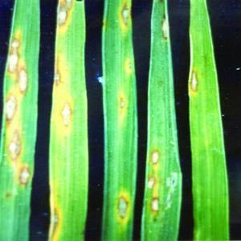
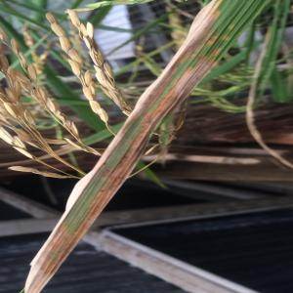
PROPOSED SYSTEM
Data Collection
Model building
Simple cnn
Lenet
Resnet
Inception
Data Preprocessing
Final Dataset
Final Classification
Using Deep Learning methods
Training dataset
Testing Dataset
Validation dataset
Feature extraction

Slide 10
Functional Requirements
Data Ingestion:
The system should be able to ingest and preprocess image datasets containing examples of rice leaves affected by bacterial blight, blast, tungro, and brown spot.
Preprocessing:
Implement a preprocessing pipeline to clean, normalize, and augment the input images for effective model training.
Deep Learning Algorithm:
Identification and selection of relevant features, potentially including domain-specific knowledge to enhance the model's ability to discriminate between different diseases.
Model Training:
Provide functionality to train the deep learning model on the preprocessed dataset.
Model Evaluation:
Implement evaluation metrics such as accuracy score to assess the model's performance.
Prediction:
Develop a prediction model that can predict the presence of brown spot,bacterial blight,blast,tungro.

Slide 11
Non-Functional Requirements
Performance:
The model should achieve a reasonable level of accuracy in predicting rice leaf diseases . The training process should be optimized for efficiency.
Scalability:
Design the system to handle varying dataset sizes, accommodating future expansion.
Accuracy:
The deep learning model should demonstrate high accuracy in predicting disease, minimizing false positives and false negatives.
Robustness:
The model should be robust enough to handle diverse images, lighting conditions, and variations in leaf appearance.

Slide 12
RESULTS
Optimized Disease Prediction.
Improved accuracy.
Adaptive Learning Mechanism.
Enhanced User Experience.

Slide 13
SIGNIFICANCE
Classification of Rice diseases
Technology integration in agriculture.
Crop yield improvement
Time and Cost Savings
Effective Decision Analysis through DL algorithms .

Slide 14
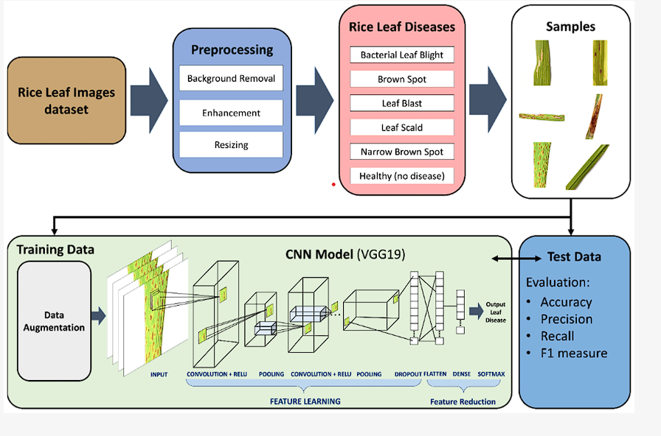
Architecture

Slide 15
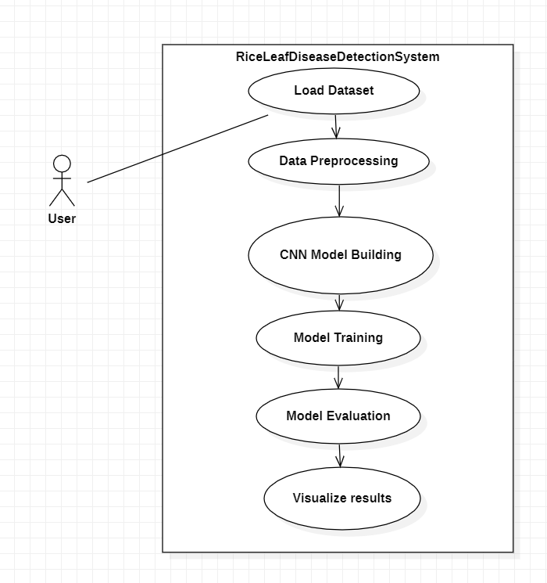
Use Case Diagram

Slide 16
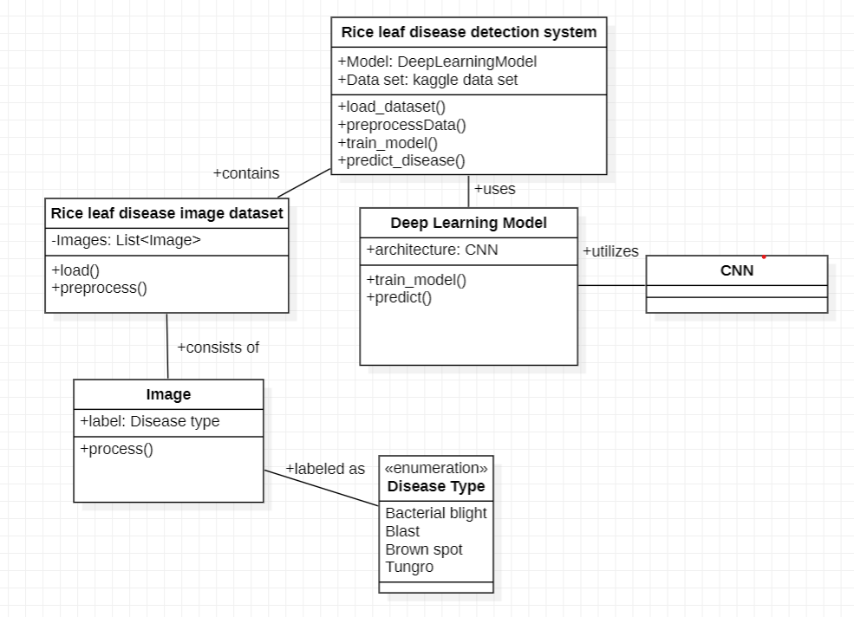
Class Diagram

Slide 17
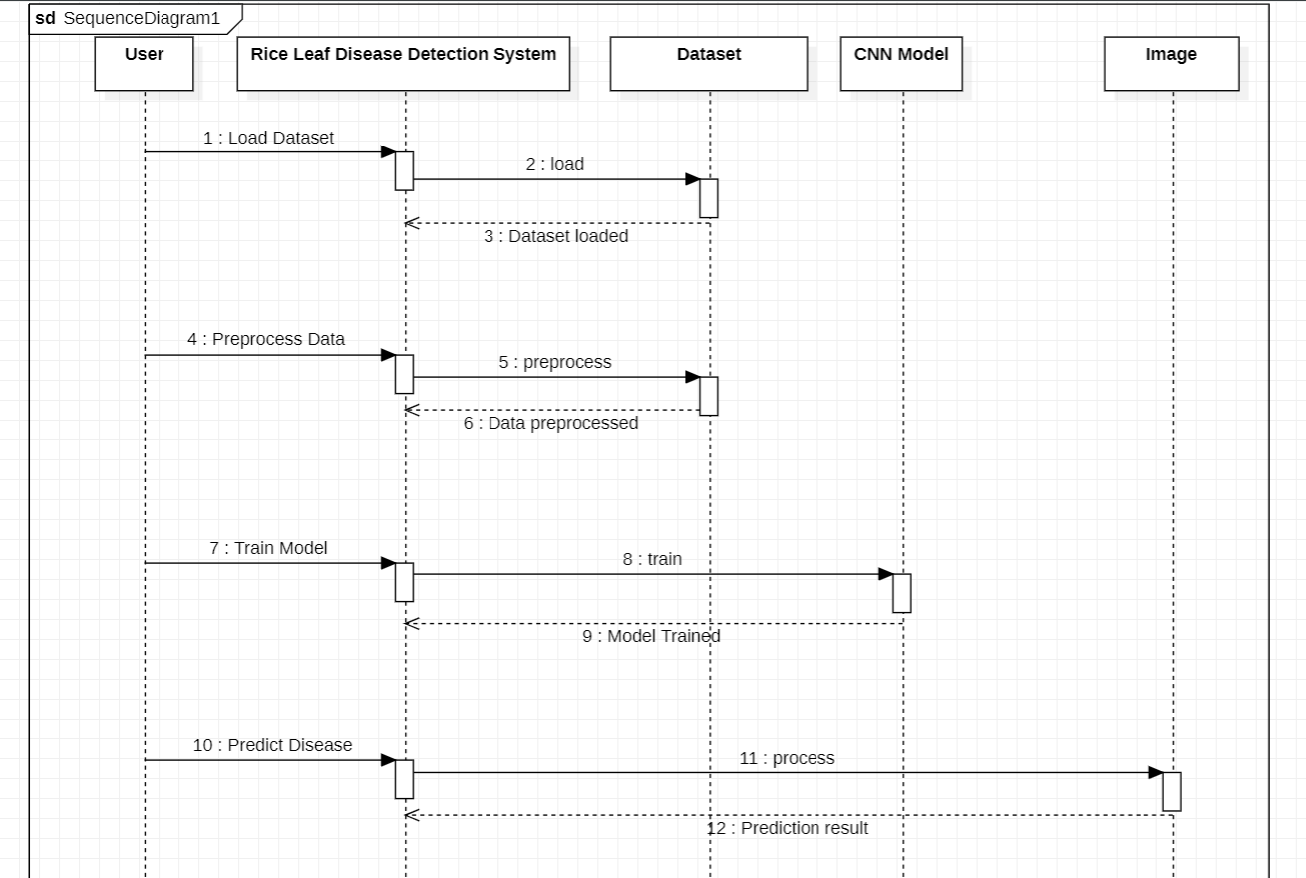
Sequence Diagram

Slide 18
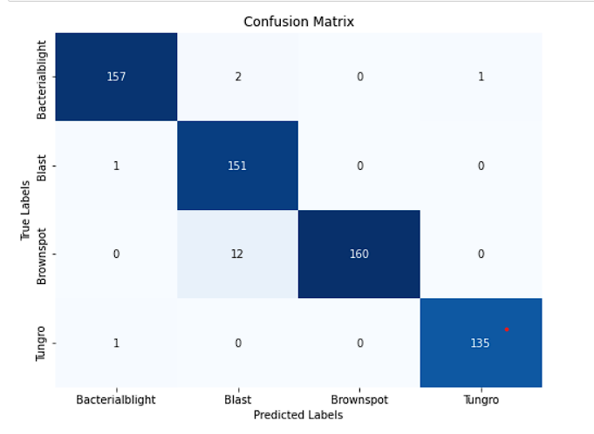
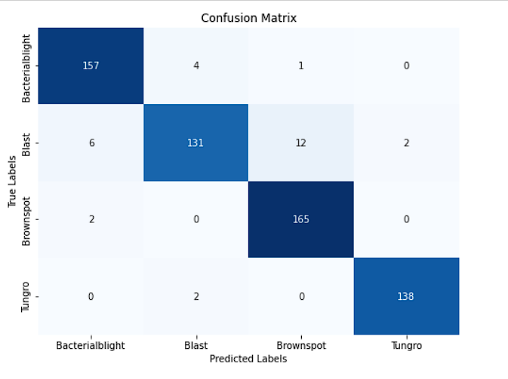
Outputs
Lenet Model
Simple cnn

Slide 19
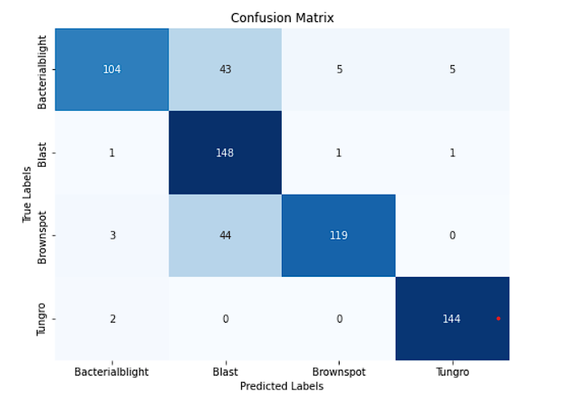
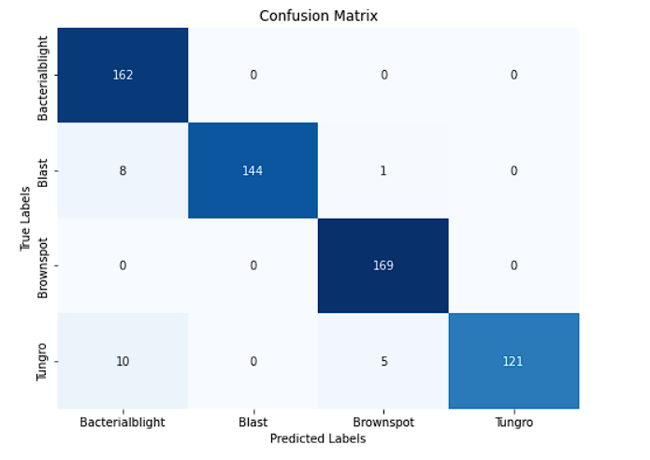
Resnet
Inception

Slide 20
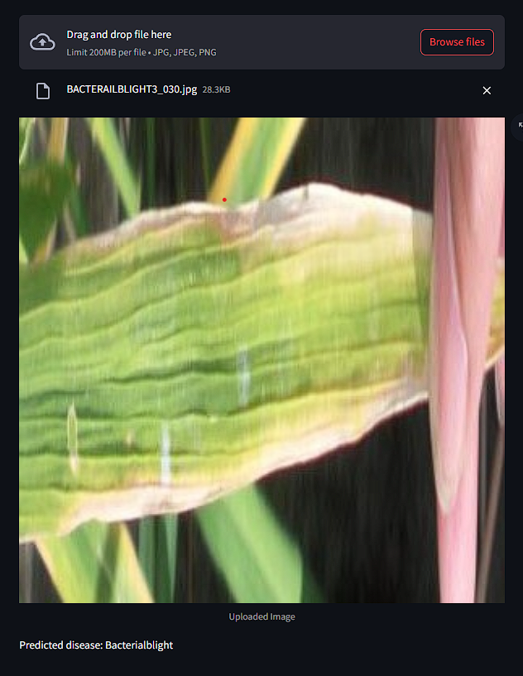
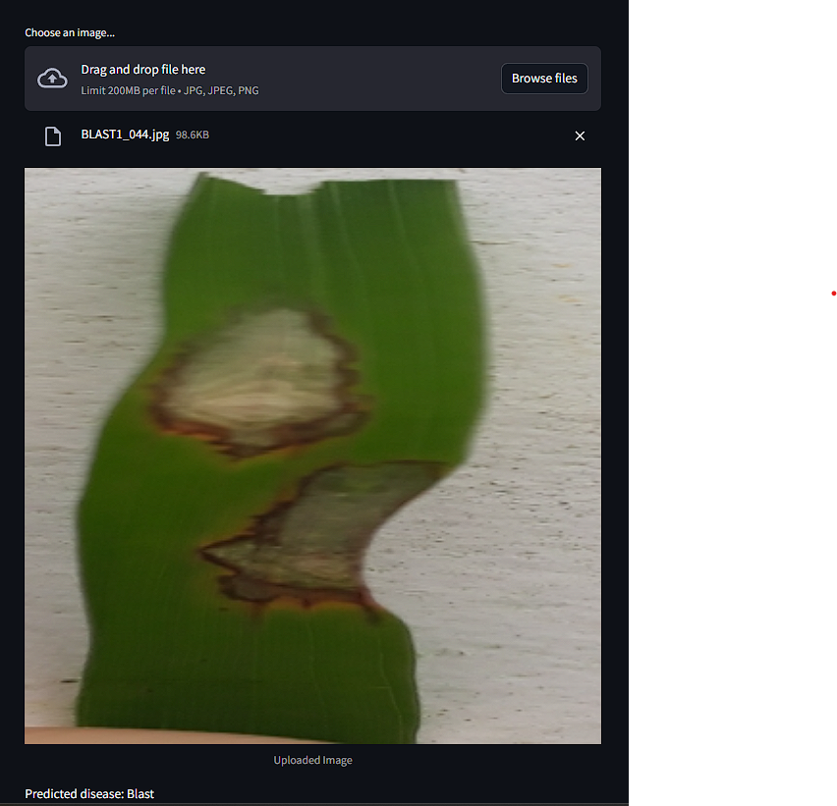

Slide 21
Conclusion
The project showcases the efficiency of deep learning models in accurately identifying and categorizing rice leaf diseases, providing a robust framework for disease detection.
Through the development of a user-friendly interface using the Streamlit library, the project enhances accessibility, enabling farmers and agricultural experts to swiftly upload images and obtain precise disease predictions.
Implementation of the project holds substantial potential for revolutionizing agricultural practices, facilitating early detection and diagnosis of rice leaf diseases, thereby minimizing crop losses and maximizing productivity.
The project's adaptable and scalable framework ensures its relevance in the face of evolving datasets and advancements in deep learning techniques, allowing for seamless integration of future enhancements.
By empowering farmers with advanced technological tools for crop management, the project contributes to broader initiatives aimed at ensuring food security and sustainability, underscoring its significance in global efforts to address agricultural challenges.

Slide 22
FUTURE SCOPE
Expansion of Disease Categories
Multimodal Data Integration
Integration with Precision Agriculture Technologies
Real-Time Monitoring and Alerts

Slide 23


