Slide 1
Customers Like You
A small, fast "also bought" engine for GiftLane, and a map of our customers
Jagadeesh Aravind Kalyan Shetti | Data & ML Team | 13 October 2026
Notes:
Sarah asked for two things: a 'customers who bought this also bought' box that runs nightly and beats best sellers, and a customer map marketing can name. I'll give the short answer first, then how we got there. About five minutes.

Slide 2
Small and fast, but not yet better
2.4 s
11x smaller
21% vs 27%
whole nightly job: refit, box for every product, top 10 for every customer
14.7 MB of compressed data against a 161 MB full table
customers with a correct suggestion: our model vs the best-seller list
Our advice: keep best sellers on the product pages for now.
Notes:
Two of Sarah's targets are met: the data is much smaller and the job is fast, about 2.4 seconds on my laptop. The third, beating best sellers, is not met: about 21 in 100 customers got a correct suggestion from our model, about 27 in 100 from best sellers. I will say that plainly, and the advice follows from it. One caveat on 'smaller': the stored factors are 14.7 MB, but our scoring step still builds big temporary tables, so batching is a next step.

Slide 3
From invoices to one table
1
2
3
4
Clean
Split by time
Hide new buys
Build the table
802,632
2 months
44,727
97.95%
invoice lines kept from 1,067,371
last two months are the test; cutoff 9 Oct 2011
purchases of new products, from 1,913 customers
empty: 5,473 customers x 3,687 products
Each cell = how much one customer bought of one product (log scale, so one huge order does not dominate). Products with fewer than 10 buyers are left out.
Notes:
We cleaned out cancellations, returns, zero prices, postage and fee codes and lines without a customer. Then we split by time: the last two months are the test, and we hid the purchases where a customer bought something new to them. No test data touches the model. The table has one row per customer and one column per product, and almost every cell is empty. Products with fewer than 10 buyers were dropped, which is 19% of products.

Slide 4
Why Truncated SVD
Truncated SVD: our choice
PCA: the comparison
Works on the sparse table as it is
Gives customer and product patterns in one fit
Products are similar when the same customers buy them
Subtracts the average customer first
Describes how customers differ from the average
Same settings: 0.2180 vs 0.2148, a gap of about 6 customers
Chosen before any model was fitted. In both, component 1 is simply how much a customer buys (correlation 0.97).
Notes:
SVD boils the table down to 200 shopping patterns. Each product gets a short fingerprint, and two products with similar fingerprints are bought by the same customers. I chose it because the table is almost empty and SVD works on it directly. PCA subtracts the average customer first, so it answers a different question. I still ran PCA at the same size as a check: it scored almost the same. In both methods the first component is mostly overall buying volume.

Slide 5
What compressing loses
64%
of the table is not rebuilt at k = 200. The curve has no elbow, so we took the lowest error.
This measures copying the table, not suggestion quality.
Notes:
Compression always loses something. At 200 patterns, about 64% of the training table is not rebuilt. The error falls steadily with no sharp elbow, so I took the lowest of the five and fixed k = 200 before any test scoring. Important: this number is about how well we copy past buying. It is not a measure of how good the suggestions are, so we tested the suggestions directly on the next slide.

Slide 6
Best sellers still win
Best sellers ahead by 5.4 points
1,913 test customers, 44,727 purchases the model never saw
Hit = at least one of 10 suggestions was bought
One split, one run; k not changed after seeing this
Notes:
We hid the last two months of new purchases and asked: does at least one of our 10 suggestions match something the customer really bought? Best sellers: 0.2687, so about 27 in 100 customers. Our SVD model: 0.2148, about 21 in 100. PCA: 0.2180, practically the same as SVD. So both methods lose. I did not change k after seeing this, because that would leak the test set into the choice. A likely, untested reason: best sellers are bought by many people, while suggestions from one customer's history lean to niche items. One split and one run, so this is a measurement, not a proven gap.

Slide 7
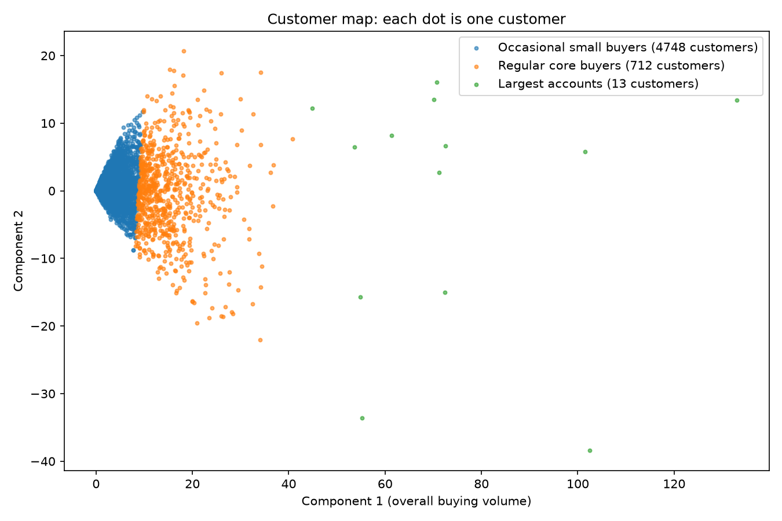
Three groups, mostly volume tiers
Occasional small buyers
4,748 customers (87%), about 48 products each
Regular core buyers
712 customers (13%), about 238 products each
Largest accounts
13 customers (0.2%), about 1,146 products each
Groups differ mainly in how much people buy, not in taste. No customer IDs shown.
Notes:
Each dot is one customer, placed using two components. The horizontal direction is overall buying volume, so the groups are mostly volume tiers: occasional small buyers, regular core buyers who lean to retro-spot cake cases and lunch bags, and 13 very large accounts. The 13-account group is a limit of using only two components, not a finding about taste. I did not call anyone wholesale because the data does not show who is. There are no customer IDs in the figure.

Slide 8
Risks and next steps
What could go wrong
Next steps
22% of new purchases (13,829 of 63,252) come from customers with no history
19% of products (842 of 4,529) are too rare to recommend
Variants of one product can fill a whole list
One split, one run; the top group is 13 customers
Choose k with a validation slice of older data
Blend best sellers with personal suggestions
Batch the scoring to cut memory
Show best sellers to new customers
Notes:
Main risks, each with its base: new customers with no history are about 22% of new purchases, so show them best sellers. 19% of products had too few buyers to recommend. Variants of one product can crowd a list. And this is one split and one run. Next steps: pick k properly with a validation slice, try a blend of best sellers and personal suggestions, batch the scoring to cut memory, and show best sellers to new customers. Ready for questions.

