Slide 1

Artificial Intelligence and Data Science
Project Title
Plant Disease Detection using YOLOv8
KOPPISETTI JAGADEESH
Roll No: 22765A5402

Slide 2
Abstract
This project focuses on the detection of plant diseases using the YOLOv8 model. By leveraging computer vision and deep learning techniques, we aim to help farmers identify plant diseases early, ensuring better crop management and healthier yields.

Slide 3
Introduction
Plant diseases are a major concern in agriculture, leading to significant losses in crop yield. Traditional methods of disease detection are time-consuming and often inaccurate. The advancement of deep learning models like YOLOv8 enables faster and more accurate detection of diseases, providing real-time assistance to farmers.

Slide 4
Project Objectives
1. Develop a robust model for detecting plant diseases.
2. Implement the YOLOv8 architecture to classify and localize plant diseases in real-time.
3. Assist farmers in early disease detection for effective crop management.

Slide 5
Dataset Used
We used a publicly available dataset containing images of various plant diseases from roboflow. The dataset was pre-processed and annotated to make it compatible with the YOLOv8 model.

Slide 6
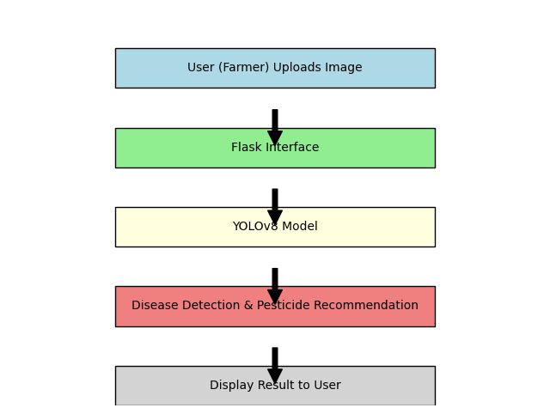
Model Architecture (YOLOv8)
YOLOv8 is a state-of-the-art object detection model that performs real-time detection. It uses convolutional neural networks to identify objects and their corresponding classes in images. The model was trained on the annotated plant disease dataset for accurate disease identification.

Slide 7
Training Process
The model was trained using a dataset of labeled plant disease images. The training involved fine-tuning the YOLOv8 architecture for optimal accuracy and speed. We used techniques like data augmentation and learning rate scheduling to improve model performance.

Slide 8
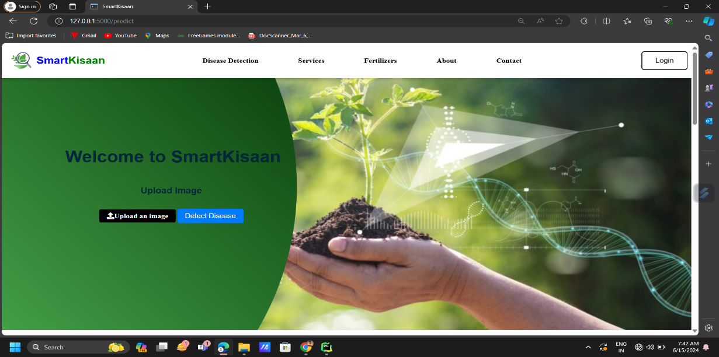
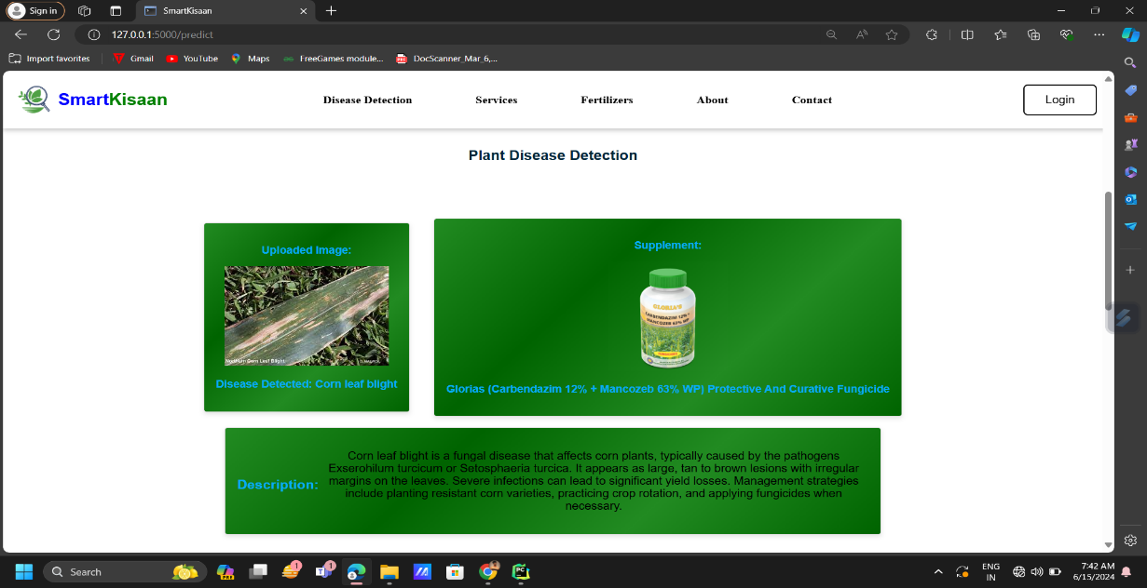
Results and Evaluation
The YOLOv8 model achieved a high accuracy in detecting plant diseases with minimal false positives. The model's real-time detection capability makes it highly useful in field applications, where farmers can use it to diagnose plant health instantly.

Slide 9
Future Scope
Future work can focus on expanding the dataset to include more plant species and diseases. Additionally, integrating the model into mobile applications can provide farmers with a portable tool for disease detection.

Slide 10
Conclusion
The plant disease detection system using YOLOv8 is an effective solution for early identification of diseases. By utilizing deep learning and computer vision, this project aims to revolutionize agricultural practices, leading to healthier crops and more sustainable farming.

