Slide 1

ASTON HACKERS
DATA SCIENCE FOR HEALTH CARE

Slide 2
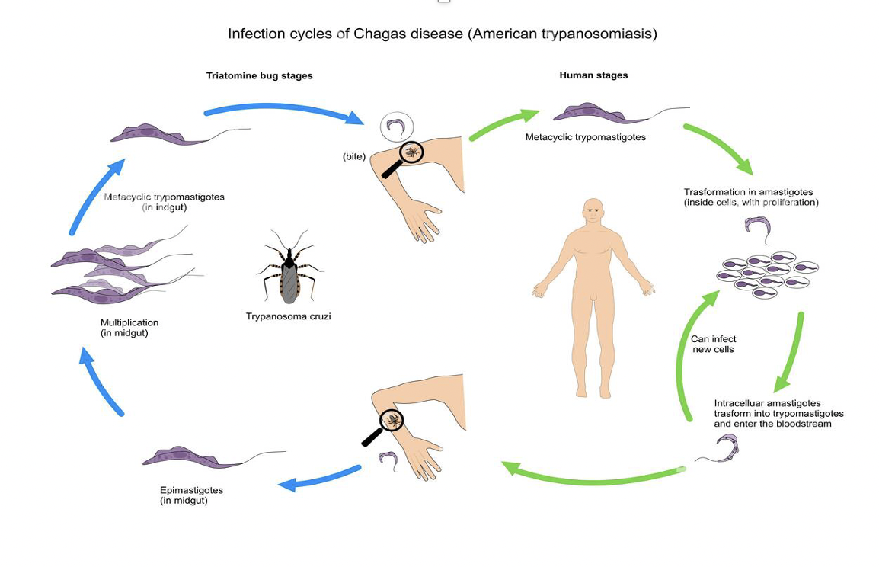
Introduction
In this challenge, We are exploring an epitope dataset that is related to a parasite called Trypanosoma cruzi which is the causative agent of the disease Chagas which affects our liver.

Slide 3
So why are we Performing the task ?
B-cell epitope prediction is a crucial step in early exploration of potential candidates for the development of diagnostic, preventive and therapeutic interventions against the chagas disease which affects our liver. A B-cell epitope is the antigen portion binding to the immunoglobulin or antibody. These epitopes recognized by B-cells may constitute any exposed solvent region in the antigen and can be of different chemical nature. However, most antigens are proteins and those are the subjects for epitope prediction methods.

Slide 4
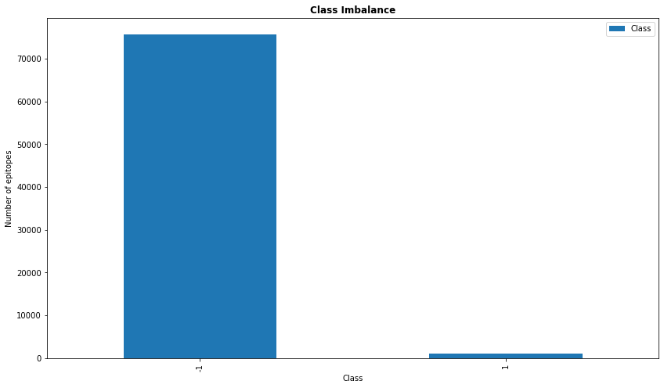
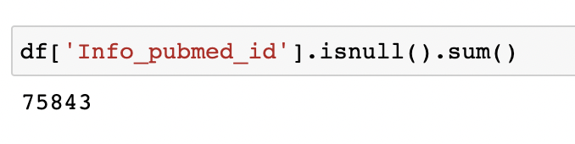
Data familiarisation/EDA
Initially its important to get to know our data and get familiarised with it which is the exploratory data analysis by getting to know the number of columns and rows present in the dataset, statistical analysis of the dataset just like a complete walkthrough of the dataset. In this process we got to know that there are missing values in our dataset which adds ambiguity to the analysis process and that there is imbalance in the dataset.

Slide 5
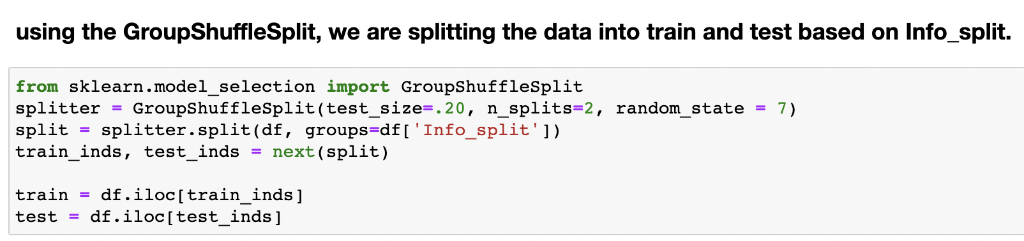
Data Pre-processing
We then divide our data into Train and Test using GroupShuffleSplit based on the column Info_Split. In data pre-processing , we generate random numbers to fill the null values present in the column using rand int function. We are also balancing the dataset using RandomUnderSampler to the train Dataset.

Slide 6
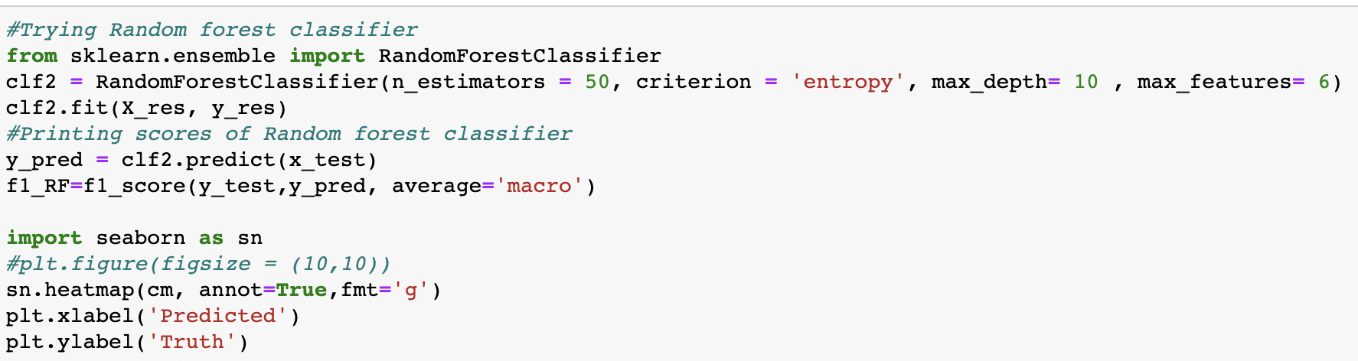
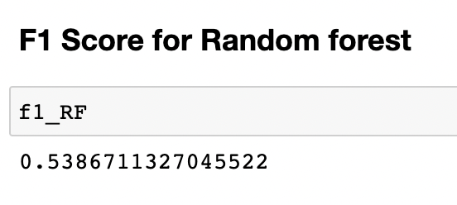
Modelling
Data modelling is the creation, training, and deployment of machine learning algorithms that emulate logical decision-making based on available data. ML models provide a foundation to support advanced intelligence methodologies such as real-time analytics, predictive analytics, and augmented analytics.
The models used in this analysis are : Logistic Regression, K-NN, random forest , decision tree and x-g boost .

Slide 7
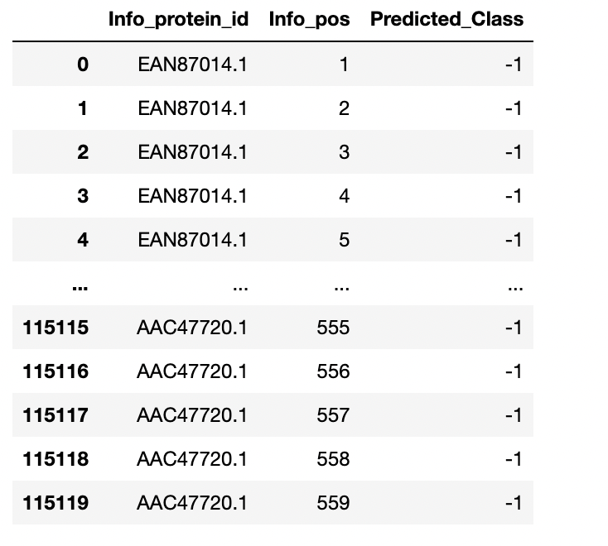
Prediction
Prediction here refers to the output of an algorithm after it has been trained on the dataset and applied to new data
we have used F1 score and confusion matrix to predict the performance of our model.
F1-score is one of the most important evaluation metrics in machine learning. It elegantly sums up the predictive performance of a model by combining two otherwise competing metrics — precision and recall
Confusion matrices are used to visualize important predictive analytics like recall, specificity, accuracy, and precision. Confusion matrices are useful because they give direct comparisons of values like True Positives, False Positives, True Negatives and False Negatives.
Lastly, we have categorized the dataset into predicted class which is either 1 or -1 into a csv file .

Slide 8
THANK YOU

