Slide 1
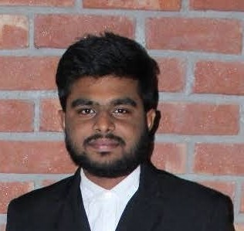



Gudipalli Jagadeesh
Bachelor of Computer Application
Batch:2017-2020
Master of Computer Application
Batch : 2020-2022
Analyst/Software Engineer
N/A
Skills
xxxxxxxxxxx@capgemini.com
Java 8 /J2EE | Java Basics, OOPS, Generics, Collections, Arrays, Loops, Lambda Exp, Stream API Junit, Mockito.
Spring core | IOC & Dependency Injection, Autowire
Spring REST | REST controllers, Implementation of GET, POST, PUT & DELETE, Bean Validation & Exception Handling, Testing Services, Controller & Repository layer
Spring Data JPA | Implement DAO layer using spring Data repositories, Transaction Management
Spring Boot Microservices | Spring Boot Starters, annotations, Messaging Service, Sync/Async comms, Swagger API specifications
Spring Cloud | Eureka, Netflix Ribbon, Feign Client, Hystrix & Config Server
React | Components, Hooks, Event handling, Redux, Reducers, Testing using Jasmin & Karma
Database | MongoDB No Sql Basic My SQL.
UI Tech | HTML 5 & CSS 3,JavaScript, ES6 & TypeScript Reusable templates, Optimized UI Designed
Tools | Git, Postman, Maven, IDE,PMD, Sonarqube
Add On skills | Communications, Team management. Peer learning
+91 8978494663
A4
Java Full Stack Developer
Hands on experience in developing web pages using HTML5, CSS3, Object Oriented Java script, ES6, React JS, MongoDB, Java, Spring Boot. Good understanding of Document Object Model (DOM) and DOM Functions.
Practical understanding of advanced JavaScript concepts, such as Prototype, Closure, Scope Chain and Promise.
Proficient in creating Single page Web Application in React with Authentication with route guards, React forms, React routing.
Java Microservice Development knowledge using Spring boot and spring cloud framework on an intermediate level.
Implemented spring Boot and MongoDB in case study and upskilling knowledge continuously.
Used tools like Mockito, Junit 5, ensuring quality in project
Online Hotel Management System Application
Completed end to end case study of Online Hotel Management System Application along with React JS as a frontend technology, Spring boot as backend ,JWT for security , Swagger for API documentation, and Junit 5 and Mockito testing. Bootstrap used for user-interface.
HTML CSS JAVASCRIPT for web developers at Udemy
Completed this course, where I learned about HTML5, CSS#, Java and Designed responsive Foob website using HTML5 CSS3 Bootstrap and Javascript
Completed ” Fundamental of Red Hat Enterprise Linux“ course at Coursera
Check out my work on GitHub & Video Profile

