Slide 1

Multi-Page Responsive Website
SUBMITTED BY
-- B.JAGADEESH
--Internship project in web development

Slide 2
Abstract
This web development guide focuses on creating a multi-page responsive website using HTML and CSS.
It emphasizes the importance of combining these languages to build visually appealing and interactive websites that adapt to different devices.
The guide outlines essential pages, including the index page, services page, contact page, and a portfolio section showcasing previous works.
It emphasizes the goal of creating a responsive design to optimize user experience across various screen sizes, aiming to help readers develop their web development skills and deliver exceptional user experiences.

Slide 3
What is Mutli-Page Responsive Website
A multi-page responsive website is a website that consists of multiple interconnected web pages and is designed to adapt and provide an optimal viewing experience across various devices and screen sizes. The term "responsive" refers to the website's ability to automatically adjust its layout, content, and design elements based on the screen size of the device being used to access it. This ensures that the website is accessible and visually appealing, whether it is viewed on a desktop computer, laptop, tablet, or mobile phone. The responsive design approach allows users to navigate through different pages of the website seamlessly while maintaining a consistent and user-friendly experience across all devices.

Slide 4
Introduction to project
This guide explores the process of creating a multi-page responsive website using HTML and CSS for an IT company called LightCode. The website will include essential pages such as index, services, contact, and a showcase of previous works. HTML provides the structure and content, while CSS handles the design and layout. By combining these languages, visually appealing and interactive websites that adapt to different devices can be created.

Slide 5
Idea of Implementation
The Light Code website will consist of an index page as the landing page, showcasing a brief introduction and navigation links. The services page will provide detailed descriptions of the offerings, potentially including visuals. The contact page will feature a form for inquiries. A portfolio section will display previous works, demonstrating skills and expertise. The focus will be on creating a responsive website that adapts to different devices for an optimal user experience. This guide aims to help both beginners and experienced developers in building a captivating multi-page responsive website using HTML and CSS.

Slide 6
Requirements
To build the mentioned website, you'll need a text editor or IDE for coding, a web browser for testing, and a good understanding of HTML and CSS. HTML will be used to structure the content, while CSS will handle the visual design. Responsive design techniques, such as media queries and flexible layouts, are crucial for ensuring the website looks great on different devices.
You may also need images or multimedia assets, which can be created or sourced from graphic design tools or platforms. Additionally, consider web hosting and domain registration to make your website accessible online.
Depending on the complexity, you may require additional resources like JavaScript for interactivity, libraries/frameworks for specific features, or content management systems (CMS) for easier website management.

Slide 7
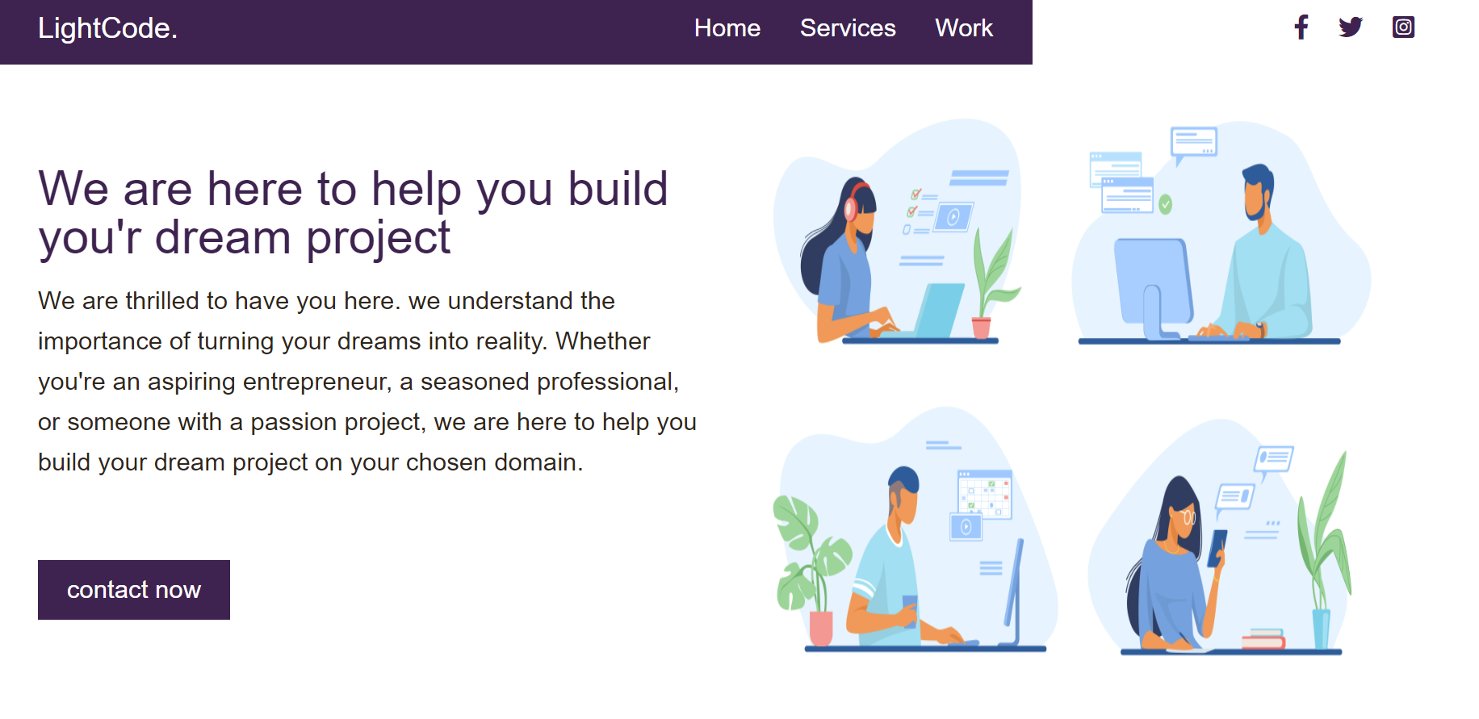
Website Images
1.Index page

Slide 8
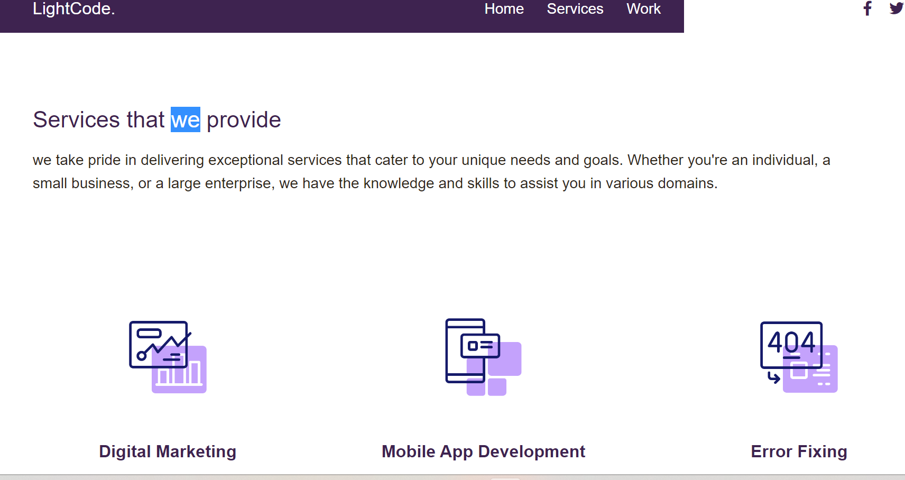
Website Images
2.services page

Slide 9
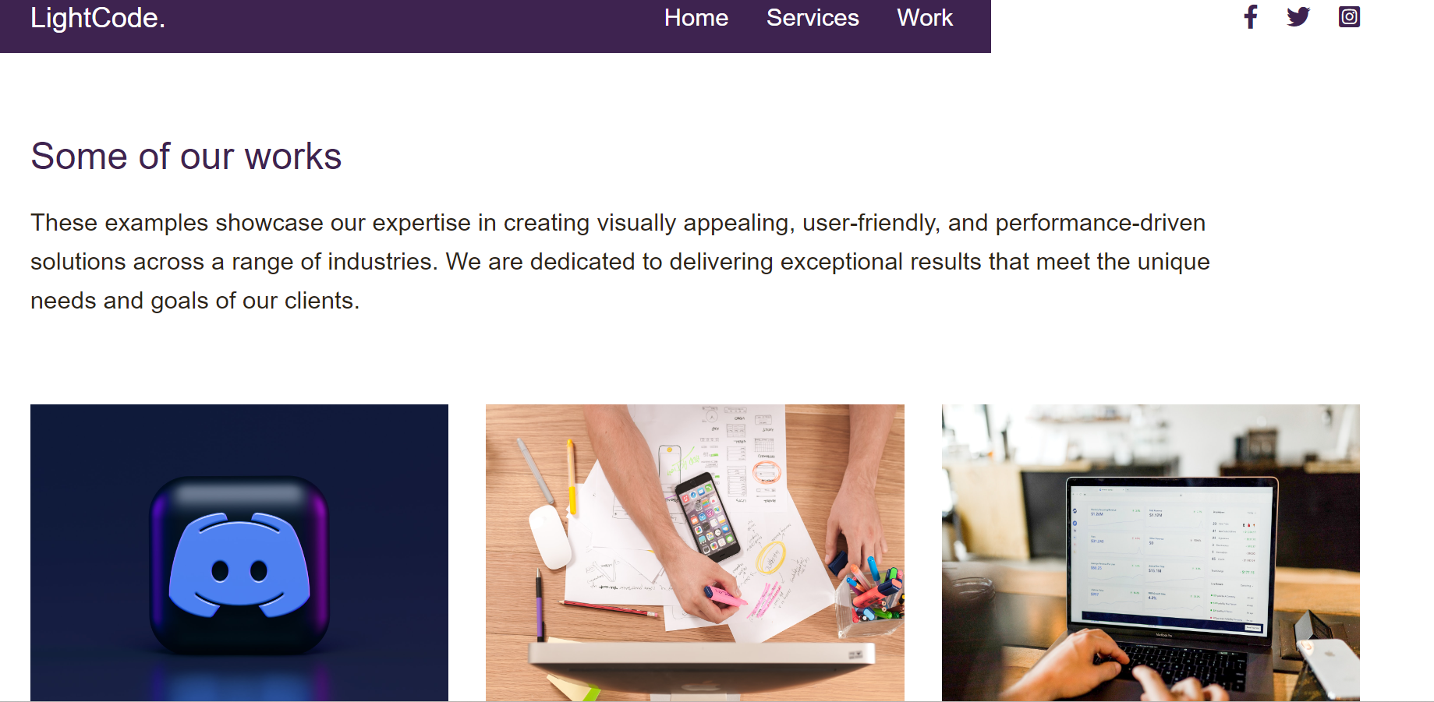
Website Images
3.works page

Slide 10
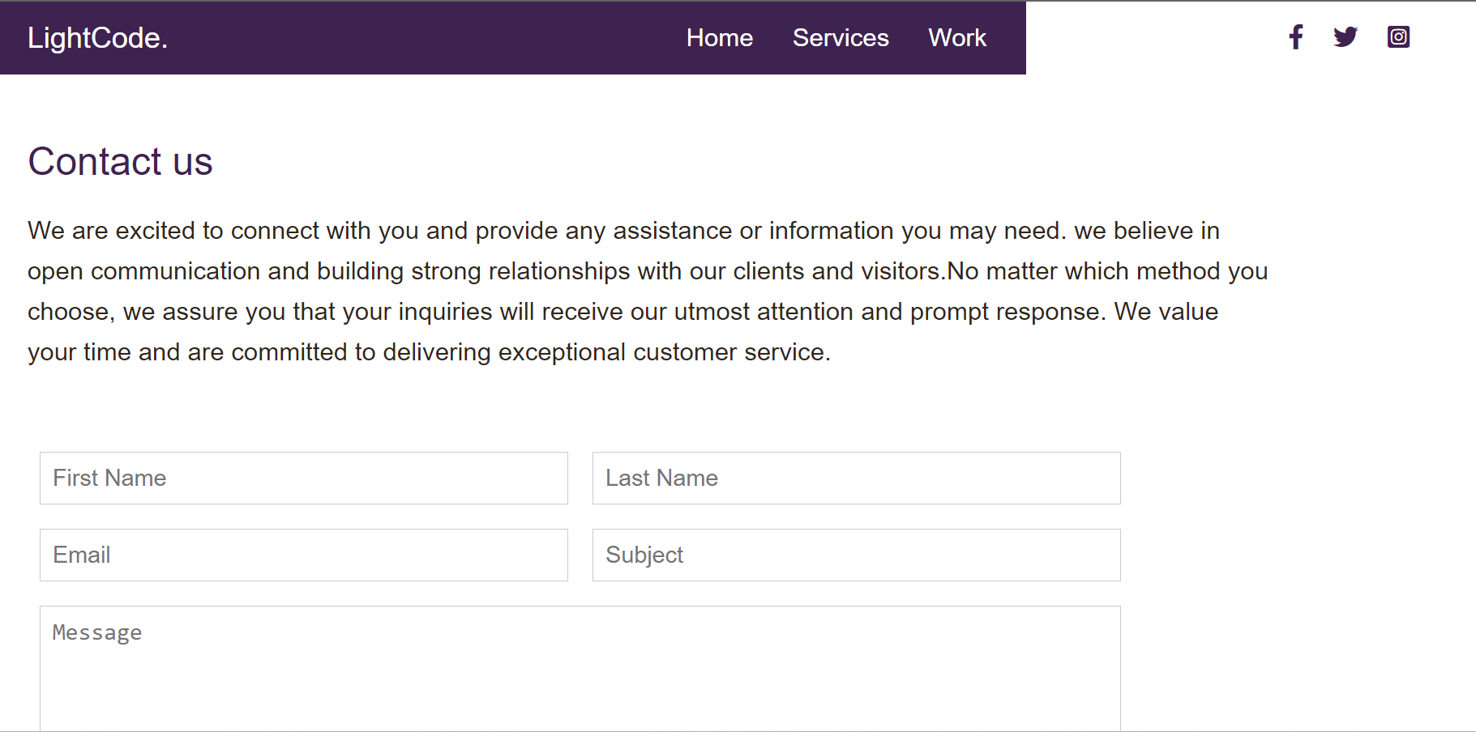
Website Images
4.contact page

Slide 11
Conclusion
The provided information includes four HTML files (index.html, services.html, work.html, and contact.html) and a style.css file, representing the web pages of an IT company's website.
In summary, the collection of HTML files and the style.css file collectively create a website for an IT company. The website offers visitors an overview of the company's services, showcases their previous works, and provides a means to contact them. The design elements specified in the CSS file enhance the overall user experience and maintain a consistent visual theme across the web pages.

Slide 12
THANK YOU

