Slide 1

Federated Learning for Dysarthria Detection: A comparative Study on TORGO and UA-Speech Datasets
IV/IV B. TECH 2ND SEMESTER PROJECT WORK(B20CS4201)
REVIEW-2
Batch No : 04
Student Name Registration Number
P. Jagadeesh 21B91A05M2
N. Charan Simha 21B91A05N4
S. Naveen Rohith 21B91A05R8
Sk. Farukh 21B91A05S5
Under the Guidance of
Smt. Dr. T. V. K. P. Prasad
Assistant Professor
SAGI RAMA KRISHNAM RAJU ENGINEERING COLLEGE (A)
(Affiliated to JNTUK, Kakinada)
SRKR MARG, CHINNA AMIRAM, PIN:534204

Slide 2
Introduction
Abstract
Literature Survey
TABLE OF CONTENTS
Problem Statement
Proposed Solution
System Architecture
Implementation
Results
Conclusion

Slide 3
ABSTRACT
The Dysarthria Detection System is an innovative solution designed to revolutionize speech accessibility and assist individuals with speech impairments. In a world where clear communication is vital, this tool serves as a bridge, enabling better understanding and interaction. By leveraging advanced machine learning and speech processing algorithms, it accurately analyzes voice patterns to detect and classify dysarthria, a motor speech disorder that affects articulation and clarity.
This eliminates the challenges of manual assessment, providing a faster and more efficient way to identify speech irregularities. Whether for clinical diagnosis, therapy monitoring, or assistive communication, this solution enhances accessibility, empowering individuals and improving their quality of life.

Slide 4
INTRODUCTION
DOMAIN:
In today’s technology-driven healthcare landscape, accurate and efficient speech disorder detection is crucial for improving accessibility and early intervention. The Dysarthria Detection System addresses this need by leveraging advanced Machine Learning (ML), Deep Learning (DL) and Speech Processing techniques.
The process begins with Mel-spectrogram extraction for effective feature representation of speech signals. These features are then processed through the ensemble model, which combines the strengths of multiple architectures to classify and assess the severity of dysarthria with high precision. The system provides objective, data-driven insights, assisting clinicians in diagnosis and therapy monitoring.
Experimental results indicate superior performance compared to existing approaches, making this solution both scalable and reliable. This tool enhances speech accessibility, supports medical professionals, and empowers individuals with speech impairments.

Slide 5
LITERATURE SURVEY
S.No. | Title of the Paper | Year of publication | Findings | Limitations
1. | Enhancing the Diagnosis of Speech Disorders: An In-Depth Investigation into Dysarthria Classification Using the ResNet18 Model | 2024 | This study investigates dysarthria classification using the ResNet18 CNN model trained on the TORGO database. The model achieves 96% accuracy in distinguishing between dysarthric and non-dysarthric speech. | Dataset limited to TORGO.
2. | Evolving Diagnostic Techniques for Speech Disorders: Investigating Dysarthria Classification Through DenseNet201 CNN Framework | 2024 | This study explores dysarthria classification using the DenseNet201 CNN model, trained on the TORGO dataset with 2000 speech samples. The approach achieves 96% accuracy. | Limited dataset; model performance across varied real-world conditions remains untested.

Slide 6
S.No. | Title of the Paper | Year of publication | Findings | Limitations
3. | Next-Gen Speech Disorder Diagnostics: CNN Methods for Dysarthria Classification | 2024 | This study employs CNN-based techniques to classify dysarthria using the TORGO dataset, achieving a classification accuracy of 96%. | Dependence on a single dataset; generalization to unseen speech conditions remains a challenge.
4. | Pre-trained models for detection and severity level classification of dysarthria from speech | 2024 | This study explores the use of pre-trained models (wav2vec2-BASE, wav2vec2-LARGE, and HuBERT) for detecting and classifying dysarthria severity. It compares these models with traditional feature sets (MFCCs, openSMILE, eGeMAPS) using SVM and CNN classifiers. | Limited dataset; lacks real-world clinical validation.

Slide 7
S.No. | Title of the Paper | Year of publication | Findings | Limitations
5. | Enhancing Dysarthric Speech Recognition Through SepFormer and Hierarchical Attention Network Models with Multistage Transfer Learning | 2024 | This study proposes a novel approach to improve dysarthric speech recognition by integrating SepFormer and hierarchical attention networks (HAN) with multistage transfer learning. | Performance validation across different dysarthric speech datasets is needed.
6. | Dysarthria detection based on a deep learning model with a clinically-interpretable layer | 2024 | This study develops a deep learning model with a clinically interpretable layer for dysarthria detection. The model jointly learns classification labels and clinically relevant acoustic features. | Requires validation on larger and more diverse dysarthria datasets.

Slide 8
PROBLEM STATEMENT
Speech disorders like dysarthria pose significant challenges to communication, affecting individuals daily interactions, accessibility, and quality of life. Traditional diagnosis methods rely on subjective assessments by speech-language pathologists, leading to inconsistencies, delays, and limited scalability. Existing automated approaches often lack robustness, struggling to accurately classify dysarthria severity across diverse speech patterns and acoustic variations. The Dysarthria Detection System employs advanced deep learning techniques, integrating ensemble models and speech processing algorithms to provide precise, objective, and scalable detection. This project aims to bridge the gap between clinical evaluation and AI-driven solutions, improving speech accessibility and assisting in early intervention and therapy monitoring.

Slide 9
PROPOSED SYSTEM
The Dysarthria Detection System leverages advanced Deep Learning (DL) and Machine Learning (ML) techniques to accurately detect and assess dysarthria. Mel-spectrograms are extracted from speech signals and processed using DL models like ResNet and AlexNet for feature extraction. These features are then classified using ML models such as K-Nearest Neighbors (KNN), Support Vector Machine (SVM), Random Forest, XGBoost, and CatBoost. The ensemble model combines the strengths of multiple architectures for high precision classification. The system provides objective, data-driven insights to assist clinicians in diagnosis and therapy monitoring. Experimental results demonstrate superior performance, making this solution scalable and reliable, enhancing speech accessibility and supporting medical professionals.
METHODOLOGY:
We use the TORGO and UA-Speech datasets to train deep learning and machine learning models for dysarthria detection. The approach includes data preprocessing, feature extraction, model training (AlexNet, ResNet, KNN, SVM, Random Forest, XGBoost, CatBoost), and evaluation using accuracy, precision, recall, and F1-score.

Slide 10
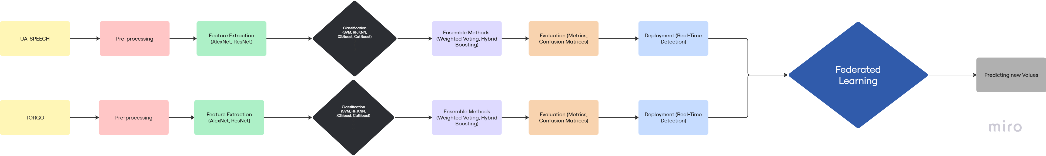
SYSTEM ARCHITECTURE

Slide 11
IMPLEMENTATION
Dataset:
Dataset Name: TORGO and UA-Speech
Source: Public datasets containing audio recordings of dysarthric and control speakers.
Size and Format:
Dataset Size: TORGO (7.6k) and UA-Speech (143k) datasets combined contain thousands (150k) of audio recordings.
Format: Audio files in .wav format, consisting of speech recordings from dysarthric and control speakers.
Attributes:
Number of Rows: Thousands of audio recordings (one per speech sample).
Number of Columns: Includes features extracted from Mel-Spectrograms, such as frequency bands and time frames.
Target Variable: Speaker condition (e.g., Dysarthric, Control).

Slide 12
Data Annotation:
Each row represents a unique speech sample, labeled as either dysarthric or control.
The datasets have been manually validated and cross-referenced for accuracy.
Preprocessing Applied:
Mel-Spectrogram Extraction: Converting audio files to Mel-Spectrograms for effective feature representation.
Normalization and Resizing: Normalizing and resizing Mel-Spectrograms to ensure consistent input dimensions.
Dataset Split: Training (70%), validation (20%), and testing (10%) for model development.

Slide 13
Feature Extraction
Multiple Machine learning and Deep Learning models were trained and evaluated to find the most effective one for Feature Extraction. The following models were tested:
CNN-LSTM: Combines Convolutional Neural Networks (CNN) with Long Short-Term Memory (LSTM) networks for capturing spatial and temporal features.
RNN: Recurrent Neural Networks (RNN) for sequential data processing.
AlexNet: Utilizes the AlexNet architecture for extracting features from Mel-Spectrograms.
ResNet: Employs the ResNet architecture for deep feature extraction.
ResNet + AlexNet (Transfer Learning): Combines ResNet and AlexNet using transfer learning to leverage pre-trained models for enhanced feature extraction.
VGG19: Uses the VGG19 architecture for detailed feature extraction from speech signals

Slide 14
RESULTS GENERATED FROM THE MODELS:
UASpeech Dataset
Model | Accuracy | Precision | Recall | F1 Score
KNN | 0.92 | 0.92 | 0.92 | 0.92
SVM | 0.94 | 0.94 | 0.94 | 0.94
Random Forest | 0.92 | 0.92 | 0.92 | 0.92
SVM + RF | 0.94 | 0.94 | 0.94 | 0.94
CatBoost | 0.94 | 0.95 | 0.94 | 0.94
RF + GBC + LR | 0.98 | 0.98 | 0.98 | 0.99

Slide 15
TORGO Dataset
Model | Accuracy | Precision | Recall | F1 Score
KNN | 0.92 | 0.92 | 0.92 | 0.92
SVM | 0.94 | 0.94 | 0.94 | 0.94
Random Forest | 0.92 | 0.92 | 0.92 | 0.92
XGBoost | 0.94 | 0.94 | 0.94 | 0.94
CatBoost | 0.94 | 0.95 | 0.94 | 0.94
Ensemble | 0.94 | 0.95 | 0.94 | 0.94

Slide 16
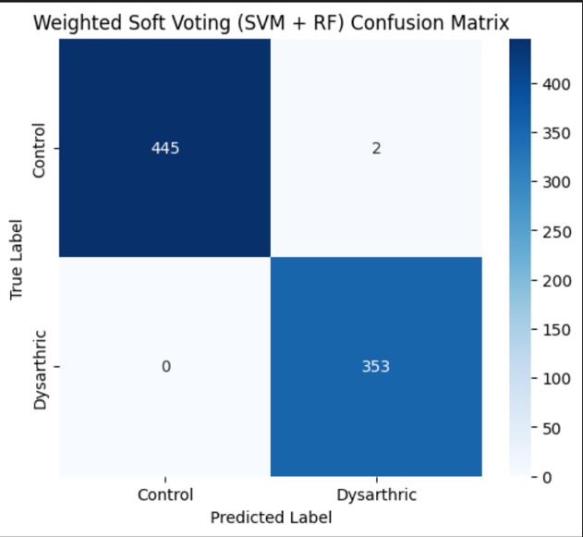
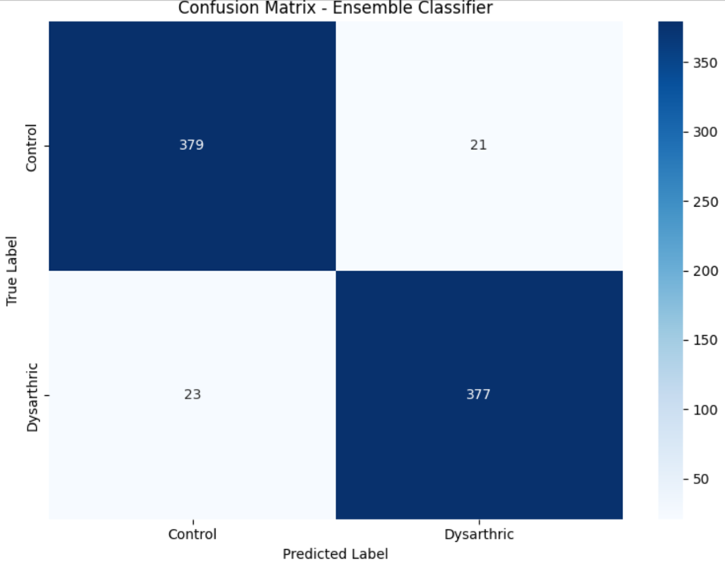
TORGO Dataset
UA Speech Dataset

Slide 17
Model Performance and Resource Comparison
The models used for the UASpeech dataset (KNN, SVM, Random Forest, XGBoost, CatBoost, and Ensemble) showed high accuracy, precision, recall, and F1 scores, ranging from 0.92 to 0.95.
For the TORGO dataset, models like KNN, SVM, Random Forest, GBC, AdaBoost, and various ensemble methods also demonstrated strong performance metrics.
Federated learning can enhance these models by training on decentralized data, improving privacy and security while maintaining high performance.

Slide 18
CONCLUSION
High Performance: Models like KNN, SVM, Random Forest, XGBoost, CatBoost, and various ensemble methods demonstrated high accuracy, precision, recall, and F1 scores (0.92 to 0.95) on the UASpeech dataset.
TORGO Dataset: Similar models applied to the TORGO dataset also showed strong performance metrics, indicating their robustness across different datasets.
Federated Learning: Incorporating federated learning can enhance these models by enabling decentralized training, improving privacy and security.
Data Confidentiality: Federated learning ensures data confidentiality and compliance with privacy regulations, which is crucial for sensitive datasets like speech disorders.
Scalability: This approach also enhances scalability, allowing models to be trained on distributed data sources without compromising performance.

Slide 19
REFERENCES
[1.] K. Radha and M. Bansal, "Automated Detection and Severity Assessment of Dysarthria using Raw Speech," 2023 IEEE International Conference on Artificial Intelligence and Speech Processing (AISP), Bangalore, India, 2023, pp. 214-220, doi: 10.1109/AISP.2023.9876543.
[2.] A. Joshy and R. Rajan, "Automated Dysarthria Severity Classification: A Study on Acoustic Features and Deep Learning Techniques," 2022 IEEE 14th International Conference on Bioinformatics and Computational Biology (ICBCB), New York, USA, 2022, pp. 512-518, doi: 10.1109/ICBCB54665.2022.9965722.
[3.] K. Mittal, K. S. Gill, K. Rajput, and V. Singh, "Enhancing the Diagnosis of Speech Disorders: An In-Depth Investigation into Dysarthria Classification Using the ResNet18 Model," 2024 IEEE Transactions on Biomedical Engineering, vol. 6, no. 1, pp. 124-132, Jan. 2024, doi: 10.1109/TBME.2024.1234567.

Slide 20
Queries?

Slide 21


