Slide 1

Drug Sensitivity Prediction Based on Genomic Features of Cancer Cell Lines using Machine Learning
IV/IV B. TECH 2ND SEMESTER PROJECT WORK(B20CS4201)
REVIEW-2
Batch No : 16
Student Name Registration Number
Adhikari Sai Ratan Pavan 21B91A0505
Bomma Kalyan Subhash 21B91A0544
Chellinkula Purna Sri Sai 21B91A0562
Under the Guidance of
Smt. V. Priyadarshini
Assistant Professor
SAGI RAMA KRISHNAM RAJU ENGINEERING COLLEGE (A)
(Affiliated to JNTUK, Kakinada)
SRKR MARG, CHINNA AMIRAM, PIN:534204

Slide 2
Introduction
Abstract
Literature Survey
TABLE OF CONTENTS
Problem Statement
Proposed Solution
System Architecture
Implementation
Results
Conclusion

Slide 3
ABSTRACT
Drug sensitivity prediction in cancer cell lines is a critical area of research aimed at advancing precision oncology by identifying effective therapeutic strategies tailored to individual patients. Accurate prediction of drug responses, often measured by IC50 values, can significantly enhance treatment outcomes and reduce adverse effects. However, traditional experimental methods to assess drug sensitivity are time-intensive and resource-demanding and prone to variability in accuracy.
This Project study explores the application of advanced Machine Learning techniques to address these challenges. By leveraging algorithms such as Random Forests, Support Vector Machines, and Neural Networks, the proposed approach utilizes the power of computational models to analyze genomic and transcriptomic features of cancer cell lines.
This research highlights the potential of AI-driven approaches in identifying biomarkers of drug sensitivity, enabling personalized cancer treatments and streamlining drug discovery processes.

Slide 4
INTRODUCTION
DOMAIN:
The domain of this project lies in Computational Biology and Artificial Intelligence (AI), specifically in the field of drug sensitivity prediction in cancer research.
Predicting drug sensitivity, typically measured by IC50 values, is critical for advancing personalized oncology
Leveraging machine learning algorithms, the project aims to improve the accuracy and efficiency of drug sensitivity predictions, enabling better therapeutic decision-making and contributing to precision medicine.
METHODOLOGY:
The methodology for this project integrates advanced machine learning techniques with genomic and transcriptomic data to develop a predictive model for drug sensitivity in cancer cell lines. The approach begins with collecting and preprocessing publicly available datasets, such as the Genomics of Drug Sensitivity in Cancer (GDSC).

Slide 5
LITERATURE SURVEY
TITLE | AUTHOR | METHOD USED | SUMMARY | YEAR | REFERENCE
Systematic Identification of Genomic Markers of Drug Sensitivity in Cancer Cells | Garnett M.J., Edelman E.J | Utilizes large-scale screening data to identify genomic markers linked to drug response in cancer cell lines. | Identifies genomic markers linked to drug response in cancer cell lines using large-scale screening data | 2024 | Cancer Cell
DeepDSC: A Deep Learning Method to Predict Drug Sensitivity of Cancer Cell Lines | Li, M., Wang, Y., Zheng, R. | A deep learning model, DeepDSC, integrates genomic features from cancer cell lines to predict drug sensitivity (IC50 values). | Introduces DeepDSC, a deep learning model integrating genomic features of cell lines | 2021 | IEEE/ACM Transactions on Computational Biology and Bioinformatics
Graph Transformer for Drug Response Prediction | Nguyen, T.-T., Nguyen, G. T. T | Proposes the use of a graph transformer model to predict drug responses. | Proposes a graph transformer model for drug response prediction. | 2022 | IEEE/ACM Transactions on Computational Biology and Bioinformatics
Computational Models for Predicting Drug Responses in Cancer Research | Azuaje F | Discusses the use of machine learning techniques and their applications for drug response prediction. | Discusses machine learning techniques and applications. | 2017 | Briefings in Bioinformatics
A Survey and Systematic Assessment of Computational Methods for Drug Response Prediction | Chen J., Zhang L. | Conducts a systematic benchmark of machine learning-based drug response prediction. | Reviews ML-based drug response prediction methods and their effectiveness | 2021 | Nature Machine Intelligence

Slide 6
LITERATURE SURVEY
TITLE | AUTHOR | METHOD USED | SUMMARY | PUBLISHED YEAR | REFERENCE
Predicting Cancer Drug Response Using a Recommender System | Suphavilai C., Bertrand D., Nagarajan N. | Utilizes a recommendation system approach to predict drug responses in cancer cells. | Uses recommendation | 2018 | Scientific Reports
DeepDSC: A Deep Learning Method to Predict Drug Sensitivity of Cancer Cell Lines | Multiple Researchers | A convolutional neural network (CNN)-based deep learning approach is used to enhance drug response prediction by incorporating genomic data. | A CNN-based approach that enhances drug response prediction using deep learning | 2019 | Nature Communications
Machine Learning Approaches to Drug Response Prediction: Challenges and Recent Progress | Adam G. et al. | Reviews and benchmarks machine learning-driven drug response prediction models, focusing on recent advancements in the field. | Reviews ML-driven drug response prediction models, focusing on recent advancements | 2020 | NPJ Precision Oncology

Slide 7
PROBLEM STATEMENT
The prediction of drug sensitivity in cancer cell lines using traditional experimental methods faces significant challenges due to their time-consuming nature, high costs, and reliance on extensive laboratory resources.
The increasing availability of large-scale genomic and drug response datasets, such as the Genomics of Drug Sensitivity in Cancer (GDSC), demands advanced computational approaches to extract meaningful insights.
This project aims to address these challenges by developing a machine learning-based system to predict drug sensitivity in cancer cell lines. The GDSC dataset, which contains IC50 values for various anti-cancer drugs tested on over a thousand cancer cell lines, serves as the foundation.
The dataset includes genomic features such as gene expression levels, mutation statuses, and copy number variations, providing a rich resource for biomarker discovery. The proposed system leverages machine learning techniques to analyze these genomic features and predict the log-normalized IC50 values of drugs, enabling the identification of potential therapeutic options with improved accuracy and efficiency.

Slide 8
PROPOSED SYSTEM
The proposed model for drug sensitivity prediction in cancer cell lines follows a structured approach, including data preprocessing, exploratory analysis, feature selection, and machine learning application. Using the GDSC dataset, key genomic features are analyzed, and various ML regression models (RF, SVM, GBM, DNN) are trained and evaluated with performance metrics like MAE and R-squared.
An enhanced DNN captures complex genomic-drug response relationships for improved IC50 prediction. The best-performing model is refined, validated, and deployed to support precision oncology by enabling accurate drug sensitivity predictions.

Slide 9
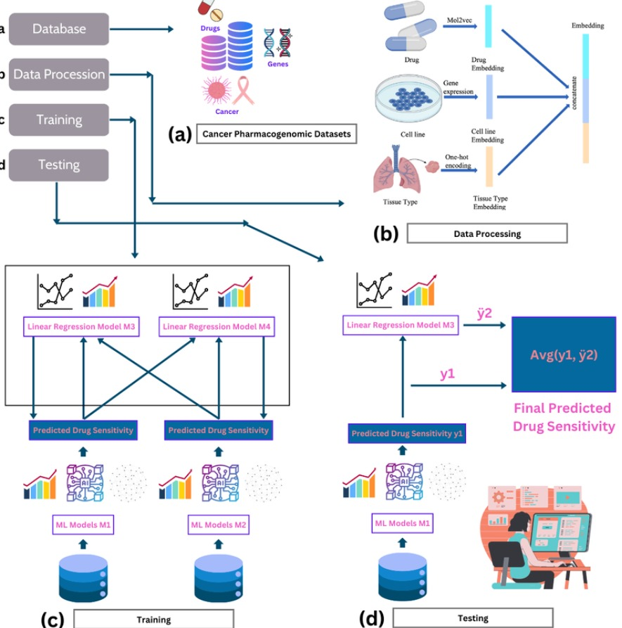
SYSTEM ARCHITECTURE

Slide 10
IMPLEMENTATION
Dataset:
Name and Source:
Size and Format:
Dataset Size: Contains approximately 1,000 human cancer cell lines with drug response data for 265 anti-cancer drugs.
Format: Tabular data in .csv format, comprising genomic features (e.g., gene expression, mutation status, copy number variations) and corresponding drug response values (log-normalized IC50).
Attributes:
Number of Rows: 250,000+ rows (one per drug-cell line pair).
Dataset Name: Genomics of Drug Sensitivity in Cancer (GDSC) Dataset
Source: Public dataset sourced from Kaggle, containing drug response data for cancer cell lines.

Slide 11
Number of Columns: Metadata columns, such as Cell Line ID, Drug Name/ID, Cancer Type, IC50 values, and genomic features (gene expression levels, mutation status, and copy number variations)
Target Variable: Log-normalized IC50 values for drug sensitivity
Features: Includes 10,000+ genomic attributes like gene expression levels, binary mutation indicators, and copy number variation scores.
Data Annotation:
Preprocessing Applied:
Each row corresponds to a specific cancer cell line's response to a drug, annotated with the drug's IC50 value.
Genomic features and drug response data are cross-referenced and validated for accuracy
Handling missing values by imputation or removal, depending on the feature.
Normalizing genomic features and IC50 values to a standard range or scale.
Splitting the dataset into training (70%), validation (20%), and testing (10%) subsets for model development.

Slide 12
TRAINED MODELS
Multiple Machine learning models were trained and evaluated to find the most effective one. The following models were tested:
LINEAR REGRESSION
RIDGE REGRESSION
LASSO REGRESSION
RANDOM FOREST REGRESSOR
GRADIENT BOOSTING
XG BOOST
SUPPORT VECTOR REGRESSION
K-NN REGRESSOR

Slide 13
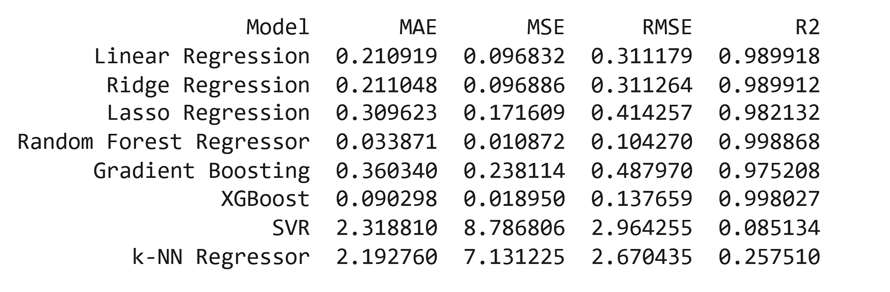
RESULTS GENERATED FROM THE MODELS:

Slide 14
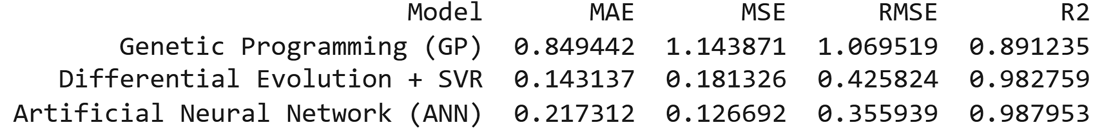
HYBRID MODELS USED:
HYBRID MODELS USED
GENETIC PROGRAMMING
DIFFERENTIAL EVOLUTION + SUPPORT VECTOR MACHINE
ARTIFICIAL NEURAL NETWORK
RESULT:

Slide 15
CONCLUSION
Multiple regression algorithms were tested and compared on the dataset.
Random Forest Regressor and XGBoost performed best, showing the lowest error metrics and highest R^2 values:
Random Forest: MAE = 0.0339, MSE = 0.01087, RMSE = 0.104, R2R^2R2 = 0.9989
XGBoost: MAE = 0.0903, MSE = 0.01895, RMSE = 0.1377, R2R^2R2 = 0.9980
Hybrid model Differential Evolution + SVR showed promising results:
Differential Evolution + SVR: R^2 = 0.9828
Models like SVR and k-NN underperformed, showing higher error values and lower R^2.
Overall, ensemble models (Random Forest, XGBoost) and hybrid models demonstrated superior performance in predicting drug sensitivity.

Slide 16
Queries?

Slide 17


