Slide 1
IPL DATABASE PROJECT
D Mohith Akhilesh • 16CS01002
R Jagadeesh • 16CS01025

Slide 2
Overview
ABOUT
TABLES
SQL QUERIES
TRIGGER USAGE

Slide 3
ABOUT
Indian Premier League (IPL) is the cricket league consisting of various Indian cities and has a brand value of around $5.3Bn. It started in 2008 and attracts large viewership.
The IPL data is available on Kaggle as csv files. We created tables matches and deliveries using the data.

Slide 4
ABOUT
Database contains statistics of all players who played in IPL between 2008 and 2017.
Database includes every match, every over,every ball bowled in IPL seasons 1 to 10.
The dataset contains 2 files: deliveries.csv and matches.csv.

Slide 5
ABOUT
Matches.csv contains details related to the match such as location, contesting teams, umpires, results, etc.
Deliveries.csv is the ball-by-ball data of all the IPL matches including data of the batting team, batsman, bowler, non-striker, runs scored, etc.

Slide 6
SETUP DATABASE
Create database ipl;
Use ipl;
create table matches(id int, season int, city varchar(30),match_date date,team1 varchar(30),team2 varchar(30),toss_winner varchar(30),toss_decision varchar(10),result varchar(10),dl_applied int,winner varchar(30),win_by_runs int,win_by_wickets int,player_of_match varchar(50),venue varchar(50),umpire1 varchar(50),umpire2 varchar(50));

Slide 7
SQL Queries
create table deliveries (match_id int , inning int , batting_team varchar(30), bowling_team varchar(30) , over int, ball int, batsman varchar(30), non_striker varchar(30), bowler varchar(30), is_super_over int , wide_runs int, bye_runs int, legbye_runs int, noball_runs int, penalty_runs int, batsman_runs int, extra_runs int, total_runs int, player_dismissed varchar(30), dismissal_kind varchar(20), fielder varchar(30));
LOAD DATA LOCAL INFILE '~/deliveries.csv' INTO table deliveries FIELDS TERMINATED BY ' , ' ;

Slide 8
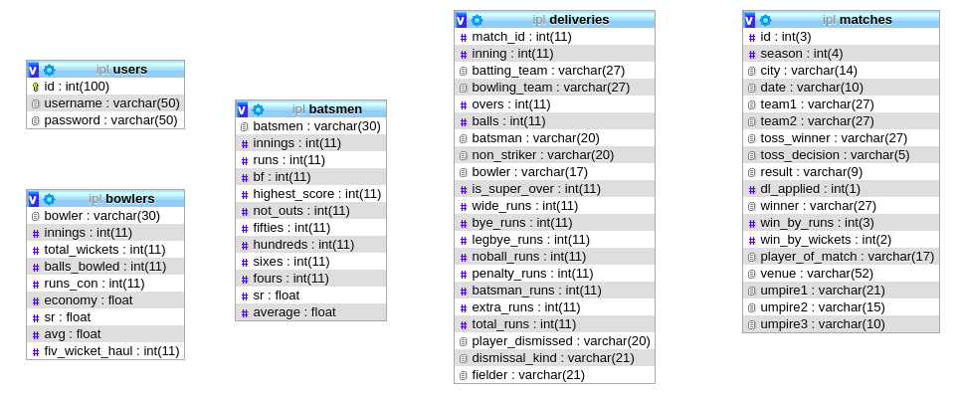

Slide 9
SQL QUERIES
Tables Batsmen and Bowlers are created from deliveries by executing series of SQL queries. They include all the information about batsmen and bowlers ranging from number of runs scored to strike rate of bowlers.
Those SQL queries are executed using PHPMYADMIN.

Slide 10
SOME SQL QUERIES

Slide 11
MOST SIXES IN AN INNINGS
Select batsman , batting_team as team , bowling_team as against , season , count(*) as sixes from deliveries , matches where batsman_runs=6 and matches.id=deliveries.match_id group by batsman , match_id , batting_team , bowling_team , season order by sixes desc limit 200 ;

Slide 12
HIGHEST INDIVIDUAL SCORES
Select batsman , batting_team as team , bowling_team as against , season , sum(batsman_runs) as individual_score from deliveries , matches where matches.id=deliveries.match_id group by batsman , match_id , batting_team, bowling_team , season order by individual_score desc limit 200 ;

Slide 13
MOST DOT BALLS
Select bowler , count(*) as dot_balls from deliveries where is_super_over=0 and wide_runs=0 and noball_runs=0 and batsman_runs=0 and bye_runs=0 and legbye_runs=0 group by bowler order by dot_balls desc;

Slide 14
MOST NUMBER OF MAIDEN OVERS
Select a.bowler , count(*) as maidens from ( select bowler, sum(batsman_runs+noball_runs+wide_runs) as runs_scored , over , match_id , count(*) as balls_bowled from deliveries group by match_id, bowler , over order by runs_scored) as a where a.runs_scored=0 and a.balls_bowled=6 group by a.bowler order by maidens desc ;

Slide 15
MOST FOUR WICKET HAULS
Select q.bowler, count(*) as four_wicket_haul from (select a.bowler, a.match_id, count(*) as innings_wickets from (select bowler, match_id from deliveries where player_dismissed is not null and dismissal_kind!='run out') as a group by a.bowler, a.match_id order by innings_wickets) as q where q.innings_wickets=4 group by q.bowler order by four_wicket_haul desc;

Slide 16
INSERTION OF NEW DATA
For inserting/modifying data in a database, we added an extra feature so that not everyone can modify database data.
This is done to improve database security.

Slide 17
TRIGGERS
create trigger batsmen_trigger after insert on deliveries for each row begin update batsmen set runs=runs+new.batsman_runs where batsmen=new.batsman;
update batsmen set bf=bf+1 where batsmen=new.batsman and new.wide_runs=0 and new.is_super_over=0;
update batsmen set sixes=sixes+1 where batsmen=new.batsman and new.batsman_runs=6; update batsmen set fours=fours+1 where batsmen=new.batsman and new.batsman_runs=4; end;

Slide 18
Create trigger bowler_trigger after insert on deliveries for each row
Begin update bowlers set balls_bowled=balls_bowled+1 where bowler=new.bowler and new.wide_runs=0; update bowlers set runs_con=runs_con+new.batsman_runs+new.wide_runs+new.noball_runs;
update bowlers set total_wickets=total_wickets+1 where new.player_dismissed is not null and new.dismissal_kind!='run out'; update bowlers set economy =6*runs_con/balls_bowled; update bowlers set sr=balls_bowled/total_wickets;
update bowlers set avg=runs_con/total_wickets; end;

Slide 19
Create trigger matches_batsman after insert on matches for each row
Begin insert into temps select batsman,sum(batsman_runs) as runzzz,count(*) as balls from deliveries where match_id=new.id and wide_runs=0 group by batsman,match_id;
update batsmen left outer join temps on batsmen.batsmen=temps.batsmen set innings=innings+1 where batsmen.batsmen=temps.batsmen;

Slide 20
update batsmen left outer join temps on batsmen.batsmen=temps.batsmen set highest_score=runzzz where runzzz>highest_score and batsmen.batsmen=temps.batsmen; update batsmen left outer join temps on batsmen.batsmen=temps.batsmen set fifties=fifties+1 where runzzz>=50 and runzzz<100 and batsmen.batsmen=temps.batsmen;
update batsmen left outer join temps on batsmen.batsmen=temps.batsmen set hundreds=hundreds+1 where runzzz>=100 and batsmen.batsmen=temps.batsmen;
update batsmen set sr=runs/bf; end;

Slide 21
THANK YOU

