Slide 1
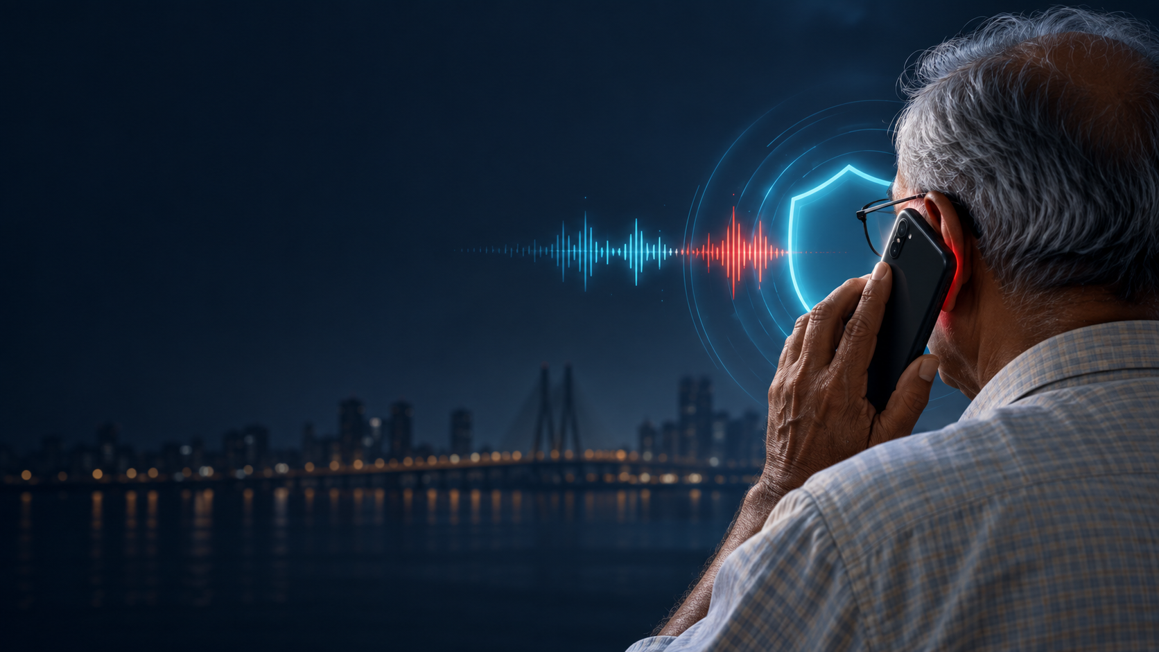
SCAMTRACE
Conversational Attack Firewall
Detect the manipulation.
Explain the attack.
Protect the decision.
A privacy-preserving AI security layer for live conversations
CodeGyaan’26 · Cybersecurity · AI for Inclusive Digital Transformation
Notes:
Cover image: generated concept art for SCAMTRACE. Present the project in one sentence: a local system that spots social-engineering behavior as a conversation unfolds.

Slide 2
THE PROBLEM
The scam happens inside the conversation
Fraud relies on authority, fear, isolation and an irreversible request.
24,02,579
₹22,495 crore
THE DECISION GAP
A victim has seconds to decide while the caller controls the story.
financial cyber-fraud complaints received by NCRP in 2025
amount reported by citizens in those 2025 complaints
The intervention must work before payment or credential sharing.
Digital-arrest fraud scripts impersonate police, CBI, RBI or customs. They invent a crime, force secrecy and demand money.
SCAMTRACE / 02
CodeGyaan’26 · Cybersecurity
Notes:
Sources: Ministry of Home Affairs, Rajya Sabha USQ 1341, 11 Feb 2026, https://sansad.in/getFile/annex/270/AU1341_tmaxdx.pdf?source=pqars
MHA/PIB advisory on digital-arrest fraud, 14 May 2024, https://www.pib.gov.in/Pressreleaseshare.aspx?PRID=2020570&lang=2&reg=48
Use precise wording: ₹22,495 crore is the amount reported by citizens, not a confirmed-loss estimate.

Slide 3
PROPOSED SOLUTION
A local security layer for live conversations
SCAMTRACE reads how a conversation behaves, then gives an explainable intervention.
1
2
3
4
5
CONVERSATION
LOCAL ASR
BEHAVIOR SIGNALS
THREAT DECISION
SAFE ACTION
Audio or text
English, Tamil, Hindi, Hinglish
Timestamped
local transcript
Authority
Threat
Isolation
Extraction
Score
Timeline
Evidence
Uncertainty
Stop
Verify independently
Protect accounts
Privacy boundary: audio processing, ASR and inference stay local. Cloud API calls: none.
SCAMTRACE / 03
CodeGyaan’26 · Cybersecurity
Notes:
Product definition: SCAMTRACE is a decision-support layer. It does not accuse a caller of a crime and does not depend on a deepfake signal alone.

Slide 4
LIVE DECISION
Threat escalation across a single call
The score changes when the evidence changes. It is not a decorative confidence number.
00:08
00:18
00:27
00:38
VERIFY
HIGH
HIGH
CRITICAL
28 / 100
47 / 100
60 / 100
100 / 100
Authority claim
Crime allegation
Isolation attempt
Payment request
“Do not disconnect. Transfer money to the safe account immediately.”
SCAMTRACE / 04
CodeGyaan’26 · Cybersecurity
Notes:
Motion cue: this slide uses a fade transition. Reveal the four points in sequence while speaking. Measured local real-time scenario: VERIFY 28 at 8s, HIGH 47 at 18s, HIGH 60 at 27s, CRITICAL 100 at 38s.

Slide 5
ARCHITECTURE
Local architecture
Independent signals converge into one explainable intervention.
INPUT
Audio file · Microphone capture · Transcript stream
LOCAL INFERENCE
whisper.cpp ASR · Security-term normalization · Acoustic anomaly signal
CONVERSATION INTELLIGENCE
Tactic detector · Language baseline · Attack progression · STDM-1 shadow model
INTERVENTION
Threat score · Timeline · Evidence · Recommended action · Local incident report
Fail-safe design: if voice analysis fails, scam-language and behavior analysis continue.
SCAMTRACE / 05
CodeGyaan’26 · Cybersecurity
Notes:
Architecture is editable native PowerPoint content. Key implementation detail: realtime sessions are bounded in local memory and are explicitly closed after use.

Slide 6
TECHNICAL APPROACH
Behavior-first detection
Voice authenticity can add context. The conversation drives the safety decision.
1
Tactics
2
Progression
Direct phrase evidence for authority claims, threats, urgency, isolation, credentials, payments and remote access.
Accumulates timestamps and repeated tactics. A scam can branch and escalate without following one fixed script.
3
Evidence fusion
4
Uncertainty gate
A human scam script can reach HIGH or CRITICAL even when the voice signal is human or unavailable.
Conflicting or insufficient evidence stays VERIFY. The tool recommends independent verification, not a legal conclusion.
SCAMTRACE / 06
CodeGyaan’26 · Cybersecurity
Notes:
Mention the hard contrast example: ‘Never share your OTP’ differs from ‘Share the OTP with me.’ The engine preserves this behavioral distinction.

Slide 7
DECISION QUALITY
STDM-1 and calibrated uncertainty
A bounded model measures decision state. It does not create artificial certainty.
STATE OUTPUT
NORMAL
CURRENT DEPLOYMENT GATE
SUSPICIOUS
SHADOW ONLY
IMPERSONATION
STDM-1 returns a state distribution and uncertainty, but it cannot alter alerts until independent real-call validation passes.
MANIPULATION
CREDENTIAL EXTRACTION
FINANCIAL EXTRACTION
Development check: 66.67% state accuracy · ECE 0.09708
Synthetic contrast data only.
SCAMTRACE / 07
CodeGyaan’26 · Cybersecurity
Notes:
Do not present STDM-1 as production-ready. Explain that a calibrated decision requires consented, multilingual, speaker-disjoint real-call data. Current shadow mode is deliberate risk control.

Slide 8
FEASIBILITY
Measured local performance
The prototype runs offline after one-time model setup.
0.85 ms
1.08 s
22
20 / 20
mean text analysis
mean local Whisper ASR
on a 10.5 s validation clip
automated tests passed
curated multilingual regression
suite passed
Offline core
Privacy
Safety fallback
Local whisper.cpp model, local JSON classifiers, local evidence fusion
Cloud API calls: NONE
Transcript persistence: OFF by default
Voice-auth failure never stops scam-language and behavior analysis
SCAMTRACE / 08
CodeGyaan’26 · Cybersecurity
Notes:
Measured locally in this workspace. Full SCAMTRACE regression suite is curated and must not be presented as independent real-world accuracy. Benchmark reports: reports/performance.json and reports/evaluation.json.

Slide 9
LIVE DEMO
A 90-second judge demonstration
Show the decision boundary before showing any implementation detail.
01
Safe human call
LOW
02
Synthetic voice, safe content
LOW
03
Digital-arrest scam in segments
VERIFY → HIGH → CRITICAL
04
Tamil or Hinglish scam
HIGH / CRITICAL
Decision rationale: authority claim · legal threat · isolation attempt · payment request
SCAMTRACE / 09
CodeGyaan’26 · Cybersecurity
Notes:
Run scripts/realtime_demo.py --scenario human_digital_arrest. Use the real local browser for the audio-upload or text scenario. Keep Wi-Fi disabled after setup to demonstrate offline inference.

Slide 10
TECH STACK
Practical technology choices
Small, local components reduce demo risk and make the system explainable.
LOCAL SPEECH
SECURITY ENGINE
DECISION MODELS
DELIVERY
whisper.cpp
multilingual base model
ffmpeg conversion
Python 3.11
rule taxonomy
attack progression
fusion
JSON Multinomial NB
ASR-noise augmentation
STDM-1 shadow model
Local HTTP service
browser microphone
incident report
pytest
Why this stack is feasible
No cloud LLM dependency. Safe JSON artifacts. Graceful degradation when ASR or voice analysis is unavailable.
SCAMTRACE / 10
CodeGyaan’26 · Cybersecurity
Notes:
All components are currently present in the repository. The project runs with ./run.sh after local model setup.

Slide 11

IMPACT
The intervention protects the decision
A clear pause can prevent irreversible action.
People
A plain-language warning gives families time to stop, verify and ask for help.
Institutions
Explainable evidence helps banks, telecom teams and cyber volunteers guide users without making accusations.
Inclusion
English, Tamil, Hindi and Hinglish — security beyond English-only tooling.
SCAMTRACE / 11
CodeGyaan’26 · Cybersecurity
Notes:
Impact visual: generated concept art, not a real photograph. Reference: PMO/PIB, 27 Oct 2024, states there is no legal system of ‘digital arrest’ and recommends Stop–Think–Take Action and reporting through 1930/cybercrime.gov.in: https://www.pib.gov.in/PressReleasePage.aspx?PRID=2068606&lang=2&reg=48

Slide 12
CLOSING
SCAMTRACE
LIVE DEMO
Detect the manipulation.
Explain the attack.
Protect the decision.
Human scam
Threat progression
Explainable intervention
A local conversational security layer designed for the moment a person needs to pause.
Ready locally at 127.0.0.1:8765
SCAMTRACE / 12
CodeGyaan’26 · Cybersecurity
Notes:
Motion cue: fade into this closing slide after the live demo. End with the tagline, then invite judges to try the real-time scenario.

Slide 13
REFERENCES
Research and reference base
Primary public sources and model-development references.
1
Ministry of Home Affairs, Rajya Sabha USQ 1341, 11 Feb 2026. Cybercrime Reporting and Investigation.
2
MHA / PIB, 14 May 2024. Advisory on digital-arrest fraud.
3
PMO / PIB, 27 Oct 2024. Mann Ki Baat warning: no system of digital arrest.
4
Rajya Sabha Standing Committee, Report 254, 20 Aug 2025. Cyber-financial crime context.
5
CERT-In CIAD-2024-0060, 27 Nov 2024. Deepfake risks include synthetic audio and social engineering.
6
Radford et al., 2022. Robust Speech Recognition via Large-Scale Weak Supervision.
7
Yamagishi et al., 2021. ASVspoof 2021: deepfake speech detection evaluation.
Direct links and source notes appear in the speaker notes. SCAMTRACE performance claims refer only to its recorded local reports.
SCAMTRACE / 13
CodeGyaan’26 · Cybersecurity
Notes:
Direct sources:
1. https://sansad.in/getFile/annex/270/AU1341_tmaxdx.pdf?source=pqars
2. https://www.pib.gov.in/Pressreleaseshare.aspx?PRID=2020570&lang=2&reg=48
3. https://www.pib.gov.in/PressReleasePage.aspx?PRID=2068606&lang=2&reg=48
4. https://sansad.in/getFile/rsnew/Committee_site/Committee_File/ReportFile/15/197/254_2025_8_12.pdf?source=rajyasabha
5. https://www.cert-in.org.in/s2cMainServlet?VLCODE=CIAD-2024-0060&pageid=PUBVLNOTES02
6. https://cdn.openai.com/papers/whisper.pdf
7. https://doi.org/10.48550/arXiv.2109.00537

