Slide 1
THE IMPACT OF FEATURE SELECTION ON THE REGRESSION TASK FOR LIFE EXPECTANCY PREDICTION
Life expectancy prediction is important for decision-making to facilitate advanced care planning processes.
Machine learning techniques are used to predict the life expectancy values for different people using regression algorithms.
Feature selection methods are known for their power to enhance the prediction quality results by selecting the best features that affect the prediction of the results.
In this paper, different regression techniques are applied to a life expectancy dataset provided by the World Health Organization.
These algorithms include Linear Regression, KNearest Neighbor Regression, and Decision Tree Regression which are combined with two different feature selection methods which are the Correlation Feature Selection and The Mutual Information Feature Selection methods.
Mariam M. Biltawi
Raneem Qaddoura

Slide 2
INTRODUCTION
FS is the approach used to reduce the number of inputted data. It is conducted automatically to select relevant features and reduce noise. The main benefits behind using FS are; removing redundant and irrelevant data, reducing training time.
FS techniques can be found, and categorized into three main categories; the wrapper, filter, and embedded.
Wrapper FS methods assign a score to each set of features and select the best one. The wrapper includes forward selection, backward selection, and recursive feature elimination
Filter FS methods aim to analyze the relationship between each input data and the label (target) using different measures and then selecting the input data accordingly.
Filter methods can include Mutual Information Feature Selection (MIFS), Correlation Feature Selection (CFS), Chi-square test, dispersion ratio, and fisher’s score methods.
Embedded FS methods combine the advantages of the wrapper and filter methods and include Lasso, and autoencoder with bottleneck.

Slide 3
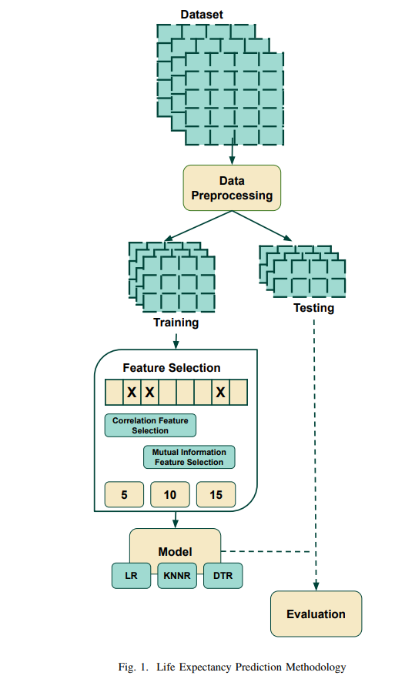
METHODOLOGY
Data preprocessing consists of two main processes: encoding categorical values and removing the missing values.
The dataset is split into training and testing parts having 0.20 instances for the testing part and 0.80 instances for the training part. The training part is used for model generation using a machine learning algorithm whereas the testing part is used for the model evaluation to check the model performance
Feature selection is performed using two feature selection methods for the training part to enhance the quality of the prediction. The two methods are CFS and MIFS.
The regression model generation is applied to the training part with the selected features. Three different algorithms are used including the LR, KNNR, and DTR algorithms.
Finally, the regression model is evaluated with the testing part of the dataset using two evaluation measures which are the R2 and the RMSE measures.

Slide 4
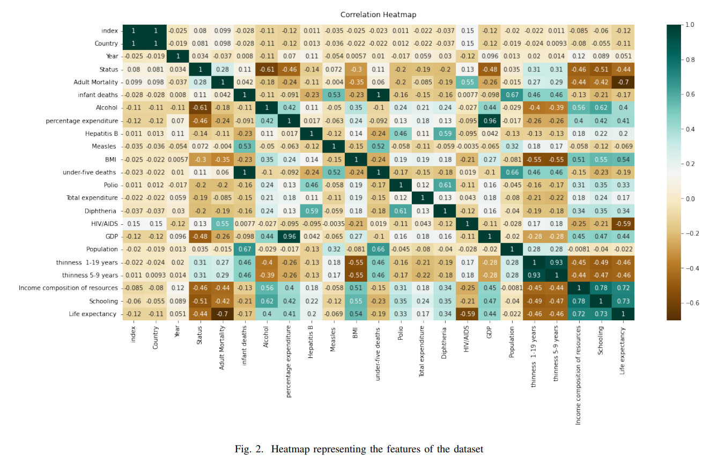
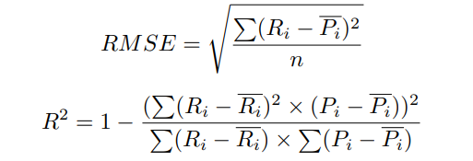
EXPERIMENTS AND RESULTS
R2 and RMSE measures are used to test the regression model and the feature selection process
Figure 2 shows the correlation values between the different features and between each feature and the life expectancy label.

Slide 5

CONCLUSION
The results showed that applying feature selection for the KNNR and DTR algorithms produced better results than running them without feature selection.
In addition, using feature selection for these algorithms produced better results than the LR algorithm.
The best result was obtained with the combination of MIFS, DTR, and k value of 15 with the value of 0.917 for R2.
The value of 2.36 for RMSE was obtained as the best result for the combination of CFS, DTR, and k value of 10.

