Slide 1

B-Tech Data Science-C Major Project Review
Smart Intelligent Passenger Assistance System for Airports
(SIPAS)
Batch No.
Student Name | Roll Number
23071A67E5 | D. Nitish Varma
23071A67E9 | G. N. Nishanth
23071A67F6 | K. Sai Venkat
23071A67J6 | T. Pranavi
Under The Supervision of
Name: Mr. Manmath Nath Das
Designation: Assistant Professor
Dept. of CSE-(CyS, DS) and AI&DS

Slide 2


Abstract:
Airports are complex environments where passengers, particularly elderly travelers, first-time flyers, and those unfamiliar with airport procedures, may face difficulties in navigation, flight management, baggage identification, transportation, and emergencies. This project proposes an AI powered Airport Assistant that provides a unified, context-aware platform for seamless passenger assistance throughout the airport journey. The application offers indoor navigation to terminals, gates, and essential facilities, optimized for airport environments. It also provides real-time flight tracking, including flight status, gate information, and live flight location. A baggage assistance module enables passengers to monitor baggage status after landing and scan baggage barcodes using their smartphone camera to verify ownership and reduce accidental exchanges. The application provides information on airport transit services such as buses and metro systems, with links to their official websites and applications. An agentic AI assistant understands the passenger’s journey context and performs relevant actions, such as automatically opening navigation when directions to a specific gate are requested. An emergency assistance feature allows passengers to send their location to designated authorities during medical or safety emergencies. Additionally, a personal mentor feature allows passengers to register a trusted Gmail contact who receives important journey updates, including security completion, baggage check-in, and boarding.
Keywords: Airport Assistant, Indoor Navigation, Real time Flight Tracking, Baggage Verification, Emergency Assistance

Slide 3
CHAPTER-1 Introduction:
1.1 Background of the problem
Airports are large and dynamic environments where passengers need to complete several activities during their journey, such as finding terminals and gates, checking flight information, locating baggage, using airport transportation, communicating with airport staff, and responding to unexpected situations. Unlike simple travel environments, airports require passengers to continuously understand and respond to changing information within limited time. These challenges can become more difficult for first-time flyers, elderly passengers, passengers with limited mobility, and travelers who are unfamiliar with airport procedures or the local language. As a result, passengers may experience confusion, stress, and difficulty in making the right decisions at different stages of their journey.
The existing airport assistance experience is often distributed across multiple systems and information sources. Flight updates may be available through airline applications or airport displays, navigation may require separate maps or signage, transportation information may be provided through different websites or applications, and emergency assistance may require direct communication with airport authorities. Similarly, passengers may need to approach staff members whenever they require personalized assistance. In such situations, they may have to explain their complete context, including their flight number, source, destination, gate, current location, and specific requirement. Repeatedly providing this information can consume time and may become inconvenient, particularly when the passenger needs immediate assistance.
Recent developments in Artificial Intelligence (AI), Large Language Models (LLMs), multimodal systems, and agentic AI provide an opportunity to address these challenges through a unified and context-aware assistance platform. An intelligent system can understand natural-language requests, identify the passenger's current context, and connect the request with the appropriate service instead of requiring the passenger to manually search through different features. Therefore, there is a need for an AI-powered airport assistance system that can bring multiple passenger services together and provide personalized support throughout the airport journey. Such a system can help passengers access navigation, flight information, baggage guidance, transportation, language assistance, emergency support, and other services through a single platform, reducing confusion and making the overall airport experience more convenient.

Slide 4
1.2 Need and Relevance
The increasing complexity of modern airports creates a need for passenger assistance that is simple, accessible, and available throughout the entire journey. Passengers are required to make several decisions within limited time, often while dealing with unfamiliar surroundings, changing information, language barriers, or unexpected situations. For first-time travelers, elderly passengers, and passengers who require additional assistance, even basic activities such as finding the correct gate, understanding airport information, or locating baggage can become challenging.
The relevance of an intelligent assistance system comes from the need to provide timely and personalized support based on the passenger's situation. Airport information is not always useful when presented without context. For example, knowing a gate number does not help much if a passenger does not know how to reach that gate, and knowing that baggage is available does not help if the passenger cannot identify the correct baggage belt. Similarly, during an emergency or language-related difficulty, passengers need immediate and understandable assistance rather than having to search through multiple sources.
There is also a need to reduce the communication gap between passengers, their families, and airport services. Family members may want to remain informed about a passenger's journey, while passengers may need assistance without repeatedly explaining their complete travel details to different people. A system that can maintain relevant journey context can make this interaction more efficient and reduce unnecessary delays. Therefore, an intelligent, context-aware airport assistance platform is relevant for creating a more connected, accessible, and passenger-oriented airport experience. The use of AI and multimodal interaction further provides an opportunity to make assistance more natural, allowing passengers to communicate their requirements in their own words rather than having to understand the structure of the application first. This makes the concept relevant not only for providing information, but also for helping passengers understand, navigate, communicate, and respond to situations throughout their airport journey.

Slide 5
1.3 Problem Statement
Fragmented Passenger Information and Service Access:
Passengers often need to access boarding information, baggage details, and essential airport services through different sources, making it difficult to obtain the required information quickly and conveniently.
Communication and Language Barriers:
Passengers may face difficulties communicating with airport personnel or understanding travel-related information due to language barriers and the absence of personalized, conversational assistance.
Complex Airport Mobility and Changing Travel Information:
Passengers may struggle with indoor airport navigation, transportation planning, and continuously changing flight or boarding information, particularly in unfamiliar airport environments.
Limited Integrated Safety and Assistance Mechanisms:
Passengers may not have a unified mechanism to receive timely assistance during emergencies or to keep trusted contacts informed about important stages of their journey, affecting the responsiveness and accessibility of airport support.

Slide 6
1.4 Objectives:
* To develop an intelligent passenger information and assistance framework that automates boarding-pass information extraction, baggage guidance, and access to essential airport services.
* To develop an AI-driven multilingual and conversational assistance mechanism that enables effective passenger–airport personnel communication and provides intelligent responses to travel-related queries.
* To design an intelligent mobility and navigation framework that supports indoor airport navigation, transit planning, flight-time monitoring, boarding alerts, and real-time airport transportation tracking.
* To enhance passenger safety and operational efficiency through integrated emergency notification and assistance mechanisms, contributing to a more accessible, responsive, and passenger-centric airport environment.

Slide 7
1.5 Scope of Work
• Integrated Passenger Assistance:
Develop a unified platform that provides passengers with essential assistance throughout different stages of their airport journey.
• Intelligent Information & Service Access:
Provide access to flight information, baggage guidance, airport services, and public transit information through a single platform.
• Multilingual & Conversational Assistance:
Support passengers through voice and visual language translation and enable natural-language interaction with an AI-based assistant.
• Navigation & Mobility Support:
Provide indoor airport navigation, route guidance, flight updates, and assistance in identifying and tracking available airport transportation.
• Safety & Personalized Assistance:
Provide emergency assistance, SOS-based location sharing, and automated journey updates to registered parents or guardians.
• Context-Aware Agentic AI:
Enable the AI assistant to understand the passenger's request and available journey context, and initiate the relevant service or action automatically.

Slide 8
1.6 Organization of the Report
Chapter 1 – Introduction
Presents the background of the problem, need and relevance, problem statement, objectives, and scope of the project.
Chapter 2 – Literature Review
Discusses existing research and approaches related to AI-based airport assistance, identifies their limitations, and presents the research gaps addressed by SIPAS.
Chapter 3 – Approach / Design Methodology
Describes the proposed methodology, technical approach, system design, key components, tools, and technologies used to develop SIPAS.

Slide 9
Chapter 2 – LITERATURE REVIEW
2.1 Overview of Existing Work
Existing airport assistance systems mainly focus on providing passengers with information and support for specific aspects of their journey. Airport and airline applications commonly provide flight status, boarding information, gate updates, baggage information, and transportation details. Navigation solutions and digital airport maps have also been developed to help passengers locate terminals, gates, facilities, and other important locations. In addition, chatbot-based systems and AI assistants have been explored to answer passenger queries and provide information through conversational interfaces.
Recent research has further introduced Artificial Intelligence, Large Language Models (LLMs) and multimodal systems into airport-related applications. These approaches enable systems to understand natural-language queries and interact with structured airport information or backend services. Some existing works also explore baggage-data analysis, multilingual assistance, and intelligent passenger support. However, these solutions are generally focused on individual services or specific use cases rather than providing a unified assistance experience covering navigation, flight updates, baggage, transit, communication, safety, and personalized journey support. This provides the basis for developing SIPAS as an integrated and context-aware passenger assistance platform.

Slide 10
2.2 Critical Analysis of Literature:
Title of the Paper | Author details and Journal / conference publishing information | Proposed method used in the Journal or conference paper | Dataset used in the Paper | Advantages of the proposed paper | Research Gap Identified
1. A Multimodal LLM-Based AI Assistant for Intelligent Exploration of Airport Baggage Records | O. Adiguzel et al.; IISEC 2026, IEEE | Multimodal LLM assistant using text/voice, intent & parameter extraction, tool selection and predefined backend services | 4 million baggage records, Izmir Adnan Menderes Airport | Natural-language airport-data interaction; multimodal input; reliable service orchestration | Mainly focused on baggage analytics, not complete passenger assistance; voice evaluated with one ASR model
2. STING-BEE: Towards Vision-Language Model for Real-World X-ray Baggage Security Inspection | D. Velayudhan et al.; CVPR 2025 | Vision-language AI assistant for scene comprehension, threat localization, visual grounding and VQA | STCray: 46,642 image-caption scans, 21 threat categories | Multimodal baggage understanding; supports multiple visual-language tasks; strong cross-domain performance | Specialized for X-ray security screening, not passenger-facing assistance
3. Chatbots in Airport Customer Service: Exploring Use Cases and Technology Acceptance | Airport customer-service chatbot research; Future Internet, 2024 | Investigates airport chatbot use cases and passenger acceptance | Passenger/traveler study and chatbot use-case evaluation | Directly studies chatbot acceptance in airports; identifies practical customer-service applications | Focuses mainly on acceptance/use cases, rather than context-aware AI orchestration
4. An Efficient and Simple Approach for Indoor Navigation: Using Smart Phone and QR Code | V. V. Chirakkal, M. Park, D. S. Han, J. H. Shin; IEEE ISCE 2014 | Smartphone IMU combined with QR-code localization | Indoor navigation test environment | Low-cost and simple indoor positioning; QR codes compensate for IMU errors | Requires QR-code infrastructure; not specifically designed for complex airport passenger workflows
5. Evaluating the Performance of RAG Methods for Conversational AI in the Airport Domain | Y. Li, P. J. M. Kerbusch, R. H. R. Pruim, T. Käfer; NAACL-HLT 2025 | Compares Traditional RAG, SQL-RAG and Knowledge-Graph RAG for conversational access to airport flight information | Amsterdam Airport Schiphol flight-information data; straightforward and complex/jargon-based question sets | Graph RAG achieved 91.49% accuracy and performed particularly well for reasoning-based airport queries; structured RAG approaches reduced hallucinations | Focuses on airport staff and flight-information systems, rather than passenger-facing assistance; evaluated around a specific airport/domain

Slide 11
2.2 Critical Analysis of Literature:
Title of the Paper | Author details and Journal / conference publishing information | Proposed method used in the Journal or conference paper | Dataset used in the Paper | Advantages of the proposed paper | Research Gap Identified
6. A Multimodal LLM-Based AI Assistant for Intelligent Exploration of Airport Baggage Records | Yan et al.; Transactions in GIS, 2022 | QR-code localization with indoor navigation-network/path planning | Shopping-mall indoor environment | Provides practical QR-based path planning and addresses indoor positioning challenges | Demonstrated primarily in a shopping-mall environment; not integrated with airport/flight context
7. Indoor Airport Wayfinding for Blind and Visually Impaired Travelers | G. E. Legge, C. Downey, N. A. Giudice, B. S. Tjan; FAA Technical Note, 2016 | Analysis of airport wayfinding challenges and accessibility requirements | Study of visually impaired travelers and airport wayfinding requirements | Identifies real accessibility problems and critical airport destinations | Primarily a wayfinding/accessibility study, not an AI implementation
8. Design Mechanisms of Airport Visual Guidance Systems on Passenger Wayfinding Performance | Liyun Wang & Xiaochan Wang; 2025 | Causal machine learning and moderated mediation analysis of visual guidance | Airport passenger wayfinding/visual-guidance observations and evaluations | Connects airport visual guidance with passenger wayfinding performance | Concentrates on visual guidance design, rather than integrated digital/AI assistance
9. Flight Delay Prediction for Commercial Air Transport: A Deep Learning Approach | B. Yu et al.; Transportation Research Part E, 2019 | Deep Belief Network with Support Vector Regression for delay prediction | High-dimensional data from Beijing Capital International Airport (PEK) | Captures nonlinear delay patterns; useful for predictive flight management | Focuses on delay prediction, not passenger assistance or personalized recommendations
10. Chatbots in Airport Customer Service Exploring Use Cases and Technology Acceptance | I. Auer, S. Schlögl, G. Glowka; Future Internet, 2024, Vol. 16(5), 175 | Extended Technology Acceptance Model (TAM) using perceived usefulness, ease of use, trust and enjoyment to study airport chatbot adoption | Survey of 191 travelers | Identifies airport chatbot use cases and shows that usefulness, trust, ease of use and enjoyment positively relate to intention to use airport chatbots | Studies acceptance and customer-service use cases, rather than implementing context-aware or agentic AI; does not integrate navigation, flight, baggage and emergency services

Slide 12
Chapter 3 – Approach / Design Methodology
3.1 Overview of Phase –I Work and Outcomes
• Boarding-Pass Information Extraction:
Developed a QR-based module to automatically extract passenger and flight information from boarding passes.
• Passenger Context Generation:
Generated structured passenger profiles from the extracted boarding-pass information to support personalized assistance.
• Multilingual Conversational AI:
Developed text- and voice-based conversational assistance with automatic language detection and support for multiple languages.
• Knowledge-Based Airport Assistance:
Integrated passenger context with airport-related knowledge to provide baggage guidance, airport-service recommendations, transit assistance, and travel-related responses.
• Prototype Evaluation:
Evaluated the integrated system using multiple passenger scenarios, including domestic travel, international travel, transit, baggage inquiries, and airport services.

Slide 13
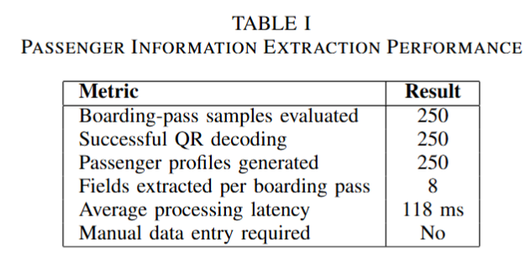
3.1 Overview of Phase –I Work and Outcomes
PASSENGER INFORMATION EXTRACTION
• Developed a QR-based boarding-pass information extraction module to automatically capture passenger and flight details.
• The system extracts key information including passenger name, flight number, terminal, gate, departure time, airline, seat number, and ticket identifier.
• The extracted information is automatically used to generate a structured passenger profile without requiring manual data entry.

Slide 14
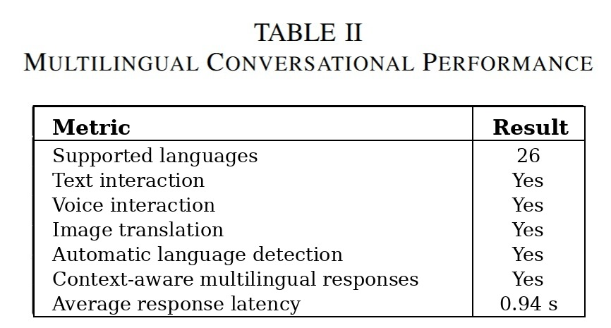
3.1 Overview of Phase –I Work and Outcomes
MULTILINGUAL CONVERSATIONAL ASSISTANCE
• Developed a multilingual conversational AI subsystem to support natural interaction between passengers and airport services.
• The system supports both text and voice interactions, with automatic language detection, contextual translation, and passenger-specific response generation.
•Automatically detects the language in the uploaded image and translates the extracted text into the passenger’s selected destination language.

Slide 15
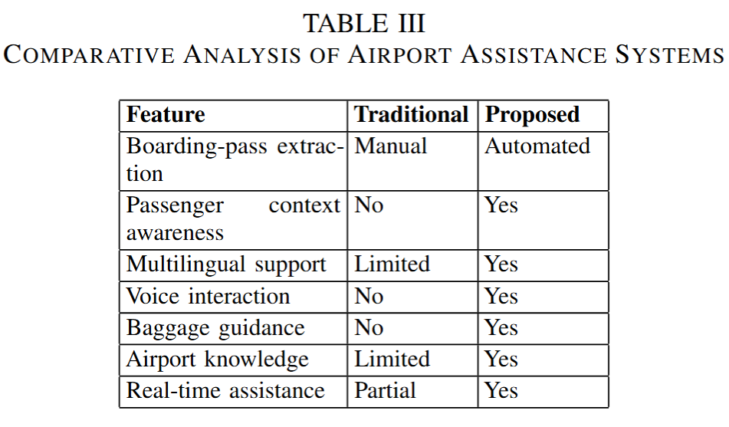
3.1 Overview of Phase –I Work and Outcomes

Slide 16
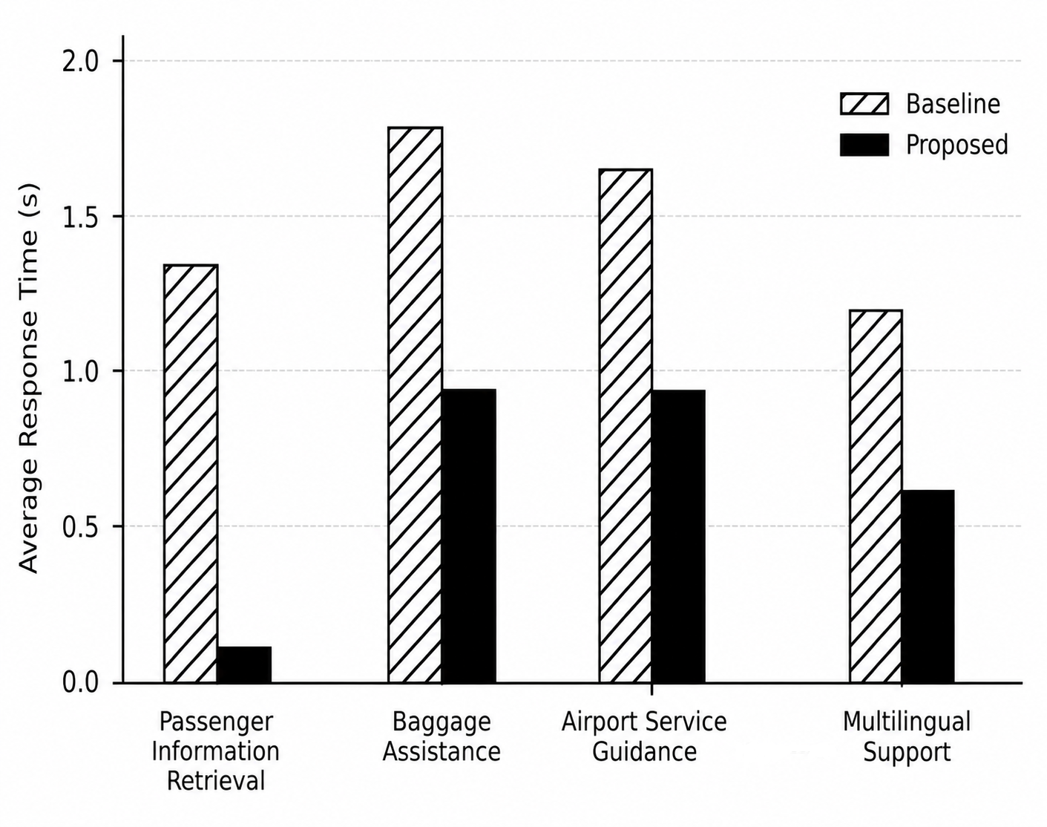
3.1 Overview of Phase –I Work and Outcomes
END-TO-END PASSENGER ASSISTANCE & PERFORMANCE OUTCOMES
• Based on the extracted passenger context, the system provides baggage guidance, airport-service recommendations, transit assistance, and multilingual conversational support without requiring manual flight-information entry.

Slide 17
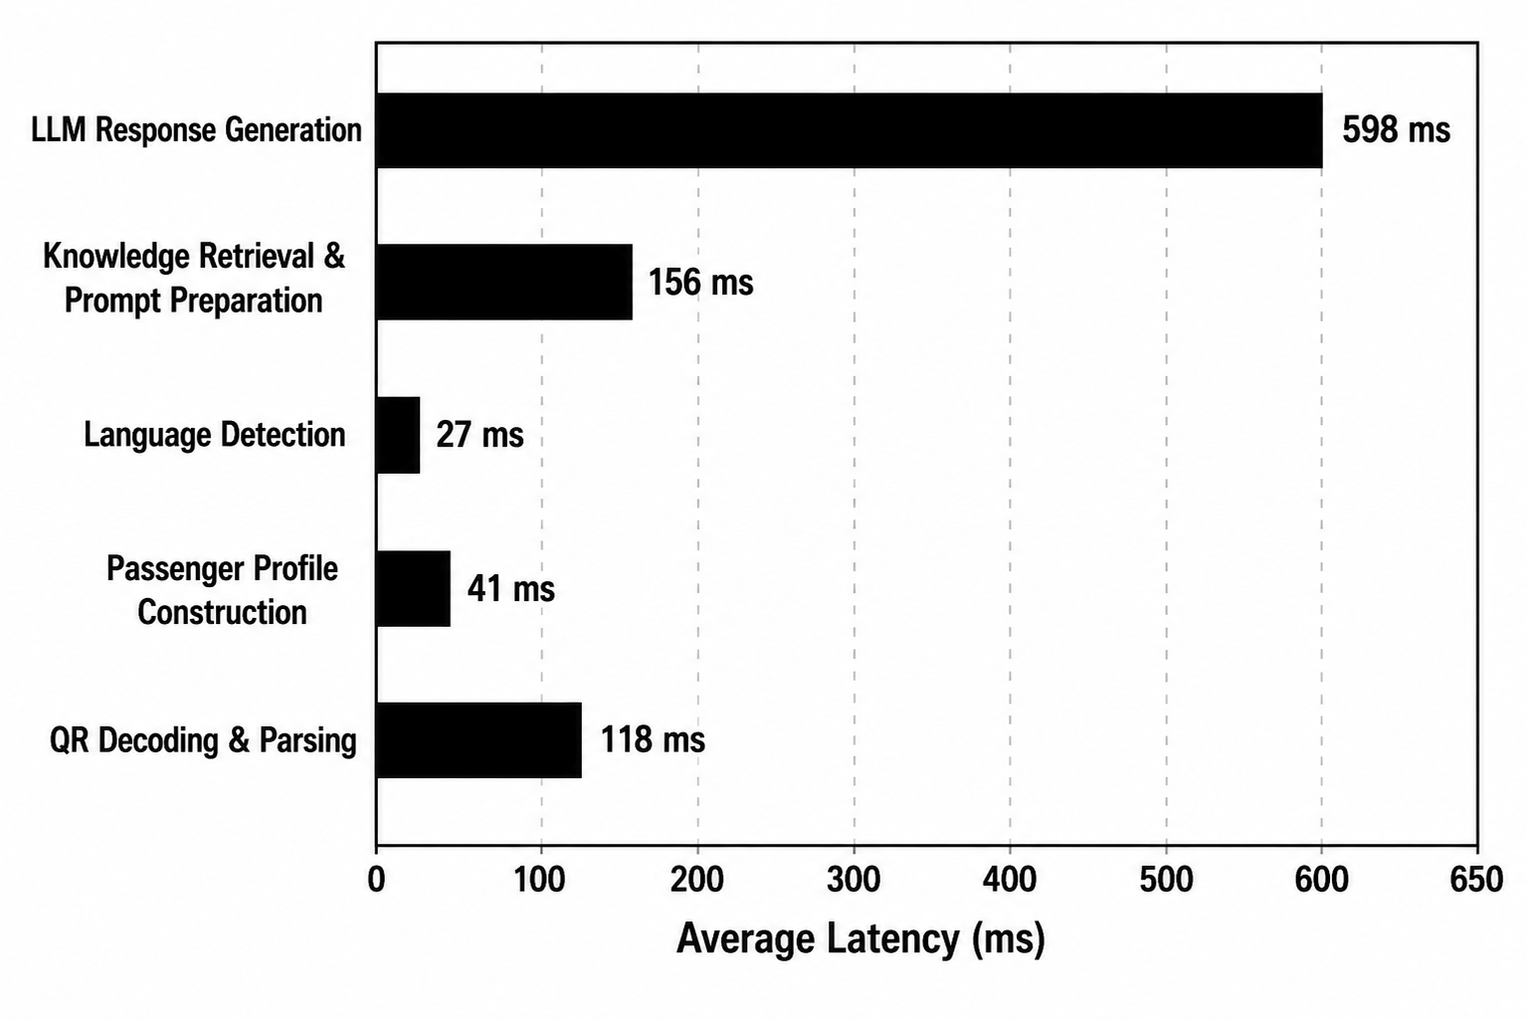
3.1 Overview of Phase –I Work and Outcomes

Slide 18
3.2 Refinement of Problem and Objectives based on Feedback
* Initially, the project problems were identified as individual passenger-level issues such as airport navigation, flight updates, baggage, transit, language barriers, emergency assistance, and passenger–guardian communication.
* Based on the feedback, these individual issues were consolidated into four broader problem areas to provide a clear and structured problem definition.
* The refined problem areas focus on fragmented passenger information and service access, communication and language barriers, complex airport mobility and changing travel information, and limited integrated safety and assistance mechanisms.
* The objectives were refined accordingly and aligned with these four major problem areas: intelligent passenger information and assistance, AI-driven multilingual and conversational assistance, intelligent mobility and navigation, and integrated passenger safety and assistance.
* This refinement established a clear relationship between the identified problems and the project objectives, providing a structured foundation for developing the SIPAS framework.

Slide 19
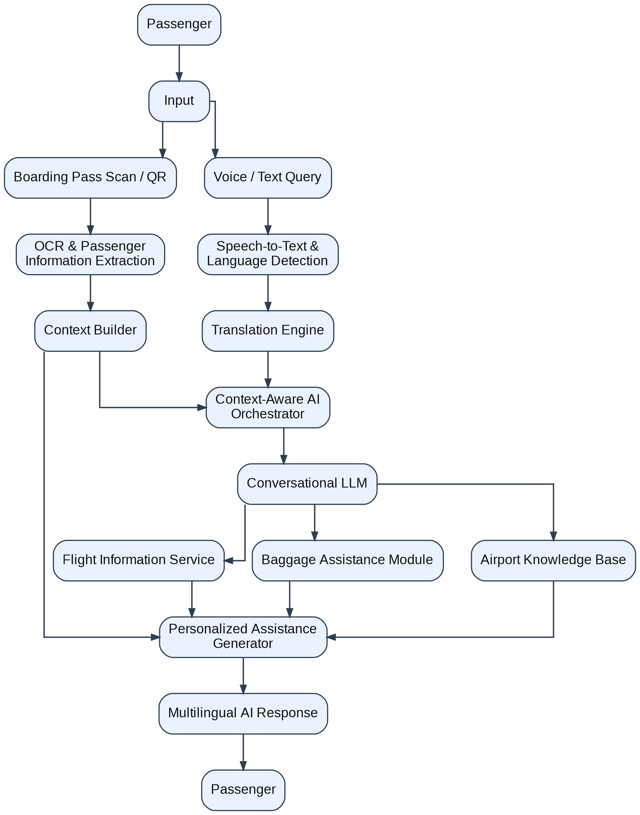
3.3 Selection of Approach / Methodology (Architechture):

Slide 20
3.4 Technical Approach and Key Elements
1. Boarding-Pass Information Extraction:
The system uses ZXing-WASM and ZXing Library for QR/barcode decoding from boarding passes. The extracted IATA BCBP/JSON data is processed to obtain passenger name, flight number, ticket ID, source, destination, terminal, gate, departure time, and seat number.
2. Passenger Context & Baggage Assistance:
The extracted boarding-pass details are stored as a structured passenger context and passed to the assistance modules. This context is used to provide baggage guidance and airport-service information without requiring repeated manual entry of flight details.
3. Multilingual Conversational AI:
The conversational module uses Google Gemini 2.5 Flash to understand passenger queries and generate context-aware responses. Automatic language detection and Gemini-based translation support multilingual text interaction, while the Web Speech API enables voice input and speech-based interaction.
4. Image-Based Translation & Voice Assistance:
For visual airport information, the system sends uploaded images to Gemini Vision for OCR and translation, with Tesseract.js as a fallback. Responses can be converted to speech using the backend TTS service, HTML5 Audio, or Speech Synthesis, enabling accessible multilingual passenger–airport communication.

Slide 21
3.5 Supporting Analysis / Design Considerations
Passenger Context Management: Extracted passenger and flight information is stored in the database and used as persistent context for subsequent assistance and personalized responses.
LLM-Based Intelligence: The Large Language Model (Gemini 2.5 Flash) acts as the core intelligence layer, understanding natural-language queries, interpreting passenger context, generating responses, and supporting multilingual communication.
Multimodal Interaction: The system supports text, voice, and image-based inputs, enabling passengers to communicate naturally and translate airport signs or other visual information.
Real-Time & Modular Design: The system follows a modular architecture where passenger information, AI assistance, translation, baggage guidance, and airport services can operate as interconnected components while maintaining responsive interaction.

Slide 22
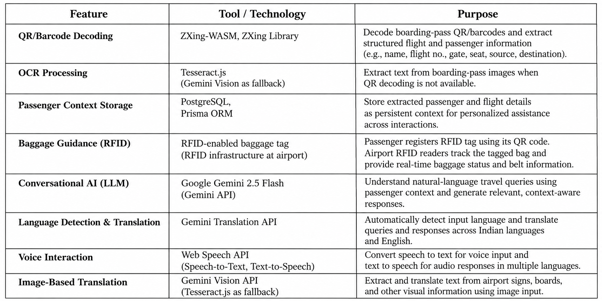
3.6 Tools / Techniques Used

Slide 23
3.7 Justification of Selected Approach
QR/Barcode + OCR: Selected to automate boarding-pass information extraction and reduce manual entry while supporting different boarding-pass formats.
PostgreSQL + Prisma ORM: Selected to store passenger and flight information as persistent context, enabling personalized assistance across subsequent interactions.
RFID-Based Baggage Tracking: Selected to provide baggage status and baggage-belt information using RFID-enabled tags and airport-side RFID infrastructure.
Gemini 2.5 Flash (LLM): Selected as the core intelligence layer because it can understand natural-language travel queries, use passenger context, and generate context-aware responses.
Multimodal Multilingual Interaction: Gemini Translation, Web Speech API, and Gemini Vision were selected to support language detection, translation, voice interaction, and image-based translation, enabling more accessible passenger–airport communication

Slide 24
THANK YOU

Slide 25
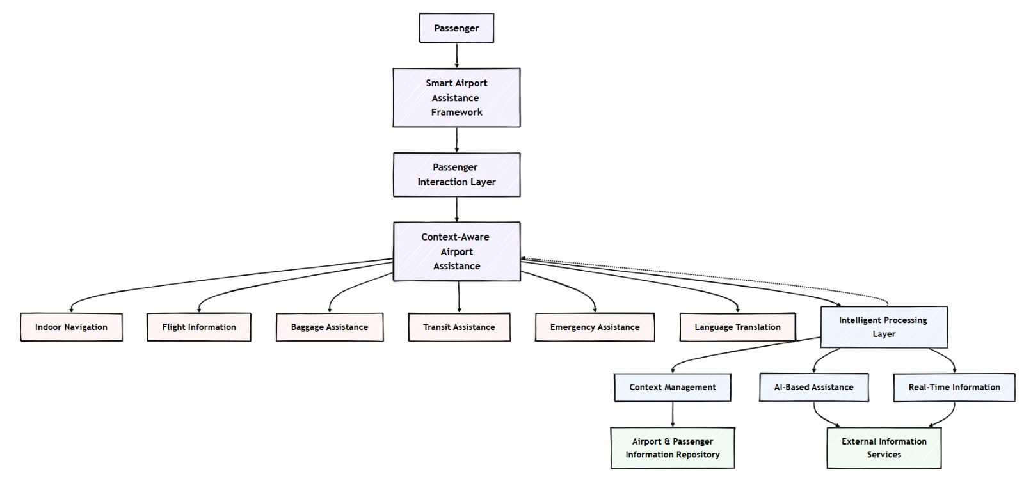
Proposed System Architecture:

Slide 26
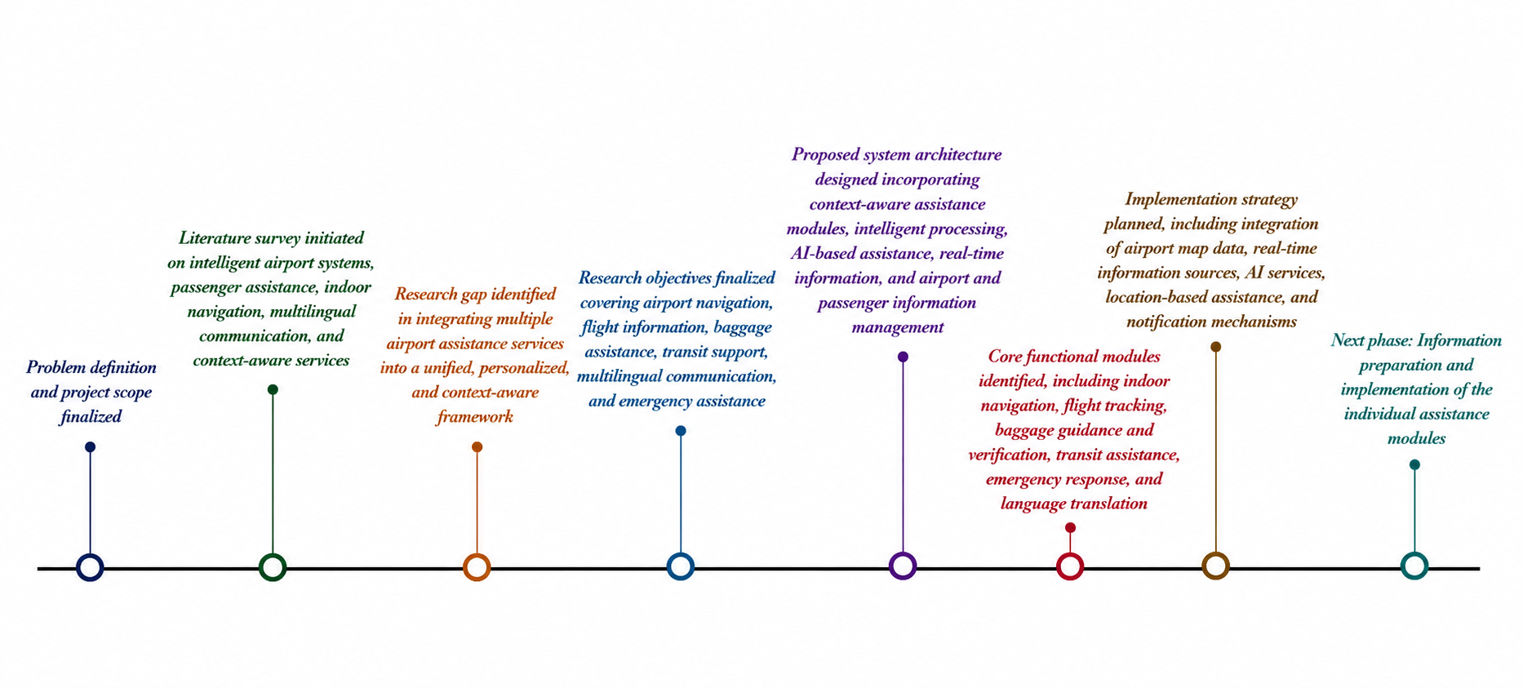
Progress of the Work:

Slide 27
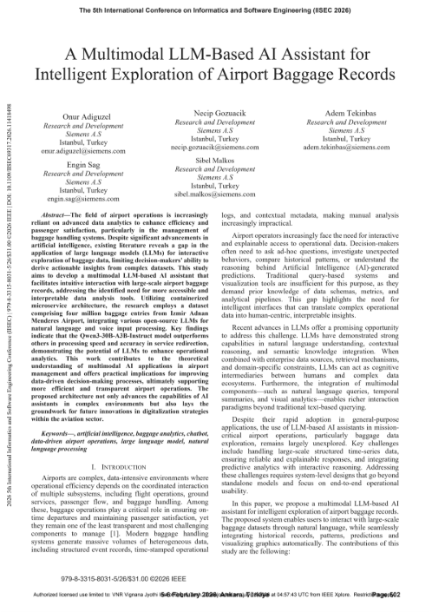
Base Paper along with Link:
_A_Multimodal_LLM-Based_AI_Assistant_for_Intelligent_Exploration_of_Airport_Baggage_Records/

Slide 28
References:
1. A_Multimodal_LLM-Based_AI_Assistant_for_Intelligent_Exploration_of_Airport_Baggage_Records​
​
2. A_QR_Code_Enabled_Intelligent_Navigation_Assistance_System_fo_Public_and_Indoor_Spaces​
​
3.Digitalization_of_Airside_Operations_Process_to_Improve_Airport_Operations_For_The_Case_of_Malaysia_Airports​
​
4. Research_on_Data_Governance_Methods_and_Systems_for_Large_Hub_Airports​
​
5. Airport_Ground_Assistance_Rover​
​
6.Machine_Learning_of_Air_Traffic_Controller_Command_Extraction_Models_for_Speech_Recognition_Applications​
7. Design Mechanisms of Airport Visual Guidance Systems on Passenger Wayfinding Performance
8.Navigation Network Derivation for QR Code-Based Indoor Pedestrian Path Planning

