Slide 1


An AI-Driven Autonomous DevOps Framework for Intelligent Cloud Infrastructure Provisioning and Application Deployment
Batch Number:
Name of the Team Members | Roll Numbers
G. Vibhas Naidu | 23071A67F1
Jagadeeswar Jonnadula | 23071A67F4
K Parvez Alam | 23071A67F5
Y. Uday Bhaskar Reddy | 23071A67K4
Under The Supervision of:
Name: Dr. P Jyothi
Designation: Assistant Professor
Dept. of CSE-(CyS, DS) and AI&DS

Slide 2

Abstract:
Modern software development requires efficient, scalable, and reliable cloud deployment, but developers often face challenges in analyzing application requirements, selecting suitable cloud services, configuring infrastructure, managing CI/CD pipelines, and identifying deployment or runtime failures. This project proposes an AI-Driven Autonomous DevOps Framework for Intelligent Cloud Infrastructure Provisioning and Application Deployment that integrates Artificial Intelligence, Machine Learning, Large Language Models, Natural Language Processing, and cloud automation into a unified platform. The system enables developers to connect external code repositories such as GitHub, after which an ML-based code analysis model analyzes the source code to identify the programming language, framework, dependencies, architecture, and infrastructure requirements. Based on these characteristics, an ML-driven cloud-service recommendation model recommends suitable services and deployment strategies across AWS, Microsoft Azure, and Google Cloud Platform (GCP) by considering application requirements, cost, performance, scalability, and resource utilization. A decision and rule layer allows users to enforce deployment preferences, such as selecting a specific cloud provider or choosing the most cost-effective option.
The framework also incorporates an LLM-based application intelligence module to provide context-specific insights about the codebase, architecture, dependencies, functionality, and deployment requirements. Terraform and cloud provider APIs are used to automatically provision the selected infrastructure and deploy applications through CI/CD pipelines. The system generates an explainable deployment report describing the selected cloud resources, their purpose, configuration, and the reasoning behind deployment decisions. For operational reliability, an ML-based monitoring and anomaly detection model analyzes application and infrastructure metrics and logs to identify abnormal behavior, while an ML-based error classification model identifies deployment and runtime failures and predicts their probable causes. A rule-based automation engine can initiate corrective actions such as application restart, scaling, rollback, or redeployment. By combining Machine Learning, Artificial Intelligence, Natural Language Processing, Infrastructure as Code, and multi-cloud automation, the proposed framework aims to reduce manual DevOps effort, improve deployment reliability, optimize cloud-resource selection, and enable intelligent, autonomous, and explainable application deployment across heterogeneous cloud environments.
Keywords:
Artificial Intelligence, Machine Learning, Cloud Computing, DevOps Automation, Multi-Cloud Deployment, Infrastructure as Code, CI/CD, Anomaly Detection.

Slide 3
CHAPTER-1 Introduction:
1.1 Background of the problem
Cloud computing and DevOps have become essential technologies in modern software development, enabling organizations to develop, deploy, and scale applications efficiently. However, cloud application deployment involves several complex activities, such as analyzing application requirements, identifying dependencies, selecting appropriate cloud services, configuring infrastructure, establishing CI/CD pipelines, and managing deployment issues. These activities often depend on manual effort and specialized technical knowledge. The complexity increases further when applications need to be deployed across multiple cloud platforms with different services, configurations, and resource requirements. Therefore, there is a need for intelligent approaches that can assist developers in making effective deployment and infrastructure decisions.
The proposed AI-Driven Autonomous DevOps Framework for Intelligent Cloud Infrastructure Provisioning and Application Deployment addresses these challenges by integrating Artificial Intelligence, Machine Learning, Natural Language Processing, cloud computing, and DevOps technologies. The framework analyzes application source code to identify its characteristics, dependencies, architecture, and infrastructure requirements, and uses ML-based models to recommend suitable cloud services and deployment strategies. It also incorporates cloud resource provisioning, CI/CD pipelines, application monitoring, anomaly detection, and error classification to support different stages of the deployment lifecycle. By combining intelligent decision-making with multi-cloud technologies, the proposed framework aims to improve deployment efficiency, reliability, scalability, and cost-effectiveness, while reducing the complexity and technical effort involved in cloud application deployment.

Slide 4
1.2 Need and Relevance
Modern software development increasingly depends on cloud computing and DevOps practices to develop, deploy, and manage applications efficiently. However, cloud application deployment involves several activities such as analyzing application requirements, identifying dependencies, selecting suitable cloud services, configuring infrastructure, establishing CI/CD pipelines, and managing deployment issues. These activities often require manual effort and specialized technical knowledge, making the deployment process complex for developers.
The complexity becomes greater when applications need to be deployed across multiple cloud platforms such as Amazon Web Services (AWS), Microsoft Azure, and Google Cloud Platform (GCP). Each cloud platform provides different services, configurations, and resource requirements. Therefore, developers need to carefully analyze the application and select suitable cloud resources based on factors such as cost, performance, scalability, and resource requirements. An intelligent system can help reduce this complexity by analyzing the application and recommending appropriate cloud services and deployment strategies.
The proposed AI-Driven Autonomous DevOps Framework addresses this need by integrating Artificial Intelligence, Machine Learning, Natural Language Processing, Large Language Models, Infrastructure as Code, and DevOps automation. The framework supports codebase analysis, cloud-service recommendation, infrastructure provisioning using Terraform, CI/CD-based deployment, application-specific question answering, monitoring, anomaly detection, and error classification. It also supports corrective actions such as restart, scaling, rollback, and redeployment. Thus, the framework aims to reduce manual DevOps effort while improving deployment efficiency, reliability, scalability, and cost-effectiveness.

Slide 5
1.3 Problem Statement
Complex and Manual Cloud Resource Selection:
Selecting suitable cloud services requires analysis of application requirements, cost, performance, and scalability.
Comparing services across AWS, Azure, and GCP manually can be difficult and time-consuming.
Lack of Context-Aware Application Assistance:
Developers may find it difficult to understand complex codebases, dependencies, architecture, and deployment requirements.
A context-aware system is needed to provide application-specific information through natural-language interaction.
Complex Infrastructure Provisioning and Application Deployment:
Manually configuring cloud infrastructure and deployment pipelines requires significant technical effort.
Automated provisioning and CI/CD-based deployment are needed to simplify the deployment process.
Limited Automated Monitoring and Error Handling:
Applications may experience abnormal behavior, deployment failures, runtime errors, and resource-related problems.
An integrated system is needed to detect anomalies, classify errors, and support corrective actions.

Slide 6
1.4 Objectives:
1. Codebase-Based Decision Making
To develop an intelligent ML-based decision-making system that analyzes application code and recommends suitable cloud services and deployment strategies.
• Analyze the source code, programming language, framework, dependencies, and architecture.
• Identify application infrastructure and deployment requirements.
• Recommend suitable cloud services across AWS, Azure, and GCP.
• Consider cost, performance, scalability, and resource requirements.
• Determine an appropriate deployment strategy based on application characteristics.
2. Context-Aware Application Question Answering
To develop an intelligent question-answering system that provides application-specific information based on the analyzed codebase and technical knowledge.
• Allow users to ask questions about the application using natural language.
• Provide information about application architecture, dependencies, and functionality.
• Identify application deployment and infrastructure requirements.
• Generate context-specific responses based on the analyzed application.
• Help developers understand complex codebases and configurations.

Slide 7
1.4 Objectives:
3. Cloud Provisioning and Deployment Reporting
To implement cloud infrastructure provisioning and application deployment while providing clear and explainable deployment decisions.
• Provision required cloud resources using Terraform and cloud provider APIs.
• Configure and deploy applications through CI/CD pipelines.
• Support deployment across AWS, Azure, and GCP.
• Generate an explainable deployment report.
• Describe selected cloud services, configurations, and their purpose.
• Provide the rationale behind each cloud and deployment decision.
4. Deployment Monitoring and Error Response
To develop an intelligent monitoring and error-handling system that identifies deployment and runtime problems and supports appropriate corrective actions.
• Monitor application and infrastructure metrics, logs, and resource usage.
• Detect abnormal behavior using ML-based anomaly detection.
• Classify build, deployment, runtime, and resource-related failures.
• Identify the probable causes of detected errors.
• Support corrective actions such as restart, scaling, rollback, or redeployment.
• Evaluate system reliability, response time, and reduction in manual intervention.

Slide 8
1.5 Scope of Work
• Codebase Analysis and Cloud Service Recommendation: Develop a system that analyzes application code and recommends suitable cloud services and deployment strategies.
• Context-Aware Application Assistance: Provide application-specific information through natural-language interaction with an AI-based assistant.
• Automated Cloud Provisioning and Deployment: Automate cloud infrastructure provisioning using Terraform and application deployment through CI/CD pipelines.
• Multi-Cloud Deployment Support: Support application deployment across AWS, Microsoft Azure, and Google Cloud Platform.
• Intelligent Monitoring and Error Response: Monitor applications, detect anomalies and failures, and support corrective actions such as restart, scaling, rollback, and redeployment.
• Explainable DevOps Automation: Generate clear deployment reports explaining selected resources, configurations, and deployment decisions.

Slide 9
1.6 Organization of the Report
Chapter 1 – Introduction
Presents the background of the problem, need and relevance, problem statement, objectives, and scope of the project.
Chapter 2 – Literature Review
Discusses existing research and approaches related to AI-based airport assistance, identifies their limitations, and presents the research gaps addressed by SIPAS.
Chapter 3 – Approach / Design Methodology
Describes the proposed methodology, technical approach, system design, key components, tools, and technologies used to develop SIPAS.

Slide 10
Chapter 2 – LITERATURE REVIEW
2.1 Overview of Existing Work
Existing work in AI-driven DevOps mainly focuses on automating cloud infrastructure, generating Infrastructure as Code (IaC), analyzing application code, monitoring system logs, and detecting deployment failures. Several approaches use Large Language Models (LLMs), Machine Learning, and AIOps to reduce manual effort in cloud deployment and infrastructure management.
Research on Terraform and LLM-based IaC generation focuses on automatically creating infrastructure configurations from application requirements. Other approaches address security-aware Terraform generation and automated cloud deployment.
Existing AIOps-based approaches also focus on log analysis, anomaly detection, resource allocation, and automated cloud healing. These systems help identify abnormal behavior, classify failures, and improve cloud resource management.
However, the existing work generally addresses individual aspects of DevOps automation. The proposed project combines codebase analysis, cloud-service recommendation, context-aware application assistance, Terraform-based provisioning, CI/CD deployment, monitoring, anomaly detection, and automated error response into a single framework.

Slide 11
2.2 Critical Analysis of Literature:
Title of the Paper | Author details and Journal / Conference publishing information | Proposed method used in the paper | Dataset used in the Paper | Advantages of the proposed paper | Research Gap Identified
1. Automatic Root Cause Analysis via Large Language Models for Cloud Incidents | Yinfang Chen et al. — EuroSys ’24, ACM, 2024 | RCACopilot uses incident handlers and an LLM to collect diagnostic data, identify root-cause categories, and generate explanations. | One year of real-world production incidents from Microsoft | Automates RCA and reduces manual investigation effort. | Performance decreases for unseen root causes; depends on incident handlers and troubleshooting knowledge.
2. Security-First Evaluation of Text-to-Terraform: Benchmarking LLMs and SLMs for Secure IaC Generation | F. L. Santos Vargas et al. — arXiv, 2026 | Evaluates LLMs/SLMs for Terraform generation using Checkov and Trivy security scanning. | 17 curated AWS Terraform generation scenarios | Evaluates both Terraform validity and security compliance. | Small scenario set; prompt engineering alone does not ensure secure IaC.
3. Cloud Infrastructure Management in the Age of AI Agents | Zhenning Yang et al. — arXiv:2506.12270, 2025 | Explores LLM-based AI agents using SDKs, CLIs, IaC platforms, and cloud interfaces for infrastructure management. | Preliminary cloud-management task evaluations | Shows potential for automating repetitive cloud-management tasks. | Safety, reliability, scalability, and long-horizon autonomous operations require further research.
4. AIOpsLab: A Holistic Framework for Evaluating AI Agents for Enabling Autonomous Cloud | Chen et al. — 2024 | Provides a framework for evaluating AI agents on cloud incident detection, diagnosis, and resolution tasks. | Cloud incident scenarios and benchmark tasks | Enables systematic evaluation of autonomous cloud agents. | More realistic environments and broader autonomous operations are needed.
5. An Architecture for Model-Based and Intelligent Automation in DevOps | Research paper on intelligent DevOps automation | Uses model-based approaches and intelligent automation to support DevOps processes. | Not specified in the paper | Supports automation and integration of intelligent decision-making in DevOps. | Limited integration of modern LLM-based autonomous cloud operations.

Slide 12
2.2 Critical Analysis of Literature:
Title of the Paper | Author details and Journal / Conference publishing information | Proposed method used in the paper | Dataset used in the Paper | Advantages of the proposed paper | Research Gap Identified
6. Automating Cloud Infrastructure Provisioning with Semantically-Enriched Large Language Models | Research paper on LLM-based cloud provisioning | Uses semantically enriched LLMs to generate and automate cloud infrastructure configurations. | Cloud infrastructure configuration examples | Reduces manual infrastructure configuration effort. | Requires stronger validation, security, and deployment reliability.
7. Generative AI as an Infrastructure Copilot: Automating Infrastructure-as-Code Across the DevSecOps Lifecycle | Research paper on GenAI and DevSecOps | Uses Generative AI as an IaC assistant across development, security, and deployment stages. | IaC/DevSecOps examples | Supports automation throughout the DevSecOps lifecycle. | Security, correctness, and long-term maintainability remain challenges.
8. Deployability-Centric Infrastructure-as-Code Generation: Fail, Learn, Refine, and Succeed through LLM-Empowered DevOps Simulation | Tianyi Zhang, Shidong Pan, Zejun Zhang, Zhenchang Xing, Xiaoyu Sun — 2025 | Uses iterative generation, deployment testing, feedback, and refinement to improve IaC deployability. | DPIaC-Eval: 153 CloudFormation templates covering about 60 AWS services | Focuses on actual deployment success rather than syntax alone. | Generated IaC still has limitations in requirement coverage and security compliance.
9. AI-Driven Cloud Operations: An Architectural Framework and Research Challenges | Shraddhaben R. Gajjar — Future Generation Computer Systems | Proposes a layered architecture connecting observability, context, reasoning, decision-making, automation, and feedback. | Conceptual/reference architecture; no conventional dataset | Provides a structured architecture for AI-driven cloud operations. | Needs real-world deployment and evaluation of autonomous operations.
10. Generative AI for Infrastructure as Code and Cloud-Native DevOps: A Review of Kubernetes Automation, Terraform Generation, Policy Validation, and Configuration Reliability | Dhiraj Kumar — IJNRD, 2026 | Systematic review of GenAI applications in Kubernetes, Terraform, policy validation, and configuration reliability. | Published research studies from the reviewed literature | Provides a broad view of GenAI-based IaC and DevOps research. | Gaps remain in security, benchmarking, cost optimization, multi-cloud portability, and maintainability.

Slide 13
2.2 Critical Analysis of Literature:
Title of the Paper | Author details and Journal / Conference publishing information | Proposed method used in the paper | Dataset used in the Paper | Advantages of the proposed paper | Research Gap Identified
11. Automatic Root Cause Analysis via Large Language Models for Cloud Incidents | Yinfang Chen et al. — EuroSys ’24, ACM, 2024. | RCACopilot uses incident handlers and an LLM to collect diagnostic data, identify root-cause categories, and generate explanations. | One year of real-world production incidents from Microsoft. | Automates RCA and reduces manual investigation effort. | Performance decreases for unseen root causes; depends on incident handlers and troubleshooting knowledge.
12. Security-First Evaluation of Text-to-Terraform: Benchmarking LLMs and SLMs for Secure IaC Generation | F. L. Santos Vargas et al. — arXiv, 2026. | Evaluates LLMs/SLMs for Terraform generation using Checkov and Trivy security scanning. | 17 curated AWS Terraform generation scenarios. | Evaluates both Terraform validity and security compliance. | Small scenario set; prompt engineering alone does not ensure secure IaC.
13. Cloud Infrastructure Management in the Age of AI Agents | Zhenning Yang et al. — arXiv:2506.12270, 2025. | Explores LLM-based AI agents using SDKs, CLIs, IaC platforms, and cloud interfaces for infrastructure management. | Preliminary cloud-management task evaluations. | Shows potential for automating repetitive cloud-management tasks. | Safety, reliability, scalability, and long-horizon autonomous operations require further research.
14. AIOpsLab: A Holistic Framework for Evaluating AI Agents for Enabling Autonomous Cloud | Chen et al. — 2024. | Provides a framework for evaluating AI agents on cloud incident detection, diagnosis, and resolution tasks. | Cloud incident scenarios and benchmark tasks. | Enables systematic evaluation of autonomous cloud agents. | More realistic environments and broader autonomous operations are needed. The framework uses workloads, fault injection, observability and agent-cloud interaction.
15. An Architecture for Model-Based and Intelligent Automation in DevOps | Research paper on intelligent DevOps automation. | Uses model-based approaches and intelligent automation to support DevOps processes. | Not specified in the paper. | Supports automation and integration of intelligent decision-making in DevOps. | Limited integration of modern LLM-based autonomous cloud operations.

Slide 14
2.2 Critical Analysis of Literature:
Title of the Paper | Author details and Journal / Conference publishing information | Proposed method used in the paper | Dataset used in the Paper | Advantages of the proposed paper | Research Gap Identified
16. Building AI Agents for Autonomous Clouds: Challenges and Design Principles | Manish Shetty et al. — ACM Symposium on Cloud Computing (SoCC ’24), 2024. Authors include researchers from Microsoft, UC Berkeley, UIUC, IISc and other institutions. | Proposes AIOpsLab, combining workload generation, fault injection, observability and an agent-cloud interface to evaluate AI agents for cloud operations. | Cloud applications such as SocialNetwork, with workloads and injected faults; telemetry includes logs, metrics and traces. | Provides a modular and standardized environment for building and evaluating autonomous cloud agents. | Existing AIOps approaches lack standardized metrics, realistic workloads and integrated evaluation frameworks.
17. Autonomous Cloud Operations: The Role of AI-Driven DevOps in Self-Healing Infrastructure | Venkata M. Kancherla — IJERET, Vol. 4, Issue 1, 2023, pp. 66–76. | Uses AI-driven DevOps, predictive analytics, anomaly detection, automation and self-healing mechanisms for cloud infrastructure. | Cloud operational data and historical performance data are discussed; specific dataset is not clearly specified. | Reduces manual effort, supports predictive failure detection, resource optimization and continuous learning. | Data quality, integration complexity, security, privacy, trust and transparency remain challenges.
18. An on-premise cloud-native AIOps infrastructure system with workload | S. Zhang, D. Fan, Y. Liu et al. — SoftwareX 34 (2026) 102622, Elsevier. | Develops an on-premise cloud-native AIOps system with real-time monitoring and a lightweight Transformer-based workload forecasting model using feature-wise normalization and a combined loss function. | Kubernetes monitoring data including CPU, memory, network and disk usage at multiple temporal resolutions. | Provides secure on-premise monitoring, scalable metric collection and proactive workload forecasting. | Existing AIOps systems face high cost, integration complexity, limited customization and workload-prediction limitations.
19. Autonomous Multi-Agent AIOps Framework for Cloud-Native DevOps | Peeyush Kumar — Kuwait Journal of Advanced Computer Technology, Vol. 4, Issue 1, 2026. | Combines multiple AI/ML models and agents for failure prediction, anomaly detection, root-cause analysis and automated remediation. | Jenkins/GitHub Actions pipeline logs, Kubernetes event logs and synthetic anomaly datasets for resource spikes, pod failures and build errors. | Enables earlier failure detection, automatic recovery, reduced false alerts and a self-healing DevOps workflow. | Further work is needed on LLM-powered RCA, reinforcement learning and large-scale real-world deployments.

Slide 15
Chapter 3 – Approach / Design Methodology
3.1 Overview of Phase –I Work and Outcomes
Objective 1 – Codebase-Based Decision Making
Developed an automated static analyzer for Python, JavaScript/TypeScript, Java, and Go.
Extracted languages, frameworks, dependencies, routes, and Dockerfile parameters.
Trained 3 Random Forest ML models using 1,600 software repository profiles to predict:
  Deployment patterns
  Cloud provider (AWS / GCP)
  Compute services
Developed monthly cloud-cost estimation for comparison.
Added DevSecOps policy validation for VPC isolation and secret detection.
Outcome:
Automated Code Analysis → ML-Based Cloud Recommendation → Cost Comparison → Security Validation

Slide 16
Chapter 3 – Approach / Design Methodology
3.1 Overview of Phase –I Work and Outcomes
Objective 2 – Context-Aware Application Q&A
Develop a context-aware AI assistant to answer questions about the application codebase.
Create a dense semantic vector store using:
  384-dimensional embeddings
Ingest and store:
Chunked source code
Decision summaries
AWS technical documentation
GCP technical documentation
Generate 5–7 automated diagnostic questions for each codebase.
Provide citation-grounded answers based on the retrieved application context.
Answers include exact file names and line numbers for better traceability and verification.
Outcome:
Codebase → Semantic Embeddings → Vector Store → Context Retrieval → Citation-Grounded AI Answers

Slide 17
3.2 Refinement of Problem and Objectives based on Feedback
Initial Concept
Use direct natural-language prompting with LLMs to generate Terraform configurations.
Review Feedback & Literature Insights
Deployability Gap: Pure LLM-generated infrastructure showed limited first-attempt deployment success, highlighting the need for validation.
Security Gap: Syntax-valid Terraform does not guarantee security compliance.
Hallucination Gap: LLMs may generate non-existent cloud SKUs/services; semantic grounding improves reliability.
Scope Realism: The study was focused on comparing AWS and GCP as two major cloud platforms.
Refined Objectives for Phase-I
Objective 1 – Codebase-Driven Decision Making
Use supervised ML for deployment and cloud-service recommendations.
Apply deterministic DevSecOps validation gates for security and compliance.
Objective 2 – Context-Aware RAG Q&A
Use RAG to provide context-aware answers.
Provide verifiable, citation-grounded explanations from the application codebase.
Key Refinement
Direct LLM Terraform Generation → Codebase Analysis + ML Decision Making + DevSecOps Validation + RAG-Based Assistance

Slide 18
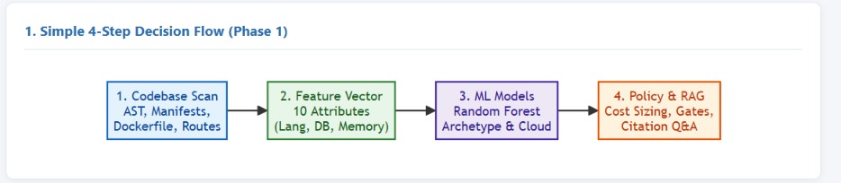
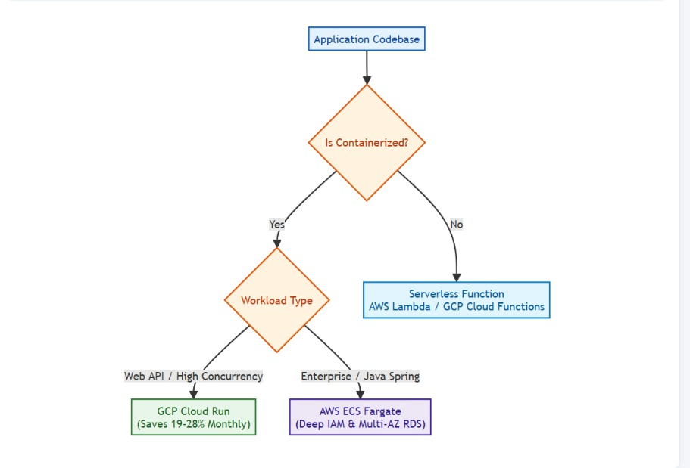
3.3 Selection of Approach / Methodology (Architecture):

Slide 19
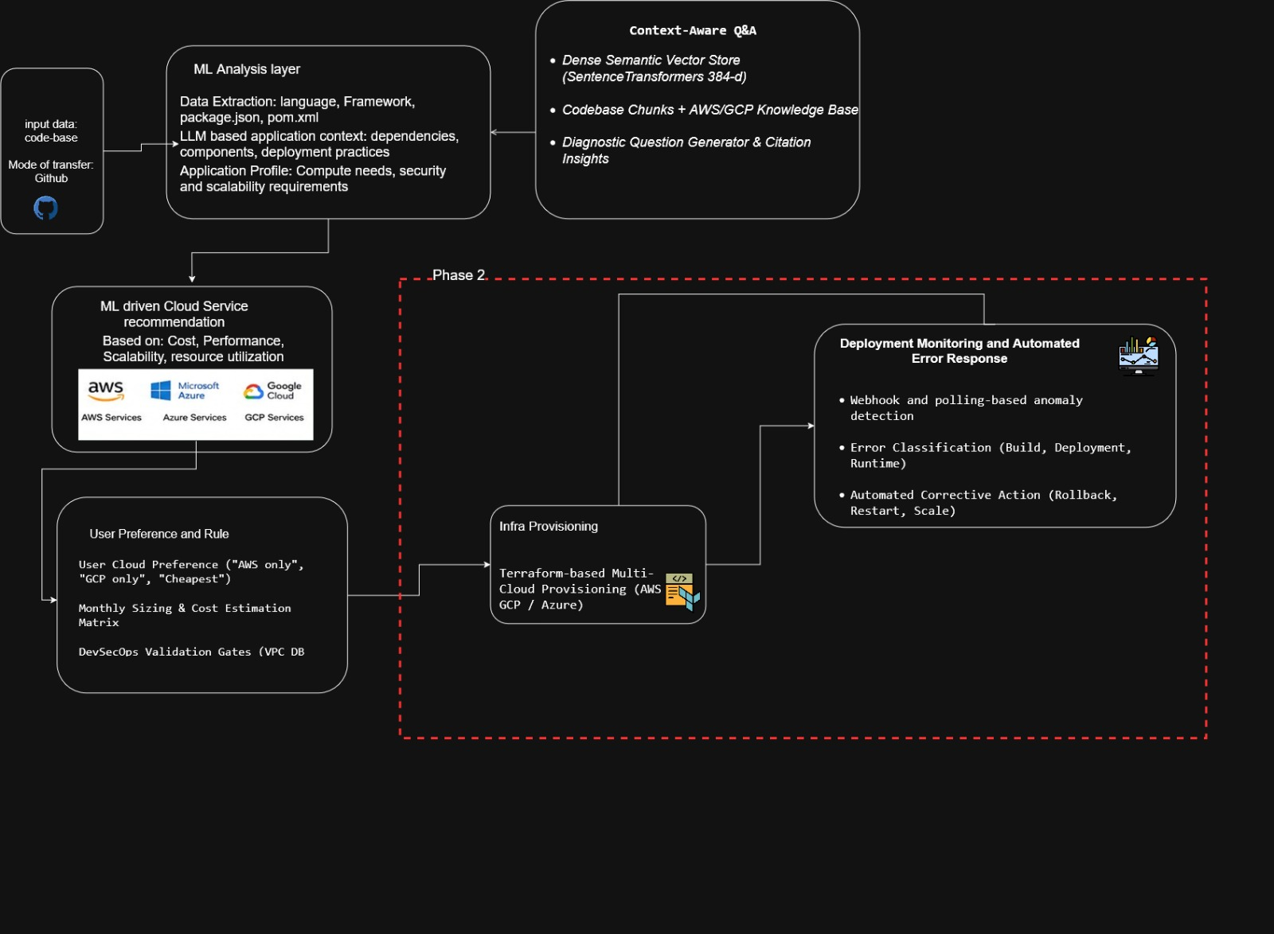
3.3 Selection of Approach / Methodology (Architechture):

Slide 20
3.4 Technical Approach and Key Elements
1. Codebase Static Scanning:
The system uses an automated static scanner to analyze application repositories and identify programming languages, dependencies, application endpoints, manifests, and Dockerfiles. It processes files such as requirements.txt, package.json, and pom.xml to understand the structure and deployment requirements of the application.
2. Feature Extraction & Application Profiling:
The extracted codebase information is converted into a 10-dimensional feature vector (X) containing important attributes such as programming language, database usage, memory requirements, and application characteristics. This feature vector provides structured input for the ML decision pipelines.
3. ML-Based Cloud & Deployment Decision Making:
The system uses Random Forest models to analyze application characteristics and generate deployment recommendations. The Archetype Model classifies applications as Microservice, Mesh, Serverless, or Monolith with 99.56% cross-validation accuracy. The Cloud Model predicts the AWS vs. GCP probability distribution with 79.13% cross-validation accuracy, while the Compute Model recommends the appropriate compute runtime with 100% cross-validation accuracy.
4. Cost & DevSecOps Policy Validation:
The system includes a cost and policy engine that estimates monthly cloud deployment costs and validates infrastructure against four DevSecOps gates: Packaging, VPC Subnets, Secrets, and Health Probe. This ensures that recommended deployment configurations satisfy basic cost and security requirements before proceeding further.
5. Context-Aware RAG Engine:
The RAG module uses dense embeddings generated with all-MiniLM-L6-v2 to retrieve relevant information from code chunks and cloud knowledge. The retrieved context is used to provide explainable and citation-grounded answers to application and deployment-related questions.

Slide 21
3.5 Supporting Analysis / Design Considerations
• Cloud Service Selection: The system evaluates application requirements such as workload type, scalability, cost, performance, and deployment architecture to select suitable AWS or GCP services.
• Cost Optimization: Cloud deployment options are compared using estimated monthly costs to identify suitable infrastructure while considering application resource requirements.
• Security & Compliance: DevSecOps validation gates are applied to check important infrastructure requirements such as packaging, VPC subnet configuration, secret management, and health probes.
• Application-Specific Decisions: The system does not use a single cloud service for all applications. Recommendations are based on the characteristics of the application, such as containerized workloads, high-concurrency APIs, enterprise applications, and serverless functions.
• Scalability & Reliability: The selected cloud services are evaluated based on their ability to handle application workload, scaling requirements, and availability needs.

Slide 22
3.6 Tools / Techniques Used
Category | Tools / Technologies | Purpose / Usage
Core Language | Python 3.12 | Main programming language used for system development
Machine Learning | scikit-learn 1.5.2, Pandas, NumPy, Joblib | Random Forest models, data processing, feature handling, and model storage
NLP & Semantic RAG | Sentence-Transformers 5.1.2, all-MiniLM-L6-v2, PyTorch, Cosine Similarity | 384-dimensional embeddings, semantic search, and context-aware Q&A
Static Analysis | Python AST, Regular Expressions, XML Parser, JSON Parser, Dockerfile Parser | Codebase scanning, dependency extraction, endpoint detection, and Dockerfile analysis
User Interfaces | Streamlit 1.38.0, Python CLI (argparse) | Interactive web dashboard and command-line interface
Verification | Python unittest | Automated testing and system validation — 7/7 tests passing

Slide 23
3.7 Justification of Selected Approach
• Random Forest for Decision Making: Selected because it handles mixed features well and provides fast and reliable deployment predictions.
• Hybrid ML + Policy Rules: Selected to combine ML-based decisions with fixed security and infrastructure validation rules, reducing unreliable recommendations.
• SentenceTransformers for RAG: Selected because all-MiniLM-L6-v2 is lightweight and provides efficient semantic search for code and cloud documentation.
• RAG-Based Assistance: Selected to provide context-aware and citation-grounded answers using the actual application codebase and relevant documentation.
• AWS + GCP: Selected to compare enterprise-focused AWS services with the container and serverless capabilities of GCP.

Slide 24
Base Paper Link(If any):
https://journals.plos.org/plosone/article?id=10.1371%2Fjournal.pone.0105297&utm_source=chatgpt.com

Slide 25
References:
[1] Humble, J., & Farley, D. (2010). Continuous Delivery: Reliable Software Releases through Build, Test, and Deployment Automation. Addison-Wesley Professional.
[2] Zhang, Q., Fang, C., Xie, Y., et al. (2023). A Survey on Large Language Models for Software Engineering. arXiv:2312.15223.
[3] Hou, X., Zhao, Y., Liu, Y., et al. (2024). Large Language Models for Software Engineering: A Systematic Literature Review. ACM Transactions on Software Engineering and Methodology, 33(8), Article 220.
[4] Patcas, R., & Motogna, S. (2026). An evaluation study of large language models for addressing code quality issues. Empirical Software Engineering, 31, 118.
[5] Abtahi, S. M., & Azim, A. (2025). Augmenting Large Language Models with Static Code Analysis for Automated Code Quality Improvements. arXiv:2506.10330.

Slide 26
THANK YOU

