Slide 1

WELCOME
TO MY PROJECT PRESENTATION

Slide 2
SOCIAL MEDIA ENGAGEMENT ANALYSIS 2024-2025
TECHNIQUE’S:
Data collection
Data Cleaning
Data Integration
Extract Transform and Load(ETL)
KPI Cards
Dashboards
TOOLS:
EXCEL
DAX
POWERBI

Slide 3
02.
PROCESS
04.
HOME PAGE
07.
TIMING &
GEOGRAPHY
01.
PROJECT OVERVIEW
03.
PAGE LAYOTS
MODULES
05.
OVERVIEW
06.
CONTENT & PLATFORM PERFORMANCE
08.
AUDIENCE
&
DEMOGRAPHICS

Slide 4

Portfolio Growth
PROJECT OVERVIEW:
Social Media Engagement Analysis 2024–2025 is an end-toend Power BI analytics project that turns raw social media post data into an interactive business intelligence dashboard.
How much reach and engagement the content is generating
Which platforms deliver the most reach and the highest engagement rate.
Who the creators and audience are (gender, age group, occupation, location)
Which Indian states generate the most engagement
The final dashboard contains a Home page + 4 analytical pages, connected through interactive navigation.

Slide 5
Investment goals
Data Collection
Kaggle,Codalab and some are synthetic data
Data Collection
Kaggle , Codalab and some data’s are synthetic data’s.
Data Cleaning
1500 >>>1200 ROWS
40>>>31 COLUMNS
PROCESS
Integration
Data’s are formed in Structure way.
ETL
Exttact from Excel
Visualization
DAX
Transform for checking
And Load into Visulaization
Dashboards
KPI cards

Slide 6

Thank you
PAGE LAY0T’S
#
1
2
3
5
5
PAGE | PURPOSE
🏠 Home | Branded landing page with navigation to all sections
📊 Overview | High-level view of posts, reach, and engagement-rate trends
🎯 Content & Platform Performance | Likes, comments, saves, shares, category and post-type performance
⏰ Timing & Geography | Best time, day, and month to post; reach by year; gender split
👥 Audience Demographics | Time spent by occupation, age groups, and engagement by state
someone@example.com

Slide 7
1
1. 🏠 HOME PAGE
The Home page is the navigation hub of the dashboard.

Slide 8

SCREEN SHOT : HOME PAGE

Slide 9
Thank you
2.OVER VIEW
Charts:
Engagement Rate Trend by Monthly Avg, 2024–2025 — Bar chart
Sum of Reach by Platform — Donut
Avg Engagement Rate by Year and Month — Area/Line chart (Jan 2024 – Dec 2025 trend)
KPIs:
Total Posts
Total Reach
Avg Engagement Rate
someone@example.com
MEASURES
Total_Posts = DISTINCTCOUNT('Engagement System Data'[Post ID])
Total_Reach = SUM('Engagement System Data'[Reach])
Avg_Engagement_Rate = AVERAGE('Engagement System Data'[Engagement Rate (%)])

Slide 10
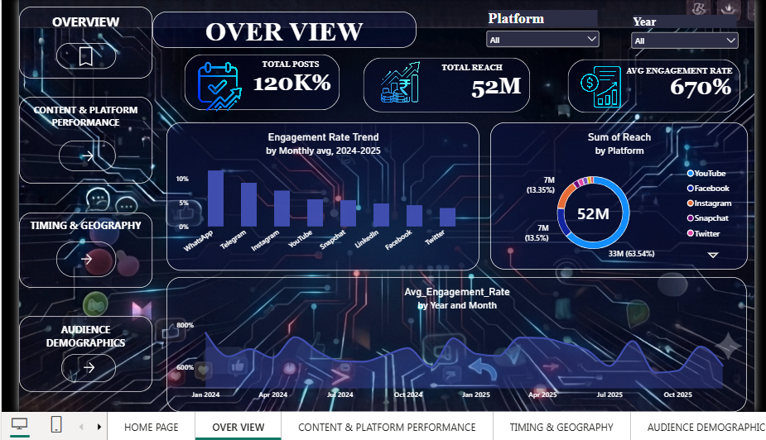
SCREEN SHOT : OVER VIEW

Slide 11

Need to know
3.🎯 CONTENT & PLATFORM PERFORMANCE
KPIs:
Total Likes
Total Comments
Total Saves
Total Shares
Charts:
Content Category Performance by Avg Engagement Rate — Horizontal Bar
Top 10 Platform × Post Type, Ranked by Post Count — Treemap
Content Funnel: Impressions → Reach → Total Engagement → Saves — Funnel (100% → 0.3% drop-off)
MEASURES:
Total Likes = SUM('Final Dataset'[Likes])
Total Comments = SUM('Final Dataset'[Comments])
Total Saves = SUM('Final Dataset'[Saves])
Total Shares = SUM('Final Dataset'[Shares])

Slide 12
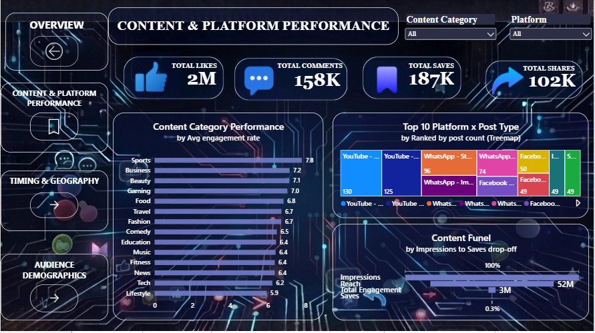
SCREEN SHOT : CONTENT & PLATFORM PERFORMANCE

Slide 13
Need to know
4.TIMING & GEOGRAPHY
KPIs:
Best Time Slot — Evening
Best Day — Wednesday
Best Performing Month — January
Best Performing Year — 2024
Charts:
Day of Week × Post Time (Afternoon/Evening/Morning/Night) — Matrix with row/column totals
Total Reach by Year — Bar chart
Total Users by Creator Gender — Donut
MEASURES:
Best Time = VAR _t = ADDCOLUMNS(VALUES('Final Dataset'[Post Time]), "@AvgER", CALCULATE(AVERAGE('Final Dataset'[Engagement Rate (%)]))) VAR _top = TOPN(1, _t, [@AvgER], DESC
RETURN CONCATENATEX(_top, 'Final Dataset'[Post Time], ", ")
Best Day = VAR _t = ADDCOLUMNS(VALUES('Final Dataset'[Day of Week]), "@AvgER", CALCULATE(AVERAGE('Final Dataset'[Engagement Rate (%)]))) VAR _top = TOPN(1, _t, [@AvgER], DESC)
RETURN CONCATENATEX(_top, 'Final Dataset'[Day of Week], ", ")
Best performing year = var _t = addcolumns(values('final dataset'[post year]),"@engagement", calculate(sum('final dataset'[total engagement])) )var _top = topn(1, _t, [@engagement], desc)returnconcatenatex(_top, 'final dataset'[post year], ", ")
Best Performing Month = VAR _t =ADDCOLUMNS(VALUES('Final Dataset'[Post Month Name]),"@Engagement", CALCULATE(SUM('Final Dataset'[Total Engagement])))VAR _top = TOPN(1, _t, [@Engagement], DESC)RETURNCONCATENATEX(_top, 'Final Dataset'[Post Month Name], ", ")

Slide 14
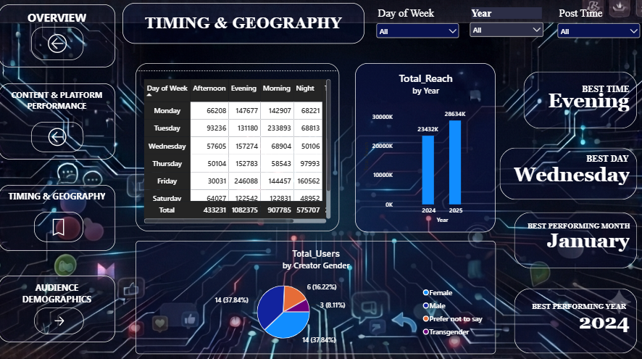
SCREEN SHOT : TIMING & GEOGRAPHY

Slide 15
5. 👥 AUDIENCE DEMOGRAPHICS
Charts:
Creator Daily Time Spent by Creator Occupation — Horizontal Bar
Total Users by Creator Age Group — Donut
Total Engagement by User State — Shape Map (India states, color-coded by engagement intensity)

Slide 16
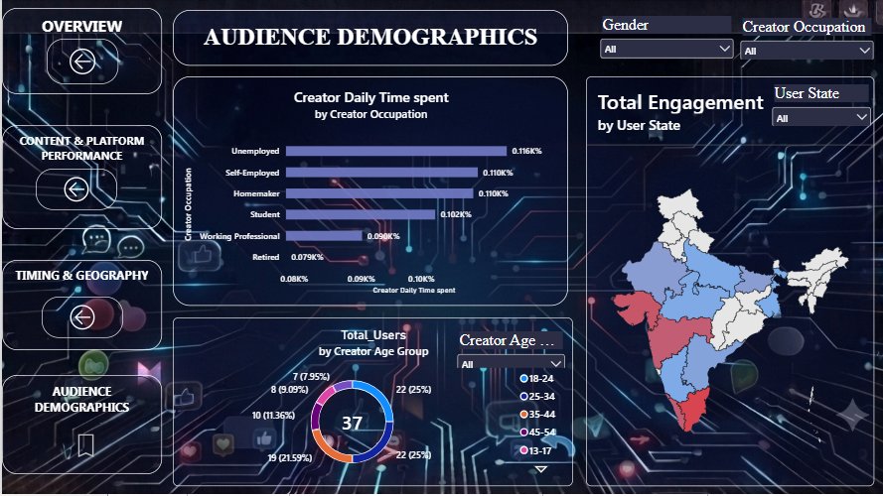
SCREEN SHOT : AUDIENCE DEMOGRAPHICS

Slide 17
Thank you
☺ - JAGADEESWARY.T

