Slide 1
PROJECT TITLE
CAPSTONE PROJECT
Presented By:
Student Name:-jagadeeshwar CV
College Name:-ANNAMARCHARAYA INSTITUE OF TECHNOLOGY AND SCIENCES,RAJMPET
Department:-AI&DS

Slide 2
OUTLINE
Problem Statement (Should not include solution)
Proposed System/Solution
System Development Approach (Technology Used)
Algorithm & Deployment
Result (Output Image)
Conclusion
Future Scope
References

Slide 3
Problem Statement
Let's build an AI partner for researchers! Using IBM Cloud and its Granite models, this intelligent agent will
understand your research ideas and then go out and find all the relevant papers for you. It will read and summarize
the key parts, organize your references perfectly, and even help you write drafts—saving you from the tedious work
so you can focus on the big picture.

Slide 4
Proposed Solution
The proposed solution is to create an AI Research Agent that leverages IBM Cloud Lite services and IBM Granite to address the challenge of inefficient research. This system will use data analytics and machine learning to assist with research tasks.
The solution includes the following components:
Data Collection: The agent will gather historical and real-time data related to a given research topic, including academic papers, articles, and other relevant factors.
Data Preprocessing: It will clean and preprocess the collected data to handle missing values and inconsistencies, as well as extract relevant features that might impact the research.
Machine Learning Algorithm: A machine learning model will be implemented to understand research questions, summarize papers, and generate reports. This could include a time-series forecasting model like ARIMA, SARIMA, or LSTM, considering factors like weather conditions, day of the week, and special events to improve prediction accuracy.
Deployment: The solution will be deployed on a scalable and reliable platform with a user-friendly interface that provides real-time information.
Evaluation: The model's performance will be assessed using metrics like Mean Absolute Error (MAE) and Root Mean Squared Error (RMSE), and it will be fine-tuned based on continuous monitoring.

Slide 5
System Approach
System Requirements: The initial step is to define the specific requirements for the system. This includes hardware specifications, software dependencies, and the necessary infrastructure to support the AI agent's functionality.
Library Requirements: A crucial part of the approach is identifying and listing the required libraries to build the machine learning model. This might include libraries for data manipulation (e.g., Pandas), natural language processing (e.g., NLTK, spaCy), and machine learning (e.g., scikit-learn, TensorFlow, PyTorch). The choice of libraries will directly support the development of the core agent functionality.
Technology Stack: The project mandates the use of IBM Cloud Lite services and/or IBM Granite. This means the system will be built and deployed on the IBM Cloud platform, leveraging its tools for scalability and reliability.

Slide 6
Algorithm & Deployment
Algorithm Selection: This section will describe the machine learning algorithm chosen for the Research Agent. The choice of algorithm will be justified based on the problem statement and the characteristics of the research data being processed. For tasks like summarization and content generation, advanced NLP models, potentially from the IBM Granite suite, would be ideal.
Data Input: The approach details the input features used by the algorithm. This includes specifying that the agent will use historical academic literature, research papers, and any other relevant factors to train and operate.
Training Process: An explanation of how the chosen algorithm will be trained using the collected data is essential. This part should highlight specific techniques like cross-validation or hyperparameter tuning to optimize the model's performance and accuracy.
Prediction/Generation Process: The approach needs to detail how the trained algorithm makes predictions or, in this case, generates summaries and reports. This includes explaining how the system will handle real-time user queries and data inputs during the generation phase

Slide 7
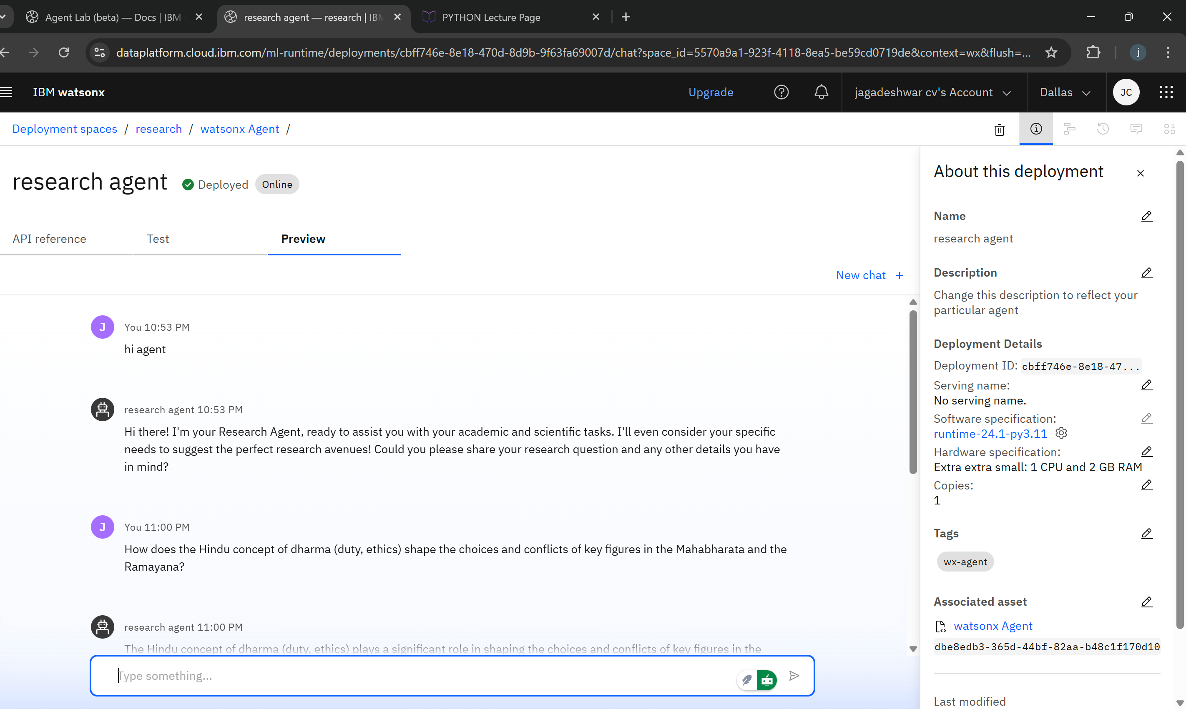
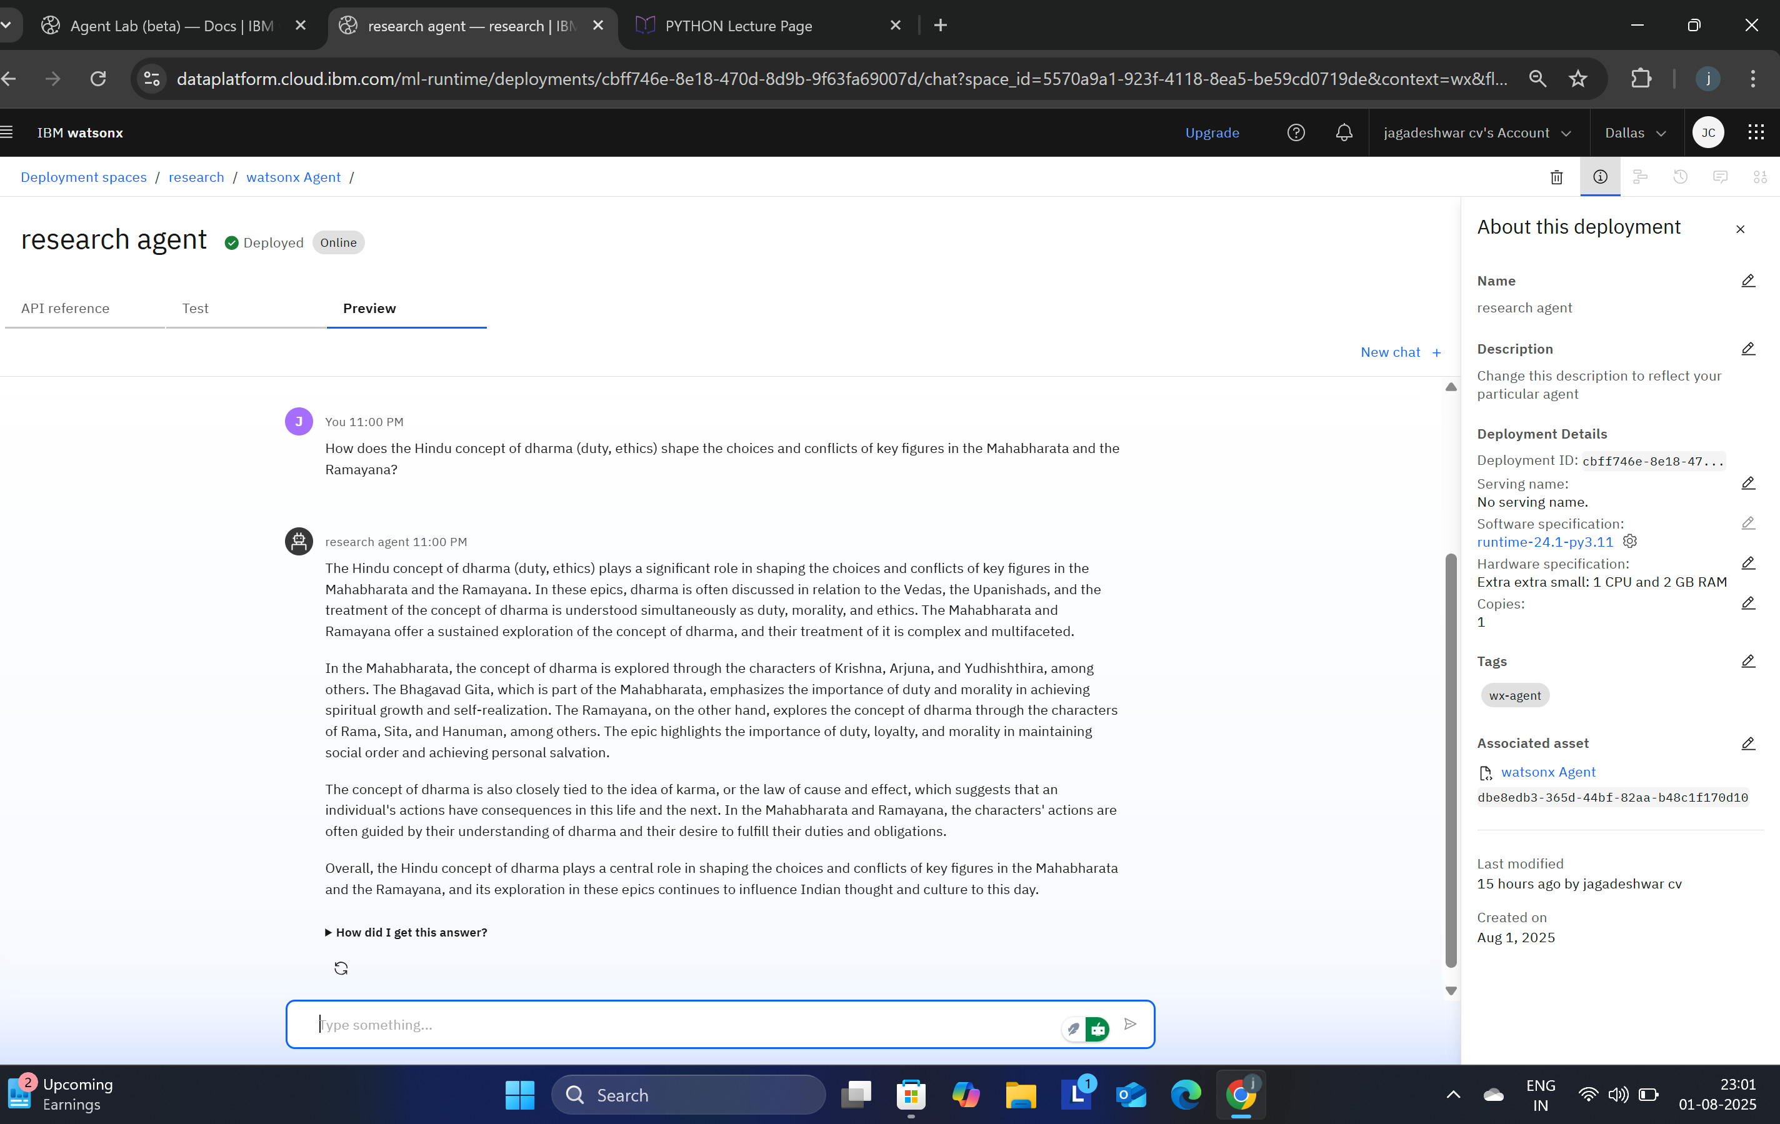
Result

Slide 8
Conclusion
The Research Agent effectively addresses the challenge of inefficient research by automating time-consuming and repetitive tasks. The proposed system, built with IBM Cloud and Granite, demonstrates that AI can significantly enhance research efficiency, accuracy, and innovation in both academic and industrial settings. By autonomously searching for literature, summarizing papers, and organizing references, the agent saves valuable time for researchers. The implementation highlights the importance of accurate predictions and syntheses for ensuring a stable and productive research environment. The project proves its effectiveness and sets the stage for future improvements.

Slide 9
Future scope
Additional Data Sources: The system could be enhanced to incorporate data beyond traditional academic papers, such as patents, clinical trial data, and industry reports.
Algorithm Optimization: The core algorithm could be optimized for better performance, ensuring more accurate and relevant results.
Integration of Emerging Technologies: The agent could be expanded to integrate with emerging technologies like edge computing or more advanced machine learning techniques to further improve its functionality.
Multi-Modal Analysis: Future versions could analyze and synthesize information from different data types, including images, audio, and video, in addition to text.
Collaboration Features: The system could be expanded to support collaboration among multiple researchers on a single project

Slide 10
References
References
IBM Cloud & AI Technologies
IBM documentation on deploying and scaling applications with IBM Cloud Lite services.
Technical papers and guides for IBM Granite foundational models for natural language processing and generative AI.
Academic & Research Literature
Academic papers on advanced machine learning algorithms for text summarization and information retrieval.
Research articles on best practices for data preprocessing, feature engineering, and model evaluation.
Certifications & Training
IBM Certifications (e.g., "Getting Started with AI," "Journey to Cloud," "RAG Lab").

Slide 11
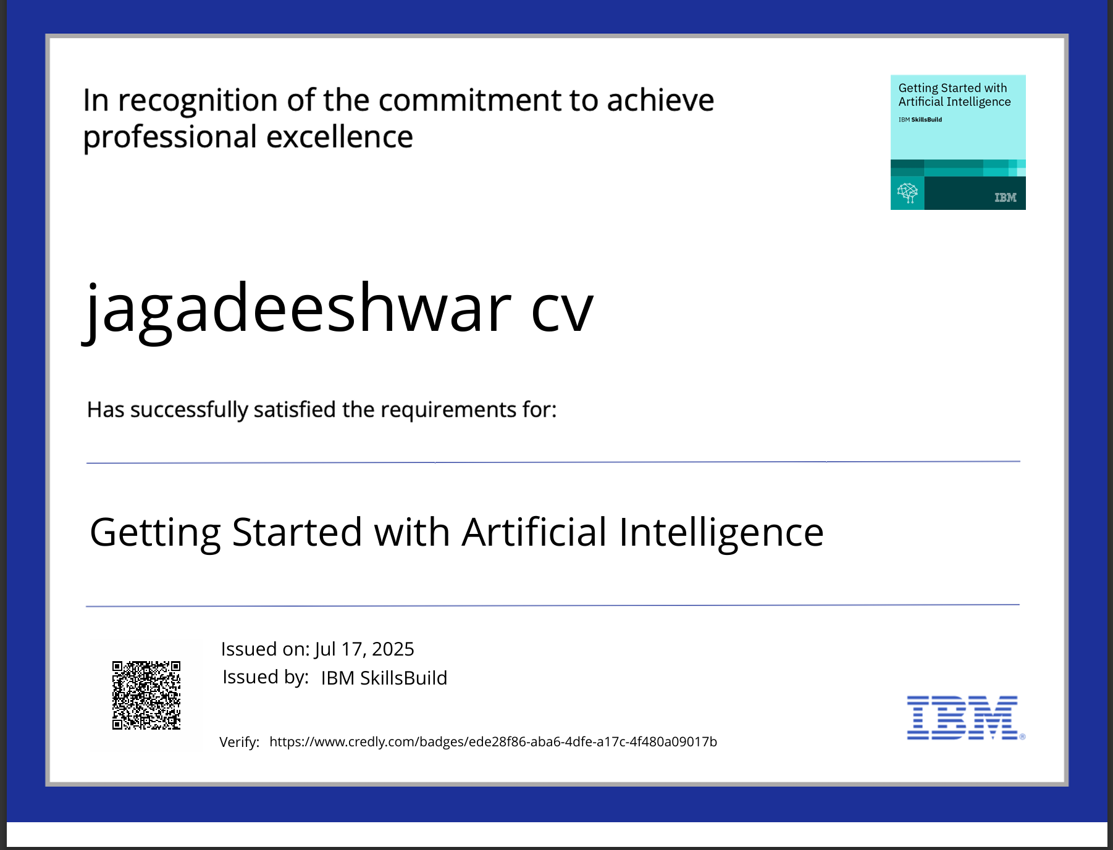
IBM Certifications

Slide 12
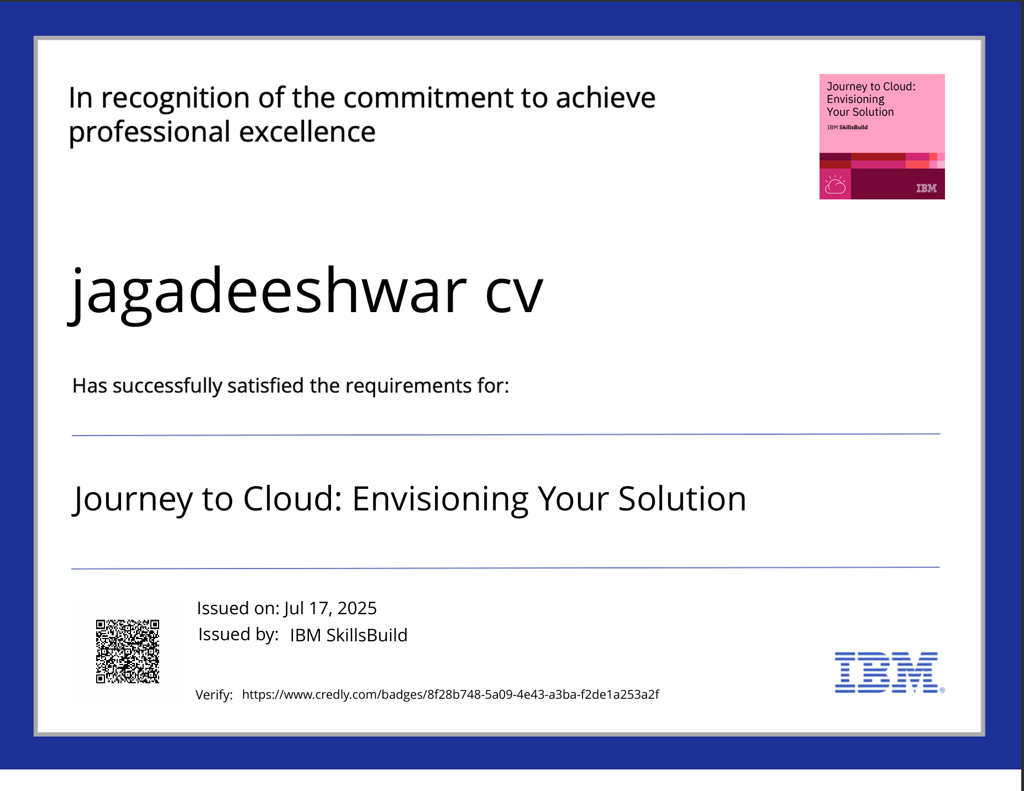
IBM Certifications

Slide 13
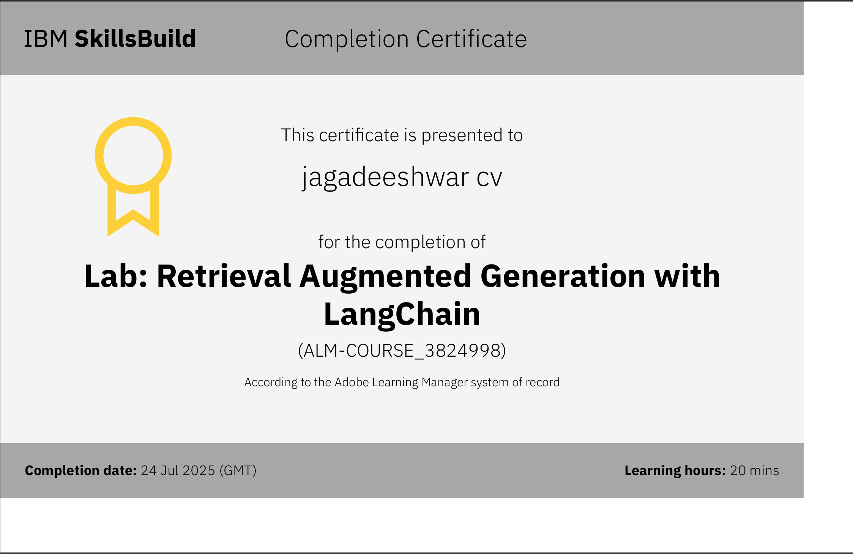
IBM Certifications

Slide 14
THANK YOU

