Slide 1
KEYLOGGER
CAPSTONE PROJECT
Presented By:
Jagadesh S
Jeppiaar Institute of Technology
B.Tech IT

Slide 2
OUTLINE
Problem Statement (Should not include solution)
Proposed System/Solution
System Development Approach (Technology Used)
Algorithm & Deployment
Result (Output Image)
Conclusion
Future Scope
References

Slide 3
Problem Statement
Develop a keylogging application that effectively captures user keystrokes on Windows operating systems while minimizing detection by antivirus software and security tools. The keylogger should operate discreetly in the background, securely encrypt logged data, and provide a user-friendly interface for configuration and data retrieval.

Slide 4
Proposed Solution
Stealth Mode Implementation: Integrate methods to execute the keylogger covertly in the background, evading detection from task managers and system monitors.
Keystroke Logging Mechanism: Develop a robust system to capture user keystrokes across diverse applications and input fields, ensuring comprehensive logging of textual input.
Encryption Measures: Employ robust encryption algorithms to encrypt the recorded keystrokes before storing them locally, safeguarding the data's confidentiality even if accessed without proper authorization.
User-Friendly Interface: Design an intuitive user interface for the keylogger application, enabling users to easily configure settings, initiate/terminate logging, and access encrypted logs for review.
Anti-Detection Strategies: Implement evasion techniques to evade detection by antivirus software and security tools. This may involve periodically altering file signatures, utilizing polymorphic code, and dynamically adjusting behavior to mimic legitimate processes.
Continuous Enhancement: Commit to ongoing updates and enhancements to the keylogger, adapting to evolving security threats and maintaining effectiveness against detection mechanisms.

Slide 5
System Approach
Planning: Begin by understanding the keylogger's purpose and its intended users.
Design: Determine the keylogger's functionality, including keystroke capture, data encryption, and user interaction methods.
Building: Develop the keylogger according to the design specifications, ensuring each component operates correctly.
Testing: Validate the keylogger's functionality by testing it on various computer systems and identifying any potential issues.
Releasing: Prepare the keylogger for distribution, including packaging it and providing user instructions.
Updating: Maintain the keylogger's relevance by addressing any bugs and enhancing its features over time.
Ethical and Legal Compliance: Ensure the keylogger adheres to ethical standards and legal regulations, particularly regarding privacy and data protection.

Slide 6
Algorithm & Deployment
Event Listeners: The script utilizes the 'pynput' library to set up event listeners for keyboard events, specifically focusing on key press and key release events. These listeners operate on an event-driven basis, which means they wait for specific occurrences (keystrokes) rather than continuously polling for input.
Callbacks: When a keyboard event occurs, the corresponding event handler function, referred to as a callback, is invoked. In this script, the 'on_press' and 'on_release' functions serve as the event handlers, executing in response to distinct events (key press or key release) initiated by the user.
Asynchronous Execution: Event-driven programming enables the asynchronous execution of code. Instead of following a linear flow, the script reacts to events as they happen. This asynchronous nature allows the script to capture keystrokes in real-time without blocking the execution of other tasks or processes.
Graphical User Interface (GUI): Employing 'tkinter', a popular Python GUI library, the script creates a simple graphical interface equipped with buttons for starting and stopping the keylogger. The GUI elements, such as buttons and labels, respond to user actions (e.g., mouse clicks) via event-driven mechanisms.
The event-driven programming paradigm employed in the script facilitates efficient capture and management of user input while providing a user-friendly interface for controlling its operation.

Slide 7
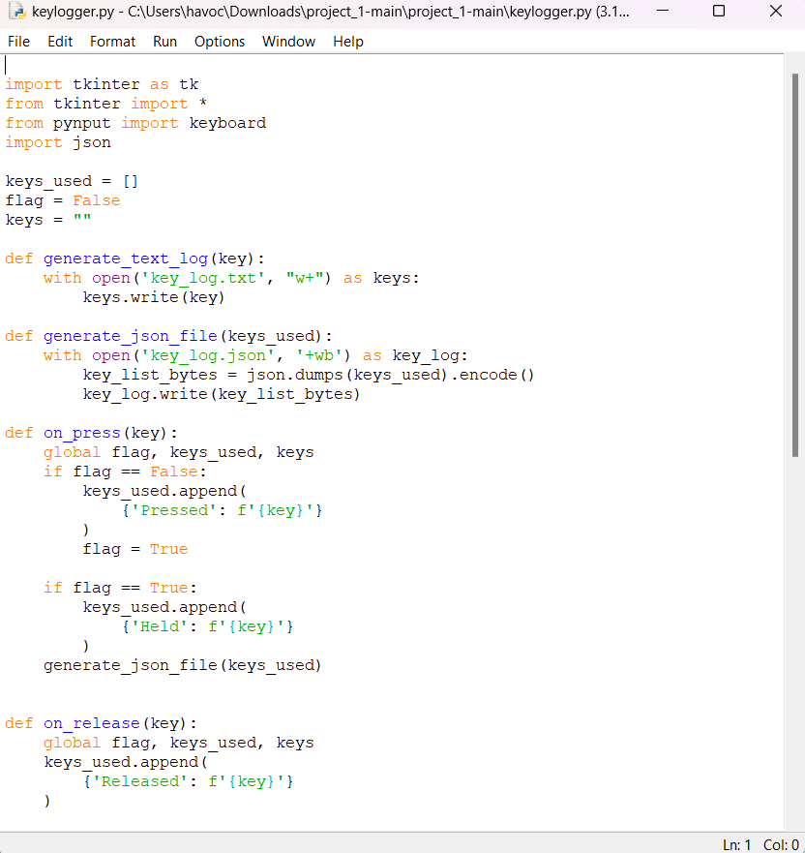

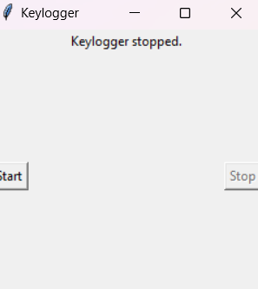
Result

Slide 8
Conclusion
The provided keylogger script adopts an event-driven programming paradigm to capture and handle keyboard input. Leveraging event listeners and handlers from the `pynput` library, the script responds asynchronously to key press and release events. Moreover, integrating a graphical user interface (GUI) with `tkinter` enhances the event-driven architecture, enabling users to interact with buttons for initiating and halting the keylogging operation. This event-driven methodology facilitates real-time monitoring of keystrokes while preserving responsiveness and user engagement.

Slide 9
Future scope
Enhancing Logging and Analysis: Elevate logging capabilities by incorporating more extensive data, including timestamps, application contexts, and user interactions. Additionally, create tools for analyzing logged data to extract valuable insights and patterns.
Integration of Machine Learning: Incorporate machine learning algorithms to analyze keystroke patterns and identify anomalous behavior, such as unauthorized access or suspicious activities.
Remote Monitoring and Management: Expand the functionality of the keylogger to allow for remote monitoring and management. This enhancement enables administrators to access logs and configure settings through a centralized dashboard.
Implementation of Compliance and Reporting Features: Introduce features to ensure compliance with regulatory requirements such as GDPR, HIPAA, or industry-specific standards. Provide options for generating compliance reports and audit trails.
Integration with Security Solutions: Integrate the keylogger with existing security solutions, such as SIEM (Security Information and Event Management) systems, to bolster threat detection and response capabilities.
User Awareness and Education Initiatives: Develop educational resources and awareness campaigns to educate users about the risks associated with keyloggers and strategies for safeguarding against potential threats.

Slide 10
References
"Principles of Cyber-Physical Systems Security: A Reference Guide“ by Ronald L. Krutz, Russell Dean Vines Published by Wiley in2019

Slide 11
THANK YOU

