Slide 1
nopCommerce website
Under Guidance of Miss.Vaishali sonanis
Presented by: Jagadheeswar Reddy Tatiparthi

Slide 2
Introduction
Objective: To perform automation testing on nopCommerce modules
Tools used: Selenium WebDriver, Cucumber, Page object Model(POM), Jenkins
Goal: Detect bugs, validate functionality, and generate test reports

Slide 3
What is nopCommerce?
nopCommerce is an open-source demo e-commerce platform
Offers features like user registration, user login, product catalog, shopping cart, checkout, user account management.
Suitable for small to large-scale businesses.
We can order our required items to deliver anywhere around the globe from this nopCommerce platform.

Slide 4
Project Overview
Modules tested: Register, Login, Search, Add to Cart, Remove from Cart, Checkout, Select Category, Add to Compare, Add to Wishlist, Changecurrency, Logout.
Approach: Module-wise testing using automation scripts.
Outcome: Identified defects, generated reports, and improved test coverage.

Slide 5
Module 1-Register Page
Tested functionalities: First name, Last name, Email, Password, Company name, Confirm Password, Register button.
Validated error messages and input field constraints.
Module 2-Login Page
Tested functionalities: Email, Password, Login Button, forgot password link.
Tested with valid and invalid email and passwords
Validated error messages and input field constraints.
Module 3-Search Page
Verified search functionality, filters, and product listings.
Checked responsiveness and accuracy of search results

Slide 6
Module 4-Add to cart Page
Checked the functionality of Add to cart button
Searched for any particular item and added it to cart successfully.
Module 5-Remove from cart Page
After search an item in search box that item is added to cart.
Then checked the functionality of remove from cart.
Module 6-Checkout
Checked the functionality of Checkout button ,Shopping cart, terms and conditions checkbox, Discount code, Gift code, Billing address details, back button, continue button, Confirm button
Verified with the correct details then only continue to checkout.

Slide 7
Module 7-Select Category Page
In this page checked the functionality of categories selected
In the selected category checked the particular product
Module 8-Add to Compare Page
Checked the functionality of add to compare button
Under any product this button is present by clicking it verified weather is added to compare list or not.
Module 9-Add to wish list Page
Verified functionality, searched for any item and added it to wish list
Verified that the added item is displayed under wishlist page

Slide 8
Module 10-Changecurrency page
Checked change currency will changing the current currency to changed currency of product prices.
Verified with the given currency
Module 11- Logout Page
First we have to login with our credentials to logout then
After login to our account with valid credentials
Clicking by Logout checked the functionality of logout button it is successfully logout account.

Slide 9
Defects
While running a test case at certain point some fields are not working as it is expected which is nothing but a defect, so I have created a Defect report on those defects.

Slide 10
Defect identifier | def_nopcommerce_reg_001
Defect summary | Expected result = After Registering the data should be stored in backend and everytime we just login with that credential Actual result = For sometime we can login with that data but after sometimes the registraion data is erased
Test Id | TC‑001
Test case name | TC_registration_valid
Module name | Register
Reproducible | Enter all the registration credentials in register page and click submit
Severity | Medium
Priority | Medium
Raised by | Jagadheeswarreddy tatiparthi
Assigned to | Vaishali
Date of assignment | 09-04-2025
Status | Open
Snap shots
Fixed by | Vaishali
Date of fixing
Approvals | Team Leader

Slide 11
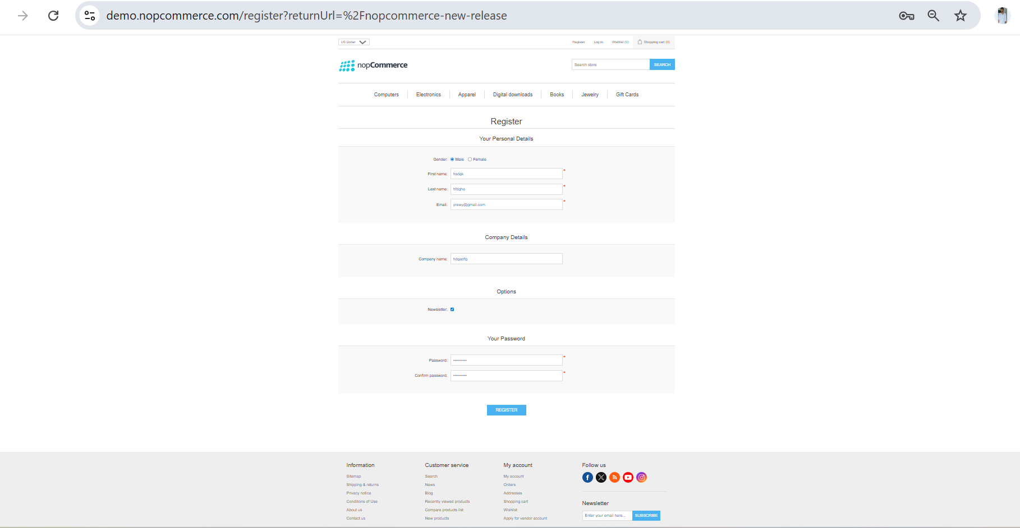

Slide 12
Defect identifier
Defect summary
Test Id
Test case name
Module name
Reproducible
Severity
Priority
Raised by
Assigned to
Date of assignment
Status
Snap shots
Fixed by
Date of fixing
Approvals
def_nopcommerce_news_004
Expected result = It should accept only characters in Title field. Actual result = It accepting special characters and only numbers.
TC-004
TC_News_Title
News
Click on News on footer ,click on details button and click on Title field
low
low
Jagadheeswarreddy tatiparthi
Vaishali
04-09-2025
open
Vaishali
Team Leader

Slide 13
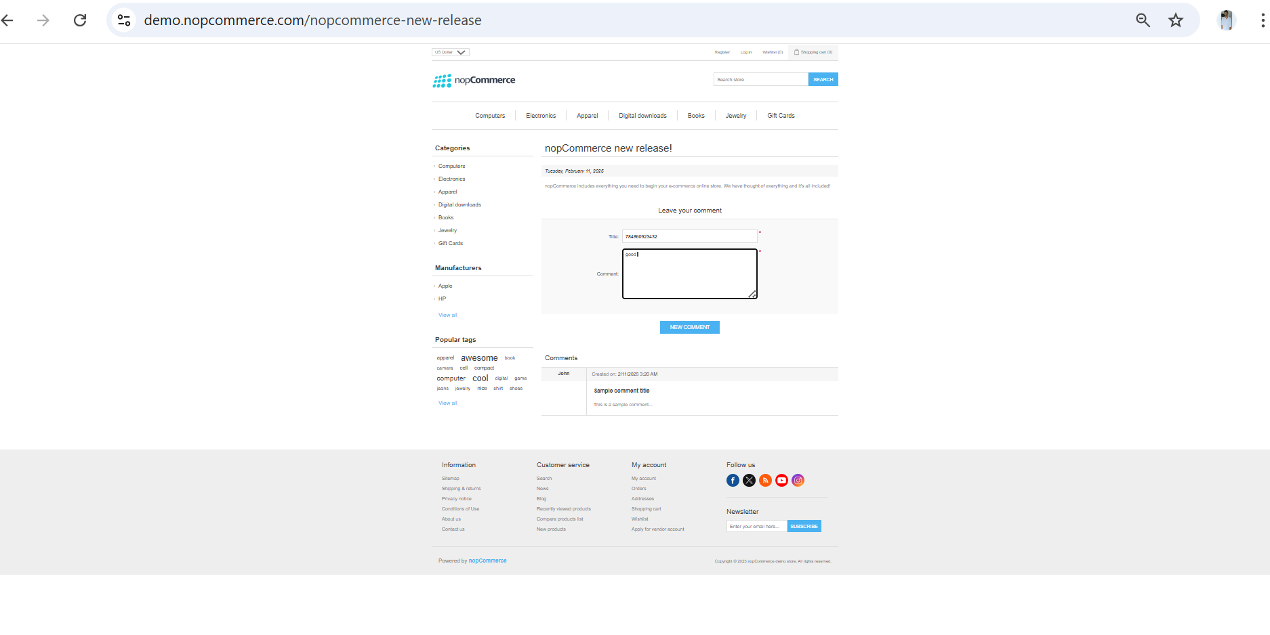

Slide 14
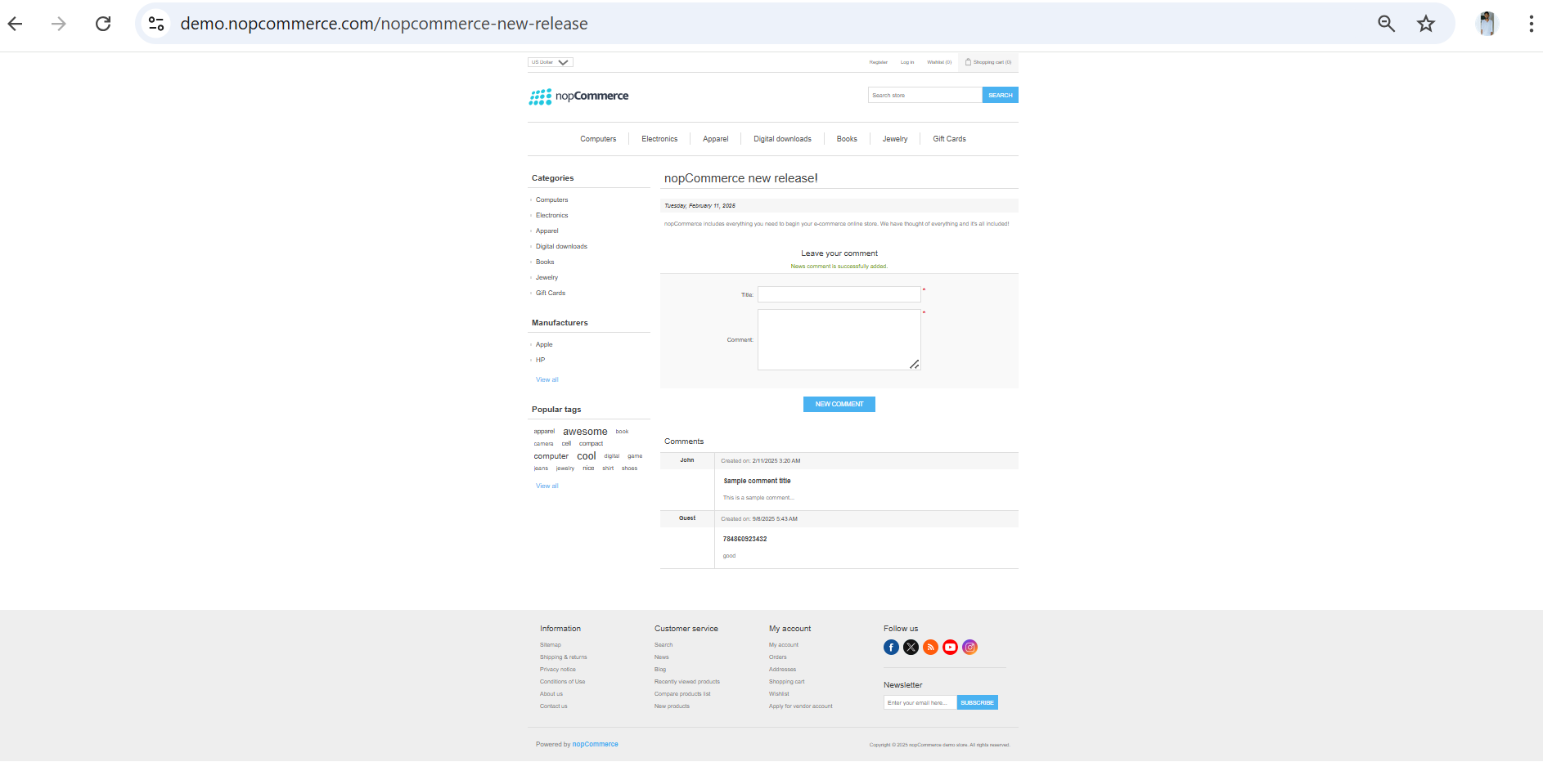

Slide 15
Challenges
There is comes difference in writing a test case and while running it.
Faced some exceptions while testing test cases if one test case fails .
Handled those issues by adding dependencies and conducted parallel testing, integration testing without affecting the other test cases.
4.Faced difficulties to find the exact loactors and their actual xpaths or cssSelector of web elements.
5. Connecting those feature file with page class faced some difficulties.

Slide 16
Experience
It is very great experience in handling these type of project it helps to keep on learning from the day by day challenges faced while doing this project.
Everything learnt is a good sign to improve myself.
Gained hands on experience in automation testing with the tools like selenium , web drivers, Cucumber framework.
Help to find out bugs.
Manual testing needs strong observation and in that testers needs to apply all possibilities in test cases.
Testing modules separately helps in find outing bugs easily.
By giving the severity and priority it is easy to developers to find the bugs and fix them according to their severity and priority.
Testing modules using the priority by default priority is given as 0.

Slide 17
Thank you!!!
Vaishali Mam For Guiding me through out the Project.

