Slide 1
MINI PROJECT Classification – House Grade Prediction
By,
B.Jagadhesh,
DSFT8

Slide 2
House Grade Classification:
Property buyers have different requirements. To facilitate this, real estate companies prefer categorizing various houses into different grades based on various parameters. This would help agents in identifying the type of house a customer is looking for. This way, the search for the house can be narrowed down by focusing only on the ‘condition of the house’.
The Grade (condition of the house that ranges from A (Best) - E (Worst) ) can also be used by existing owners to list their properties for sale. Grading helps them in arriving at a price of the house.
Business Objective :
Build a predictive model to determine the Grade of house (The grades are A,B,C,D, and E)

Slide 3
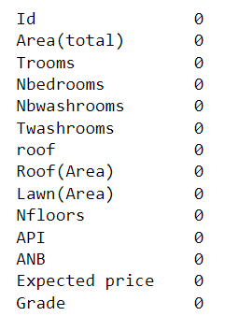
Data Set :
The given data has 3000 Rows and 14 Columns.
This data contains no null values so we can proceed with the model building.
This data has only two categorical columns and others are numerical columns

Slide 4
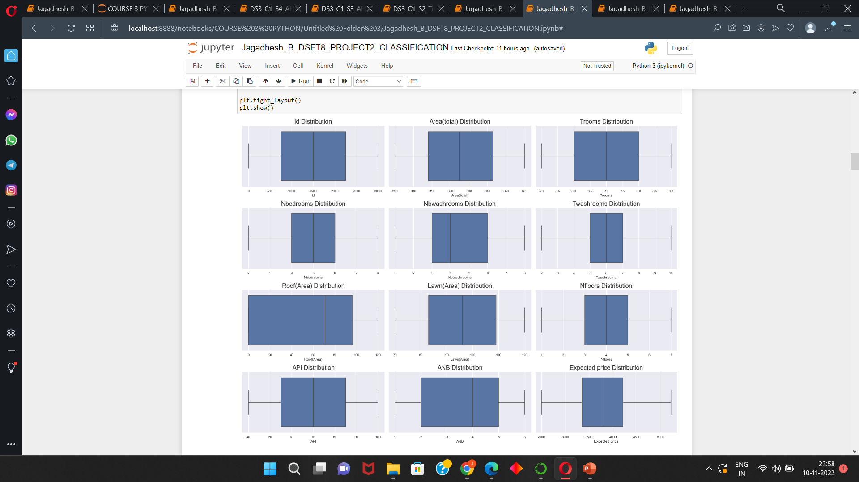
EDA : Univariate, Bivariate and Multivariate Analysis
We cannot find any outliers in the data.
Area , Trooms , Nbedrroms, Twashrooms, Lawn area
are normally distributed.
Roof(Area) has more spread than compared to all numerical columns.
Most the numerical columns are normally distributed.
Expected price column has normally distributed.
Most of the columns has the data as classification or the count ,because of that we are not getting the proper distribution.

Slide 5
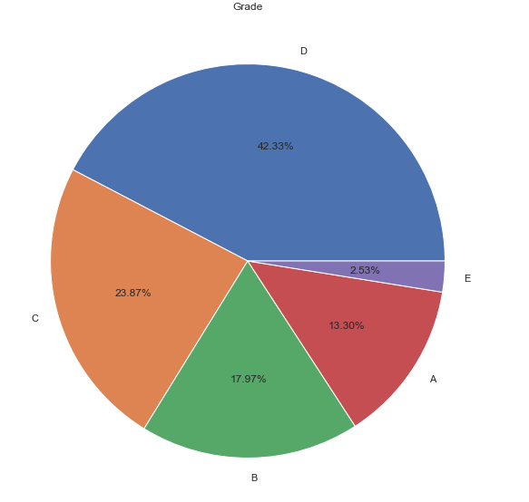
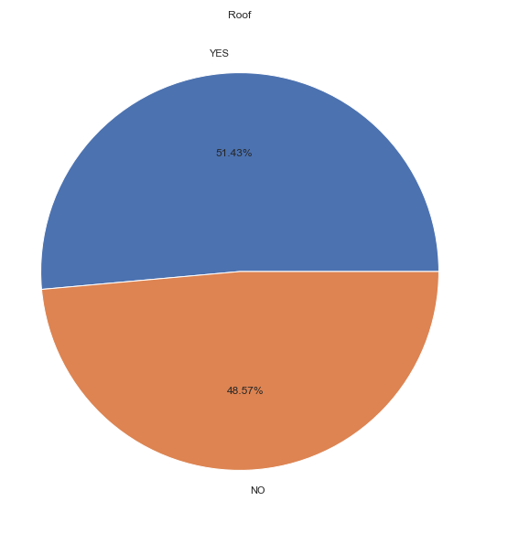
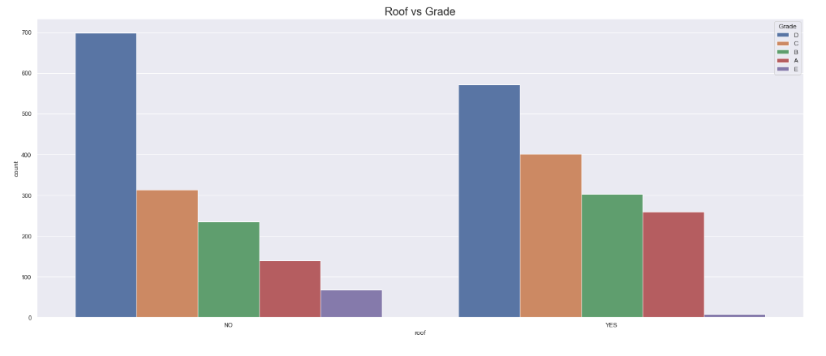
Bivariate and Mutivariate Analysis :
Most of the house has roof .
But the difference between the house with roof and without roof are not that much big.
Grade D has more number of houses.
The houses with the grade D has the more number of houses in the category roof.
The houses with grade E has the very less houses with roof from this we can say houses with grade E are poor houses.
Second highest with and without houses are in the grade C

Slide 6
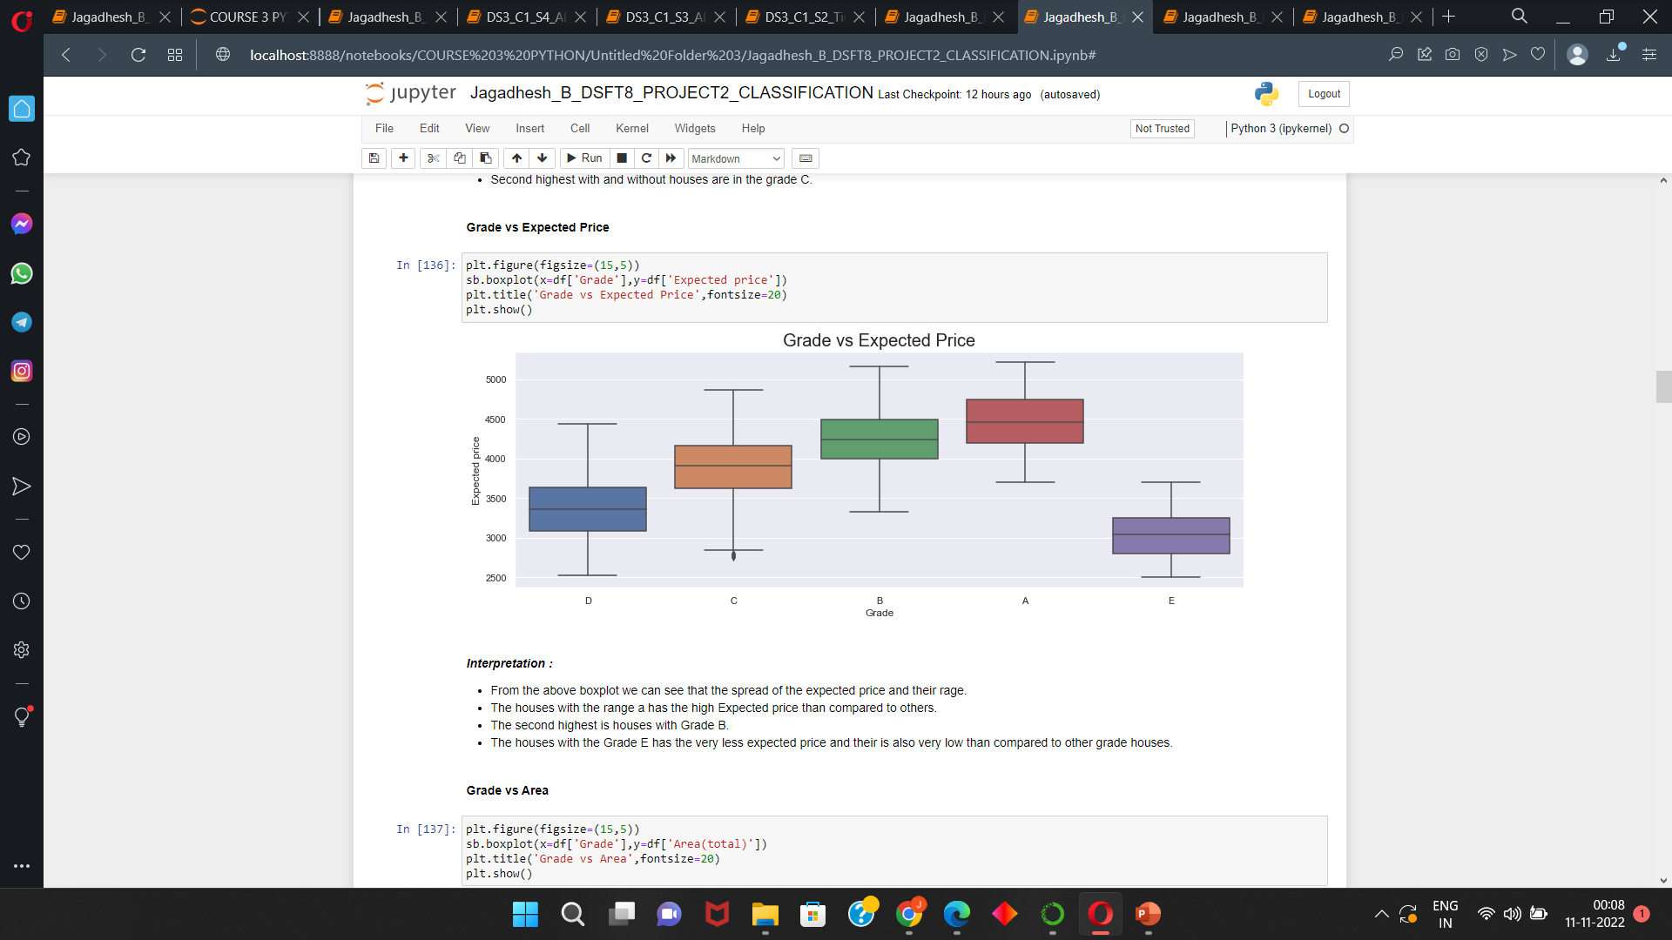
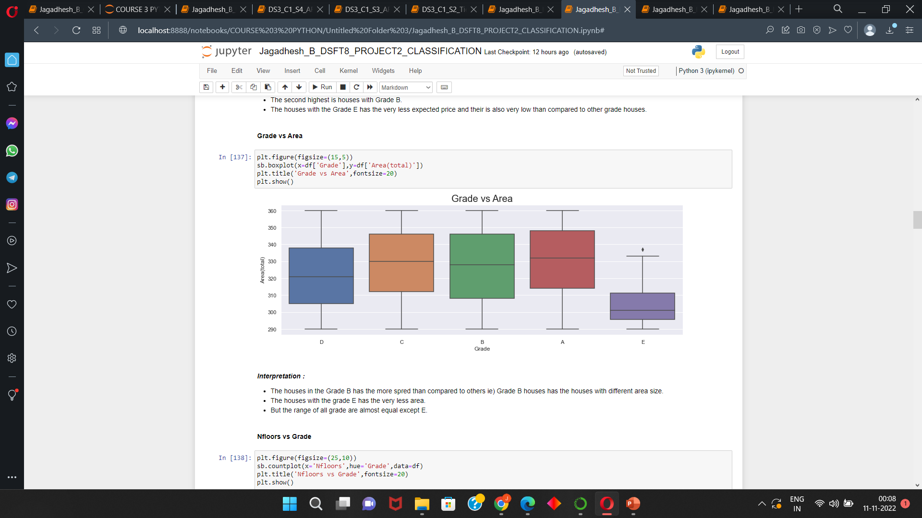
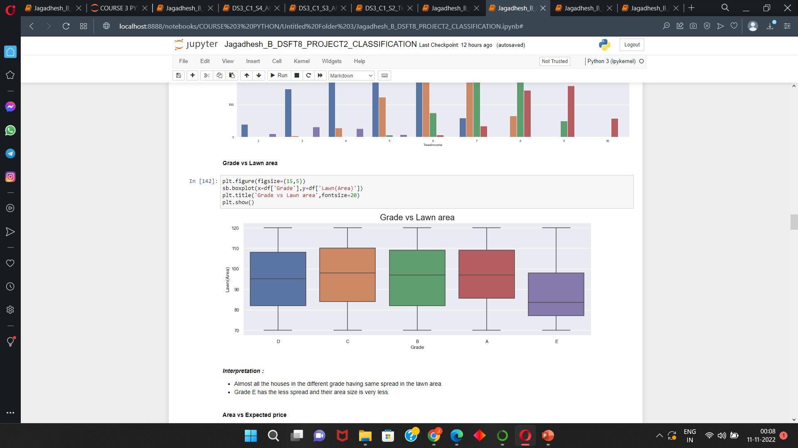
Bivariate and Mutivariate Analysis :
The houses with the range A has the high Expected price than compared to others.
The second highest is houses with Grade B.
The houses with the Grade E has the very less expected price and their is also very low than compared to other grade houses.
The houses in the Grade B has the more spread than compared to others i.e) Grade B houses has the houses with different area size.
The houses with the grade E has the very less area.
But the range of all grade are almost equal except E.

Slide 7
Preparing the Data set :
DATA PREPROCESSING :
Models performs well with numeric data .So we are converting all the columns which are in object and category we are converting them to numeric by using label encoder.
DATA SCALING :
In the given data set the value ranges can be different so we need to convert the data to some range for the good performance. The data are Normalized(0 to +1) using MinmaxScalar().
FEATURE SELECTION :
Features are checked for correlation with the dependent column and the most correlated columns are chosen for the models for the best performance.
DATA SPLITTING :
Data is splitted in the ratio of 75:25 ratio.

Slide 8
Classification Machine learning model :
For Classifier ,
Logistic Regression
Naïve Bayes
Decision Tree classifier
Random Forest classifier
Adaboost classifier
Stacking
And the cross validations are ,
Hold out method
Kfold method
Stratified Kfold
Building all the model with different cross validation and evaluating the models .

Slide 9
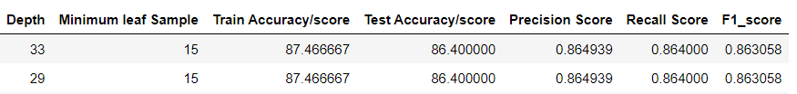
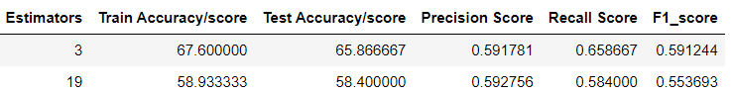
Building the models :
Logistic regression ,
Using default parameter.
Naïve Bayes ,
Using default parameter.
Decision Tree Classifier,
Using for loop for hyperparameter tuning ,So we have done tuning and chose the parameter which give lowest error and building the model using best parameters for both the cross validation.
Adaboost Classifier ,
Using for loop for hyperparameter tuning ,So we have done tuning and chose the parameter which give lowest error and building the model using best parameters for every the cross validation.
Random Forest,
Using Grid search method for finding the best hyperparameter.
Stacking ,
For Stacking using all the hyperparameter tuned model .

Slide 10
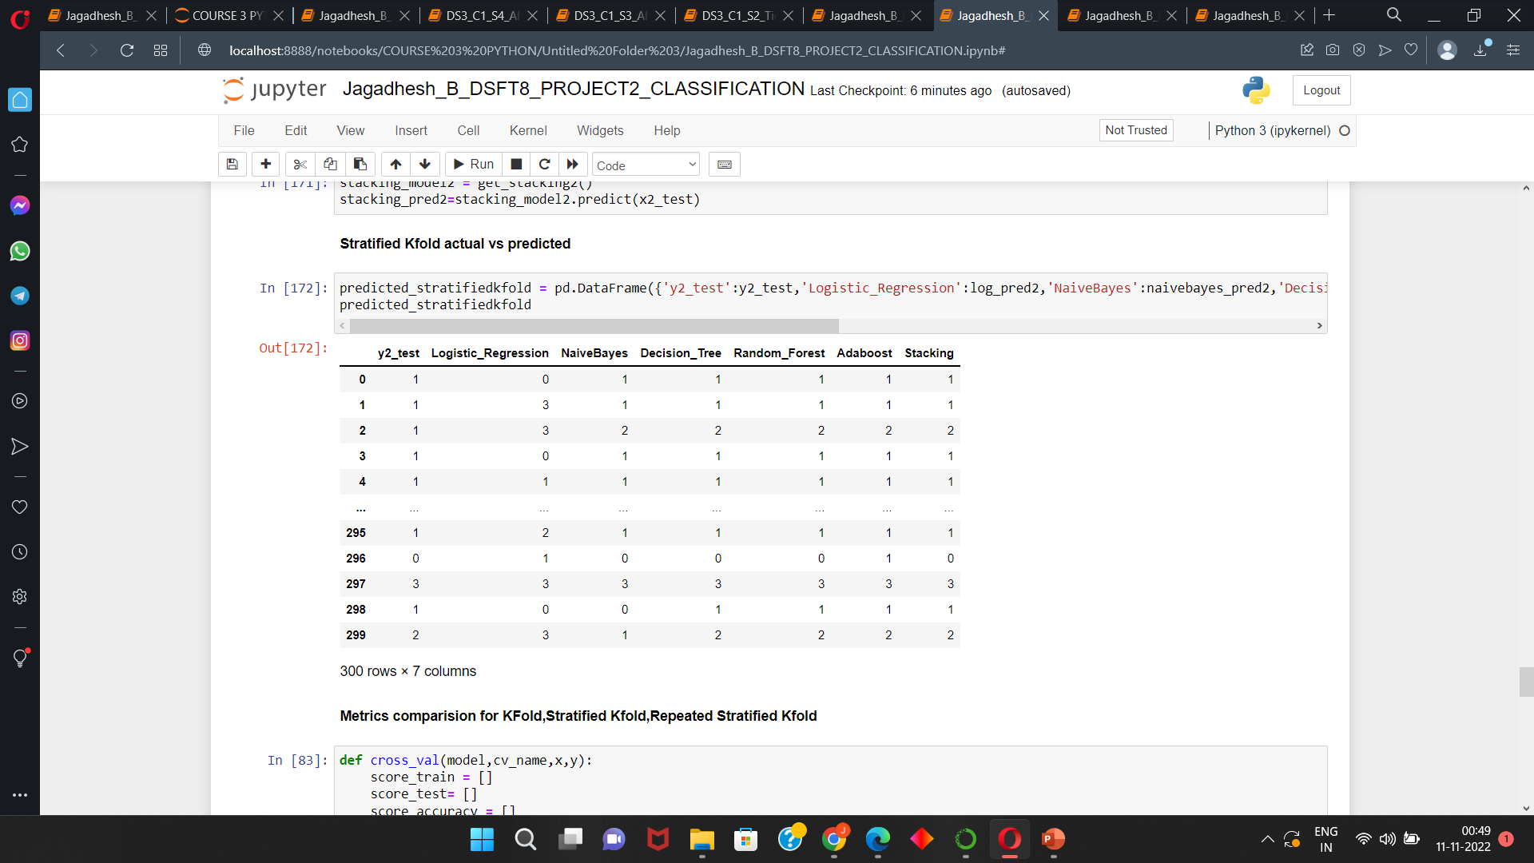
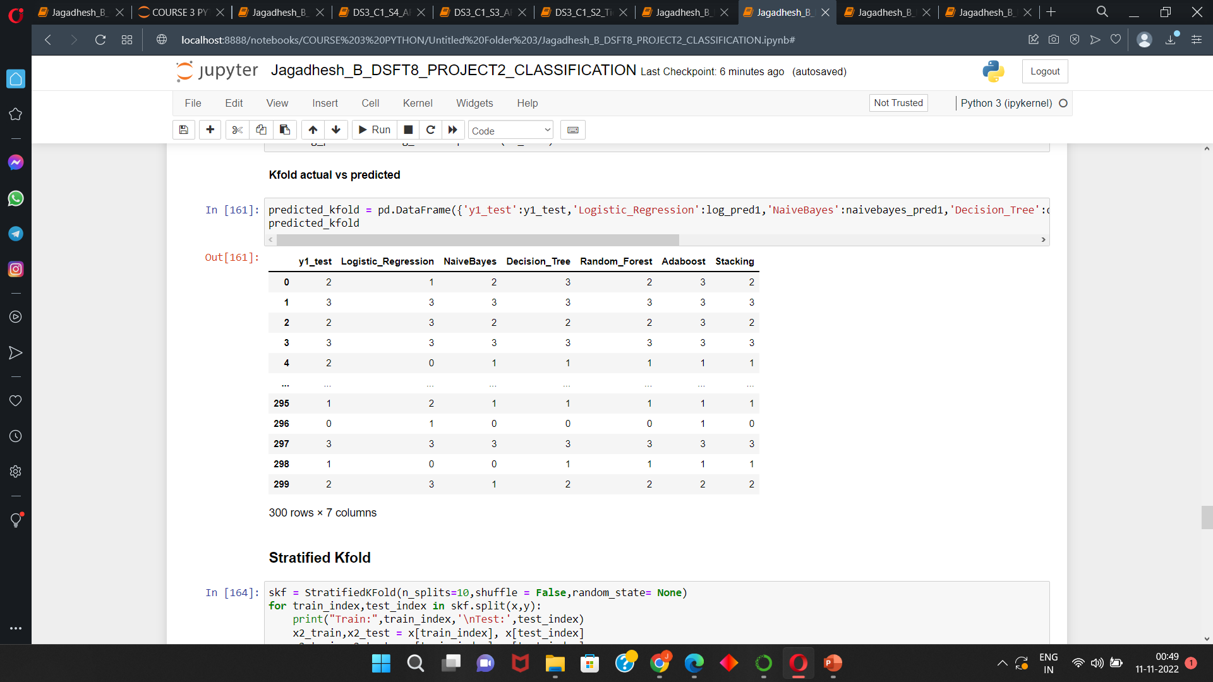
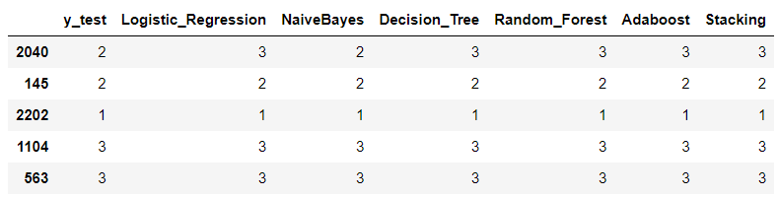
Actual and predicted values of all models using all cross validation method :
Stratified Kfold :
Kfold :
Holdout :

Slide 11
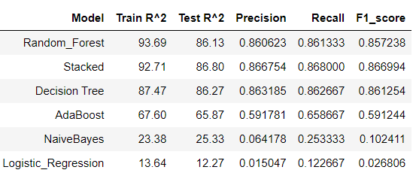
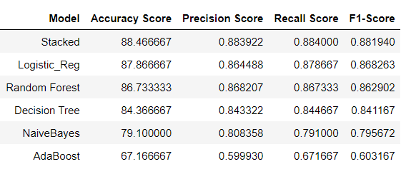
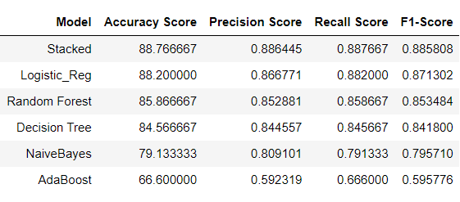
Comparision of models using Performance and Errors for different Cross validation :
Holdout :
Kfold :
Stratified Kfold :

Slide 12
Interpretations :
Random forest has the highest performance score when using holdout method.
Stacked and Decision tree are also giving good results in hold out.
Logistic regression has the lowest performance score in hold out method.
For Kfold method we are getting good results in Stacked.
In kfold method every model is performing well.
Logistic regression model performs well in other Kfold and stratified kfold methods.
Every model performance is above 80% except Adaboost.
Stacked is the model which is performing good in all cross validation method So we are selecting stacked as the best model.
Logistic is performing very well except hold out method.
Every model has the performance almost 80% and greater than 80% for every cross validation method.
Adaboost has the lowest performance than compared to all models.

Slide 13
Conclusion :
Finally we are selecting Stacked model for the best model.
Business conclusion :
By using Stacked model we can predict grade of the houses and using this we can able find the suitable houses according to our needs and we check the different category of houses available when we move to new .
When we move to new city we to Finds grades of the houses by using grades we are going to select the suitable house for us .
For the company basis we can use this model to find the grade and according to it we can able to set the sales price for the houses.

Slide 14
THANK YOU

