Slide 1
MINI PROJECT Regression – prediction of store sales
By,
B.Jagadhesh,
DSFT8

Slide 2
Store Sales Prediction :
The success of any retail store depends upon its sales. More the sales made, more is the revenue. With a good customer service and care, the customer too enjoys a good shopping experience. This will lead to more in-flow of customers, opening more store branches across a city / country.
To enable this, store owners rely heavily on past data to predict future sales. This will help them in strategizing their business models and come up with innovative techniques and ideas to attract customers and set realistic goals.
Many medium to large stores implement this kind of analytics to understand trends like which products are getting sold faster, what are the slow moving products, impact of store types, etc. With new branches of the store, the analysis can get more complex and may also involve stiff competition from other competitors.
Business objective :
Build a model to predict the Sales of a store.

Slide 3
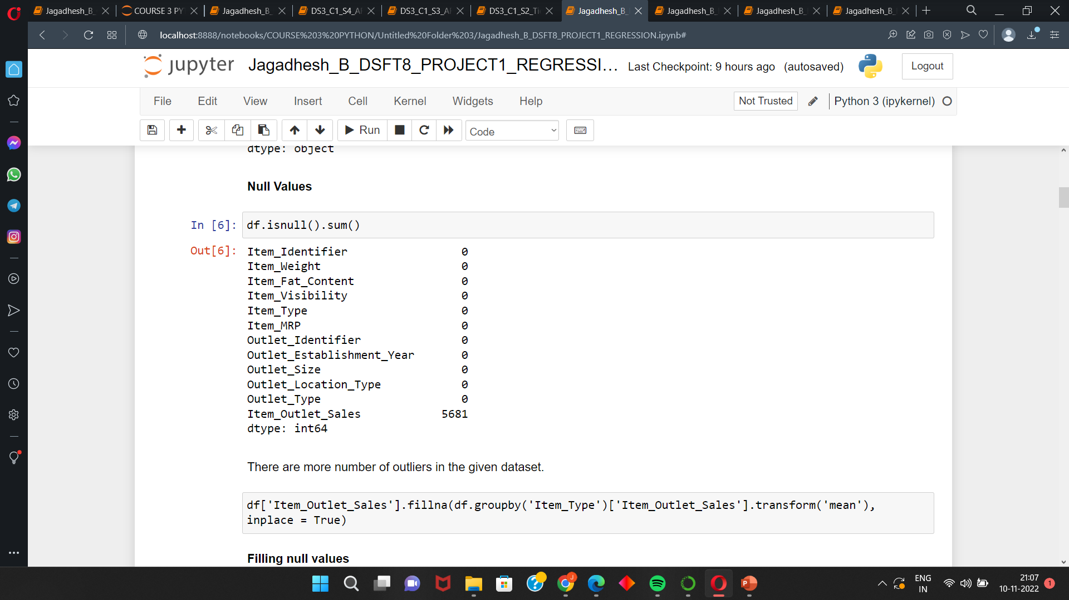
Data Set :
The given data has 14204 Rows and 12 Columns.
In this project we need to predict the Item outlet sales.
From this data we can see that there are more number of null values.
The null values are in high in numbers so we can not able to drop or will
with sum of sales.
So we can able to fill the sales value by using mean of the respective
Item category.
Even when doing any imputation technique because of very high number of
null values it is possible that the data can became bias.
Taking the columns with not null values from the data and split them
and perform the model building and take the data with null values and predict them
using the created model.

Slide 4
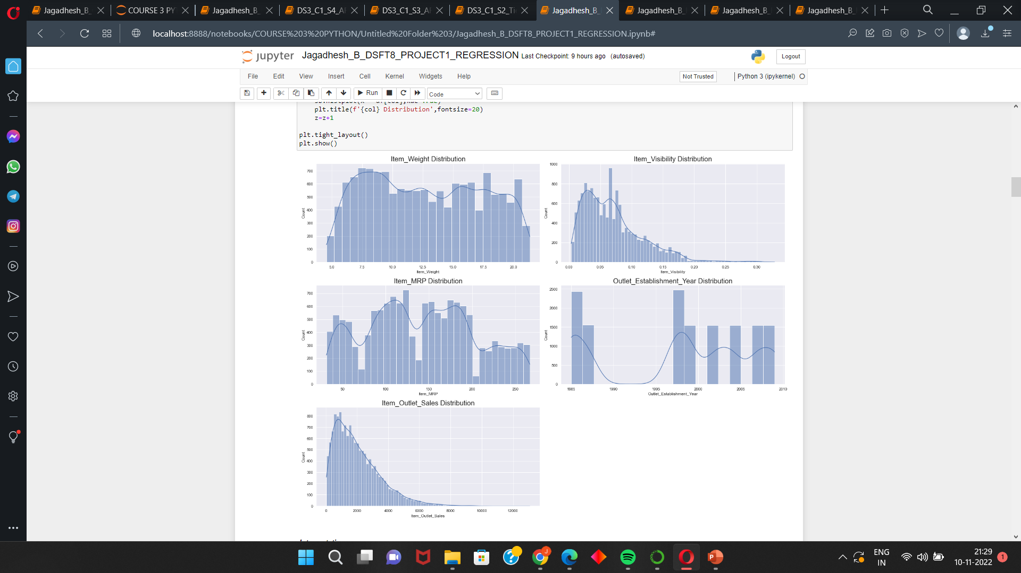
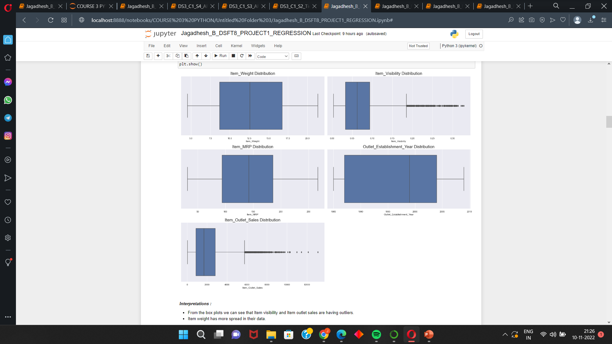
EDA : Univariate, Bivariate and Multivariate Analysis
These are the visualizations of numerical columns from this
Item MRP and Item weight are normally distributed.
The item outlet sales and item visibility are having more number of outliers these are our important column for our analysis.
In sales Outliers means extreme vales but in this case if the sales is high it is good for company .So we are keeping the outliers.
Item weight has more spread in their data.

Slide 5
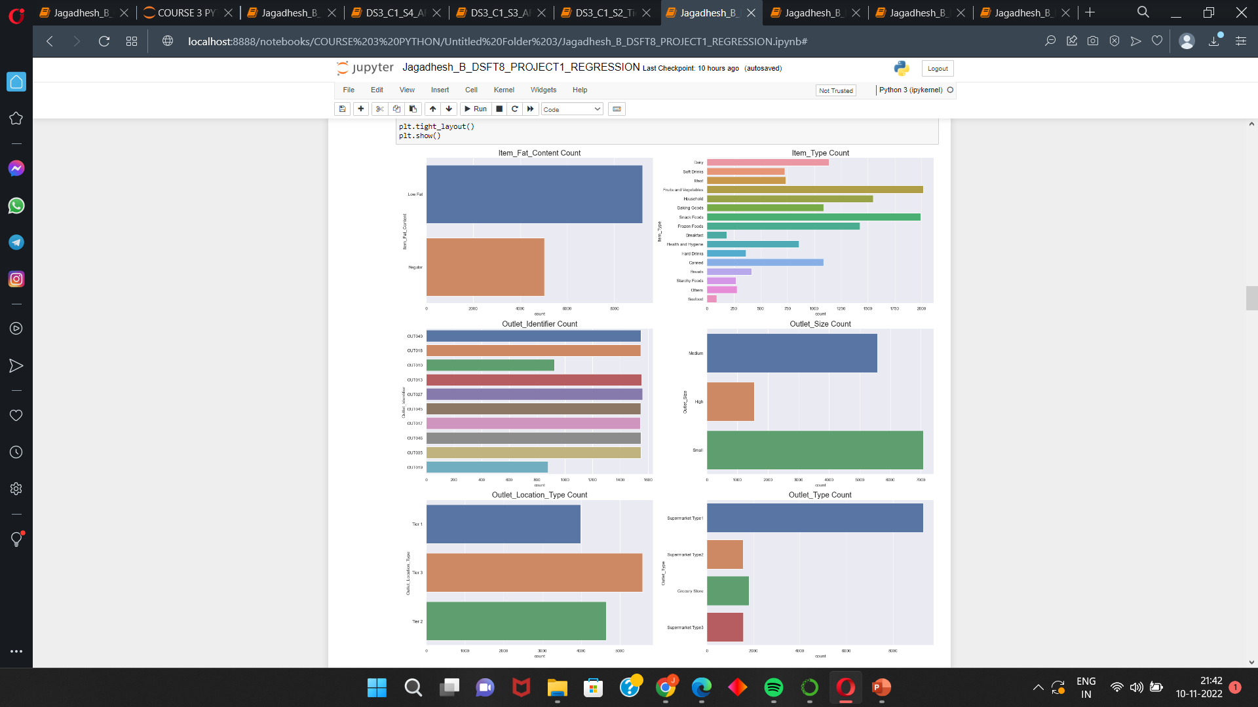
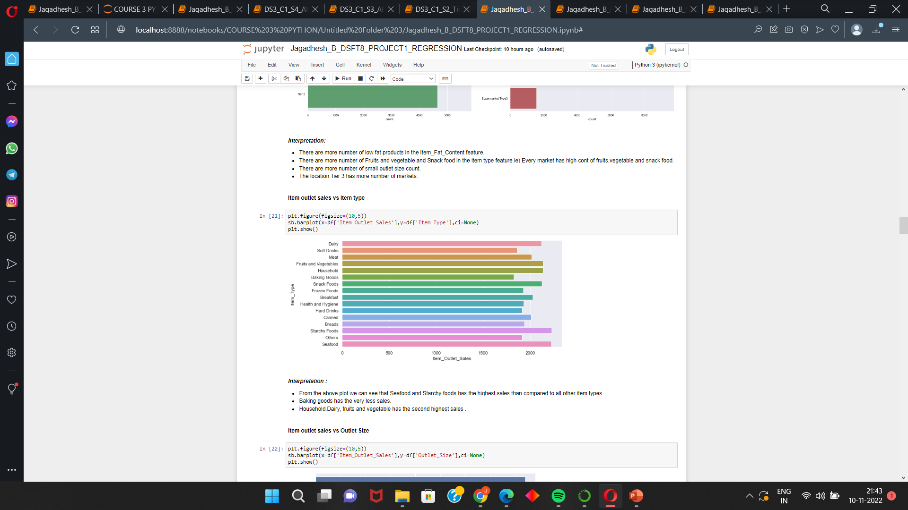
Categorical columns :
More number of low fat products in the Item Fat Content feature.
There are more number of Fruits and vegetable and Snack food in the item type feature ie) Every market has high count of fruits, vegetable and snack food.
The location Tier 3 has more number of markets.
Tier 2 market has more number of sales
Outlet size small has more number sales in their category.
Seafood and Starchy Foods has the highest number of sales than any other items.

Slide 6
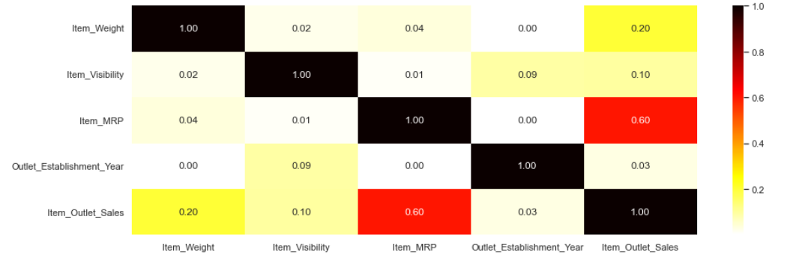
Correlation :
The target Item outlet sales has good positive correlation with Item MRP.
Except this every features has very weak positive correlation.

Slide 7
Preparing the Data set :
DATA PREPROCESSING :
Models performs well with numeric data .So we are converting all the columns which are in object and category we are converting them to numeric by using label encoder.
DATA SCALING :
In the given data set the value ranges can be different so we need to convert the data to some range for the good performance. The data are Normalized(0 to +1) using MinmaxScalar().
FEATURE SELECTION :
Features are checked for correlation with the dependent column and the most correlated columns are chosen for the models for the best performance.
DATA SPLITTING :
Data is splitted in the ratio of 75:25 ratio.

Slide 8
Regression Machine learning model :
For Regression ,
Linear Regression
Decision Tree regressor
Random Forest regressor
Adaboost regressor
Stacking
And the cross validations are ,
Hold out method
Kfold method
Here we are building all the model with different cross validation and evaluations the models .

Slide 9
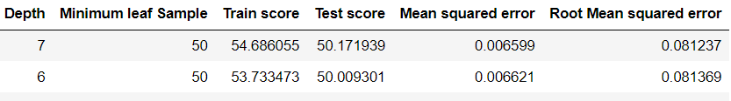
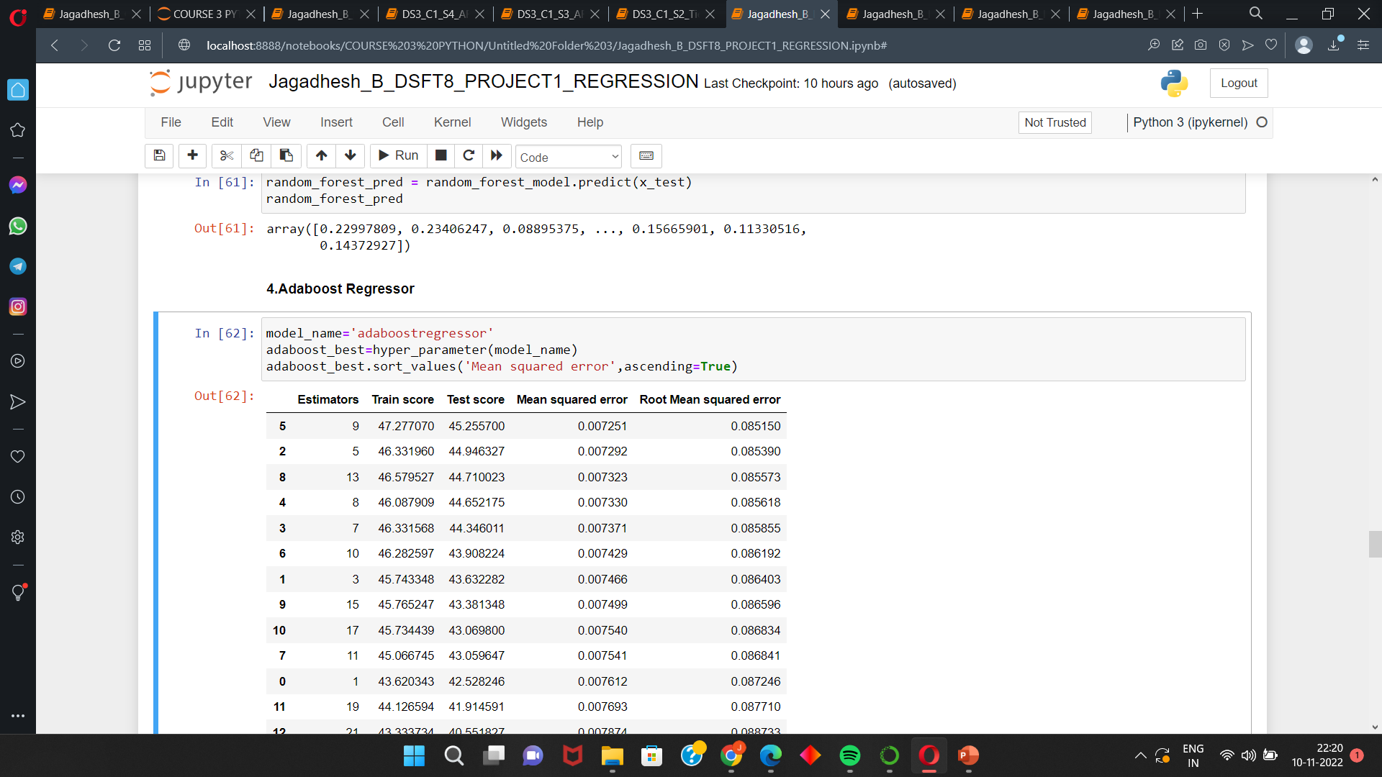
Building the models :
Linear regression ,
We are not doing any hyperparameter tuning for both the cross validation.
Decision Tree Regressor,
Using for loop for hyperparameter tuning ,So we have done tuning and chose the parameter which give lowest error and building the model using best parameters for both the cross validation.
Adaboost Regressor ,
Using for loop for hyperparameter tuning ,So we have done tuning and chose the parameter which give lowest error and building the model using best parameters for every the cross validation.
Random Forest,
Using Grid search method for finding the best hyperparameter.
Stacking ,
For Stacking using all the hyperparameter tuned model

Slide 10
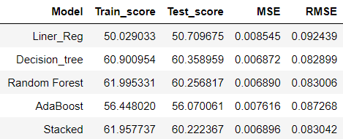
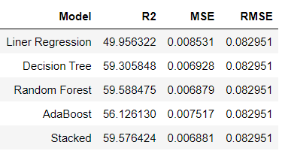
Comparision of models using R^2 and Errors :
Holdout Method :
1) Random Forest , Stacked , Decision Tree are giving good performance and low error rates.
2) Stacked Model has the highest scores and low error rates than compared to all other regressor models.
Kfold Method :
1) For Kfold method Stacked model giving the good performance than compared to other model.
2) But for this data the performance is very low.
3) The second highest is random forest.
For Both cross validation method Stacked model has good performance .

Slide 11
Interpretations :
The stacking model gives the good performance in both Hold out and Kfold method ,but their performance score is just nearer to 60% .
It can be because we are having more number of outliers and many unknown values.
And from the correlation heat map we can also see that there is no strong relation between the features.
This can affect the performance of the model.
For this data set we are getting very low performance for every model.

Slide 12
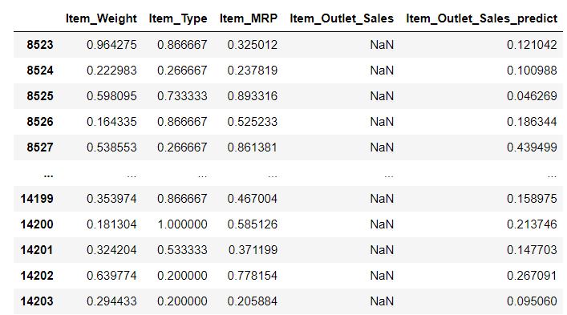
Prediction of unknown values in the Data using Best model :
Stacked Model giving good results for this data.
In this data we are having many unknown values , So by using the best trained model we are predicting unknown values in the sales column.
Business Conclusion :
From the EDA we found some of the analysis . By using that we can able to increase the sales in the places where we are getting low sales ,for eg.. In tier 3 there are more number markets but the sales are low so we can do something about increase in their sales at the stores. .

Slide 13
THANK YOU

